Slide 1

S2 Curricular Choice Evening
Thursday 19th January 2023

Slide 2
Kate sinclair
Head teacher of Eastwood High School

Slide 3
Allison mackinnon
Depute head teacher S2

Slide 4

schedule
Introduction and purpose of the evening – Mrs A MacKinnon (S2 DHT)
Pastoral Input and PSE – Mrs L Carswell (Principal Teacher of Pupil Support)
Outline of the timetable and curriculum structure – Mr C Morris (S3 DHT)
Scottish Credit and Qualifications Framework – Miss L Barrie (Principal Teacher of Wider Achievement)
Skills Development Scotland – Ms C McCanney (Careers Advisor)
Core or National 5 – Mr A Gibson (Principal Teacher of PE) and Miss S Rafferty (Teacher of RMPS)

Slide 5
The purpose of tonight
To give you an understanding of the curricular choice process
To offer parents advice on supporting your child through the process
To offer advice on making the right decisions
To give information about the curriculum and the wider supports on offer
To give the opportunity to visit and speak to staff from all areas of the school
To give the opportunity to speak to Pastoral Care Teachers (in canteen)

Slide 6

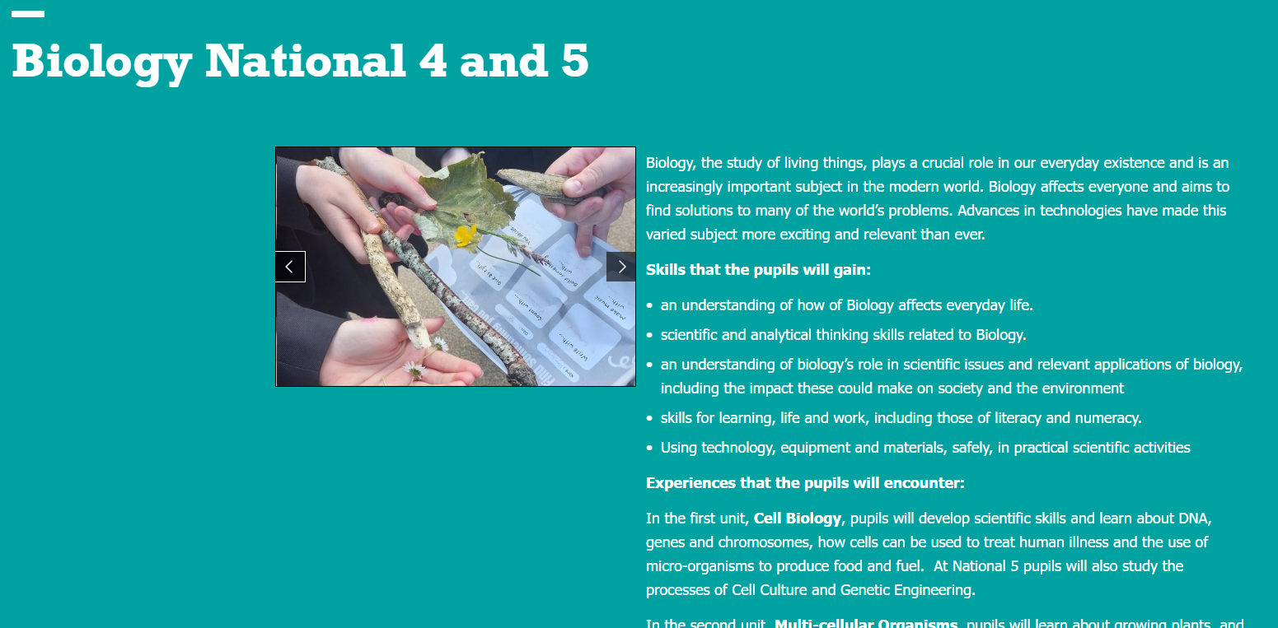

Slide 7
December | Exploring skills and qualities in PSHE Pupils issued with “Options Research” forms Interviews with SDS
19th January | Options assembly Curricular choice evening - Information on process and timeline and opportunity to visit all departments to discuss course outline/demands/progression and ask any questions Electronic options form emailed to parents/carers
23rd Jan – 3rd Feb | Exploring future choices and career pathways in PSHE Encourage pupils to complete options research form ahead of interview with Pastoral Care Teacher
1st February | Draft options forms to be submitted
Monday 6th & Tuesday 7th Feb | Options interview with Pastoral Care Teacher FINAL OPTIONS FORM COMPLETED AT THIS POINT

Slide 8

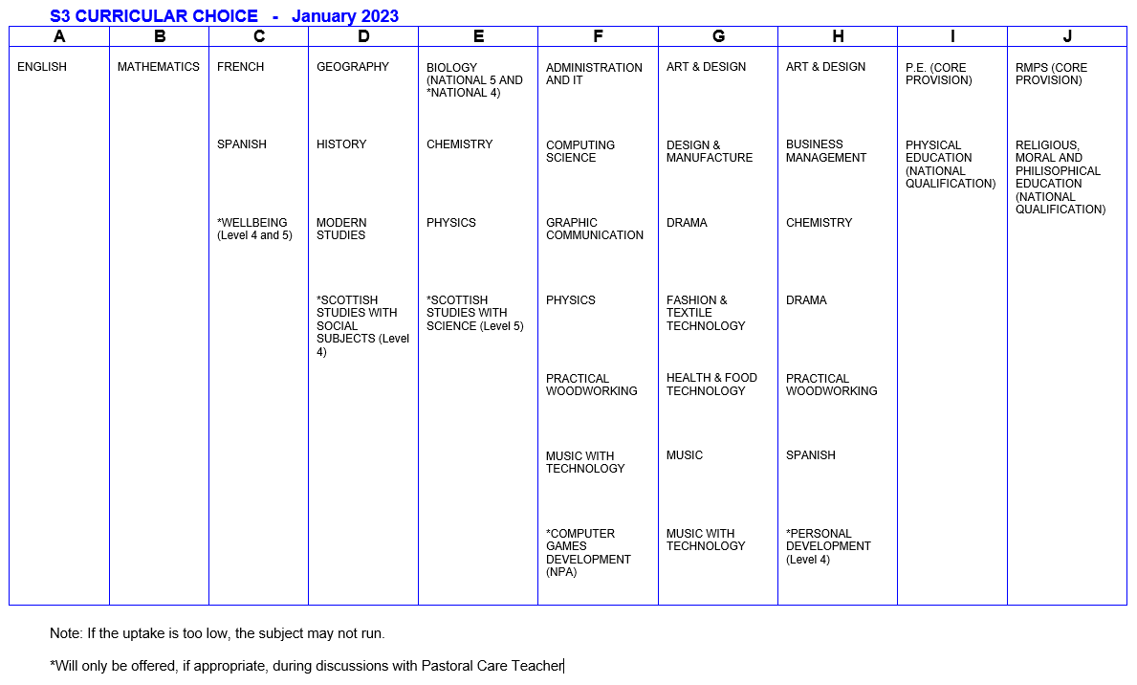
Option FORM
S3 CURRICULAR CHOICE - January 2023

Slide 9
Laura Carswell
Principal teacher of pupil support

Slide 10
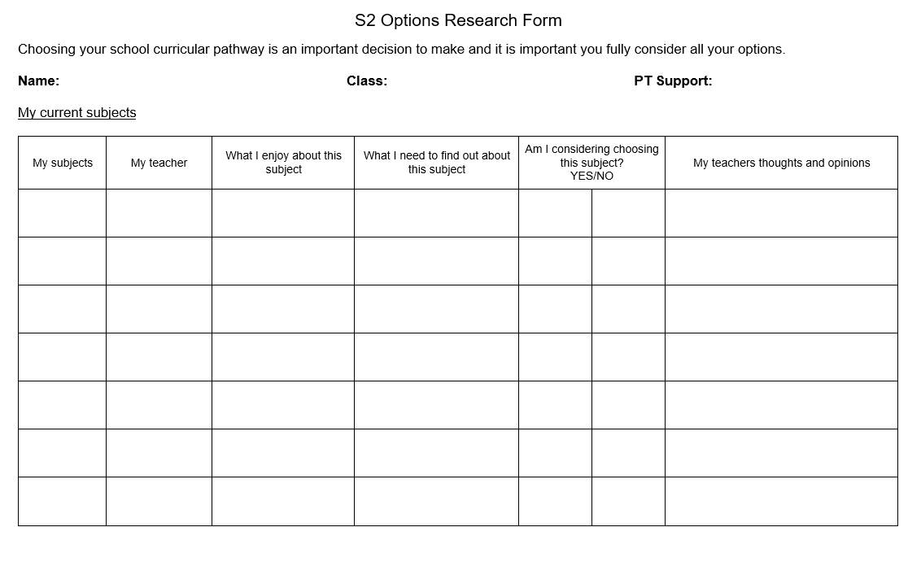
Options Research Form
To encourage pupils to make informed choices and be active participant in the options process.

Slide 11
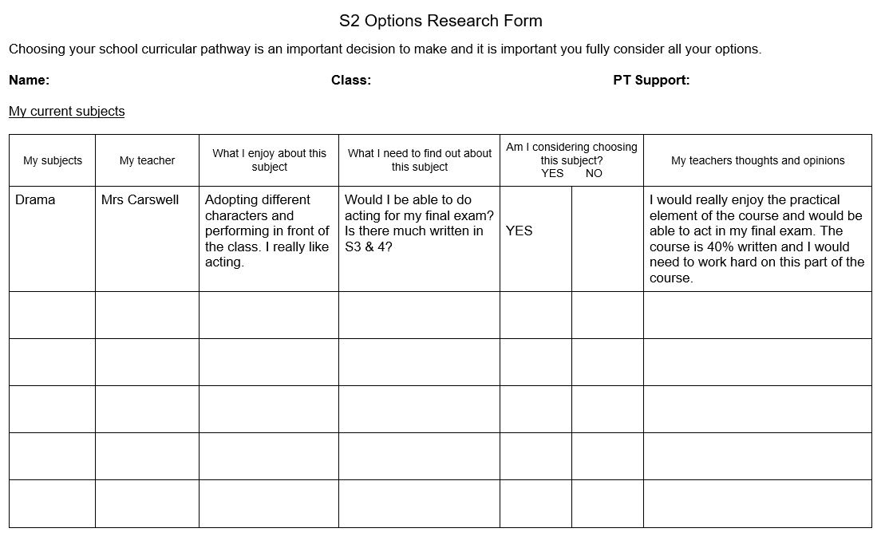

Slide 12
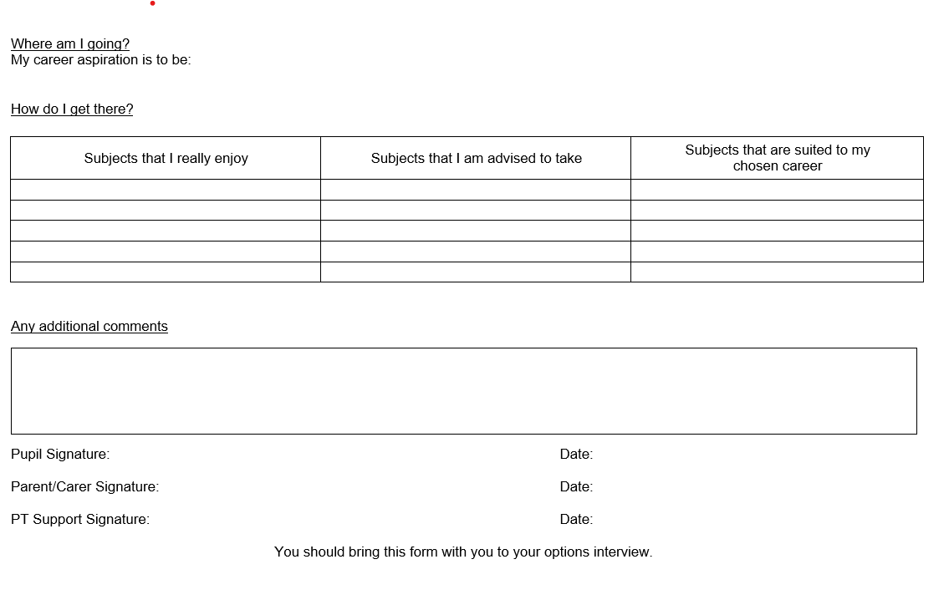

Slide 13
Chris morris
Depute head teacher And timetabler

Slide 14


Electronic options form

Slide 15
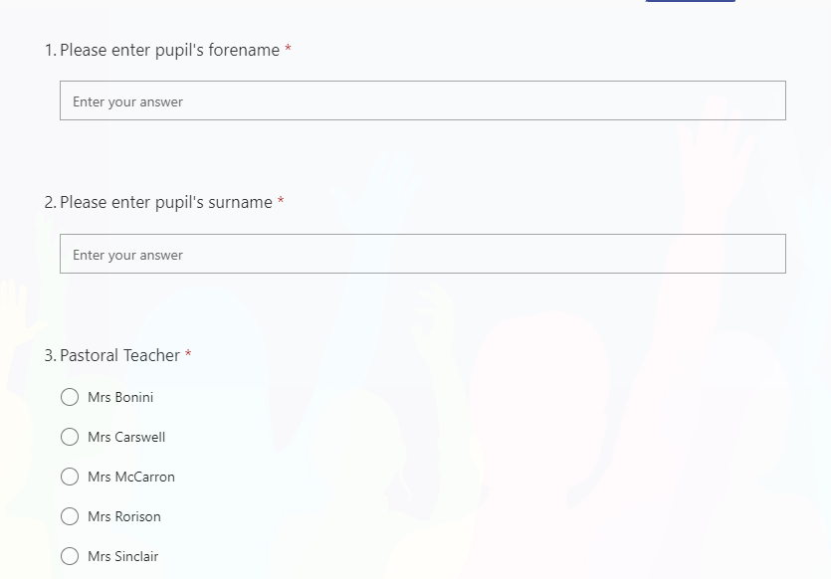

Slide 16


Slide 17
Timetable process
Completed option forms sent to ERC
Timetable schematic created of our school
We put classes and teachers in place
New timetable starts on 5th June

Slide 18
Stage | Open Curriculum | Core
S1 – S2 | 13 subjects | PE, PSHE & RE
S3 – S4 | 8 subjects | PE, PSHE & RE
Breakdown of S3 and S4 Curriculum
English and Maths (4 and 5/5 and 4 periods)
French/Spanish – continue from S2 (3 periods)
5 open choices (5 x 3 periods)
PSHE (1 period)
PE – N5 or Core (3 Periods)
RE – N5 or Core (2 Periods)

Slide 19
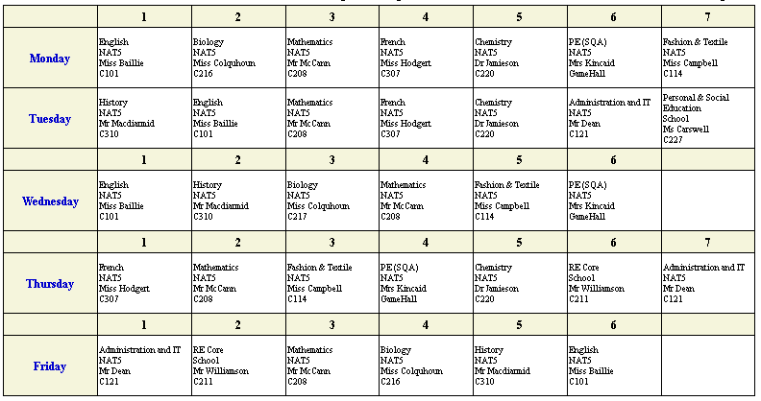

Slide 20
Lauren barrie
Principal teacher of wider achievement

Slide 21
What is the SCQF?
Scottish Credit and Qualifications Framework
It’s Scotland’s lifelong learning framework – designed to help people of all ages and circumstances to access appropriate education and training over their lifetime.
It helps pupils visualise and plan their learning journey.
It helps people understand qualifications and how they relate/compare to one another.
It recognises people’s learning and gives them credit for what they’ve achieved. 1 credit point = notional 10 hours learning

Slide 22
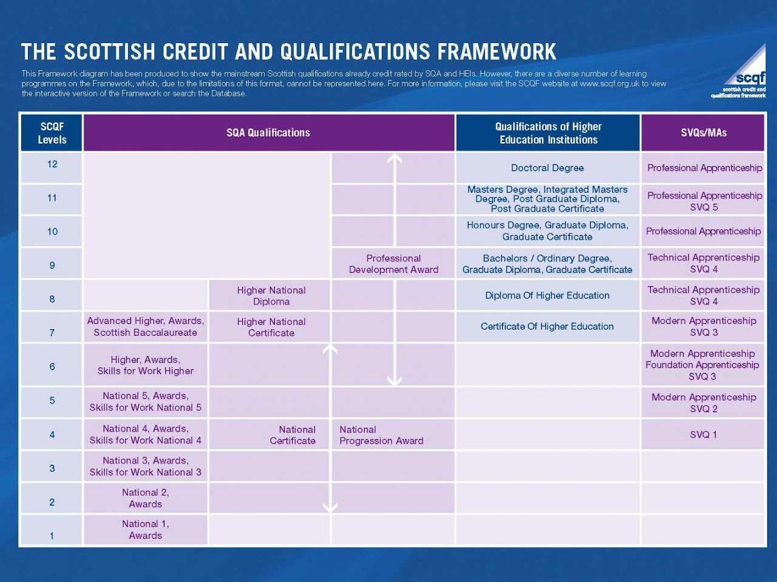

Slide 23
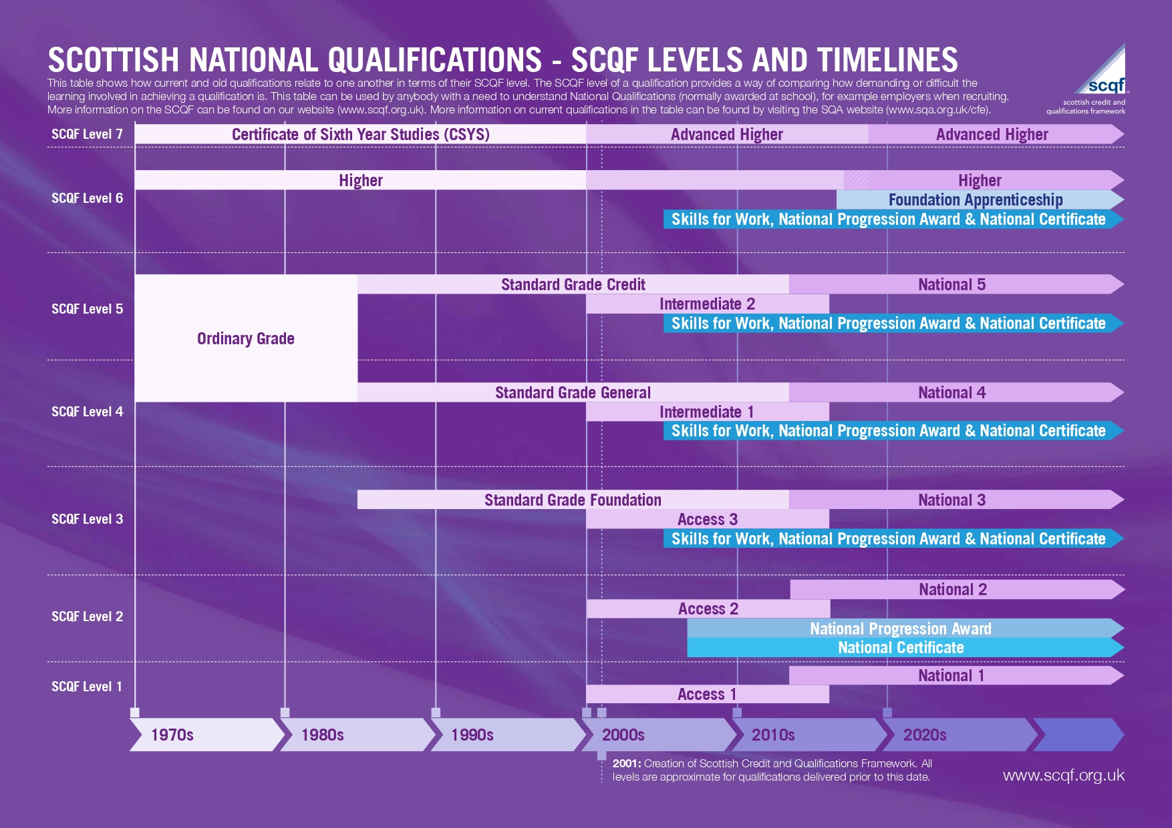

Slide 24

Claire mccanney
Careers advisor

Slide 25


Claire McCanney
Careers Adviser
Notes:
Introduce self and the idea of Career planning through the use of Career Management Skill
Why do we need to do this - the world of work can be complicated – SDS will support your preparation and transition beyond school
INTRODUCTION TO SDS
Skills Development Scotland is a national organisation We support all ages groups – however working in school is one of our main task.
From P5 we start to introduce CAREER MANAGEMENT SKILLS - some of you maybe be able to recall some work you did at Primary school???
We intend to build on this work and will see you regularly through Secondary school and add to your knowledge of career planning as you develop through school.

Slide 26
Career Management Skills - YouTube

Slide 27


Career Management Skills
These are the skills you need to make your career a success.
Your SDS Careers Adviser is just one of the people who can help you develop these skills.
Some of them you’ll have already – just by being you!
Notes:
Introduce the themes… then play video
https://www.youtube.com/watch?v=uDJu8O7Lxr8
SELF is about
understanding who I am and what I can do
knowing what is right for me
reviewing my life, work and learning plan.
STRENGTHS is about
understanding all about my skills, knowledge and experience
knowing more about what I can do
reviewing which of my skills are transferrable.
HORIZONS is about
understanding the world of work
understanding what options might be available to me
knowing which options I should choose
knowing what I need to do to make my choice
reviewing my links between life, learning and work
reviewing where I fit into the world of work.
NETWORKS is about
understanding who can help me
knowing how to make connections with those who can help me
reviewing my networks.

Slide 28


Slide 29
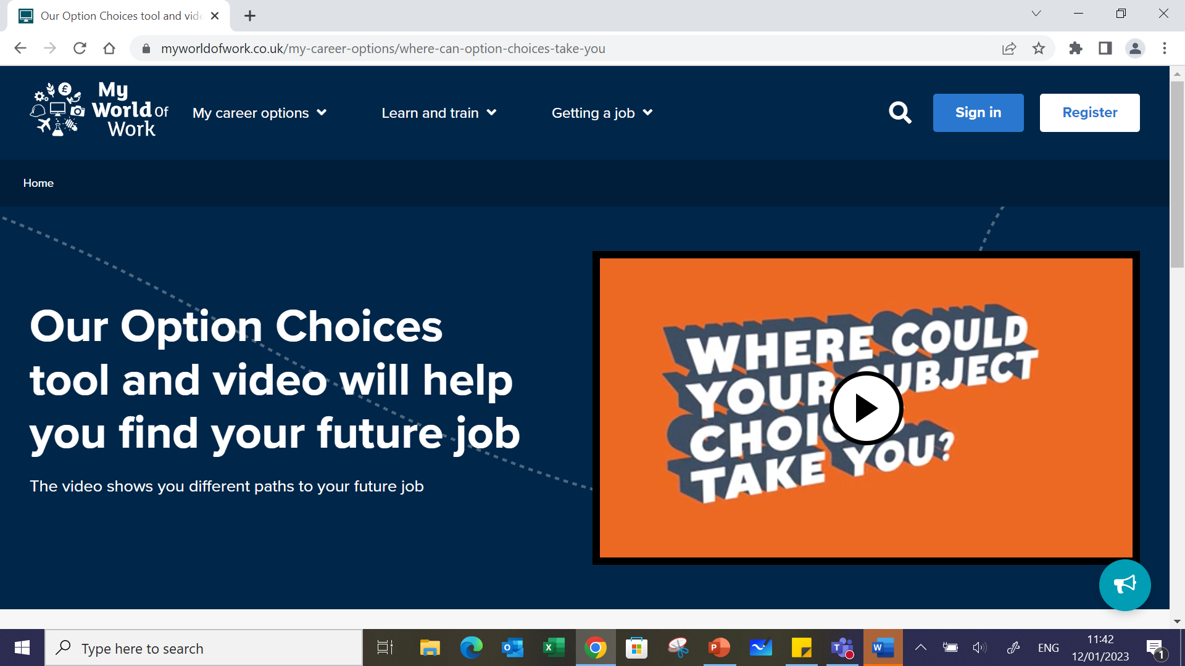

Slide 30
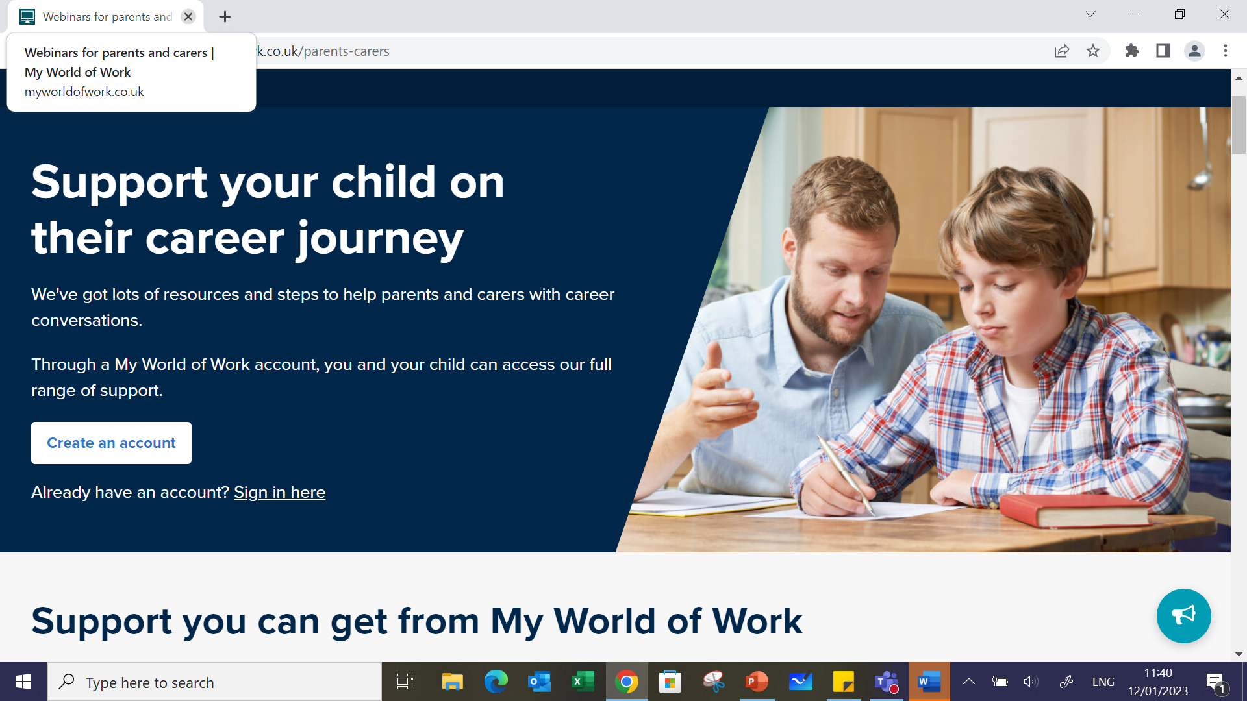

Slide 31
Adam Gibson
Principal Teacher of Physical Education

Slide 32
Sarah Rafferty
Teacher of Religious, Moral and Philosophical Studies

Slide 33


RMPS
Religion
Morality
Philosophy

Slide 34
https://youtu.be/67kTR9PrTuE

Slide 35
NEXT STEPS
Research
  Options booklet (available electronically)
  My World of Work website
  Visit departments and speak to teachers this evening
Electronic options form submitted by Wednesday 1st February
PCT will contact you with any changes following interviews

Slide 36
Making informed Choices
Career plans
Requirements for further study or employment

Slide 37


