Slide 1

S4 Curricular Choice Evening
Tuesday 21st February 2023

Slide 2
Kate sinclair
Head teacher

Slide 3

Factors affecting choice
Career choice
Skill set
Maturity
Wellbeing
Engagement
S4 exit point (data) – 94.5 % Full time in school, 4.4 % College, 0.55% in employment, 0.55% unknown
Note:
16 years old by 30th September – summer leaver
1st October onwards – Christmas leaver
Notes:
182 in the year group 10 pupils left – 8 college, 1 in employment, 1 unknown

Slide 4

Factors affecting choice
Notes:
If they decide they wish to stay on for S5, and it may be at the moment they are undecided, need to think of the levels of subject, number of Highers, number of other subjects and levels, vocational – but it must be full time.
The rest are sitting at 17% etc in prelim. Mentally that is no good.
Look at pattern for As, Bs C, D
We currently have 10 pupils who have a D at National 5 and are sitting Higher in that subject, only 1 of them is passing
We currently have 51 pupils sitting Higher off a Nat 5 C, with only 14 passing. Using progression stats along with knowledge of the pupil/circumstance etc, I can see that some of them should go on to pass. However, there is one subject where 9 pupils are sitting the Higher off either a low band C or a D and only 1 of them is passing. Prelim marks are very low. We are giving them every support but it will be a real challenge. There were other subjects that they would have had greater success in, other options.

Slide 5
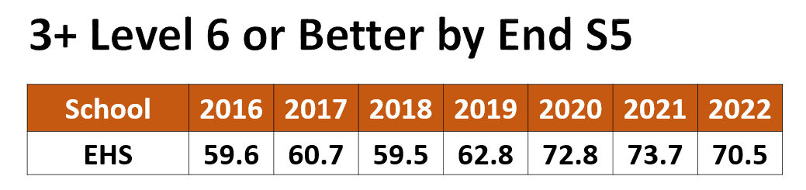
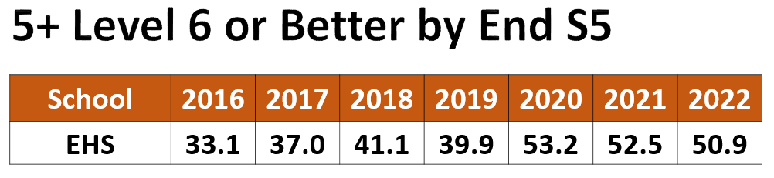
5+ Level 5 A Awards by End S4
School | 2017 | 2018 | 2019 | 2020 | 2021 | 2022
EHS | 30 | 37 | 36 | 45 | 45 | 49
Notes:
I am ambitious for pupils in this school, we want our young people to challenged, but still being realistic. You are going to hear tonight about a different qualifications that are being brought in. Barista machine being delivered next week and we will be offering an SQA Barista award, we have the vocational we have skills for work courses, NPAs in
It is also ok to fail a subject.

Slide 6
Entrance requirements
University of Glasgow
Medicine – AAAAA
Minimum AAAAA at first sitting including chemistry, biology and either physics or mathematics (minimum National 5 English at a B ) as well as AB in 2 Advanced Highers in S6, plus an additional Higher at a B
Or 3 Advanced Highers at BBB
UK Clinical Aptitude Test

Slide 7
Entrance requirements
BA Hons in Business & Marketing University of Strathclyde
Standard entry requirements*:
1st sitting: AAAA/AAABB
2nd sitting: AAAABB
(Higher English B; Maths National 5 B, or equivalent; Higher Maths A for combinations with Accounting; Higher Maths B for combinations with Finance)
Minimum entry requirements**:
1st sitting: AABB/ABBBB
2nd sitting: AABBBB
(English B; National 5 Maths B; Higher Maths at B for Finance combinations)

Slide 8
Entrance requirements
Glasgow Clyde College
Childhood Practice (HNC) – 2 Higher passes including English and relative work experience
Or
An NC in Early Education and Childcare

Slide 9
Entrance requirements
Advanced Apprenticeship
BAE Systems
5 National 4 subjects including Maths and English as well as a Science

Slide 10
Attitude/effort
Attendance / timekeeping
Work ethic
Effective time management – school work, folios, project work
Study skills
Health & Wellbeing
Supported Study

Slide 11
Important dates
Easter School Mon 3rd April – Thur 6th April & Tues 11th April – Fri 14th April
SQA study leave begins Fri 21st April
SQA exams begin Mon 24th April
New timetable begins Mon 5th June
SQA results issued Tues 8th August
Options renegotiation Thurs 10th August

Slide 12
Emma Gordon
Depute head teacher S4

Slide 13
The purpose of tonight
To help you understand the curricular choice process
To offer advice on supporting your child
To give information about the curriculum
To explain our offer of wider supports
To give the opportunity to speak with staff

Slide 14
sPeakers
Introduction – Mrs K Sinclair
Options Process - Ms E Gordon(S4 DHT)
Skills Development Scotland – Ms K Rees (Careers Advisor)
Pastoral / PSE – Mrs P Rorison (PT Pupil Support)
Scottish Credit and Qualifications Framework Ambassadors (Temwa, Nadia, Toni, Harris)
Vocational Courses – Ms B Williams

Slide 15

Choice at end of S4
Stay on at school for S5 or till the end of the year
Leave (if 16 years old by the end of September 23) and go to
college – further education
modern apprenticeship
employment

Slide 16

Karen Rees
Careers advisor

Slide 17


Karen Rees
Claire McCanney
Sean McTaggart
Careers Advisers
Notes:
Introduce self and session S4 options and routes and pathways beyond school

Slide 18

Career Management Skills
Notes:
CMS Jigsaw, remind of CMS and re introduce each theme Self, Strengths, Horizons and Networks
Expand on why the development of these skills are important to support their individual option choices at this stage and ultimately career decision making

Slide 19


My World of Work
What’s out there?
How to find the right information
Notes:
Getting the right information.......
Throughout today we have mentioned sources of information and help.
Highlight MyWoW is a great starting point for pupils and give some examples of use for information

Slide 20
Pauline Rorison
Principal teacher of pupil support

Slide 21
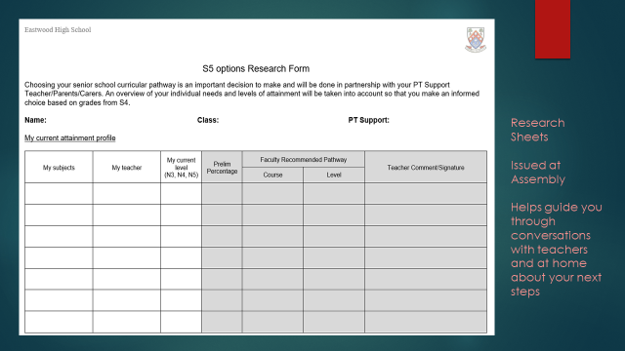

Slide 22
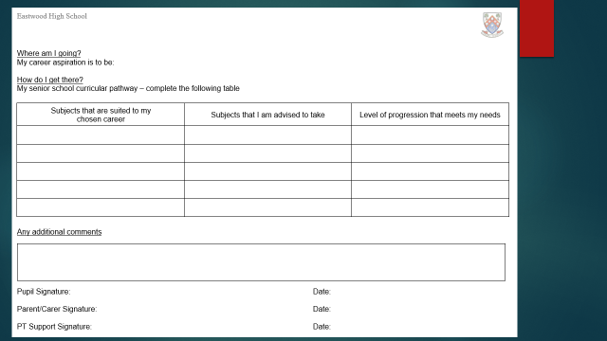

Slide 23


Slide 24
February | Exploring future choices and career pathways in PSHE Issue Options Research Form S4 Options Assembly
Tuesday 21st February Thursday 23rd February | S4 Reports Issued S4 Curricular Choice Evening Options Form emailed to parents/carers Draft Options Form to be submitted before meeting with Pastoral Care
Friday 24th February & Monday 27th February | Options interview with Pastoral Care Teacher takes place Final Options Form completed
Monday 6th March Monday 5th June | Sent to the education department S5 timetable begins

Slide 25

S4 > S5 Option FORM
All pupils choose 5 subjects (English plus 4 other subjects)
S5 pupils are advised to continue with S4 subjects including RMPS & PE
(‘crash courses’ are typically available for S6 pupils)
Vocational options should be considered in addition to 5 subjects in school
Choose subjects essential for chosen career / course
– research entrance requirements
Unsure of chosen career / course – take a balance of subjects
Choose strengths / interest / enjoyment

Slide 26
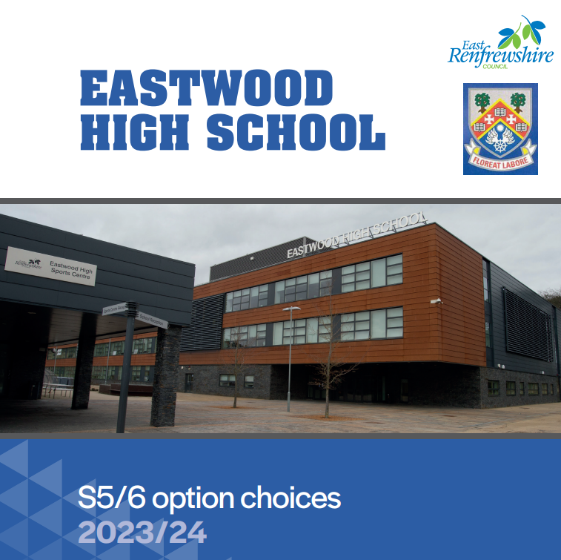
https://blogs.glowscotland.org.uk/er/public/Eastwood/uploads/sites/83/2023/01/24104507/22-23-Final-booklet.pdf

Slide 27
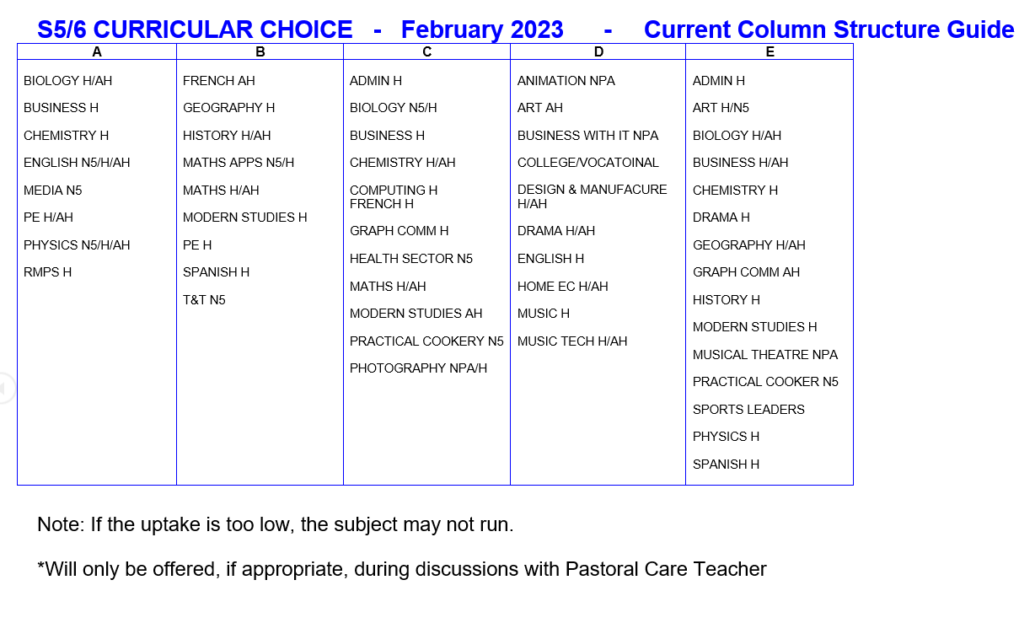

Slide 28
ScotTish CREDIT and Qualifications
Framework
Temwa nsonga, nadia Osman & harris lovatt

Slide 29
What is SCQF?
SCQF stands for Scottish Credit and Qualifications Framework.
The SCQF is a way of comparing Scottish qualifications to other qualification frameworks. It does this by giving each qualification a level and a number of credit points.
The level of a qualification shows how difficult the learning is.
The credit points show how much learning is involved in achieving that qualification.
It covers achievements from school, college, university, and many work-based qualifications

Slide 30
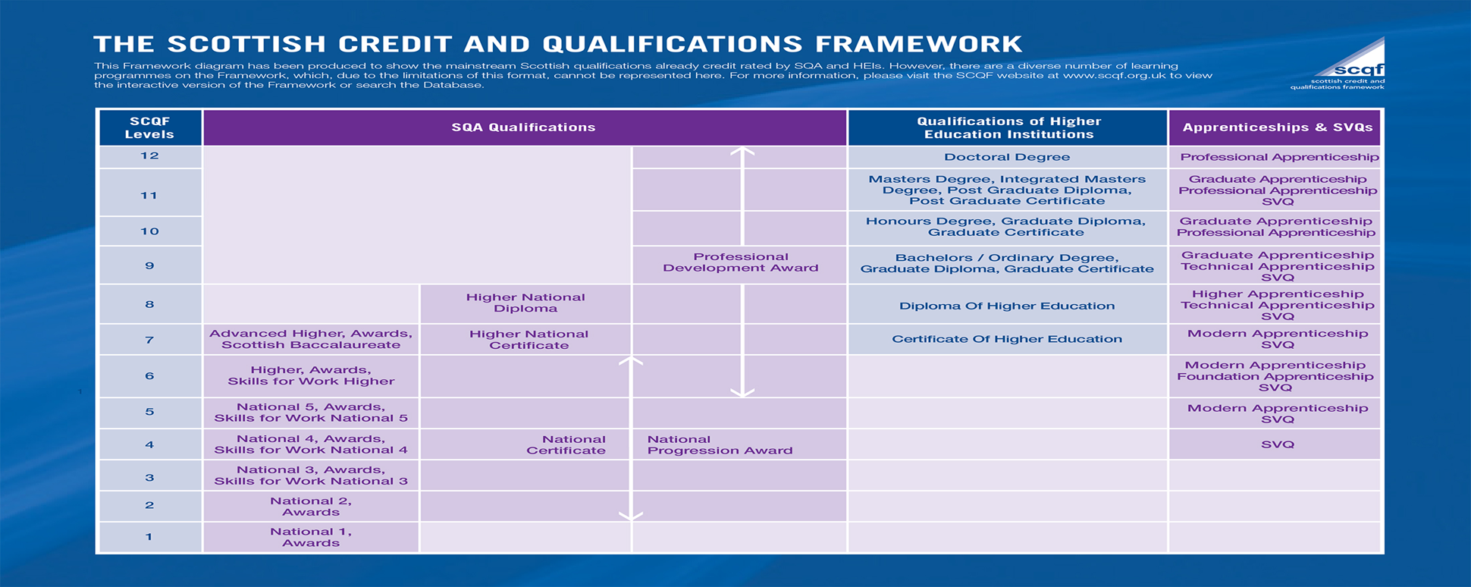
The Framework

Slide 31
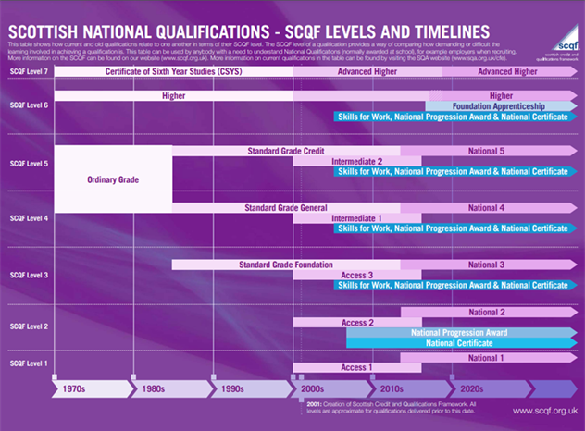
The framework allows parents to compare qualifications that they may have sat at school, to the current qualifications.

Slide 32

What are SCQF Credit Points?
•Credit points are a way of showing how much time it takes, on average, to complete a qualification or learning programme. Along with the Level Descriptors, they allow learners, learning providers and employers to compare different qualifications at the same or even different levels.

Slide 33
How do Points Work in the SCQF?
In common with other credit systems, the SCQF works on the basis that one credit point represents the amount of learning achieved through a notional 10 hours of learning time.
This includes everything a learner has to do to achieve the outcomes in a qualification including the assessment procedures.
National 5’s, Highers and Advanced Highers are all worth 24 SCQF Points.

Slide 34
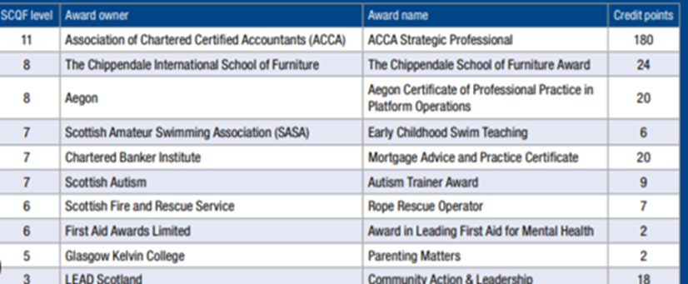
What is the Difference Between UCAS and SCQF points?
UCAS is the organisation that processes applications for higher education courses, and tariff points relate to the grade at which a qualification has been achieved.
SCQF credit points are a measure of how much learning needs to be done to achieve a particular qualification, no matter the final grade.

Slide 35

How does the SCQF support alternative pathways?
Although the most common qualifications to study at school are National 5’s, Highers and Advanced Highers, there are other qualifications available such as National Progression Awards.
The SCQF can:
help plan your learning pathways and make the right choices
help employers understand your qualifications
help universities or colleges identify the level you have studied at in a particular subject, and make it easier to transfer credits between different learning programmes
increase your confidence by showing you the level of learning you have achieved
recognise other areas of formal and informal learning or skills that may help you to develop and achieve your goals.

Slide 36
Bethany Williams
Principal teacher of pupil support

Slide 38
Programme Details
Opportunity to gain relevant qualifications and practical experience
Most courses run from August to May
Progress reports provided
Attendance/attitude/performance monitored
Courses do not run on school holidays or in-service days.

Slide 39
Benefits of Vocational Courses
Relevant for career / work
Practical work
New environment / opportunity to try college
Treated as an adult (responsibility)
Qualifications – Access, National 4, National 5, National Progression Awards, Higher, National Certificate & University Level 1 and 2

Slide 40
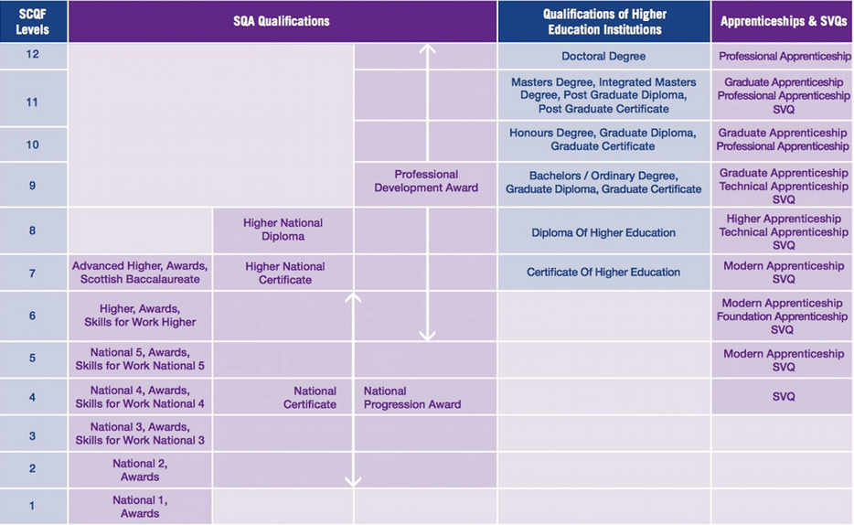
QUALIFICATIONS

Slide 41
Programme Details
2 half days
Tuesday and Thursday afternoons
Friday morning
Periods 1 and 2
2.5 days per week
Monday, Tuesday and Wednesday afternoons, Thursday all day
Transport provided or free travel card

Slide 42
Courses are available in the following areas:
Aviation and Travel
Business and Finance
Care, Health, Life Science and Social Care
Construction and Engineering
Creative and Digital Industries and Music
Events Management
Fashion and Design
Hair and Beauty
Horticulture, Hospitality and Landscaping
Humanities and Social Sciences
Sport
Uniformed and Emergency Services
Vehicle Systems

Slide 43
Applying for a course
Speak to Principal Teacher of Pupil Support and parent/guardian
Complete application forms – one with parents and one in school
Places are not guaranteed as only a small number of places are available to each school. You MUST choose five school subjects during the options process and indicate if you are interested in applying for a vocational college course.

Slide 44
The Vocational Programme is combined within the school’s options
booklet and can be viewed on the school website.

Slide 45
NEXT STEPS
Research
  Options booklet https://forms.office.com/e/n8fTYgNbMQ
  (available online – school website)
  My World of Work website
  Ask questions
Electronic options form submitted before Friday 24th February
Pastoral will contact you with any changes following interviews

Slide 46

Thank you for coming
Please feel free to ask us any questions

