Slide 1

FAB Friday
4/10/24

Slide 2
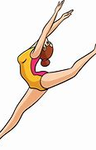
Khadijah Hussain P1
Khadijah completed her gymnastics homework.

Slide 3

Humza Hussain P1/2
Humza received a trophy for being ‘Boxer of the Week’.

Slide 4

Aurelia Kerr P6
Aurelia was awarded her green tag belt in Taekwondo.
She also successfully built a game on the Switch.

Slide 5
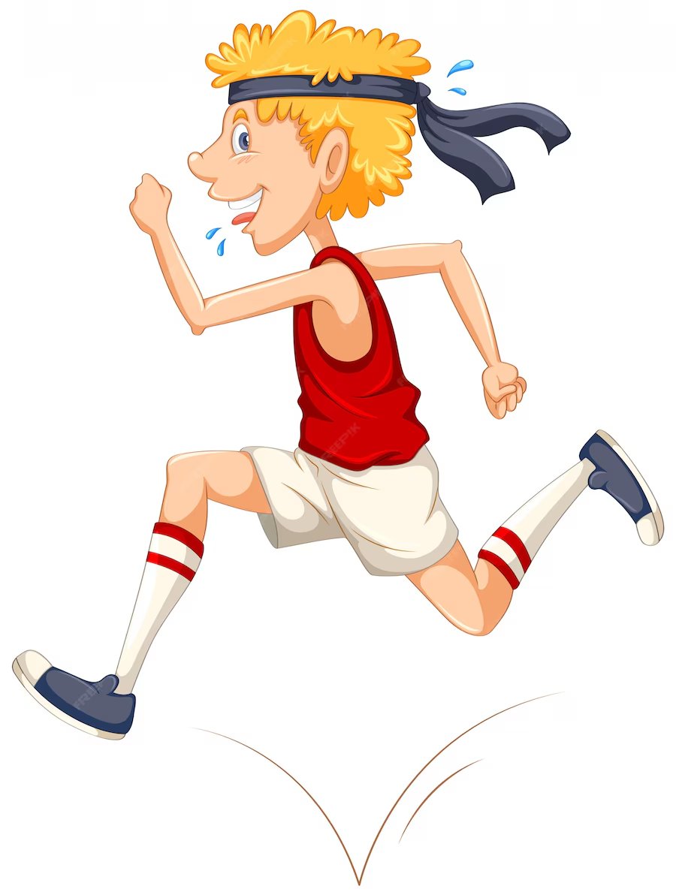
Stewart Young P4
Stewart recently ran the Mauchline 5K fun run.
In the summer holidays Stewart cycled 218 miles. These miles were recorded when Stewart cycled with his mum or dad. His longest bike ride was 20 miles which took him to New Cumnock, Cumnock and Logan and back home.
Stewart was the first player to receive the Star Award within the P4 Cumnock Rugby Club team this season.

Slide 6

Brody Donnelly P1
Brody is doing so well with swimming and is now very confident in the water without arm bands.

Slide 7
Max Caldwell P1
Max has been progressing well with his swimming lessons and can now swim unaided from one side of the pool to another.

Slide 8

Peighton Stirling P6
Peighton recently started gymnastics again, and on her second week back won a competition.

Slide 9

Piper McCracken P1
Piper won this trophy as part of a family dancing competition at New Cumnock FitFest. She tried her hardest and learned all the new moves.

