Slide 2
Update for parents 2017
SQA Liaison Manager
Lee-Anne Quinn

Slide 3
January 2016 – March 2017
January 2016 - Working Group on Assessment and National Qualifications (ANQ) established
May 2016 - ANQ report/SQA Fieldwork Report/SQA Subject Review Reports published
June 2016 - EIS ballot on industrial action
August 2016 – SSTA ballot on industrial action
September 2016 - Deputy First Minister announces removal of units from National Courses
March 2017 – Scottish Government published policy statement on the changes to National Courses

Slide 4
Removal of mandatory unit assessments
Timeline
Session 2017-18:
National 5
Session 2018-19:
Higher
Session 2019-20:
Advanced Higher

Slide 5
Removal of mandatory unit assessments
In September 2016, the CFE Management Board ratified ANQ decision to remove mandatory units and unit assessments from National 5 to Advanced Higher courses, and enhance the course assessment.
‘The removal of mandatory unit assessments has the distinct purpose of reducing the amount of assessment experienced by young people taking national qualifications and the workload created as a result of administering the units.’
- Scottish Government Policy Statement, March 2017

Slide 6
National 5 - changes to course assessment
No changes to the aims, rationale or content of the courses
Course assessments strengthened to ensure assessment of full content of course, following the removal of units
This has resulted in one or more of the following:
- extension of the existing question paper
- extension of the existing item of coursework
- new question paper
- new item of coursework

Slide 7
New question paper – 9 subjects
N5 Hospitality: Practical Cookery
Current course assessment 100% Practical Activity

Slide 8
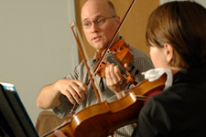
Our National Qualifications in Music provide learners
New item of coursework-4 subjects
N5 Music
Composing currently only assessed within unit

Slide 9
Grading-National 5 2018
Grade D attainment will be broadened from the current position (notional 45-49%) to a notional 40-49%. This ten per cent range brings a Grade D award into line with the ranges for Grades B and C
Higher and Advanced Higher in 2018 will certificate grade D at current arrangements 45-49%. Higher will change in 2019 and Advanced Higher in 2020 certification.

Slide 10
National 4
As detailed in the Scottish Government’s policy statement:
The Assessment and National Qualifications Group is considering National 4, with an initial focus on the form of an external assessment, and on the ability to differentiate candidate performance
It is important that these discussions are taken forward in the context of the different pathways that might be taken by a candidate who achieves a National 4

Slide 11
Understanding Standards

Slide 12
National 5 course documents

Slide 13
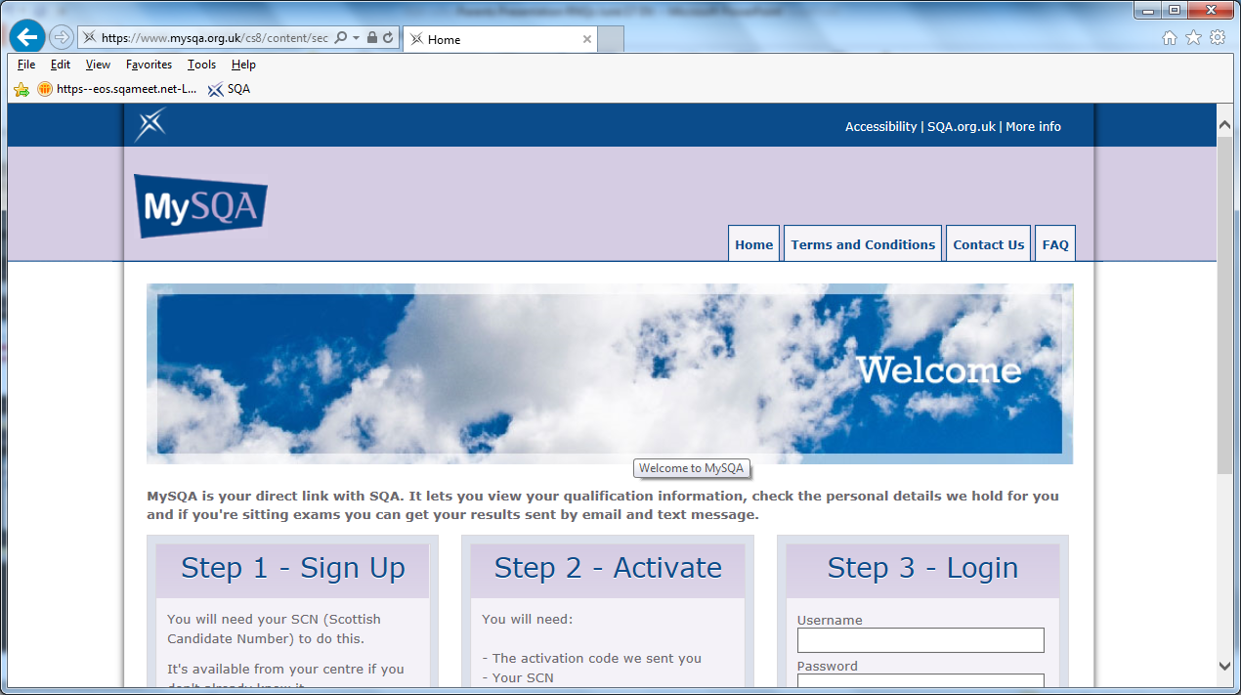
My SQA
Notes:
Register to get results by text at 8am. Great if going on holiday.

