Slide 1
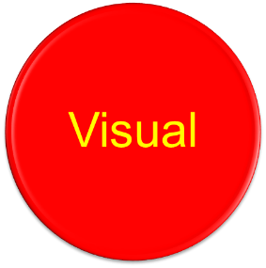
Learning Styles
S4-6 Study Skills Evening
Auditory learners
perform best when they
can hear the
information.
Tactile/Kinaesthetic learners need to have
hands on experience to perform at their best.
Visual learners learn
best when they can
see it, read it or write it.

Slide 2
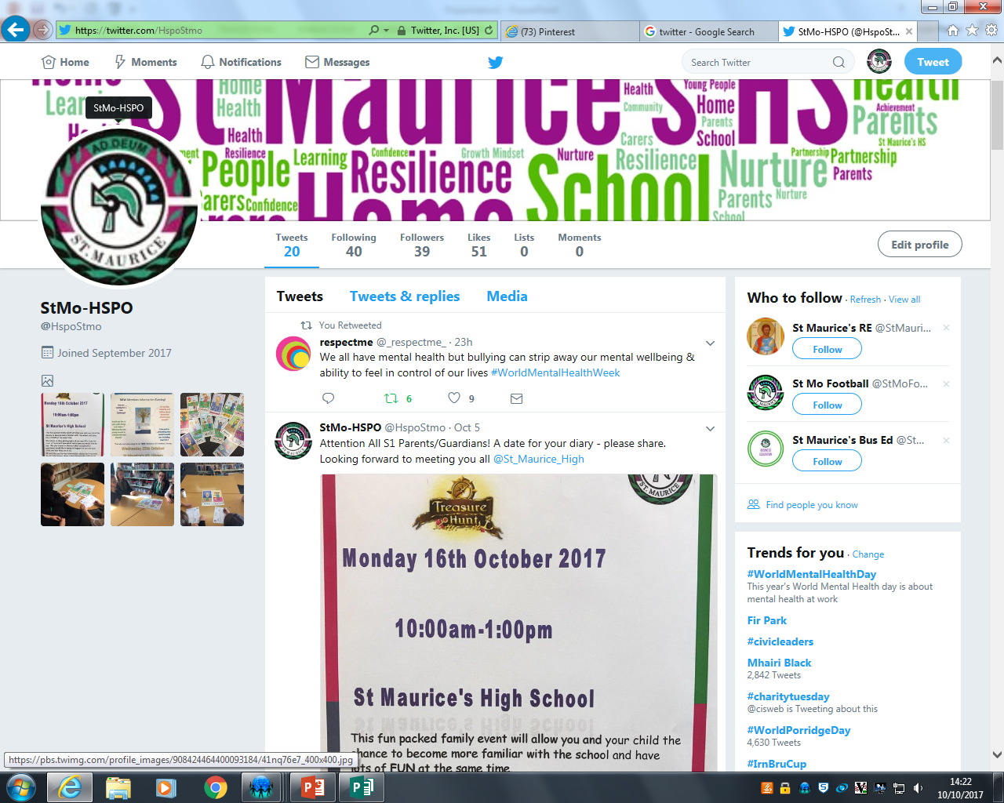
Twitter
Follow us on Twitter
@HspoStmo

