Slide 1


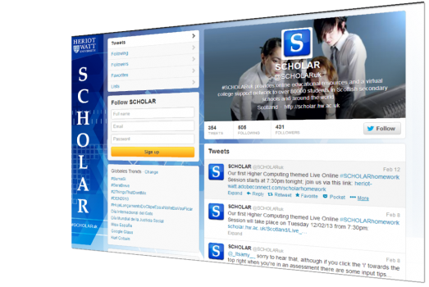
Study Skills
St Maurice’s High School
Dot Tedman– SCHOLAR AREA COORDINATOR
d02tedman@hotmail.com
http://scholar.hw.ac.uk/

Slide 2
What is SCHOLAR?
An online learning environment that supports pupils in a range of SQA courses.
Allows pupils to:
Study independently, anytime, anywhere.
Access notes, summaries, animations and simulations
Achieve instant feedback from a variety of quizzes, activities, end of topic and unit tests.

Slide 3
What is SCHOLAR?
Take part in live homework sessions
View recordings of previous homework sessions
Monitor their progress with the reporting system.
Use SCHOLAR to help catch upon missed class work (e.g. through illness)

Slide 4


SUBJECTS
Gaelic
Chemistry
Physics
German
Biology
Spanish
English
Human Biology
Mandarin
French
Maths
ESOL (English for speakers of other languages
Computing Science
Accounting
Economics
Business Management
Art & Design (Textiles)
Psychology

Slide 5
Accessing SCHOLAR
All students registered to sit any SCHOLAR course will have their own logon
Parents also have a logon:
Username: schparents2018 Password: week73city

Slide 6
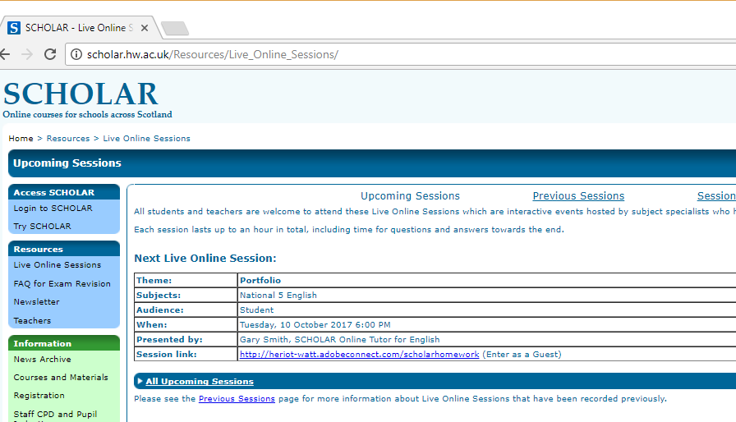
Live Sessions

Slide 7

SCHOLAR on the GO
Students can access SCHOLAR anywhere there is an internet connection.
To make full use of SCHOLAR on phones or tablets, download the free Puffin Academy web browser from the Android Play or Apple App store.

