Slide 1


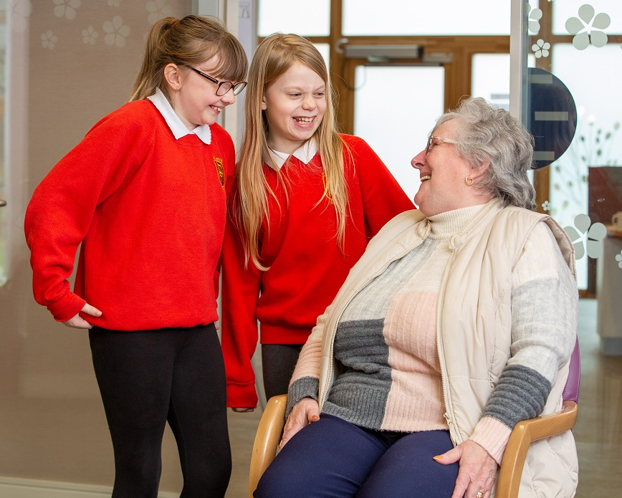
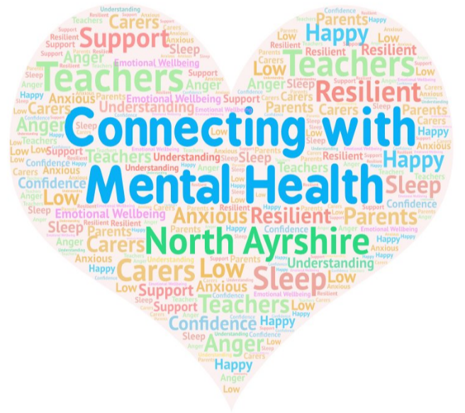




Supporting the Mental Health and Wellbeing of Children and
Young People in Your Care​
Part 2
Notes:
In this part of the course we are going to be looking at stress again and how we can manage it; explore the signs that tell us when we should be worrying about our child or young person, and learning about ways we can look after and improve mental health and wellbeing for ourselves and others.

Slide 2


Recap/ Stressors…
Stress…
Major stressors…
North Ayrshire Council
Notes:
EJ Just to recap Stress is something we all experience, it can be a motivator to get jobs done but it can also cause detrimental effects on both out physical and mental health We discussed Everyday and major stressors in children’s lives.Everyday Stressors are typical situations and challenges that most children and young people face as they develop. They include changes in routine, friendship issues, changing school or when moving into a new session. Whether these everyday events are stressful or not will depend in part on the child’s coping skills and their home and school environment.
Major stressors on the other hand are significant events like family trauma, bereavement, divorce, parental job loss and it amy be that children and young people will require support to manage these.
Everyday Stressors are to be expected and children ad young people should be able find personal solutions.

Slide 3




Activity – Shaky Person
Use the shaky person diagram to consider the effects of stress. Symptoms can fall under the following categories;
Physical – What happens to your body? Emotional – How do you feel? Cognitive – How is your brain working? Behavioural – What do you do?
Notes:
EJ – On the next slide you will see a shaky person diagram, you can either draw this on a piece of paper or print out the slide. Think about the effects of stress, they can be divided into 4 main categories Physical, Emotional, Cognitive and behavioural. If you have someone you can discuss these effects with then please do.
Activity – Shaky person (15 minutes)
Ask what causes stress in the environment.
Small group – discuss these together
Larger group – Split into 4 and allocate a category to each group
Record on Flipchart and discuss.
We can look for these changes in ourselves and others to help detect stress early and prevent symptoms worsening

Slide 4
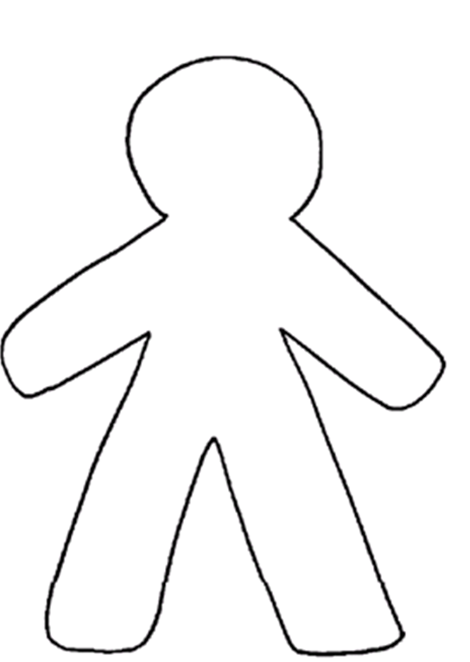
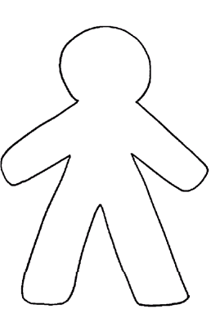
Stress
Notes:
EJ You may have discussed or thought of the some of the ideas here.
Physical effects , sweaty palms, butterflies in your stomach, nausea, racing heart, headache
Emotional and behavioural changes you may notice – increased anxiety, frustrations, fear, anger short tempered, can’t be bothered,, irritability, difficulty sleeping
Cognitive effects could include struggling to focus, being forgetful, being pessimistic,
Other behaviours may include drinking or smoking in children we may see mood swings, difficulties focusing, they may be acting out or refusing to get involved with activities they previously enjoyed.

Slide 5
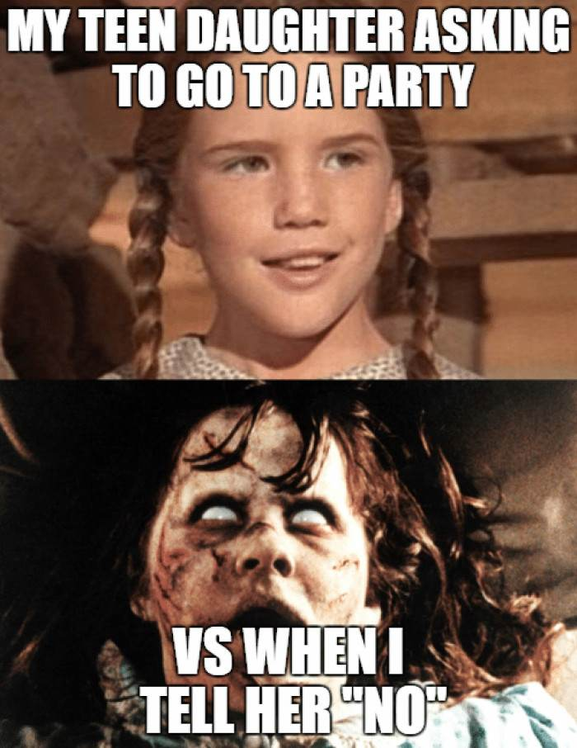
So what's normal teenage behaviour?
Before we continue let's consider the changes that occur as a child moves towards the teenage years.
Change is to be expected
Everyone is different and experiences change in their own way
Exploring identity/ trying new things
Feeling awkward about oneself/ uncomfortable about
own body
Moodiness/ short temper
Less affectionate towards parents
Ill-mannered or rude
Notes:
MF
Read slide

Slide 6
Pushing boundaries
Rebellious tendencies
Changing relationships/ social butterfly
Interest in sex
Little thought for the future/ lives in the moment
Childish actions
Bear in mind that it is okay to ask your child if they are okay! You know them best and if you are likely to worry then having a conversation or checking in is absolutely fine – just don’t press or you may be met with a sulky teenager storming to their room!
Notes:
Read slide
It could help to treat the last two slides as a checklist. Note the behaviours down as it may help you to have a visual that will remind you that there is no need to stress or worry.

Slide 7

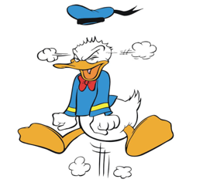
Spotting the Signs
When to Worry…
Now let's look at the things we might see that are worth being concerned about.
Severe and regular mood swings
Strong worries/ anxieties that start affecting day to day life
Concentrating is very challenging and school performance slips
Sleeping/ eating habits change
Repeated risk taking (sexual; alcohol; drugs)
Regular outbursts of anger
Strange thoughts or feelings
Claims of feeling suicidal
Wish to self-harm
North Ayrshire Council
Notes:
MF
Read slide

Slide 8


How can you support your child or young person?
Talk openly about mental health just as you would physical exercise or eating healthily. Make it part of your everyday vocabulary.
Show them how you take care of your own mental health; lead by example.
Bear in mind the importance of technology and social media by reinforcing the impact it has on our sleep.
Be watchful and pay attention to any changes in behaviour.
Talking is a powerful tool. Use it to explore how a child is feeling or what they are thinking: 'How did your day go today?...Tell me more.'
Understand a situation without judgement and don't press
your child for a response.
Make talking a regular occurrence.
Be patient and remain calm.
Notes:
MF
Read slide

Slide 9
Exploring our own mental fitness…
Notes:
How do we as parents and carers know we are mentally fit?
We know we are mentally fit if we feel optimistic, if we rise to challenges and can easily work out solutions to problems.
Mental fitness is important in maintaining your brain and your body healthy, especially as you age. There are many types of mental dexterity exercises, and you don’t need to go to the gym to do them. They include active ones, such as learning a new song or playing a game, as well as restful ones, such as relaxation and visualization exercises. Schedule a mental fitness break into your calendar right next to your workout schedule.
Ideas include reading, playing games like crosswords, sudoku and scrabble. Trying out new ideas like having some different foods. Travel is an excellent way to keep mentally fit and have new experiences, think of ways to do this within the current restrictions maybe take a different route next time you walk or drive to the shops

Slide 10

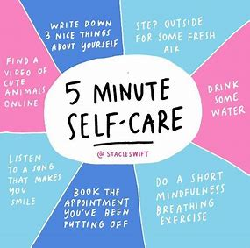
Nurture for You
Parenting and caregiving can be a stressful job that takes time and sacrifice.
It is important to set an example of nurturing for children by nurturing yourself.
Set aside time to do something just for you.
Notes:
EJ When adults nurture themselves by having their own needs met, they are more able to meet the needs of their children. The four suggestions stated in the next few slides also apply to nurturing yourself; recognize and name your feelings, stick to a schedule, give and receive gentle touch and protect yourself from things that could harm you.
Nurturing does not come naturally to all adults and nurturing practices can be learned.

Slide 11

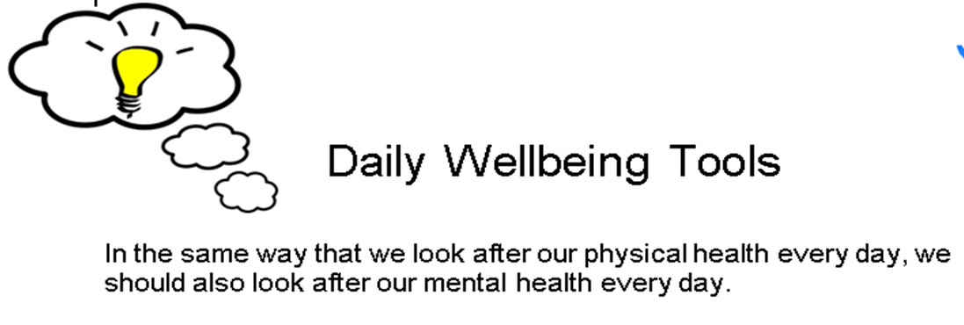
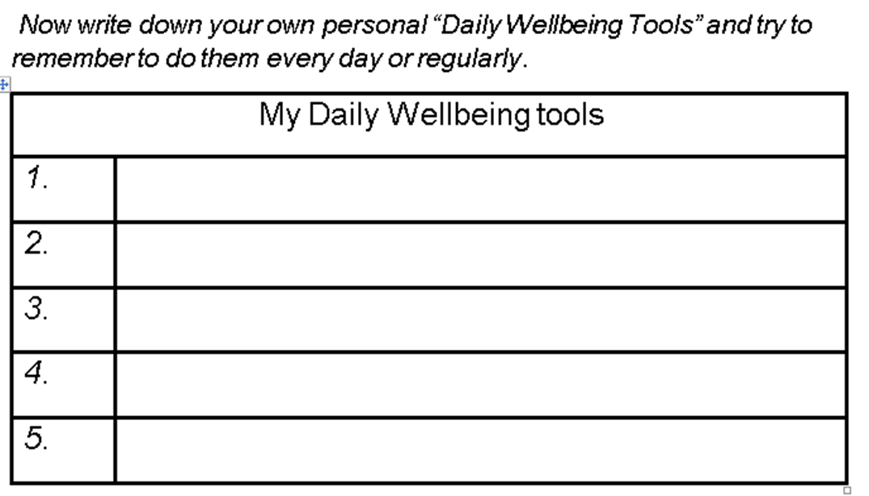
Notes:
EJ - Daily Wellbeing Toolkit
In the same way that we look after our physical health every day, we should also look after our mental health and wellbeing every day.
Little and often is best...small daily mood boosters help more than big life changes. Try to think about some of the things you like to do to boost your mental health and wellbeing. This can be any activity where you are spending time doing what makes you happy and that you enjoy. This could be a hobby or just a catch up with someone on the phone .
Think about the previous slide as a starting point and build on these with more little things that you enjoy regularly.
Michelle will go on to describe some stress busting tips.

Slide 12
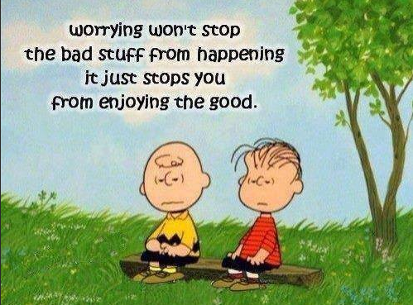
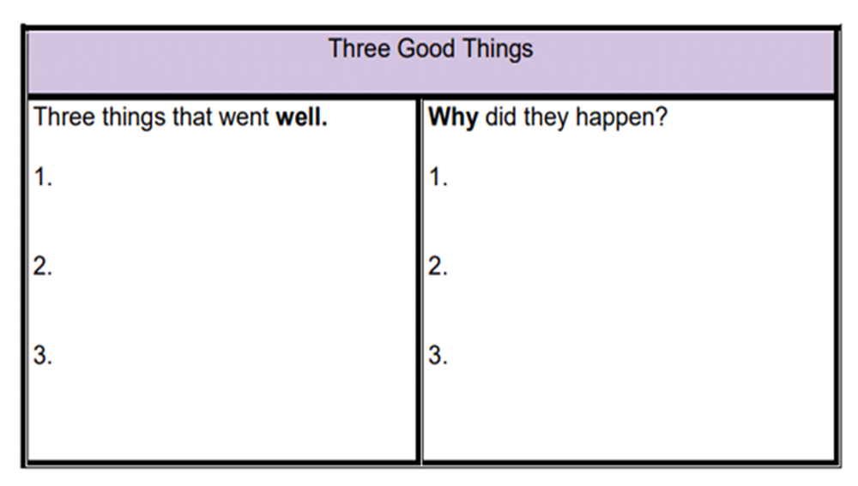
Three Good Things
Research shows that writing about three things that went
well and thinking about why each good thing happened can
increase our mood and help us to feel more optimistic.
Try doing this once a week before you go to bed and see if it
makes you feel better.
Notes:
MF - There is lots of evidence to show that practicing positivity and gratitude for the little things that give us pleasure every day can greatly improve overall wellbeing.
Three Good Things - Although big exciting events like holidays are good to look forward to, evidence shows we can actually really benefit from the little pleasures in life such as appreciating family time, walks on the beach, music and hobbies etc and living in the moment.
Consider whether you are likely to focus on the positive or the negative aspects of life.

Slide 13
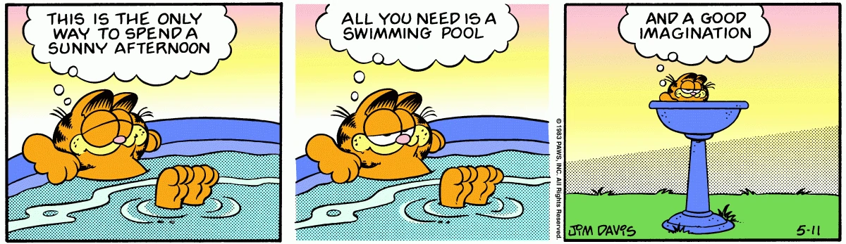
Problem Solving and Tackling Stress
Problem | Steps I can take | When? | Progress
I never make time for myself. | Walking or swimming | Twice weekly after dinner for 30 – 60 minutes
Notes:
MF
Problem solving exercise - When we are very stressed, sometimes it is hard to see a way forward (remember cognitive function from shaky person exercise). Try listing the things that make you stressed and write down steps that will help you avoid feeling like this in the future. Schedule time for the steps you will take and chart your progress.
Remember that change doesn't happen overnight – you must be patient and persevere!

Slide 14



Reflection and Evaluation
https://forms.office.com/r/nHcrh83bQ0
Notes:
EJ Thank you for taking the time to participate in this Parental Learning resource, your feedback and thoughts about learning are important to us. We would appreciate it if
You could complete the survey It should only take 2 minutes to complete Many Thanks

Slide 15
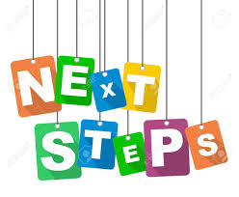
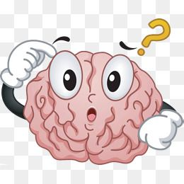
Next Steps…
Eilidh and Michelle will offer a virtual catch up session where they will answer any questions you may have, and you will have the opportunity to discuss your learning
Please email any questions to
eilidhjames@north-ayrshire.gov.uk
Or louiseking@north-ayrshire.gov.uk
Please email Eilidh or Louise if you are interested in attending a follow up session with them.
Notes:
EJ Should you wish to take part in a virtual catch up session where you will have the opportunity to ask staff questions then please contact Eilidh or Michelle. We hope to have some guest speakers at these sessions.

Slide 16
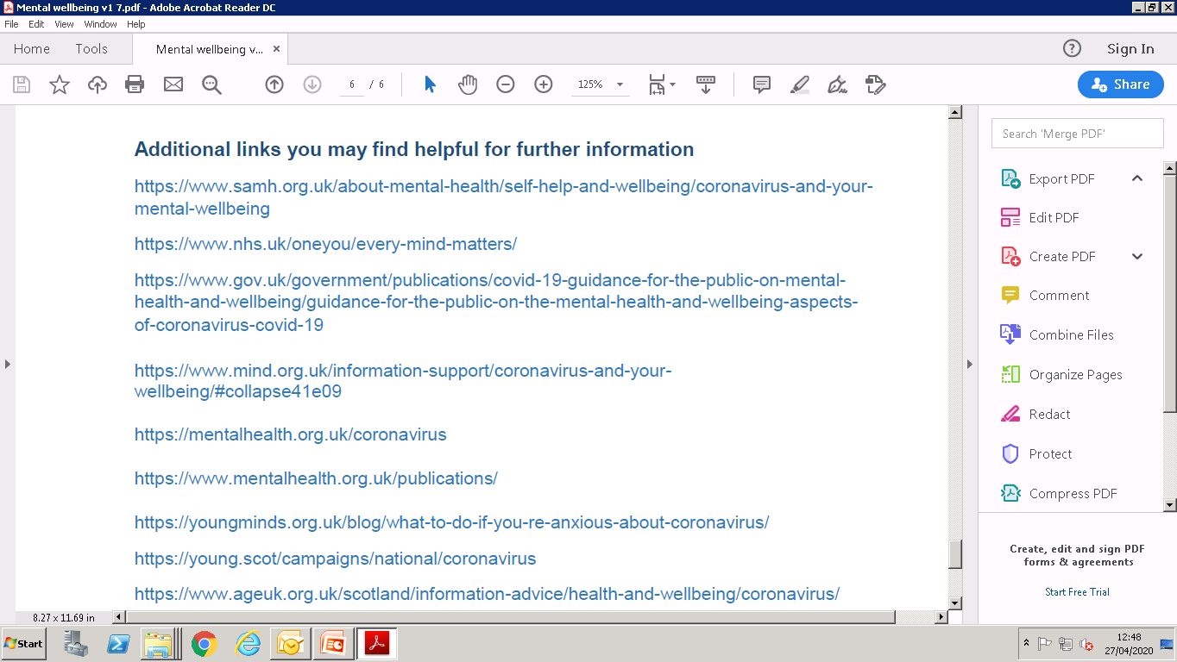
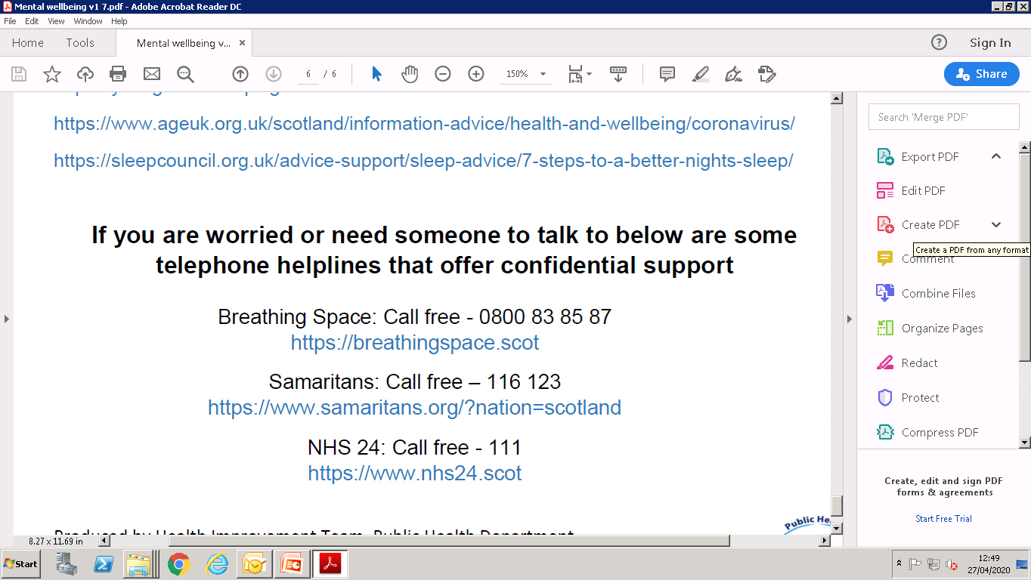
Parent Network Scotland Wellbeing Toolkit
https://www.parentnetworkscotland.com/wellbeing-toolkit-2020
Notes:
EJ Please see additional links.
Parent Network Scotland have developed a new course The Wellbeing Toolkit it is intended to help all parents/carers whatever the age of the children, culture, background or beliefs about parenting to try new tools to promote health and wellbeing. The link to further information is available on the slide

Slide 17
Additional Thanks...
NHS Ayrshire and Arran
North Ayrshire Council Educational Psychology
Notes:
TBC when consultation finalised.

