Slide 1
Starter: What jobs In the UK did not exist 50 years ago? Make a list.

Slide 2
Learning objectives
To know how employment structures can change over time
To understand why this happens and how it could happen in the future

Slide 3
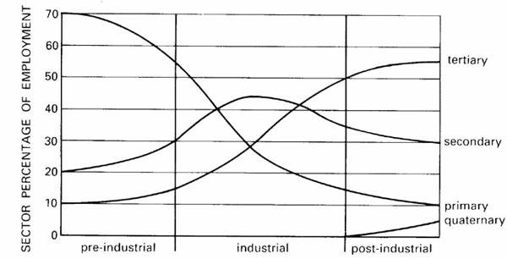
Key stages in the timeline
1) Primary predominant
2) Primary falls as more secondary and tertiary
3)Primary low, tertiary main sector now includes quaternary
1
2
3
Task 1: You have 10 minutes to draw this into your book including a small description of each stage.

Slide 4
Task 2: Make notes on this information
Key changes to employment
Movement away from people and more towards technology – Online film rentals
Outsourcing: When a company contracts out its work to another company. Usually when they can save money or utilises certain skills
E.g. Many British companies use Indian call centres

Slide 5
Task 3: Employment structure - The future
What skills to you think you will need to get a job when you leave school?

Slide 6
Tweet it….
You have only 140 characters to write a tweet to tell the rest of the class how employment structure changes over time
You need to count the letters to make sure you are not over your limit!

