Slide 1
Golden Time
A research project by P3 & 4

Slide 2
What did we want to find out?
Research questions:
  What do we think about Golden Time?
  How could we improve Golden Time?

Slide 3
Our questionnaire
Banton Primary Golden Time Questionnaire
P3 and 4 want to find out what you think about Golden Time and how it could be improved. We will not be able to tell who completed the form so please answer honestly.
Q1 Do you like Golden Time? Tick your answer. Yes No
Q2 Should getting Golden Time depend on your good behaviour?
Tick your answer. Yes No
Q 3 If you think it depends on your behaviour, do you think you should:
1. Have to earn Golden Time ( e.g. 5 minutes for each day)
2. Have to lose Golden Time for poor behaviour (e.g. you start the week with all your
time but lose minutes for misbehaviour)
Tick one choice only.
Q4 Would you like more choice at Golden Time?
Tick your answer. Yes No
Q5 What kinds of things would you like in your choices?
Write ideas in the box.
Please turn over the page.
Q6 Is Golden Time long enough?
Tick your answer. Yes No
Q7 Is there anything else you want to say about Golden Time?
Write ideas in the box.
Thank you for answering our questionnaire.
Please return the completed forms to the post box in the lunch hall by the end of Wednesday 6th October 2016.

Slide 4
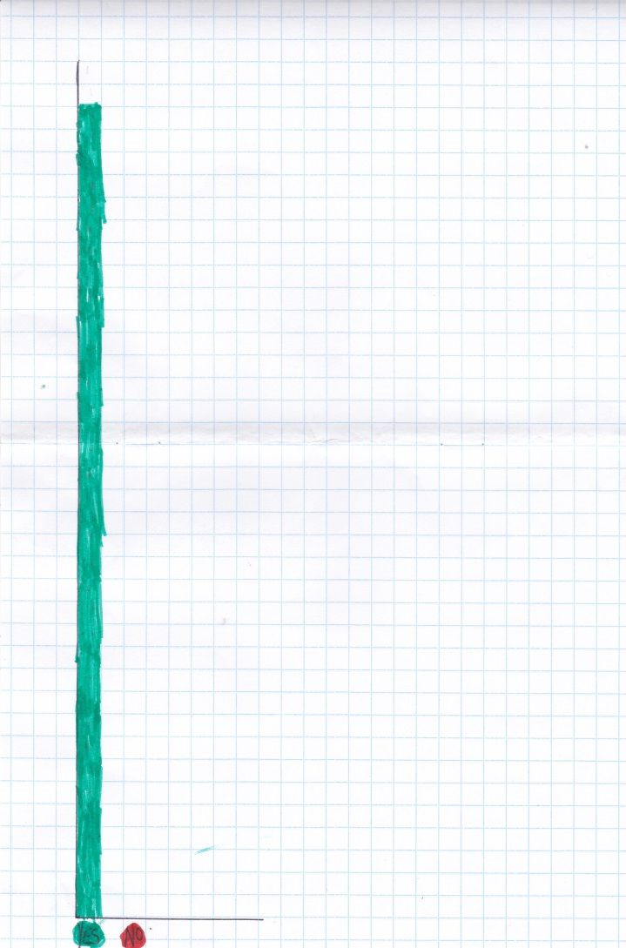
Q1 Do you like Golden Time?
Notes:
Jessica and Rhea
We asked you if you like Golden Time. We found out that everybody (36 people) like Golden Time.

Slide 5
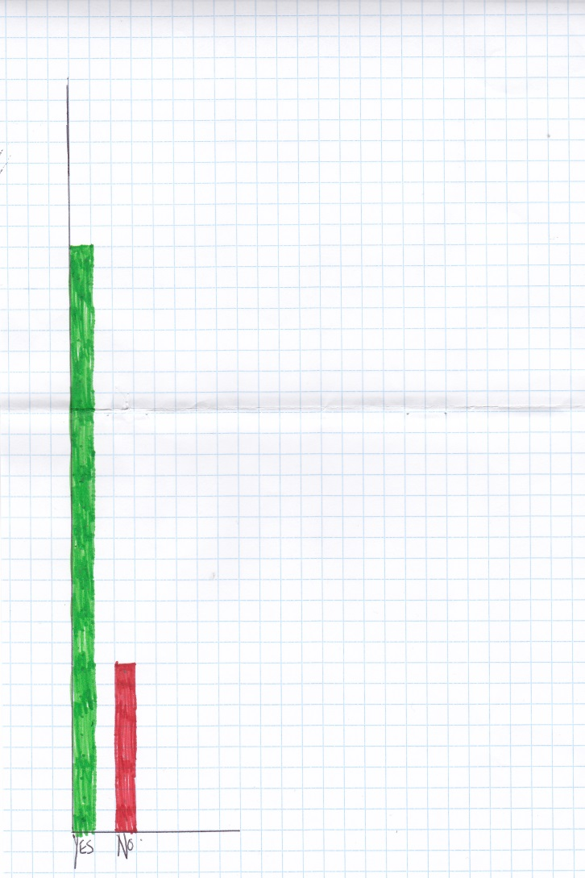
Q2 Should getting Golden Time depend on your behaviour?
Notes:
Heather
We asked you whether Golden Time should depend on your behaviour.
28 people said yes
8 people said no.
Most people believe that Golden time should depend on your behaviour.

Slide 6
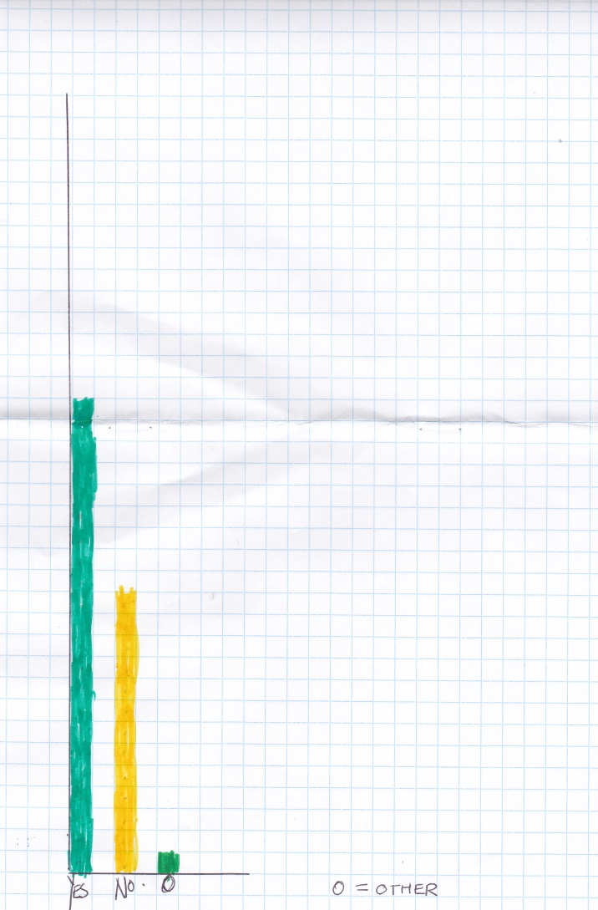
Q3 How should you earn Golden Time?
Notes:
Fulton
We asked how should you earn Golden Time.
22 people felt you should earn it
13 people felt you should lose Golden Time over the week.
1 person said both.
Most people would prefer that you earn your Golden Time during the week.

Slide 7
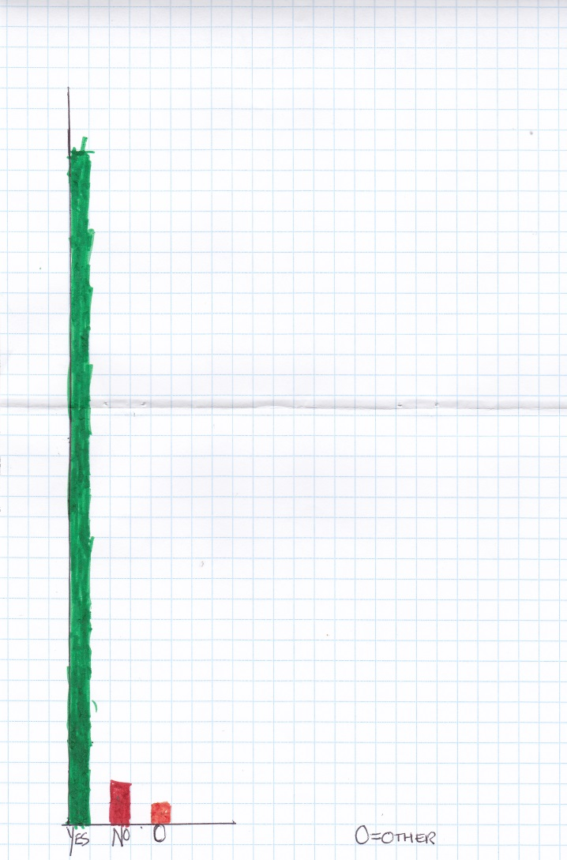
Q4 Would you like more choice at Golden Time?
Notes:
Aaron
We asked whether you would like more choice at Golden Time.
33 said yes
2 said no
1 said it didn’t matter
Most people would like more choice at Golden Time,

Slide 8
Q5 What kinds of things would you like in your choices?
activity | Number of people
More games | 6
football | 4
outside | 18
GP room | 18
Gym hall | 5
Other sports | 3
crafts | 2
Cosy room | 7
park | 2
movies | 2
P5/6/7 classroom | 2
music | 1
draw | 5
dancing | 5
baking | 1
gardening | 1
P1/2/3/4 classroom | 6
art | 4
Cooking | 3
total | 95
Notes:
We asked what you would like to do at Golden Time.
The most popular answers were-
Outside
GP room (top 2 answers)
Cosy room
P1/2/3/4 classroom
More games
Gym hall
Drawing
Dancing

Slide 9
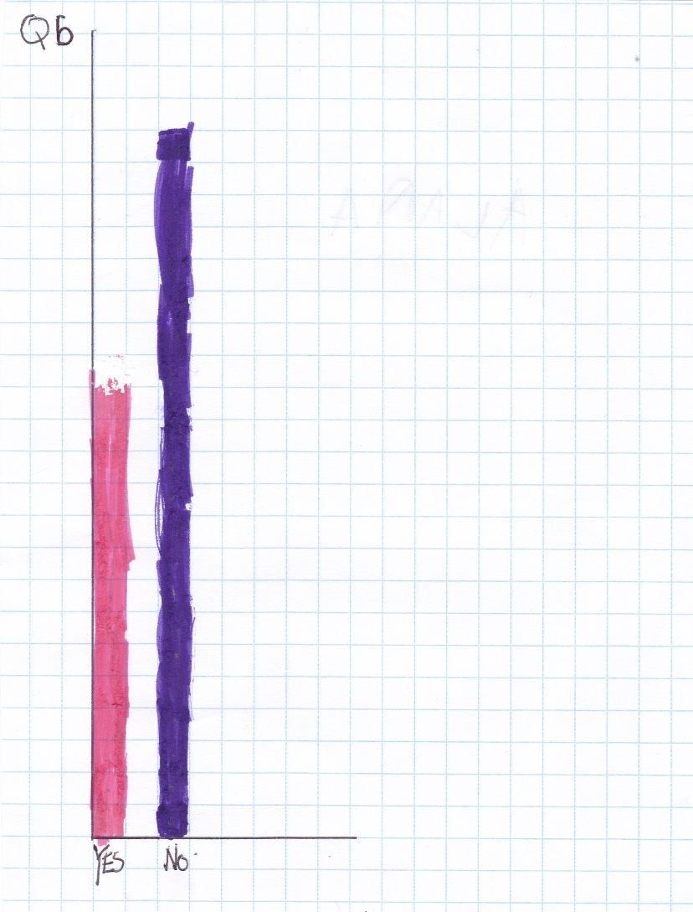
Q6 Is Golden Time long enough?
Notes:
Alana (with Jessica)
We asked you whether Golden Time is long enough.
14 people said yes
12 people said no.
Most people want a longer Golden Time.

Slide 10
Q7 Is there anything else you want to say about Golden Time?
activity | Number of people
Go to other rooms | 2
Not fun sometimes | 1
Mix with other children | 1
Write on the chalk board | 1
colouring | 1
baking | 1
Get more things outside | 1
GP room | 1
Gym hall | 1
Have golden time like last years | 1
Notes:
At the end, we asked you if you had anything else to say.
Most people said they would like to go to other rooms.
Some people had more ideas for choices such as mix with other children, baking, get more things outside, GP room, gym hall, colouring, write on chalk boards and baking.

Slide 11
Thank you for taking part in our project.
Please give us feedback on our project.

