Slide 1
Some Things Autistic
Chris Atherton – Senior Educational Psychologist, East Renfrewshire EPS

Slide 2
This is my truth, tell me yours
The Manic Street Preachers

Slide 3
Ways to Have A Conversation
https://www.youtube.com/watch?v=sr1uS8KZbto

Slide 4
10 Ways to Have a Better Conversation…
https://www.youtube.com/watch?v=R1vskiVDwl4

Slide 5
You don’t need to show you are paying attention, if you are paying attention
Be interested in other people

Slide 6
Celeste Headlee
Don’t multi-task – be present – be in that moment
Assume that you have something to learn - Set aside your own opinions
Ask open ended questions – complicated questions = simple answer
Let your thoughts go – if you hold onto your thoughts – you are not fully listening
Say you don’t know if you don’t know
Don’t compare your experiences – all experiences are individual – it is not about you
Don’t repeat or rephrase the same message
Leave out the details
LISTEN– we’d rather talk as we are in control – when listening we can be distracted = don’t listen to learn but to reply to the speaker
Be brief

Slide 7
‘He’s coping really well…’
How positive is your communication, really?

Slide 8
How positive is your communication?
What is normal?
What is abnormal?
What is neurotypical?
What is neuro-atypical?

Slide 9
He / She has…
Problems with…
Weakness in…
Difficulty with…
Presenting concerns in / with…
Trouble with…
Restricted…
Impairments in…
Narrow range…
Struggled to…
A Neurodevelopmental DISORDER!!!!

Slide 10
Well done everyone
Claps hands
Three cheers
Pats on back
Getting totes emoji…
Pure wellin up…
Nodding dogs
Or

Slide 11
(Face palm emoji)
That’s my daughter you are talking about…
Am I supposed to be pleased?
Are you kidding me?
You want me to be thankful?
All I heard there was that you are finding my son really difficult?

Slide 12
Retreat to…
Those parents are actually really tricky…
There is no pleasing some folk…
We’re bending over backwards here…
They are being completely unreasonable…
There isn’t enough support…
We are far too stretched…
I live in the real world…
Honestly, it’s that Ed Psych’s fault…

Slide 13
This can lead to…
Splitting between:
Young people and parents
Young people and professionals
Parents with each other
Professionals with each other
Parents and professionals

Slide 14
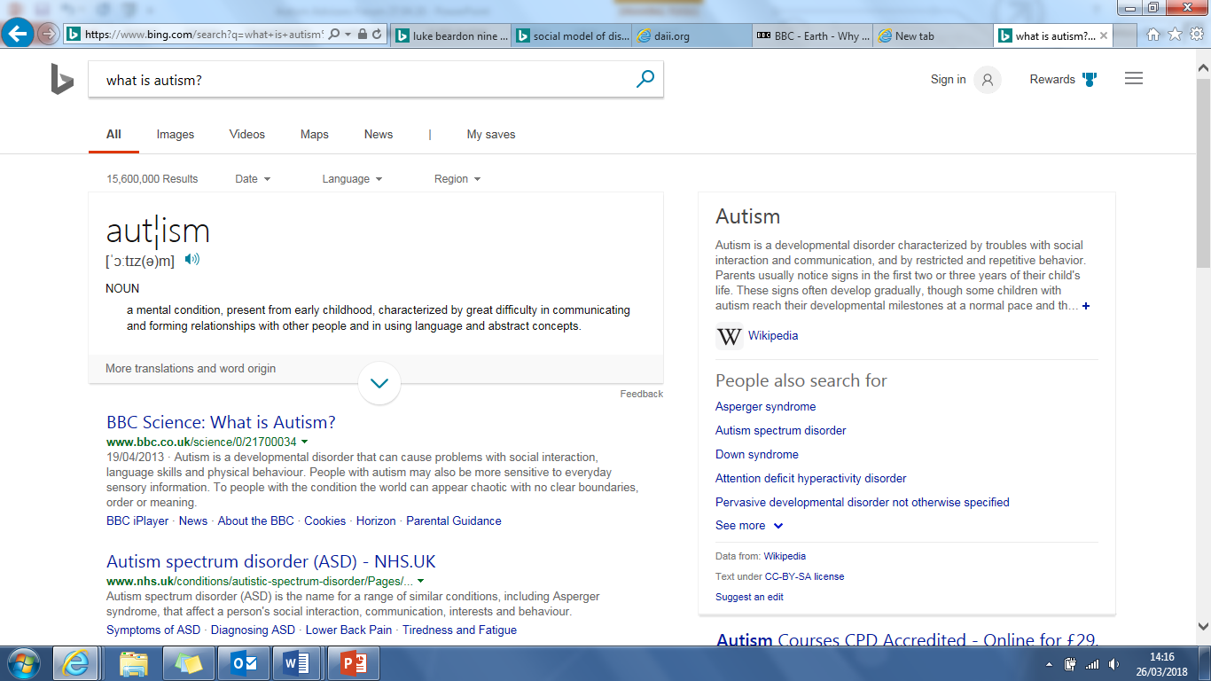

Slide 15
DSM V
Autism Spectrum Disorder
“persistent difficulties with social communication and social interaction”
“restricted and repetitive patterns of behaviours, activities or interests” (this includes sensory behaviour)
present since early childhood, to the extent that these “limit and impair everyday functioning”
Source: NAS
Notes:
ASD – collective term for all of the previously used terms:
Asperger’s syndrome / disorder
Childhood autism
Autistic disorder
Childhood disintegrative disorder
Pervasive developmental disorder – not otherwise specified

Slide 16
ICD 10
International Classification of Diseases (WHO)
“ASD refers to a range of conditions characterised by some degree of impaired social behaviour, communication and language, and a narrow range of interests and activities that are both unique to the individual and carried out repetitively.”
WHO
ICD 11 expected in 2018

Slide 17
Q1: What is autism spectrum disorder?
A1: A neurodevelopmental disorder or condition.
Q2: What is autism?
A2: Autism is a social construct. It is a medical label used to categorise and, through implicit bias, subjugate by defining as disabled, a very large group of people who happen to have neurological and sensory differences that result in them exhibiting behaviours that the majority of other people don’t consider to be normal.

Slide 18
What has it got to do with psychiatry?
It’s not a diseases or an illness.
It’s a different cognitive state
Luke Beardon

Slide 19
Cognitively, How has Autism been Viewed?
Triad of Impairments
Weak Central Coherence
Extreme Male Brain
Executive Dysfunction
Lack Theory of Mind
Context Blindness
How many different ways can we say Autism is a negative thing???

Slide 20
Changing Perspective…
And the conversation…

Slide 21
positive communication
Move toward:
Predominant and Autistic Neuro-types (PNT and ANT)
Move away from:
Normal and abnormal?
Neuro-typical and neuro-atypical?

Slide 22
Central Coherence Profile
Attention to detail at the expense of the bigger picture.
The ability to focus on detail
The ability to filter out distracting information
The ability to be more accurate
The ability to persevere for a prolonged period of time on a preferred task
The ability to excel in particular subject areas…

Slide 23
Executive Functioning Profile
Control centre of the brain can get over -loaded.
The ability to create order and sequence

Slide 24
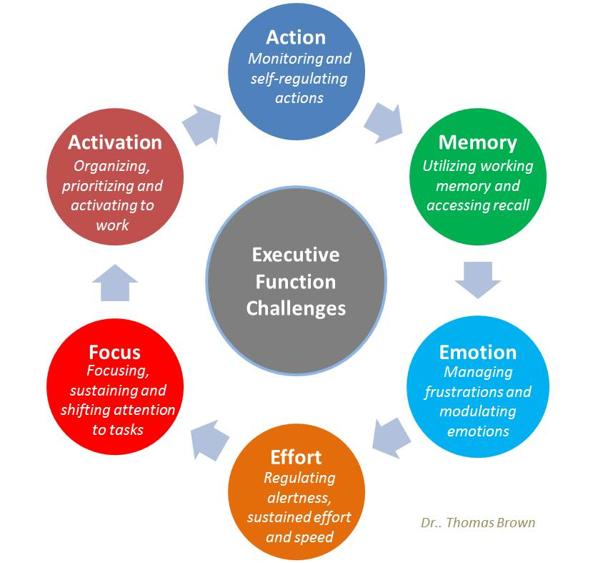

Slide 25
“Why are you still fat?”

Slide 26
Theory of Mind
Difficulty seeing things from another perspective.
How good are predominant neuro-types (PNTs) at seeing things from the perspective of an autistic mind?
Double empathy problem:
ANTs better understand other ANTs
PNTs better understand other PNTs

Slide 27
Context Blindness
Difficulty understanding how meaning relates to a given situation.
Can become…context accuracy
The ability to recognise that each situation is different – to see variance – to see that each specific context in isolation is unique
http://www.bing.com/search?q=oasis+stand+by+me&src=IE-TopResult&FORM=IETR02&conversationid=&adlt=strict

Slide 28
Extreme Male Brain
Empathic v Systematic Brain
The drive to identify emotions within our experiences vs the drive to identify patterns and a logic within our experiences
Extreme male brain can become…a logically driven brain
The ability to see and identify patterns
The ability to be logical
The ability to identify and create systems
The ability to see how things connect
https://www.youtube.com/watch?v=nRoxCqCd77E

Slide 29
Presenting A Positive View of Autism (by identifying some myths)
Luke Beardon

Slide 30
Myth 1: Autism is a spectrum
Not possible to grade autism
Not a homogenous group
How autistic is a person?
Can you be more autistic than another person?
Autism is complex
Can’t be mildly complex – oxymoronic.
Concept that one can grade autism – stupid question to ask
People with ‘mild’ autism / asperger’s syndrome so commonly told they were mildly autistic

Slide 31
Myth 2: Everyone is a bit autistic
Autistic traits / tendencies etc. are useless concepts and only demonstrates inadequacies in current thinking as well as demeaning the entire population.
Two terms of school forcing coping strategies to go to assembly…child gets there with their ear defenders on, sitting on their hands and rocking…
Child thinks – I’ve done it now, leave me alone…
Staff – great, they have shown that they are capable of doing it now. That’s that problem solved!
“You are in the wrong, you are impaired, you are disordered, you have to change…”
Not the natural state of that individual’s cognitive process.

Slide 32
Myth 3: Autism is a triad of impairments
Lead to believe that people with autism are impaired in certain areas
Is this a case of majority rules – judgement?
Is the skill set of predominant neurotypes (PNT) really so wonderful?
Could an autistic manner of behaving be far more sensible and rewarding? Yes – in some instances.

Slide 33
Myth 4: People with autism are unsociable
The PNT people make very little logical sense
“Unwritten rules” are unwritten
Autistic people lack PNT type social skills
Social niceties could be seen as banal, utterly incomprehensible, and a waste of energy, really what is the point, and get to the point!!!
How many PNT people have great Autistic social skills
Concept of ‘lesser’ needs addressed
Different, not less…
Many people with autism can socialise with one another very well

Slide 34
Myth 5: People with autism are impaired in verbal comprehension
Literal interpretation is accuracy
Being pedantic is being linguistically honest
If we actually say what we mean and mean what we say life could be improved considerably
Who is the one that is impaired?
If you say something linguistically inaccurate, why is that the other person’s fault of not understanding it.
“You said that was a tautology and it’s a pleonasm.”
I get told off for being pedantic!!!

Slide 35
Myth 6: Non-verbal communication is useful and effective
Actually it leads to misinformation and confusion and lack of clarity for all of us
Would you prefer everything to be clear expressively and receptively, or prefer doubt, uncertainty and stress?

Slide 36
Myth 7: People with Autism lack a Theory of Mind
Non autistic people lack a theory of mind
Cross neurological theory of mind
A double-empathy problem (Mills…)
Autistic people find it difficult to understand non-autistic
Try the experiment the other way around…
People with autism have to develop an intellectual theory of mind – takes a lot of energy
Point the finger elsewhere!
Teaching an autistic theory of mind – everyone would know already…
Non autistic population get away with lying frequently and that is seen as a good thing…

Slide 37
Myth 8: Dis-executive Functioning leads to organisation – is there any dysfunction at all??
Allows for detailed planning
Order over chaos
Knowing what happens when, for how long and in what order is logical and sensible
Reduction in wasted time
Unpredictability is scary

Slide 38
Myth 9: Weak central coherence is bad
Central Coherence Profile… (Happe, Frith et al revisited)
Cognitive preference…
Meticulous attention to areas of interest
Detail is important
Ability to remain focussed
Provision of a wonderful balance with the gestalt led PNT

Slide 39
Myth 10: Sensory processing is dysfunctional
Occupational Therapists may diagnose sensory dysfunction
Can be problematic – however…
Almost unbelievable senses
Sheer joy in processing
Perceptual beauty not a bad thing

Slide 40
Myth 11: People with autism have obsessions
No they don’t- they have intense passions
Vocations
Having an ‘obsession’ can become a wonderful thing
Interests are motivational and can become extremely useful
“Give me something better to think about then – or at least of equal worth…”

Slide 41
Myth 12:
People with autism are inappropriate
Judgement decision based on PNT concepts
Qualify inappropriate
Autistic behaviour (invariably?) makes logical sense, based on individual logical parameters

Slide 42
What is not to admire?
Sense of fairness
Loyalty
Ability to retain childlike fun
Sense of humour
Burning desire for justice and rightness
Intensity of feelings

