Slide 1
ASD Advisors Chris Atherton & Annie MCgAULEy
8th March 2019

Slide 2
Agenda Based on the evaluations from May 2018
What you said… | What we did | What we will do next…
Pupil perceptions | √ Share a scenario in November. | Look at Pupil views March 19
Revisit social stories | √ Revisited formula in November Exercise to write stories All stories uploaded on ASD Blog | Please continue to upload
Role as ASD Advisors ; Practical issues / Challenges | SWOT analysis Will share result Uploaded on ASD Blog
Emotional Regulation | Inside Out powerpoint and exercise | If time will look at further strategies November 19?

Slide 3
What you said… | What we did | What we will do next…
Time to discuss current concerns / behavioural challenges / case studies | Time given within groups and in larger group. Time given today if possible
Sharing a diagnosis | Hazel completed in November Information on ASD Blog
Nurture and attachment
Using video to show good practice e.g. SULP groups |  | Next Time?

Slide 4
AGENDA
Reflect / consider impact of November session
10.00-1230 (including break)
Nurture and attachment
Coventry Grid
1230-115 Lunch
Pupil Views
Emotional Regulatory

Slide 5
ASD Advisors November 2018……
What have you done…
What could you do…
What would help….
Pupil perception
Role of ASD Advisor - SWOT
Social Stories
Solution Circles
Sharing Diagnosis
Emotional Regulatory

Slide 6
Strengths​​
What does the role bring to the school?
KNOWLEDGE
Knowledge and experience to support practitioners and share practice
One person with deeper understanding of ASD
Sharing practice and liaising with colleagues
CLPL
Someone who has a deeper awareness of the challenges and indicators, especially with high functioning children
From ASD meetings and other staff gaining right/up to date information so your practice is effective and people trust you
Strategies, social stories
Reading, online info, etc

Slide 7
SUPPORTING STAFF
Someone to chat with re. ASD
SULP etc
Supporting other staff
Support colleagues
Listening
Give advice
Empathy (from sharing practice) from staff and developing a greater understanding and skill set
Teachers have a point of reference – ASD Advisor
Can share resources with staff, point in right direction
PARENTS
Link with parents
Supporting children and families
Supporting parents
OTHER
Support from CCC children’s needs are met

Slide 8
Weaknesses
What are the challenges in your role?
REMITS
Some ASD advisors are class committed
Full remits
Daily – in class, commitments
TIME
Time to speak to staff
Opportunities to feed back to staff
Time to share information
Opportunities to work with PSAs
Training and time @ inset, etc
CHILDREN
Opportunities to work with individual children and carry out wellbeing assessment

Slide 9
PARENTS
Relationship with parents, or when parents aren’t ready to accept information
EXPECTATION OF KNOWLEDGE
Level of knowledge/expectations
Everyone thinks you know everything
Expectation you can ‘fix’ it
Keeping up to date
STAFF
Encouraging implementation of strategies
Staff and mindset
ASN and ASD – used to de-escalate behaviours across the school; fire fighting
Don’t know all the triggers for all the children

Slide 10
Opportunities
What opportunities does the role bring to your school?
KNOWLEDGE
Expertise
Upskilling self and staff
SUPPORTING STAFF
Enhance knowledge of staff
Share good practice and ASD friendly strategies
Staff training
Signposting
Resources to staff
Raising awareness amongst staff

Slide 11
PARENTS
Parent liaison and support (peers)
Parents drop-in
Positive relationships with parents
CHILDREN
Better experiences for children
All children/equity of support
Supporting children and families holistically
To be more inclusive, get to know pupils in a different capacity, build relationships with pupils and parents
OTHER
Learning from CCC/Co-delivering/cross-visits
Supporting review meetings
Attend JSTs, reviews
Early intervention
Smooth primary/secondary transitions/beyond

Slide 12
Threats
What prevents you from completing your role and how could this change?
TIME
not enough time
time, workload
remits
PARENTS
parents don’t want help/child to be given support to make child ‘different’
EXPECTATION OF KNOWLEDGE
we don’t know everything
expectation from staff – “what do I do?”
looking for quick fix

Slide 13
STAFF
teacher views and perceptions
varied experiences – with teachers and pupils
staff potentially feel threatened or undermined if strategies/input offered
staff can feel overwhelmed
lack of understanding of importance of strategies and these enhance overall quality of TLL
OTHER
higher priority needs to be given due to rising needs
one size doesn’t fit all
human resources
working environment is often not conducive to children with ASD
large classes

Slide 14
Pupil Views

Slide 15
Pupil views What views and how do we do it for pupils with ASD
General views on likes and dislikes – number of formats
Specific to Pupils views on the summary of their needs – views on targets

Slide 16
General views
Views on likes and dislikes
How is this included in wellbeing plans?

Slide 17
Things not helpful/ you don’t like in school
Things that help / you like in school
Any ideas to help make school better for you

Slide 18
Story Map
My story so far… Now
Who is….
Dreams…
Nightmares
What am I good at?
What do I like
Action Plan

Slide 19
Example of how pupil view has been included in a wellbeing plan
When I am older I would like to be a ….

Slide 20
Mindmap
Things that help
Important things about me
Likes
Dislikes
Things I am good at
Things that can be tricky

Slide 21
All about me…
My name is…
Signed and dated
I understand that all this information will be shared with the people who are helping me in school
Helping my child to learn…
He / she is learning to….

Slide 23
Specific views
Pupils views on summary of needs?
How can we share wellbeing plans?
How is this included in wellbeing plans?
Executive Functioning – difficulty with open question, organising thoughts
Find a way that is meaningful using scales, colours, numbers
Mindful that the reasoning for selecting or not selecting could be linked to other reasons

Slide 24
My World Triangle
How I grow and develop
I am learning to be responsible
I am becoming independent in looking after myself
I enjoy times with family and friends

Slide 25
SHANARRI
When I am scared/ frightened/worried
I can
Talk to someone
Get help
Do something else
Do nothing
I don’t know

Slide 26
Pupil Views
When Mark is feeling scared/frightened/ worried, he know to talk to someone.
He doesn’t feel like he has ever been in a dangerous situation.
Mark indicated that he would get help if he felt unsafe.

Slide 27
Identifying targets
I enjoy
I find it hard to…
I need lots of help to…
I am good at
Talk to others
Listen
Work with others

Slide 29
Wider views
Homework
Playing by myself
Sharing toys/games
Spending time with my family
Spending time with my friends
Going to clubs/activities eg soft play
LIKE/
SOMETIMES/ DISLIKE

Slide 30
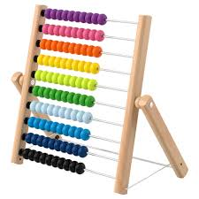
I needed some help / no help / lots of help
Listening tally
Can you help me? ı ı ı ı
I can listen to the person who is speaking without talking over them / interrupting
10 or less < = 3 Stars
 | 1 | 2 | 3 | 4 | 5 | 6 | 7 | 8 | 9 | 10 | 11 | 12 | 13 | 14
Kia
Kian
Harris
Noah
Liam
Lewis

Slide 31
Traffic lights​

Slide 32
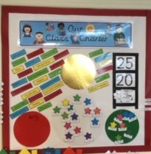

Slide 33
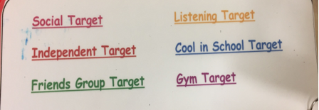
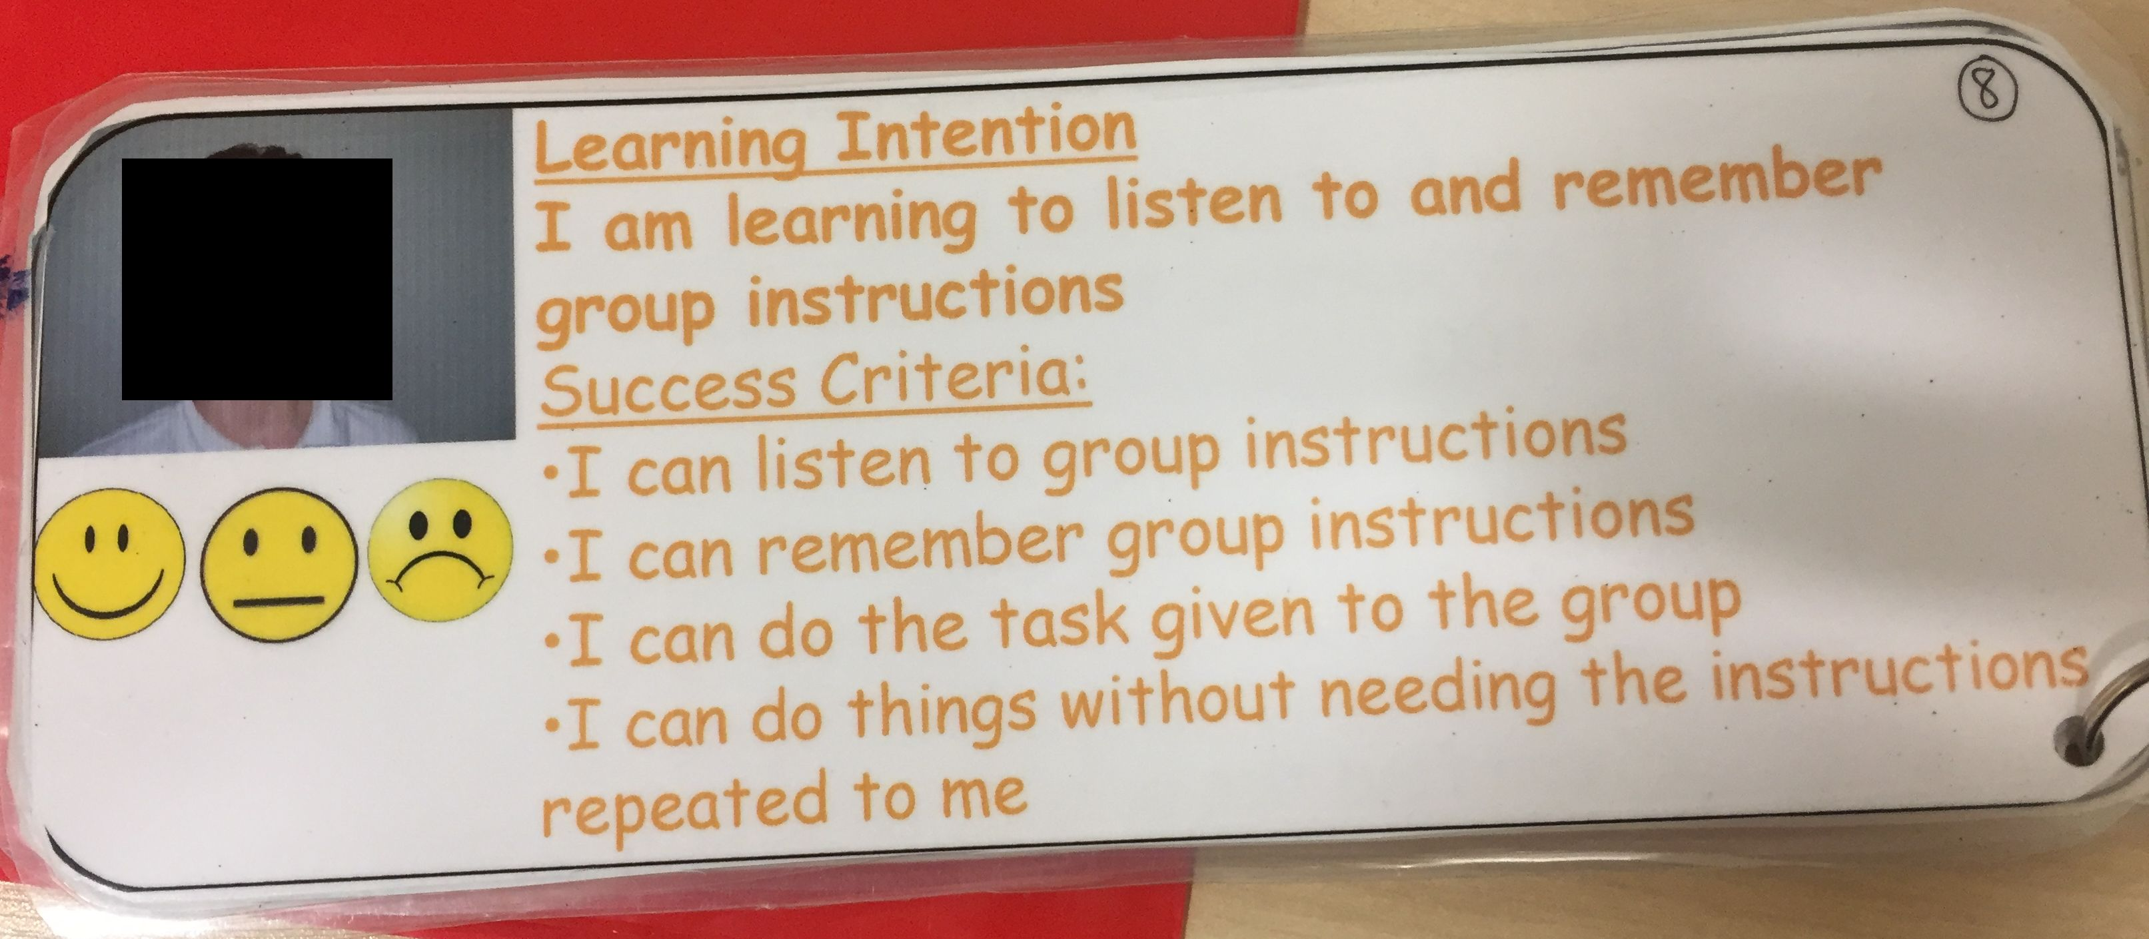
Sharing targets

