Slide 1
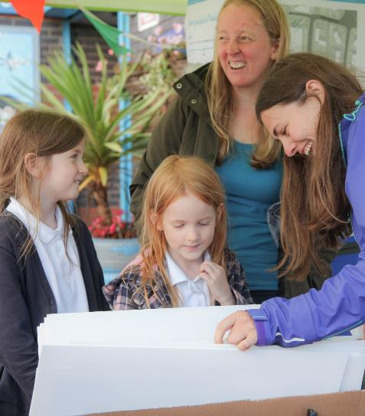
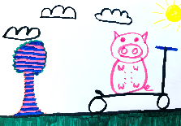
Kilbarchan Pocket Place
A little update… the artwork is nearly ready!!!!

Slide 2
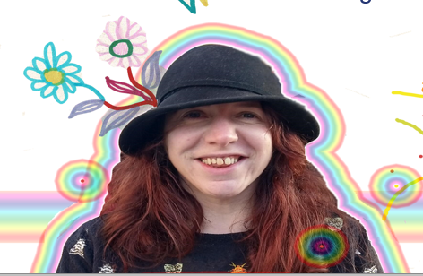
Do you remember Amelia the artist?
Here’s what she’s been doing…

Slide 3
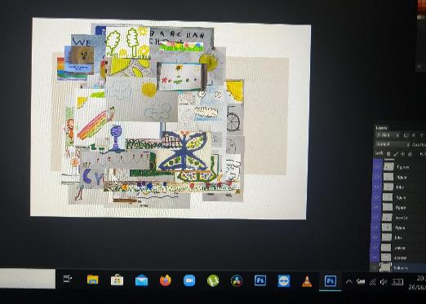
First she gathered all your creative ideas in a special programme called Photoshop.
If you look really closely and you might see yours!

Slide 4
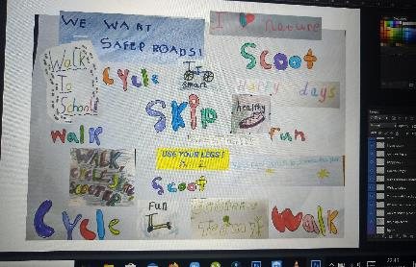
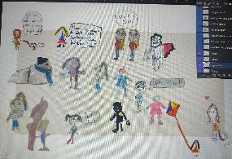
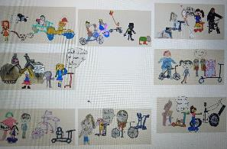
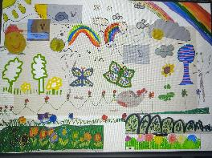
Then she collected all the nature elements, all the people, all the wheeled ones and all the words and phrases.

Slide 5
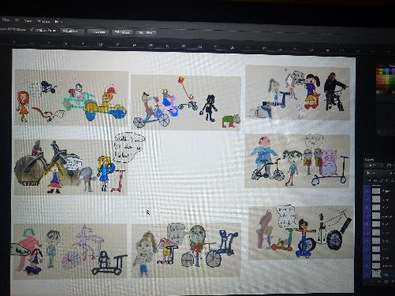
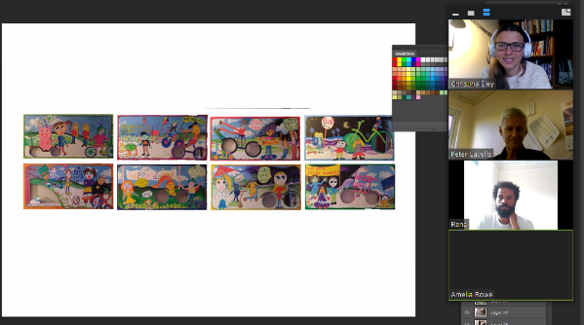
Then she shared the images over eight boards. We had a chat about how to put them on your school fence with the team who is also making a bench and shelter for your street.

Slide 6
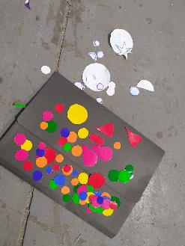
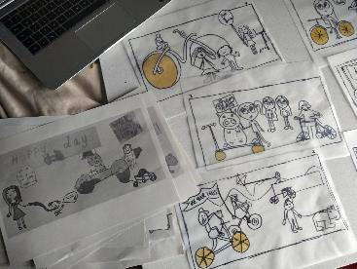
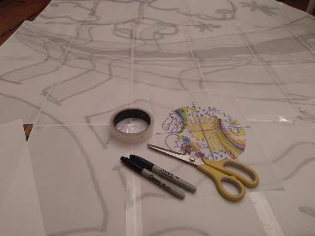
What happened next involved lots of pens, recycled materials, scissors, some wooden boards and even some varnish to protect the art from the rain and snow.
Now we have eight fantastic boards to encourage people to walk, wheel and cycle to school and brighten up the street – all inspired by you!

Slide 7
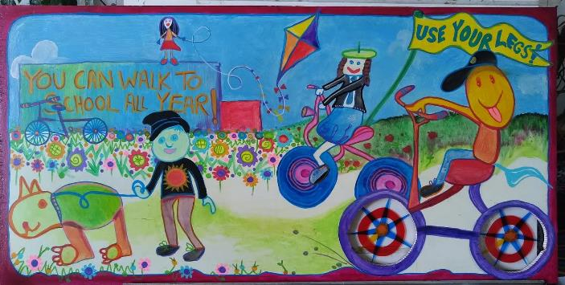
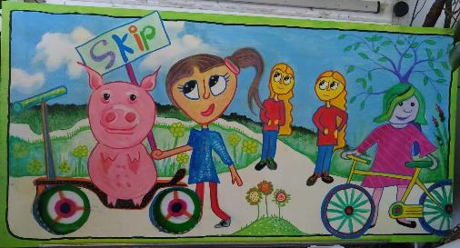

Slide 8
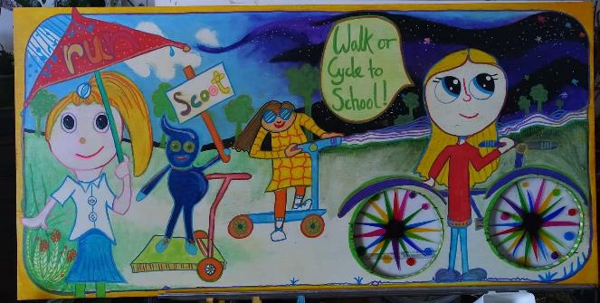
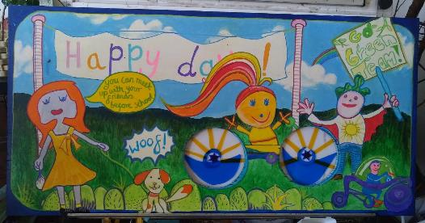

Slide 9
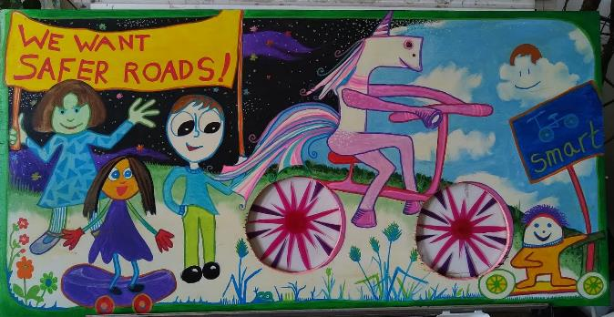
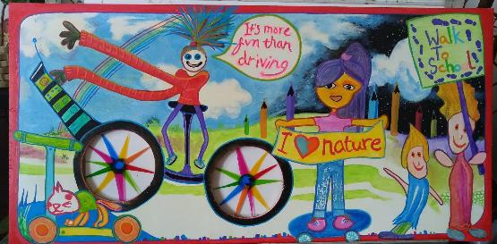

Slide 10
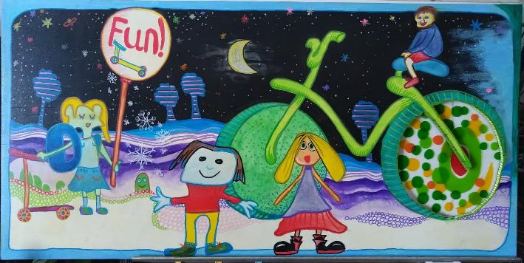
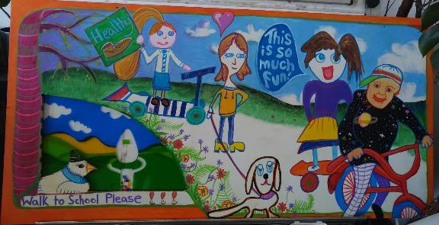

Slide 11
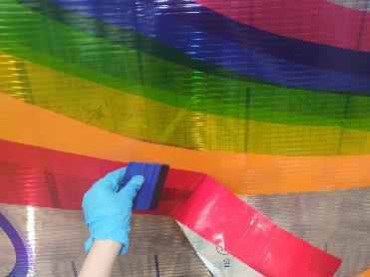
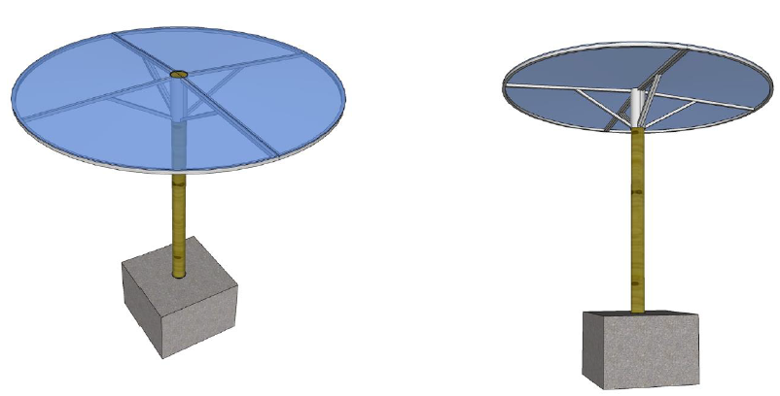
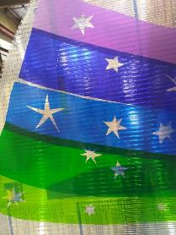
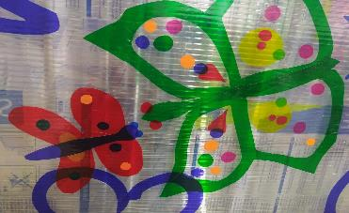
Plus, some of the artwork will go on the roof on the new shelter, which will be outside your school soon!

Slide 12
Thank you so much!
When you see the boards, maybe you could ask an adult to take a photo with you next to your drawing and share it with us?
Twitter: @SustransScot
Facebook: Sustrans Scotland
#PocketPlaces

