Slide 1
Apostrophes
L.I to use an apostrophe to show possession

Slide 2
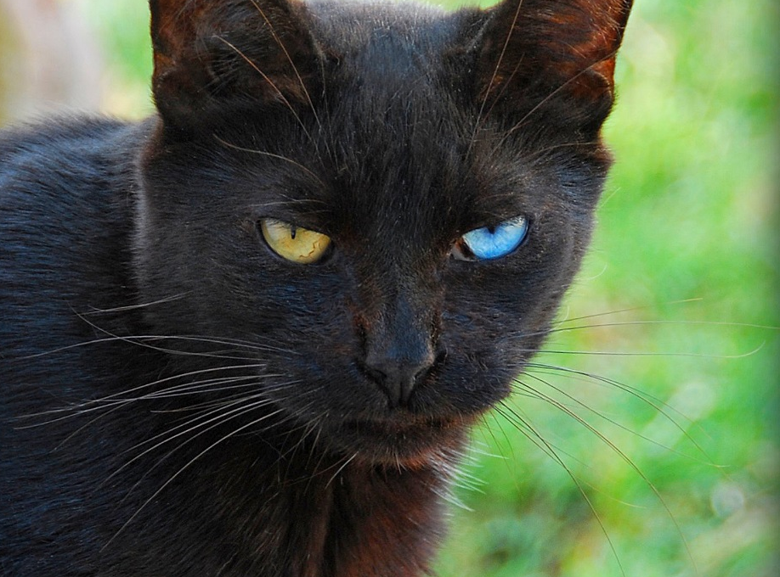
Apostrophes
An apostrophe is the same shape as a comma (,) but placed above the line (‘).
Apostrophes show two things:
That one thing belongs to another.
That some letters of a word have been left out to shorten the word.
In this Presentation, we will explore the first use of apostrophes.

Slide 3
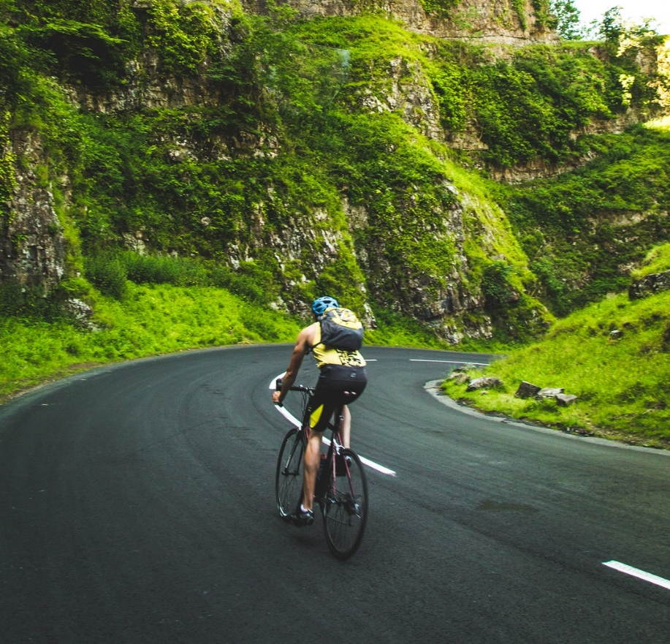
Showing Possession
Apostrophes can be used to show that something belongs to someone or something. This is called possession.
When we are talking about one thing, we call this singular.
For example, a man or a bike.
When we need to say that something belongs to something singular, we put an apostrophe and then an ‘s’ at the end of the name it belongs to.
e.g. the man’s bike.

Slide 4

Showing Possession
We also use an apostrophe and an ‘s’ to show when something belongs to a proper noun (a name that begins with a capital letter).
e.g. India’s national flag has three horizontal stripes on it.
Photo courtesy of Sanyam Bahga (@flickr.com) - granted under creative commons licence - attribution

Slide 5
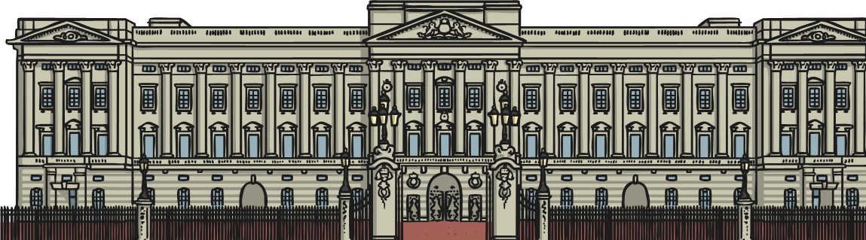
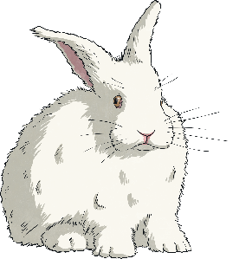
Look Out For…
When you add an apostrophe to a noun, add ‘s to the end of the last word.
e.g. Buckingham Palace’s gates are painted gold and black.
Never use an apostrophe if you have already used a possessive pronoun (his, her, its).
e.g. Dave had a rabbit and its fur was white.
The only time that it’s has an apostrophe is when it is a contraction for ‘it is’ or ‘it has’.

Slide 6

Apostrophes of Possession
The next few slides show examples of how to use apostrophes of possession with singular and proper nouns.

Slide 7
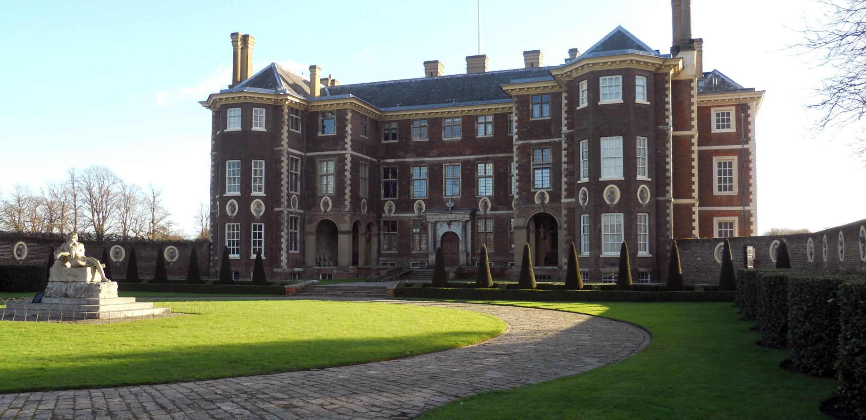
Apostrophes of Possession
Catherine’s house is old and large.

Slide 8

Apostrophes of Possession
The cat’s eyes are different colours.
Photo courtesy of Chris Yarzab (@flickr.com) - granted under creative commons licence - attribution

Slide 9
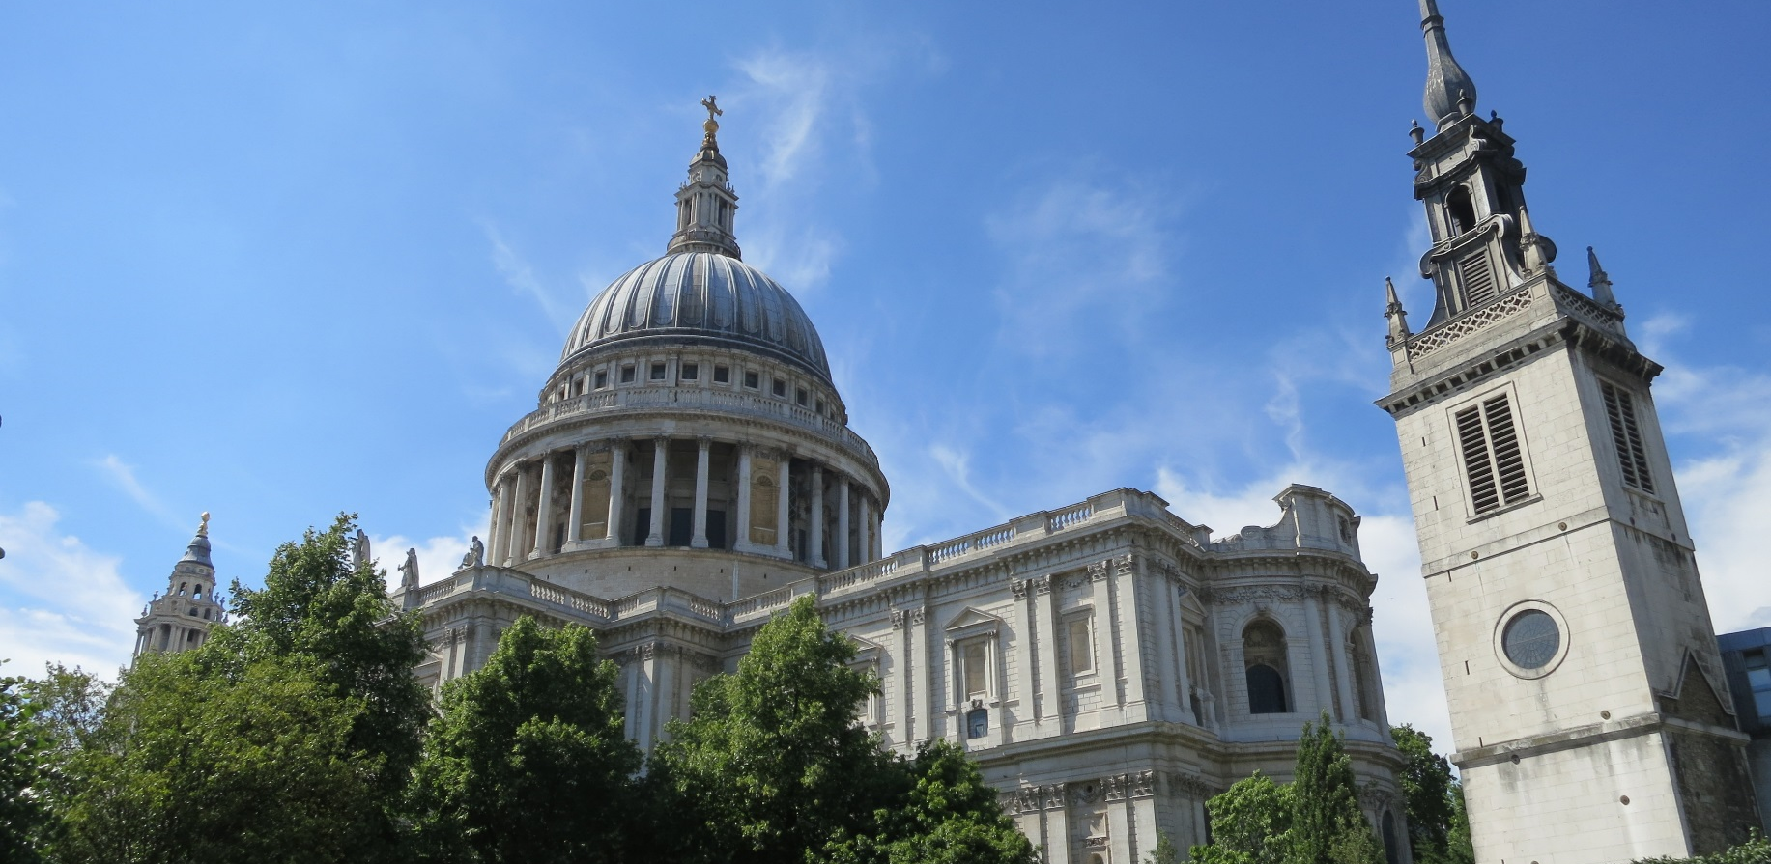
Apostrophes of Possession
St Paul’s Cathedral is in central London.
Photo courtesy of Eric Titcombe (@flickr.com) - granted under creative commons licence - attribution

Slide 10
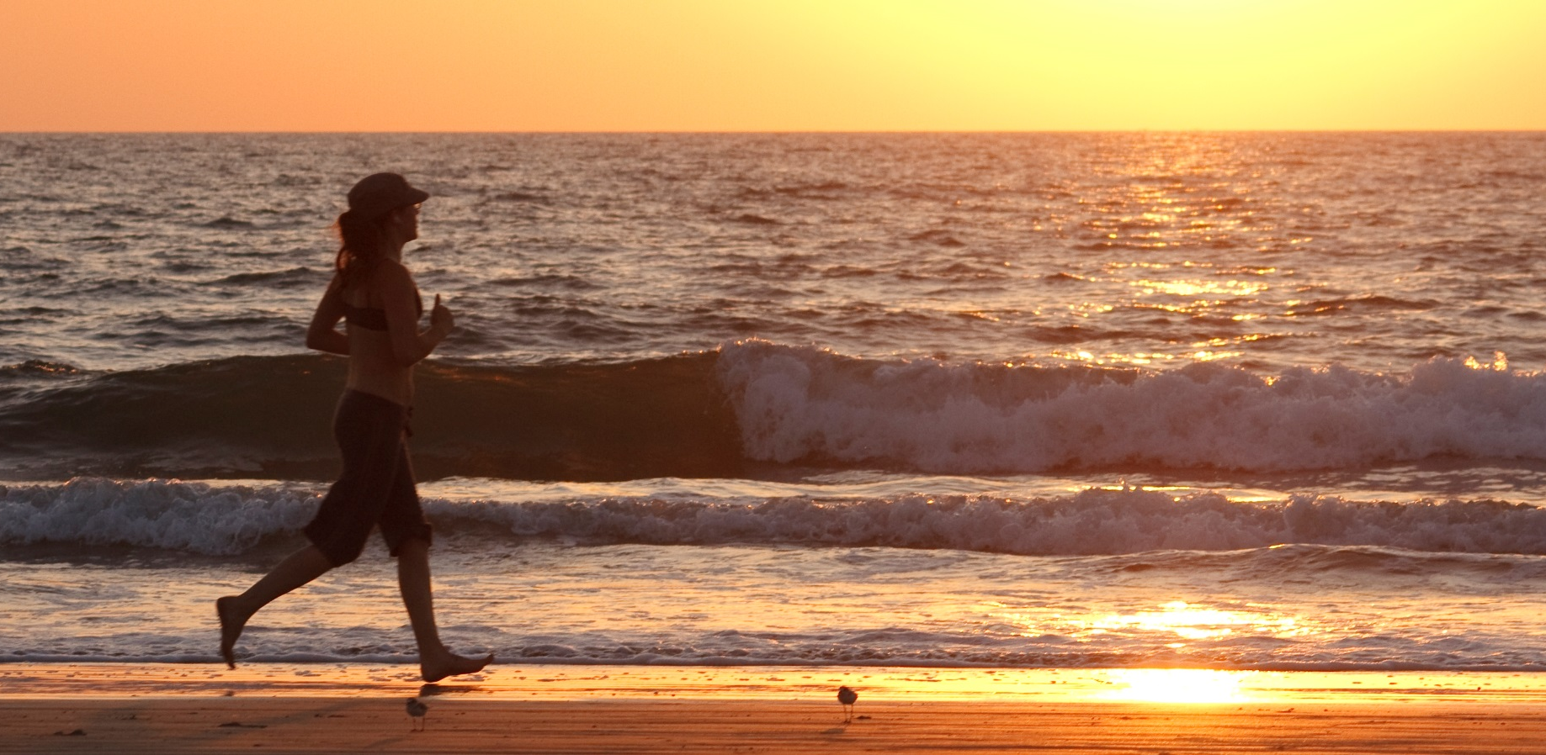
Apostrophes of Possession
Rachel’s favourite sport is running.
Photo courtesy of Richard Liblanc (@flickr.com) - granted under creative commons licence - attribution

Slide 11
Apostrophes of Possession
The forest’s light is always changing.

Slide 12
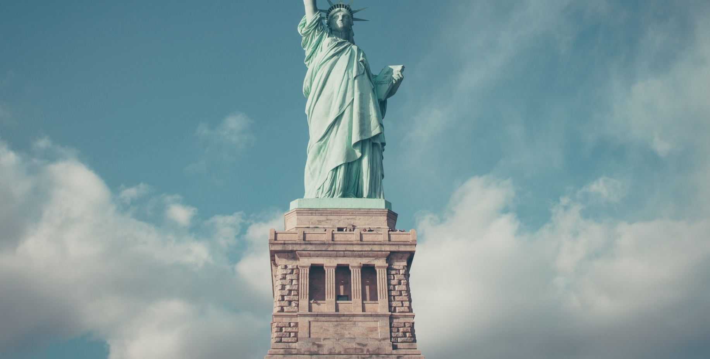
Apostrophes of Possession
The Statue of Liberty is probably one of America’s most famous landmarks.

