Slide 1



Welcome to …
Mrs McEwan’s Monday message
Notes:
Welcome to Mrs McEwan’s Monday message!
I hope you all had a lovely weekend and are ready and looking forward to the last two weeks of this Summer term.

Slide 2

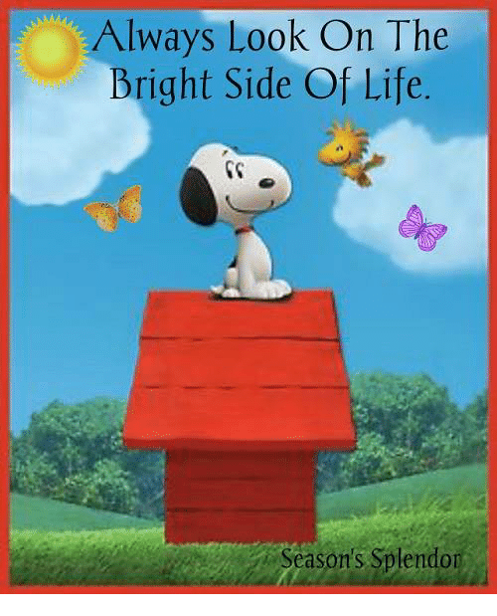
Good morning everyone!
Here is a positive song to start your Monday!
Always look on the Bright Side of Life!
https://www.fischytunes.com/video-repo/always-look-on-the-bright-side/
Notes:
I though we would start our assembly with an upbeat positive song that reminds us to always see the positives in life. We have not sung this song in assembly before but you may well recognise the tune – it’s very well known and you might end up whistling it all day!!

Slide 3

Our school Values
Kindness Honesty
Respect Love
Notes:
During this weeks assembly we are going to be thinking of our school values of kindness and love.

Slide 4

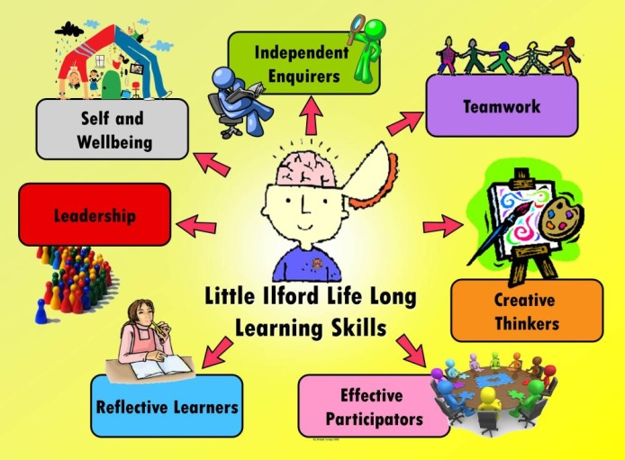
Our school Vision
Learning for Life: Together in Faith
Life Long Learning
Today’s Focus: How to keep a positive attitude
Notes:
Today’s focus is linked to us being able to see the positive in all situations we are faced with in life. We have talked about resilience before – having the ability to keep going especially when faced with tricky situations. Today we will be thinking about seeing the positives in a situation and like the song at the beginning said – always seeking to look on the bright side of life.

Slide 5
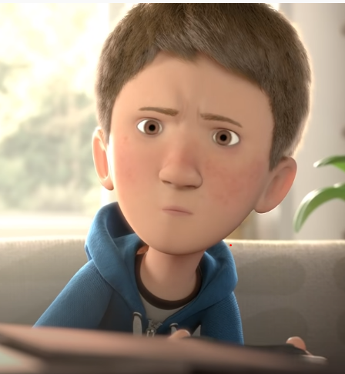
The Present
Watch the short film on the link below about the boy and the present he receives from his mum.
As you watch the film, think about what is happening at the beginning – is this ever what you are like at home ?
How do you feel about the way this boy behaves in the film and does your opinion change ?
https://www.youtube.com/watch?v=WjqiU5FgsYc
Notes:
The Present is a short film about a boy who receives a present from his Mum. You can quickly see what is happening at the start of the film, how busy the boy’s Mum is on the phone to her Boss at work and that the present is given without explanation. This film generates a wide range of feelings both towards the boy and the present he receives. Think about how your opinion changes about the boy from the beginning to the end of the film.

Slide 6
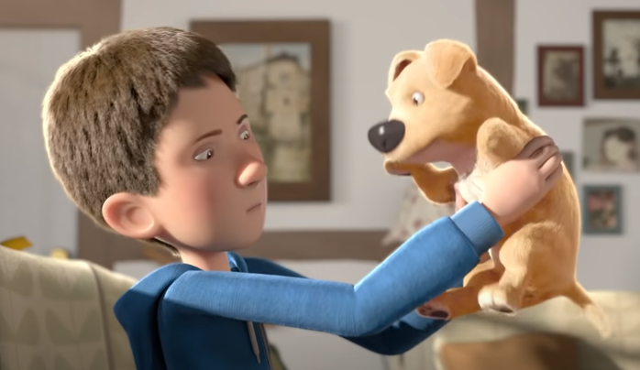
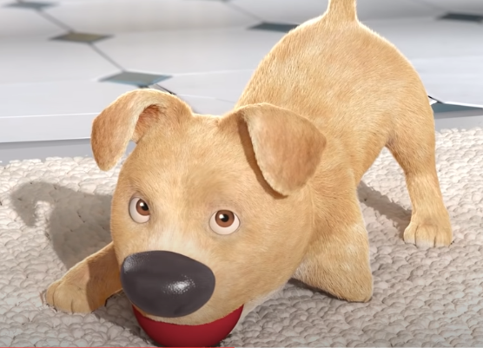
The Present
Time to reflect:
What did you feel towards the boy at the beginning ?
Have you ever felt like this and treated someone or something unfairly ?
What happens to make the boy change his mood from grumpy to happy ?
Notes:
Now it’s time to reflect on the film. Think about how you felt towards the boy at the beginning, what kind of mood was he in and why do you think that ? How did he react to the puppy at first and why did that change ? How did you react when he threw the puppy to the floor ? Have you ever treated someone or something unfairly because of your own mood? Was that a kind or loving way to be ?
What happens to the boy to change his mood ? Who is it in your life that helps you like that ? Mum, Dad, big brother or sister ? Maybe granny, grandpa or even your own family pet ? Whoever it is – why not do something kind for them this week to show them you are thankful for their help.

Slide 7
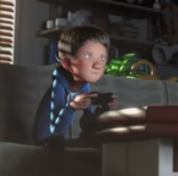
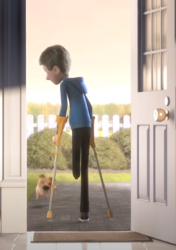
The Present
The boy in the film changes from being sat in a darkened room to going outside in the sunshine with his dog.
Which situation do you think is the most positive one to be in ?
Why is it important to have skills for life that help us maintain positive attitude ?
Why is that important for your mental health and wellbeing ?
Notes:
The film has a really positive ending and I think the boy will spend a lot of time having fun playing with his new puppy. He goes from being in a darkened room on a games console to going outside in the sunshine with his dog. Which situation do you think is the most positive one to be in ? I want you to think about why it is important to have skills for life that help you maintain a positive attitude. Why is that important ? A positive outlook on life helps you to develop more resilience and with more resilience you are likely to be able to manage through any difficult situation that comes your way. That can be the key to keeping you happy!

Slide 8
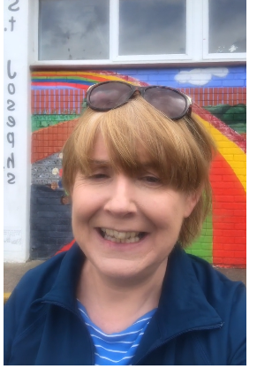
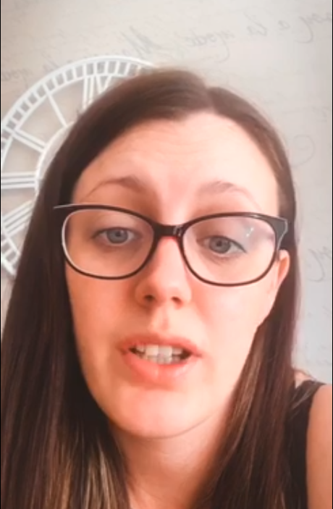
Messages from your teachers!!
This week we say hello to …..
Mrs Telfer
Mrs McLean
https://www.youtube.com/watch?v=UkLsEnILaTE&feature=youtu.be&app=desktop
https://vimeo.com/427326013/2e572eedea
Notes:
This weeks teacher messages are from Mrs McLean and Mrs Telfer. Mrs Mclean has been lucky enough to live close to the school so she can check what is happening there on her daily walk. It is great to see the school looking so great!

Slide 9
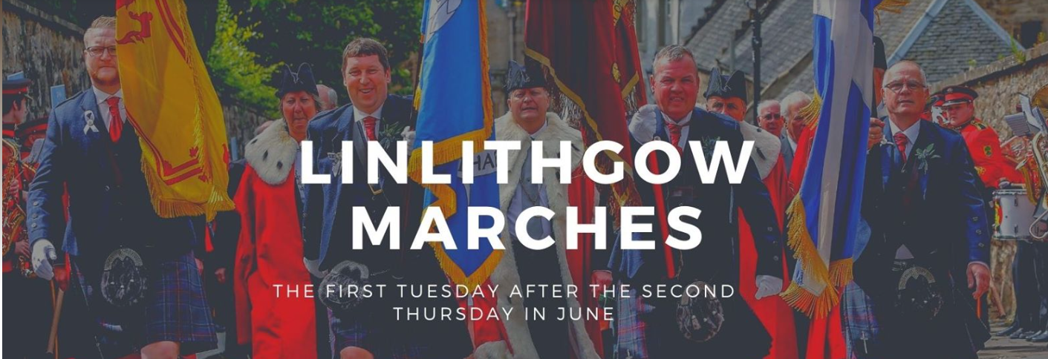
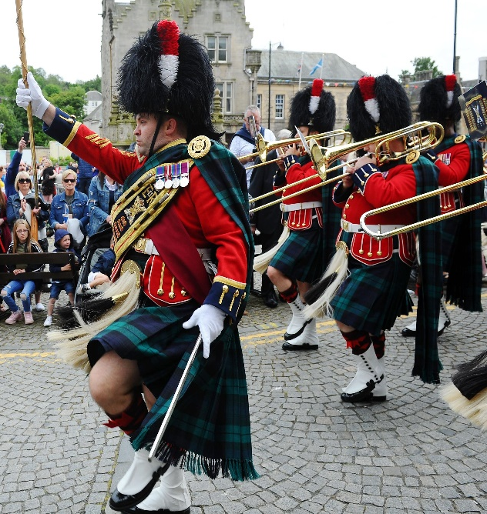
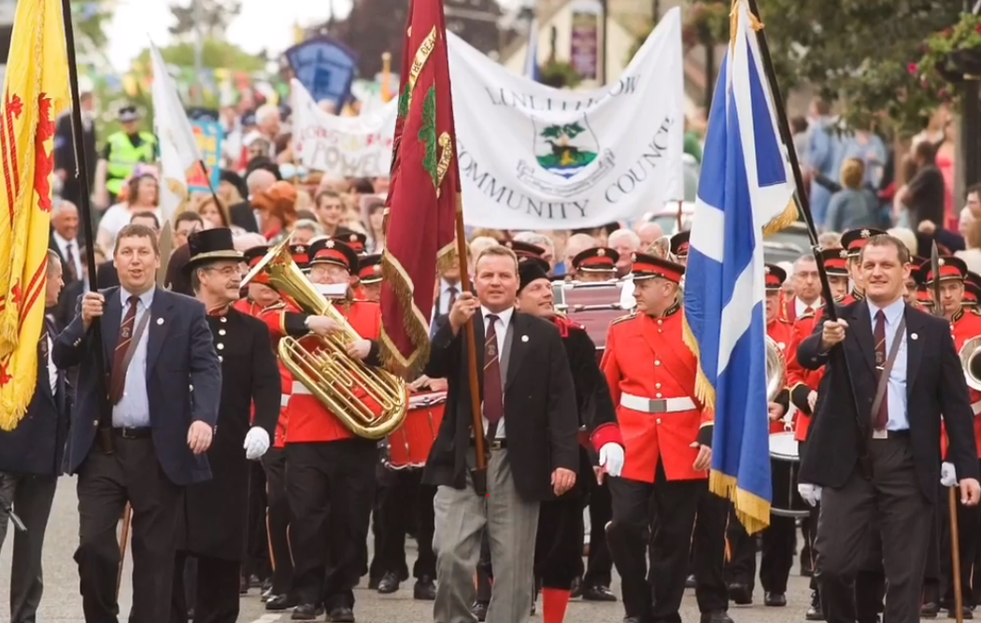
Missing the Marches ???
Notes:
This week we also have tomorrow of for the Linlithgow Marches but of course that has had to be cancelled. If you still want to join in and celebrate the Marches then there is a virtual Marches on the Deacons court facebook page. Have a great day off tomorrow !!

Slide 10
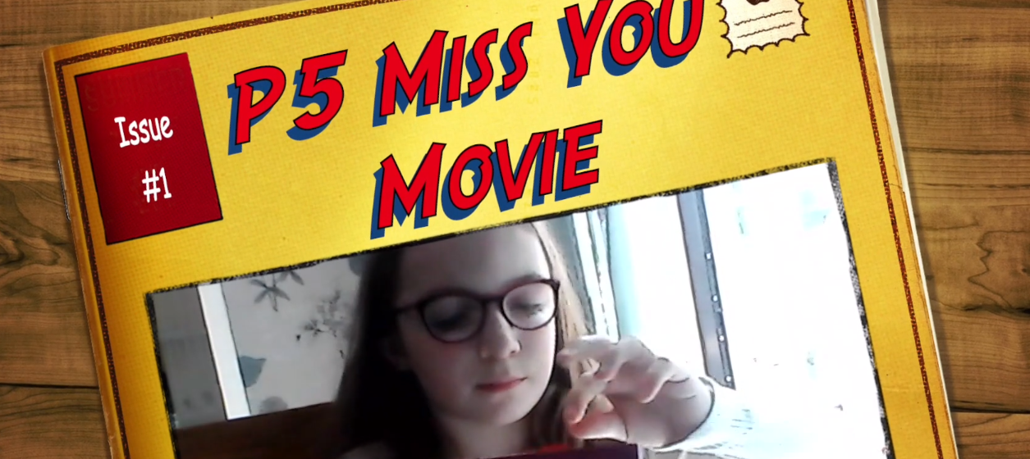
A lovely video made by Primary 5!
https://vimeo.com/426195711
Notes:
Primary 5 made this lovely video as a way of saying hello to their friends and sending positive vibes each other’s way. I’m sure they won’t mind you having a look at their lovely video too!

Slide 11
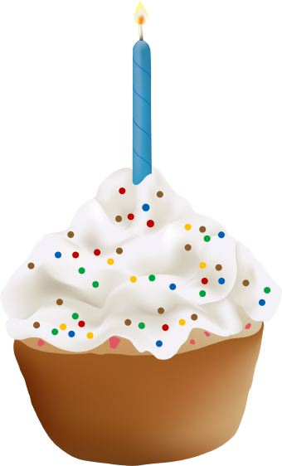
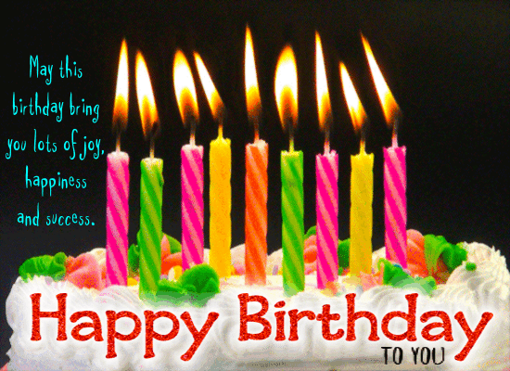

Birthdays
Jayden P4
Grace W. P3
Click on the candles
Notes:
We have two special birthday’s this week – they are Grace W. from P3 and Jayden P4 ! Have a lovely birthday both of you- enjoy your time with your family and have lots of fun!

Slide 12
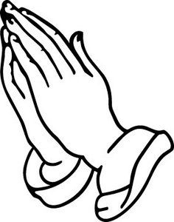
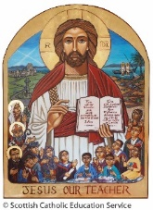
Prayer for the week
Dear Jesus,
You gave us the gift of peace making when you showed us how to love everyone.
You showed us your gift of compassion by caring for those who need your help.
You showed us your gift of mercy by forgiving all who make mistakes.
Thank you for teaching us to share your gifts with others.
We ask this with kindness, honesty, respect and love.
Amen
Notes:
This week as we think about gifts that we may have been given, let us think about the gifts that we have received from God as we say this weeks prayer. In the name of the Father and of the Son and of the Holy Spirit Amen…..

Slide 13


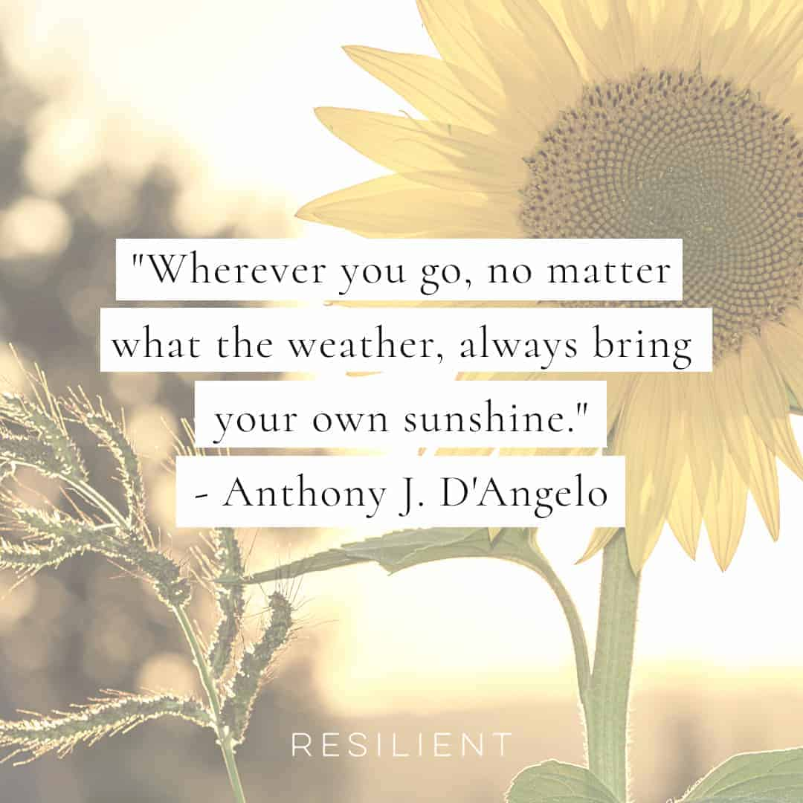
Notes:
To finish this week I have two different thoughts for the week for you. The first is in line with our prayer and it means that God gave all of us gifts – these are our talents. Our gift to him in return is in making the most of them and using them well – especially to help others. The second quote this week is thinking about how spread our positivity wherever we go. Keep smiling everyone – and have an amazing week! Mrs McEwan

