Slide 1



Welcome to …
Mrs McEwan’s Monday message
Notes:
Welcome to Mrs McEwan’s Monday message! Good morning one and all – I hope you all had a lovely weekend with your family! The weather was lovely and I think it set to continue this week which is great because I think you might be spending a good bit of it outside in the fresh air!

Slide 2


Good morning everyone!
St. Joseph’s boys and girls - you are a sky full of stars!
You are a Star –
Just the way you are!
https://www.youtube.com/watch?v=5oFO2hZ0fZc
Notes:
I hope you are all happy and raring to go this morning! I hope that you feel fine! This morning I wanted you to know that I think that every single one of you is a star! Today’s song is about just that – with a message that it is ok to be exactly who you are – just they way you are as an individual! Be yourself and I hope you enjoy singing the song! There are no words on screen this week – but you know this one!

Slide 3

Our school Values
Kindness Honesty
Respect Love
Notes:
This weeks assembly links well to our value of respect and by that I mean the respect we have for yourselves in making sure that we keep ourselves really healthy. So, I hope you have had a lovely healthy breakfast and that you can think of one positive thing you are going to do today to make someone smile!

Slide 4

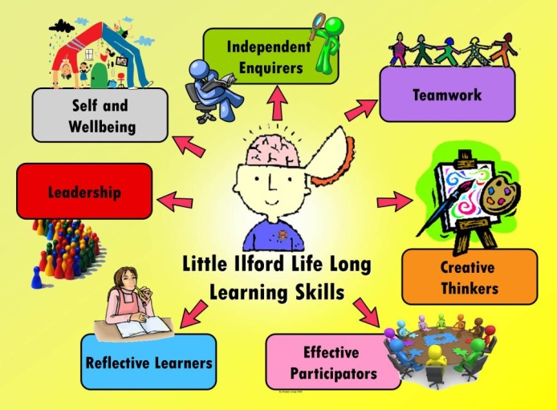
Our school Vision
Learning for Life: Together in Faith
Life Long Learning
Today’s Focus: Keeping Fit and Healthy
Notes:
This week would have been school Health week. Although we can’t be in school doing all the activities Mrs Telfer and Mrs McMaster would have planned for us, they have still worked really hard to plan your Health week anyway and have shared all of this with your teachers. In a change for the week, we have also not provided your daily powerpoint to give you lots of time to take part in all the Health week activities and this includes Sports Day!!

Slide 5

This is School Health Week
During this week we would normally take part in a range of different sports and explore ways that we can keep our bodies healthy.
I hope you enjoy all your activities and have lots of fun!
Make sure you take photos of what
you do and send them to your teacher !
Notes:
This week we would focus on all the different ways we can keep ourselves healthy by taking part in sports and learning about all sorts of other things like healthy eating, First Aid, Dental Health and mental health and wellbeing. I hope you have lot’s of fun doing these activities! Make sure you take a few photos of what you have done to let your teacher know how you are doing!

Slide 6
This is School Health Week
We are all fit and healthy
Sometimes we take this for granted
Sometimes we give up when things get hard and just can’t seem to find the effort to keep going
Getting through these times is called having…
Resilience
Notes:
We are generally keep very fit and healthy and we are lucky to have lots of help around to look after us and make us better if we do get sick or have an accident. Sometimes we can take our health for granted and forget that this is not quite so easy for many other people for lots of different reasons. They might live in a country where the water is not clean and that makes them sick or they might be born with a condition or disability that prevents them from taking part in all the things that we can do! We can also give up when things are hard and can find it difficult to keep trying ! Getting through times when things are tough is called having Resilience.

Slide 7

This is School Health Week
With the right mindset we can grow and become whatever we want to be.
Watch the clip below and think about how difficult life could be for Ezra.
Think about what he has to do to overcome his difficulties. Does this mean that Ezra has Resilience ?
https://www.youtube.com/watch?v=ekLpn4zKiNU
Notes:
Having the right mindset means that we can grow and become successful in whatever we want to be. It’s about having determination and having the resilience to never giving up! We have watched a film about a boy called Ezra before and his experience helped us to think about what we could achieve if we set our minds to it. While you are watching the clip, think about how hard things are for Ezra and what he has to do over come his difficulties. Take notice of how many times Ezra smiles and laughs even though he has many challenges to face. Is Ezra resilient ? What do you think ?

Slide 8



Mrs McEwan’s
Magic Moments
of the week!
A big WELL DONE to our P4 and P6 magic maths Superstars!
A massive achievement ! Huge congratulations!
Coming 65th and 3rd in the West Lothian Sumdog Competition!
Table of results over leaf…..
Notes:
Ezra’s video made me think a lot about how many of the boys and girls from St. Joseph’s are showing their resilience across their weeks spent at home. Last week there were some magic moments in our school that I wanted to share with you. Here is the first one which cam from P4 and P6. They took part in the West Lothian Sumdog competition and with their determination to succeed, did very well indeed. A big well done to P4 who came 65th out of hundreds of classes across the authority taking part. An even more impressive finish cam from P6 who were 3rd. Those are amazing results from our school and I couldn’t be prouder of all of you!! You are just magic!

Slide 9

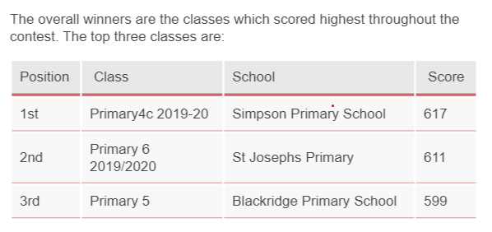
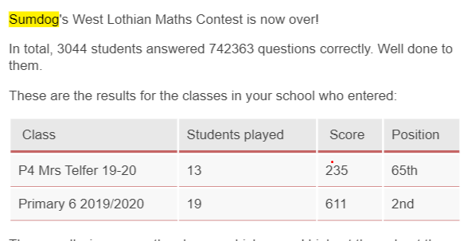
Mrs McEwan’s
Magic Moments
of the week!
Well done P4 and P6!!
We are all very proud of your efforts!
Notes:
Here are the results for our school!
Mr Reed says: Last week there was an online Sumdog competition which 419 classes entered. The competition lasted a week and during that time each member of the class had to answer 1000 maths questions. The more answers you got right the better score you finished on. Primary 6 enjoyed this activity and most of the class managed to answer all 1000 questions. Primary 6 did amazingly well and finished in second place. Everyone enjoyed the task and will be using Sumdog over the next few weeks to keep up our maths skills.

Slide 10
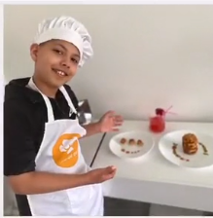
Another Magic moment
From Rocco this week!
Given the task of creating delicious meal from the humble baked bean Rocco has outdone himself creating the culinary cuisine …
Watch his picture video of him busy in the kitchen!!
https://vimeo.com/423501771/59e6007453
What a yummy looking meal!! Well done Rocco!
Notes:
Another Magic moment!
The Fine Dining Baked Bean Challenge.
As part of their topic work Primary 6 were learning about fine dining and how restaurants are judged. They looked at videos about how food is presented in the best restaurants and how with clever wording even foods which may sound horrible can be made to sound amazing. Primary 6 were then set a challenge by Mr Reed to make a meal out of baked beans and toast but using what they had learnt to make it sound and look amazing. Mr And Mrs Reed then judged all the entries and awards were handed out to those who had made a meal worthy of a Michelin Star.
All the boys and girls who took part created some very posh, tasty meals! Rocco sent us a video of his efforts which I’m sure you’ll agree look simply outstanding and utterly delicious! If Rocco opens his own restaurant in the future, I will certainly be at the front of the queue!

Slide 11
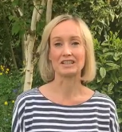
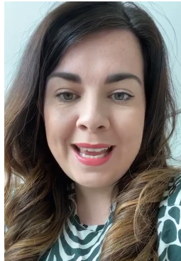
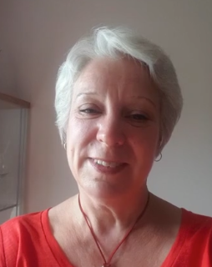
Messages from your teachers!!
This week we say hello to …..
Mrs Taylor
Mrs Farrell
Mrs Grant
https://vimeo.com/422452800
https://vimeo.com/422452670
https://vimeo.com/422452800
Notes:
The teachers have been sending me little videos of themselves to say hello to you all. This week we hear from Mrs Taylor, Mrs Grant and Mrs Farrell ! We look forward to more teacher messages next week!

Slide 12
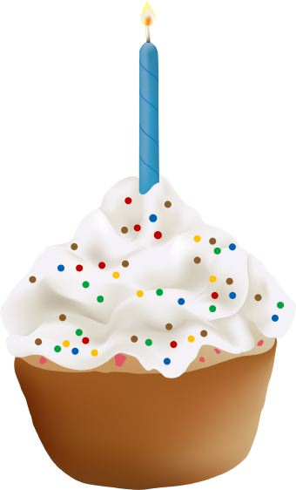


Birthdays
Bruce P5
Click on the candles
Notes:
This week’s birthday boy is Bruce from P5! We wish you a lovely birthday this week Bruce and hope you have an awesome day with your family!! Have fun and lots of cake!

Slide 13

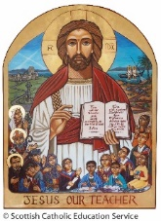
Prayer for the week
Dear Jesus,
We are called to see you in everyone.
Lord, help us to understand that we see you
When we see someone in need.
When someone is lonely, help us to comfort them.
When someone is sad, help us to console them.
When someone needs a friend to talk to, help us to be that friend and be a good listener.
Thank you for teaching us that what we do for you we do for others.
We ask this with kindness, honesty, respect and love.
Amen
Notes:
This week as are busy getting on with our Health week activities, we are thankful to have people to support us when we need help to look after ourselves. This reminds us that we are all part of God’s loving family and we must try to be like Jesus in all we say and do. Let us join our hands and say this week’s prayer together… In the Name of the Father, and of the Son and of the Holy Spirit, Amen. Dear Jesus,

Slide 14
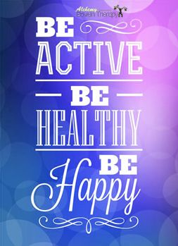

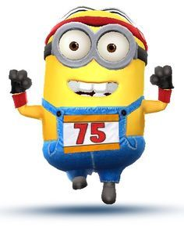
https://vimeo.com/423565791/59f4e4ac1f
Notes:
Have an amazing Healthy week – do what the sign says – Be Active, Be Healthy and most importantly Be Happy! Finally a little word from the Minions who are keeping fit too! Click on the link to a short film that made me laugh out loud! I’m sure you will too! Stay safe and enjoy your week! Mrs McEwan

