Slide 1



Welcome to …
Mrs McEwan’s Monday message
Notes:
Welcome to Mrs McEwan’s Monday message! Good morning one and all – I hope you all had a lovely weekend with your family and were able to get out for some fresh air!

Slide 2

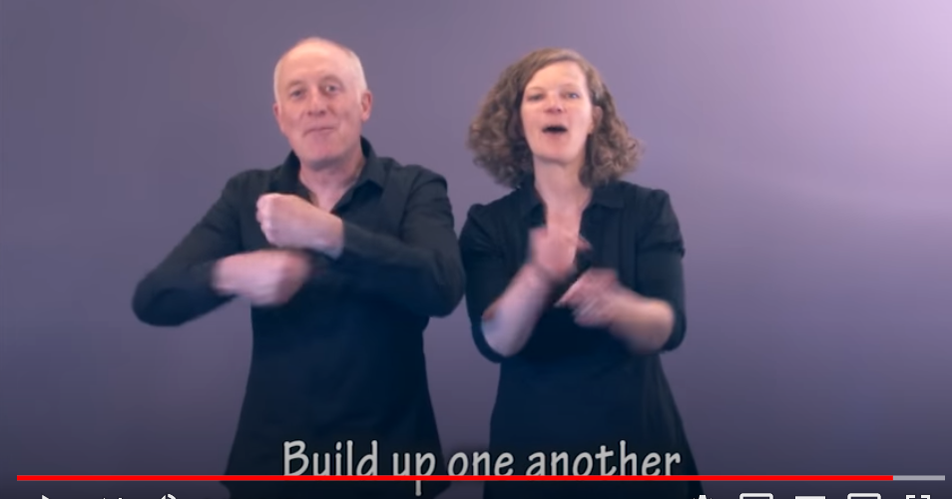
Good morning everyone!
I hope you and your families are safe and well.
Build up one another
Build up, your sisters and brothers
Build up one another
Build up
Can you build up – we can build up
Can you build up – yes we can
Can you build up – we can build up
Can you build up – yes we can
https://www.youtube.com/watch?v=Wx8jkyxraAM
Notes:
I hope this weeks message find everyone safe and well and you are ready for our Monday morning song! As the weeks go on, there might be days that you find more difficult than others – here is a really positive song that we sometimes sing to build ourselves and everyone around us up. Here we go with the build up song… click on the link to play the song. There is a short clip on youtube as a reminder of words and lyrics but the full song is found without video on the link above.

Slide 3

Our school Values
Kindness Honesty
Respect Love
Notes:
That was a really cheery song to help remind us to stay positive as well as being kind through our words and actions. This is in keeping with our school values which we think about every week.

Slide 4

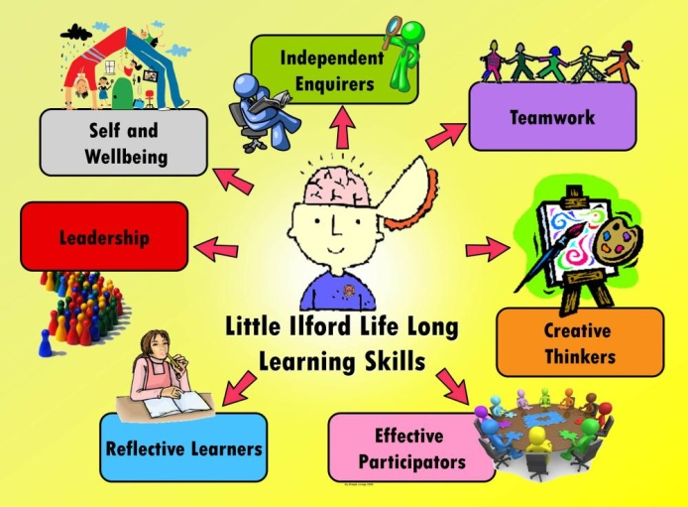
Our school Vision
Learning for Life: Together in Faith
Life Long Learning
Today’s Focus: Our wellbeing – keeping healthy
Notes:
We are going to keep our focus this week on being healthy. Last week was Mental Health awareness week which is still in line with our keeping healthy focus.

Slide 5


Notes:
Having good mental health is really important to help us a keep a positive attitude in all that we do. We can’t be cheerful and happy all the time, every day. There will be times when we feel sad. We will be missing seeing our relatives and members of our family who live in different places. We will also miss seeing our friends at school and playing with them in the playground. Being a little sad when you think about things you miss and enjoy is absolutely ok.

Slide 6

Notes:
You may have heard the phrase ‘It’s ok to not be ok!’. This is true – we would not be human if we did not have a whole range of different feelings to manage on a daily basis. These may range from, ‘I am really happy!’ ‘I feel ok today’ to ‘I feel a bit fed up’. We may have these feelings for a range of reasons – I sometimes get fed up when I wake up in the morning and it’s raining – especially just now as this might prevent me from going outside. What it is important to do is tell sometime else how you are feeling, maybe take a little time to yourself to think about why and try to find positive things to cheer you up! Most importantly – find a way to express how you are feeling. Some people like to write it down or draw a picture. I find talking to someone I trust really helpful!

Slide 7

Notes:
Remember that kindness matters most – being kind to others can make you feel good. Also remember to be kind to yourself – do something you enjoy, that makes you feel happy – bake a cake, sing a song, paint a picture, go for a cycle or sit in the garden and read a good book! Take time for yourself and give your Mum’s and Dad’s 5 minutes peace too! They need to look after themselves too!

Slide 8
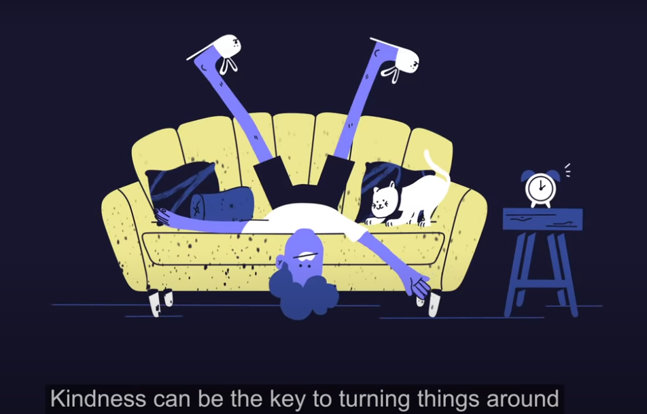
https://www.mentalhealth.org.uk/campaigns/mental-health-awareness-week
Notes:
The link on this slide is a quick clip of why things might be a bit more difficult at the moment and why kindness really matters. I am thankful every single day that I am surrounded at school (even though you are far away just now) with the kindest of people who try to help each other every single day! Thank you St. Joseph’s for being a wonderful, caring school community!

Slide 9
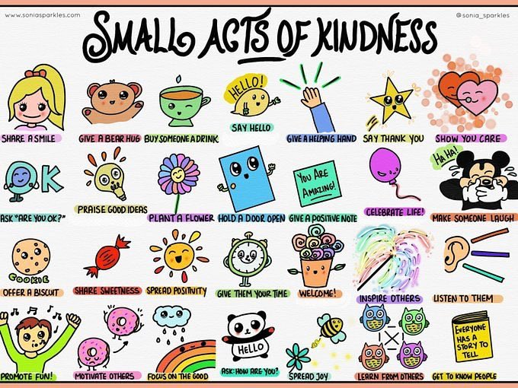
Notes:
Here are a few suggestions of some small acts of kindness you could try out this week with your family!

Slide 10

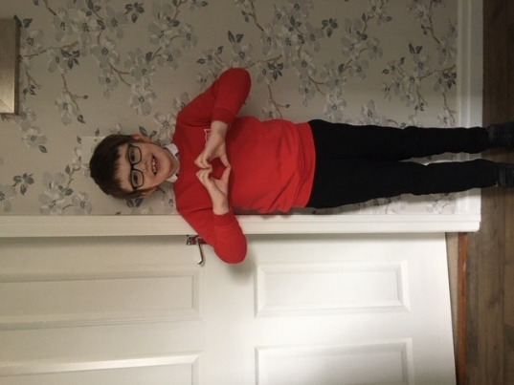
Last week was ‘Thank a Teacher’ day.
We thought it would a lovely idea to ask for your photos to help us celebrate our wonderful school community!
Thank you so much f or sending us your photographs!
A lovely slide show will be shared with you later!
Notes:
Last week was ‘Thank a Teacher’ day! We asked you to send us your photographs wearing your St. Joseph’s red! We were inundated – thank you so much for sending us these happy pictures. I had to make a separate slide show for them which I will send out to you later today! Thank you once again for doing this – I know that this will really brighten your day when you see it!

Slide 11


Some things that made me smile last week…
Seeing Mrs Grant and our P2 Superstars!
Notes:
Wow boys and girls – how you have brightened my day! P2 and Mrs Grant also made me smile last week! We know they are all superstars ! Click on the video link to watch them having fun!

Slide 12

And incase you missed it….
Here are P3 with their toilet roll challenge!
https://www.youtube.com/watch?v=hRsUAZdWxEk&feature=youtu.be
Thanks Emily and all her friends!!
Notes:
P3 were also very busy making this video of the toilet roll challenge – her are Emily and all her friends enjoying taking part in their challenge!

Slide 13
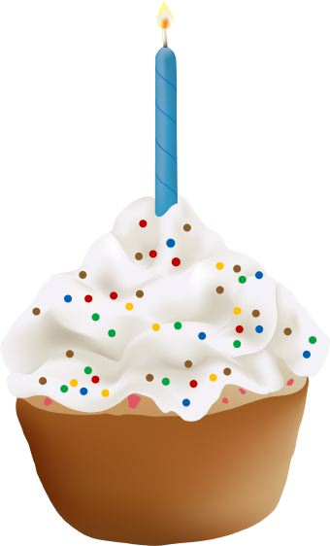


Birthdays
Emily D. P3
Click on the candles
Notes:
Emily in P3 also celebrates her birthday – it’s actually today ! Happy Birthday Emily – have a lovely day with your family!

Slide 14

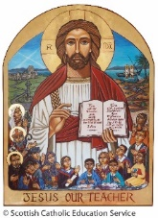

Prayer for the week
This week instead of a school prayer we are going to take a few minutes to think of the children in P4 who should have made their sacrament of First Holy Communion on Saturday 23rd May.
As you know, this is a very special day in their journey as part of God’s loving family.
P4 we are thinking of you!
Please take the time to watch this special message from Mrs Telfer.
https://www.youtube.com/watch?v=3qYQ7A5Aj9k&feature=youtu.be
Notes:
This week instead of a school prayer we are going to take a few minutes to think of the children in P4 who should have made their sacrament of First Holy Communion on Saturday 23rd May.
As you know, this is a very special day in their journey as part of God’s loving family.
We look forward to a date in the future when they will celebrate this day with their families and school community. In the meantime, please take the time to watch this special message from Mrs Telfer.

Slide 15

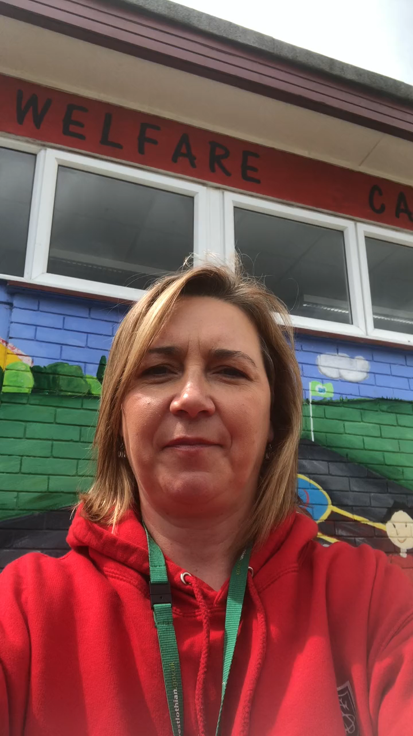
Notes:
Finally – a little message from me! Can you guess where I have been ?? Click on the image to play the short video! Take care everyone - stay safe and have a good week! Mrs McEwan.

