Slide 1
P7 Abernethy Camp
April 23rd –27th 2018

Slide 2
This year we are going on camp to Abernethy which is in Dumfries.

Slide 3
Abernethy Barcaple is not far from
Castle Douglas in Kirkcudbrightshire

Slide 4
Travel Arrangements
Meet in P7 class at 9.00am on Monday with packed lunch
Bus leaves school at 10.00am
Arrive at Barcaple 12.30am
Depart Barcaple at 10.00am on Friday
Arrive back at school at approx 12.30pm
No food or drink on bus.

Slide 5
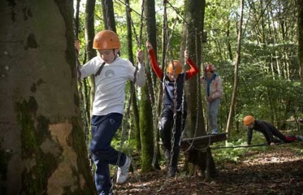
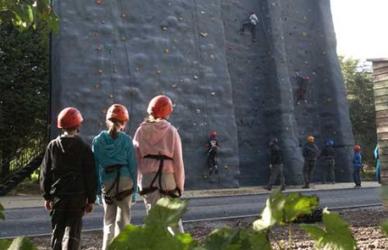
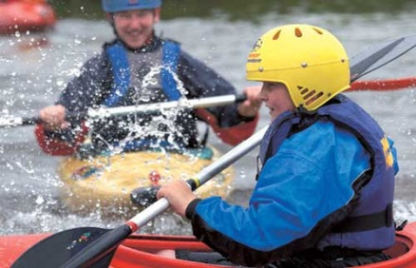
A Typical day
7-7.30am Wake up / shower
8am Breakfast
9am Outdoor Pursuit Session1
10.30 am Break Time
10.50 – 12.20pm Outdoor Pursuit Session 2
12.20 – 1.40pm Lunch Time
1.40 – 3.10pm Outdoor Pursuit Session 3
3.10pm Break Time
3.30 – 5pm Outdoor Pursuit Session 4
5.15 – 7pm Evening Meal
7 – 8.30pm Games
8.30 – 9pm Supper /Shower / ready for bed
9.30pm Lights Out

Slide 6
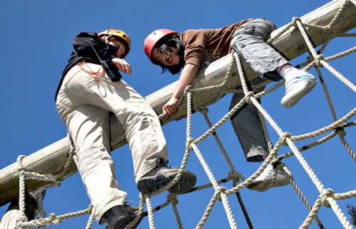
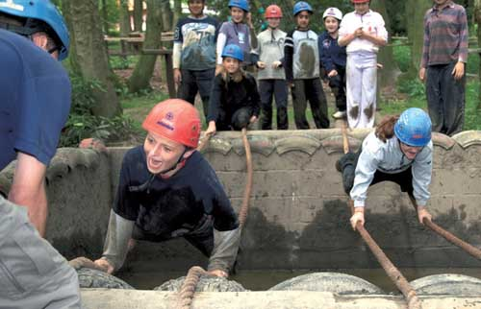
Activities
There are lots of different activity sessions to complete during our time at Abernethy.
These include;
Mountain Biking, High ropes, Canoeing, Climbing, Zip Wire, Orienteering, Abseiling, Archery, Team Challenges, Crate Stacking and A Disco.

Slide 7
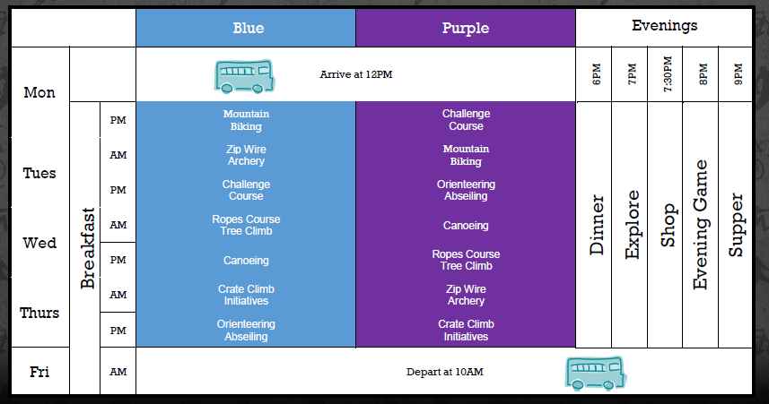
Sample Programme

Slide 8
Kit /List
GENERAL CLOTHING ESSENTIALS
Pack one bag with clothes for each dag eg Mon bag, Tues bag etc and label –
You will need
sweatshirts/hoodies -joggers -T-shirts - Socks & underwear - Suitable Nightwear (cosy) - Indoor shoes/ 2 pairs of outdoor trainers
- rainjacket and wterproof trousers

Slide 9
Kit /List
OTHER ESSENTIALS
2 towels Swimming kit Small personal first aid kit Water bootle (Named on the side) Small day rucksack

Slide 10
Kit /List
RECOMMENDED/OPTIONAL ITEMS
Sunglasses Insect repellent/anti-midge cream Sun cream, after sun & sun hat/baseball cap Torch /Inexpensive/disposable camera Bin bag for bringing wet or muddy kit home

Slide 11
Toiletries / Additional Items
Toiletries - toothpaste/ toothbrush/soap
Towels
Plastic bags
Antibacterial wipes
Water bottle
Personal belongings – please put name on labels
Spending Money – max £10 – in an envelope, purse or wallet with your name

Slide 12
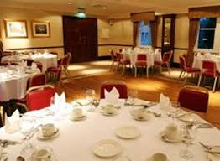
MEALS
A Wide variety of hot cooked meals during the week (see menus overleaf)
Special diet or allergies will be catered for
Daily snack – Please place in plastic bag and label with child’s name
Tuck Shop available if needed – Please ensure your child knows how much they can spend.

Slide 13
Sample Daily Menu
Breakfast: Cereals, Toast, Sausages, Hash browns, Scrambled egg, Bacon, Fresh fruit, Fruit juice
Packed Lunch : Tuna mayo, Ham, Cucumber, Chocolate biscuit, Homebaking, Fresh fruit, Carrot sticks.
Dinner: Homemade lasagne or Baked Potatoe& chiili, chicken, Salad, Coleslaw, Chocolate fudge cake & cream
Supper: Homebaking or toast

Slide 14
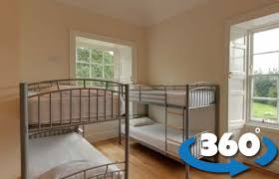
MEDICINES
Medical information form to be completed
Medication should be labelled clearly
and to be given to Mrs Mclean on
Friday morning before trip accompanied by letter stating
Dosage
Time to be taken
child’s name
Inform staff of any allergies

Slide 15
CONTACT
NO MOBILE PHONES!
The school will contact Parents/Carers after 1pm on Monday to let you know we have arrived safely.
Contact the school on Friday after 11am to check our estimated arrival time back to school.

