Slide 1
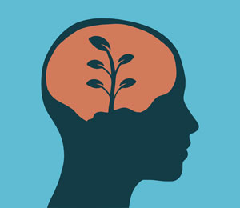
Developing a Growth Mindset
Welcome to P7b’s Assembly

Slide 2
UN Convention on the Rights of the Child
Article 28 from the UNCRC says that you have the right to go to school and achieve the highest level you can
Article 29 states that our school should help us develop our talents and abilities
Our work in Springfield Primary School on developing a Growth Mindset supports both of these articles

Slide 3
Are you Growth or Fixed?
Do you agree or disagree with each of these statements? Write the number that corresponds to your opinion. There are no right or wrong answers here.
A. People have a certain amount of intelligence and can’t do much to change it
B. People can change who they are and their qualities
C. You can do things differently but who you are cannot be changed
D. If your parents are intelligent then so are you
E. No matter who you are, you can change your intelligence level
F. No matter who someone is and how they act, they can change their ways
G. Someone’s personality is part of them and can’t be changed
H. People’s skills can be changed
1 Strongly agree | 2 Agree | 3 Mostly agree | 4 Mostly disagree | 5 Disagree | 6 Strongly disagree

Slide 4
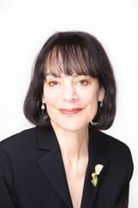
Growth Mindset Theory
Dr. Carol Dweck is a psychologist of Stanford University
Her and colleagues studied the behaviour of thousands of children
Many rebounded from failure whilst others didn’t recover from the smallest of mistakes
It’s a simple idea that can make a huge difference

Slide 5
Fixed Mindset vs. Growth Mindset
Here is a short video to explain the difference:

Slide 6
In summary…
Mindset: | Fixed | Growth
Your belief: | Intelligence can’t be changed | Intelligence grows through learning
Your priority: | Look smart, not stupid | Become smarter through learning
You feel smart: | Achieving is easy, low effort to beat others | Lots of effort, challenging yourself to learn new skills
You avoid: | Effort, difficulty, setbacks, people you think are smarter | Easy tasks, things you can already do

Slide 7
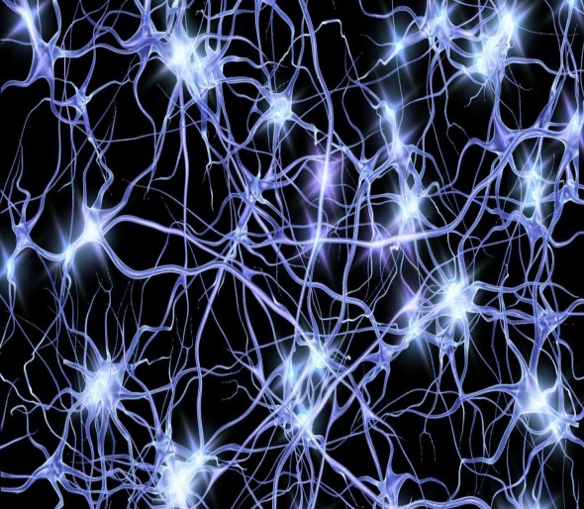
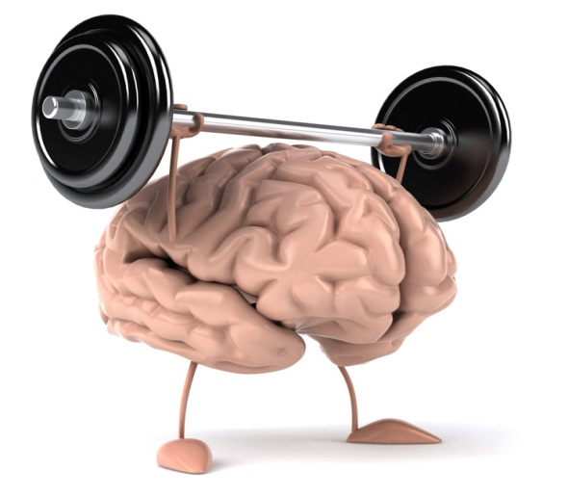
Fixed Mindset vs. Growth Mindset
Neuroscientists have found that the brain can change shape
When we try new things and challenge ourselves, neurons join together
When we practise, the neurons that have joined together become stronger
Our brain is a muscle, we can become smarter by exercising it

Slide 8
Remember, a FAIL is just a
First Attempt In Learning…

Slide 9
A Different Way of Thinking
Instead of thinking: Try thinking:
I can’t do this… → I can’t do this YET.
I’m awesome at this… → I’m on the right track.
I give up… → I’ll try a new strategy.
This is too hard… → This may take time and effort.
I made a mistake… → Mistakes help me to learn.
That’s good enough… → Is it my best work?
Well, that was a fail… → First Attempt In Learning.
I’ll never be as smart
as them… → I’m going to ask how they do it.

Slide 10
The Power of YET

Slide 11
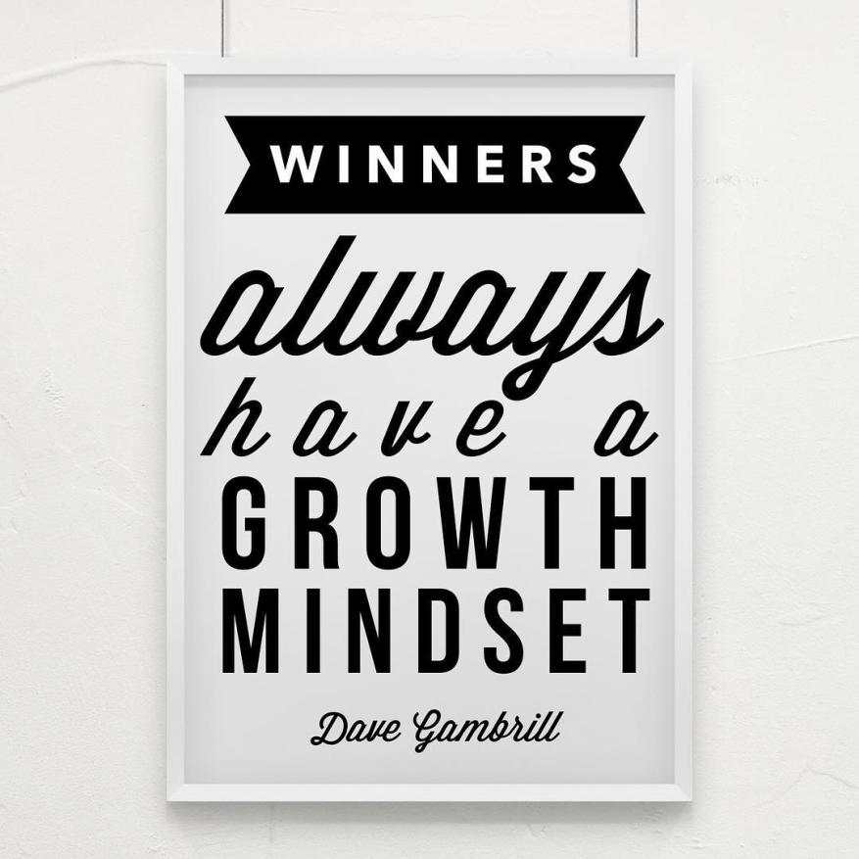
Growth Mindset Quotes

Slide 12
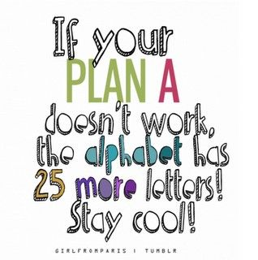
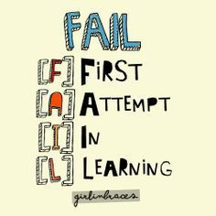

Slide 13
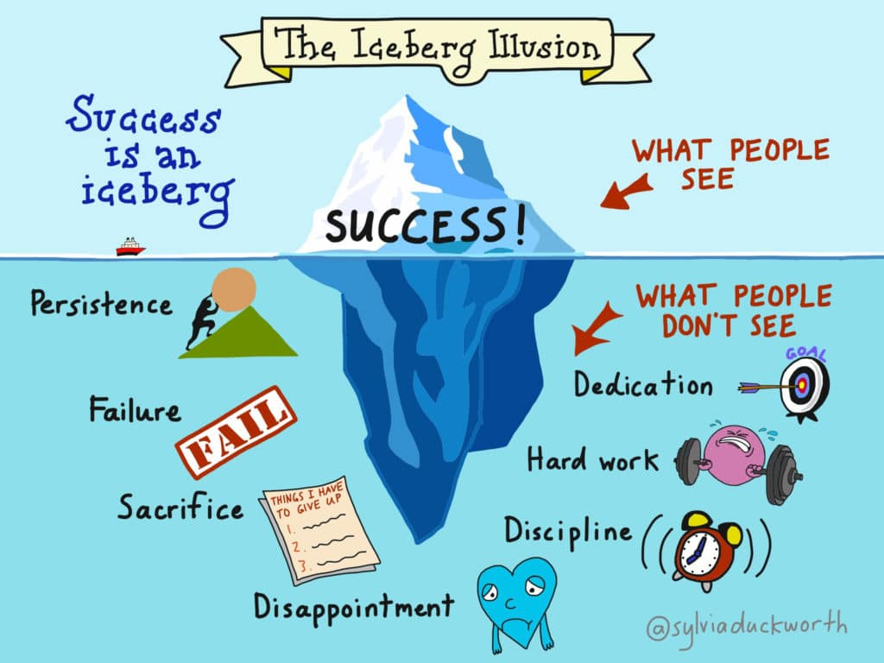

Slide 14
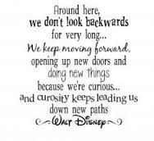
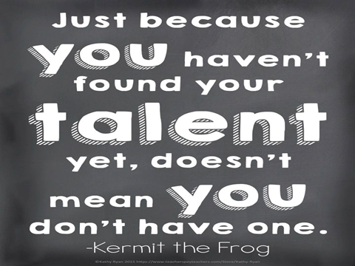

Slide 15
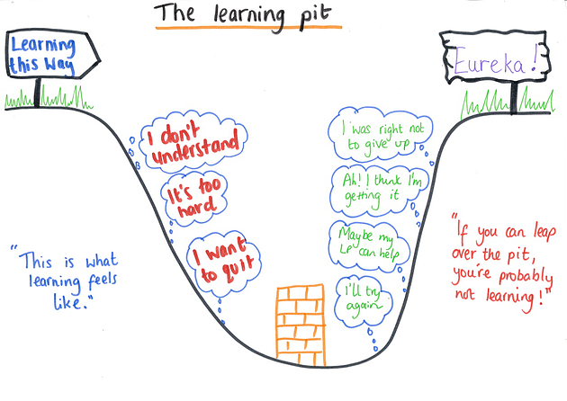
Famous Failures
Here are some examples of famous people who have demonstrated a Growth Mindset to overcome challenges and failures.

Slide 16
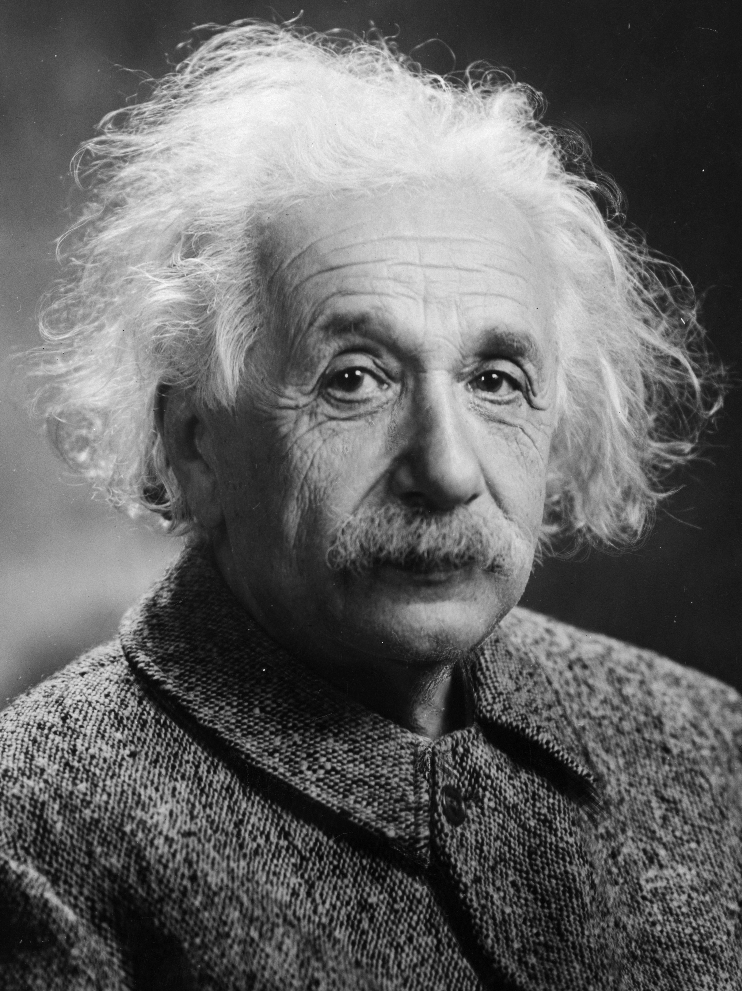
Albert Einstein
He couldn’t speak until he was 4 years old
His teachers told him he would “never amount to much”
Highly intelligent
Nobel Prize Winner
Developed the Theory of Relativity

Slide 17
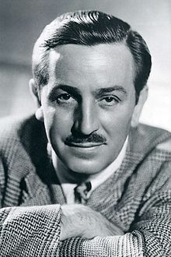
Walt Disney
Was fired from his job working for a newspaper
Told he “lacked imagination” and “had no original ideas”
Created Mickey Mouse and won 22 Academy Awards

Slide 18
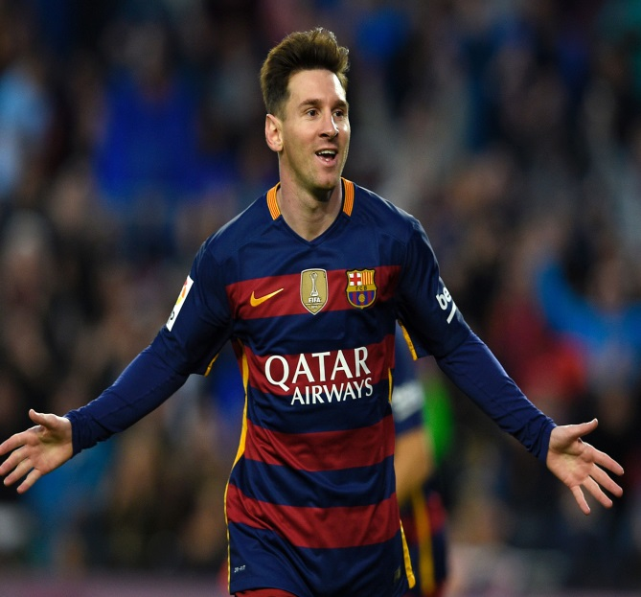
Lionel Messi
Told he was “too small” to play football
Released by his local team
Suffered from a growth disorder
Has scored over 550 goals in his career
Winner of 3 FIFA World Player of the Year awards

Slide 19
For items B, E, F and H only, change the scores you provided in the following way:
If you scored 1, change to 6
If you scored 2, change to 5
If you scored 3, change to 4
If you scored 4, change to 3
If you scored 5, change to 2
If you scored 6, change to 1
Now add the scores obtained for all 8 items (A-H) to get an aggregate score.

Slide 20
Total: | Reported implicit belief
8 - 12 | Extremely fixed
13 - 20 | Strongly fixed
21 - 25 | Mildly fixed
26 - 32 | Balanced
33 - 36 | Mildly growth
37 - 43 | Strongly growth
44 - 48 | Extremely growth

Slide 21
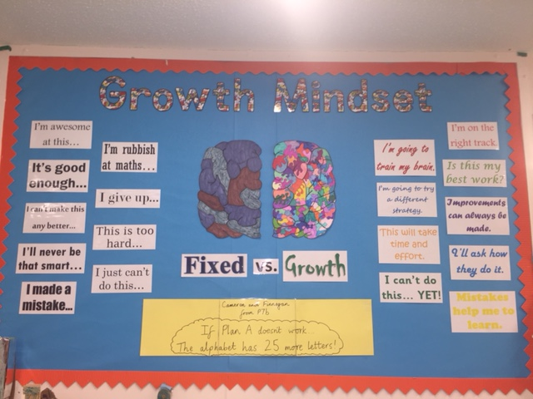
What are we doing in school?
Display
Weekly quotes
Examples on achievement wall
Teachers and pupils
Taking on new challenges
Pushing ourselves to be the best we can be
Don’t give up…

Slide 22
Thank you for listening

