Slide 1

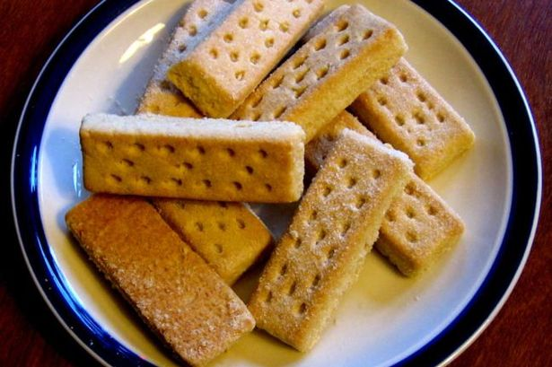
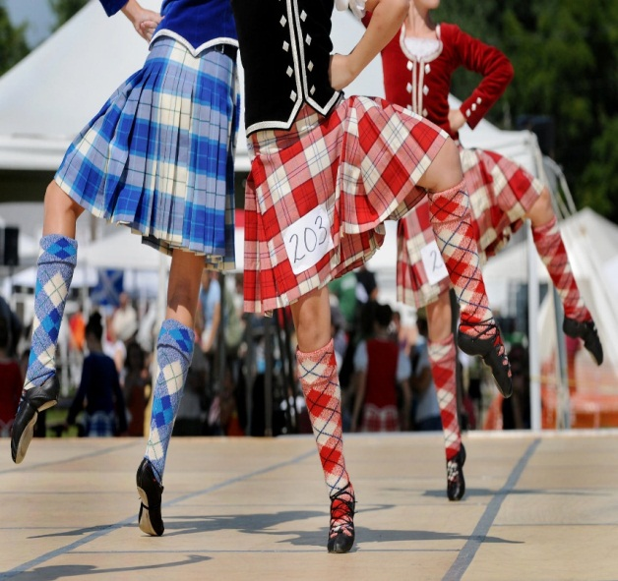

Scottish Gathering

Slide 2

Scottish clans
McDonald
Cameron
McNeil
Crawford
McCallum

Slide 3
Scottish Tartan
McDonald
McNeill

Slide 4
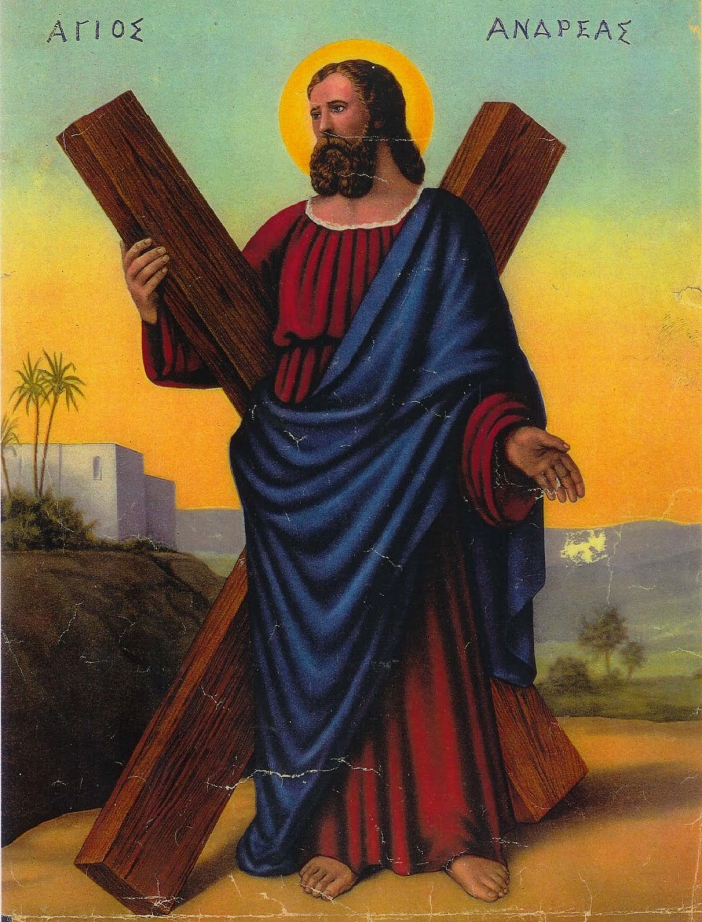
Scottish flag

Slide 5
Scottish Landmarks
Royal Botanic Gardens
Arthurs Seat
Kelvingrove art Gallery
The Highlands
Royal Yacht Brittannia
Kelpies
Edinburgh Castle

Slide 11

Scottish words
Braw Very good
Bairn Small Child
Aye Yes
Wee Small
Wee, sleekit cow’rin, tim’rous beastie,
O, what a panic’s in thy breastie,
Thou need na start awa sae hasty,
Wi’ bickering brattle!
I wad be laith to rin an’ chase thee,
Wi’ murd’ring pattle!

Slide 14
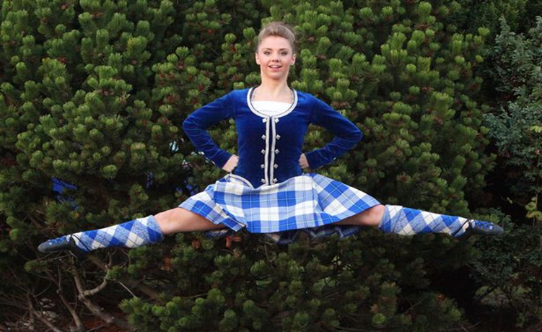
Scottish Celidh Dances
Canadian barn dance
Gay Gordon
Strip the willow
Eightsome Reel
Military two step
Dashing White Sergeant
Flying Scotsman
Riverside
Posties Jig
The waves of torry
Hanging out the washing

Slide 15
Scottish food and drink
Food
Shortbread
Haggis
Neeps
Tatties/potatoes
Drink
Irn bru
Whisky

Slide 17
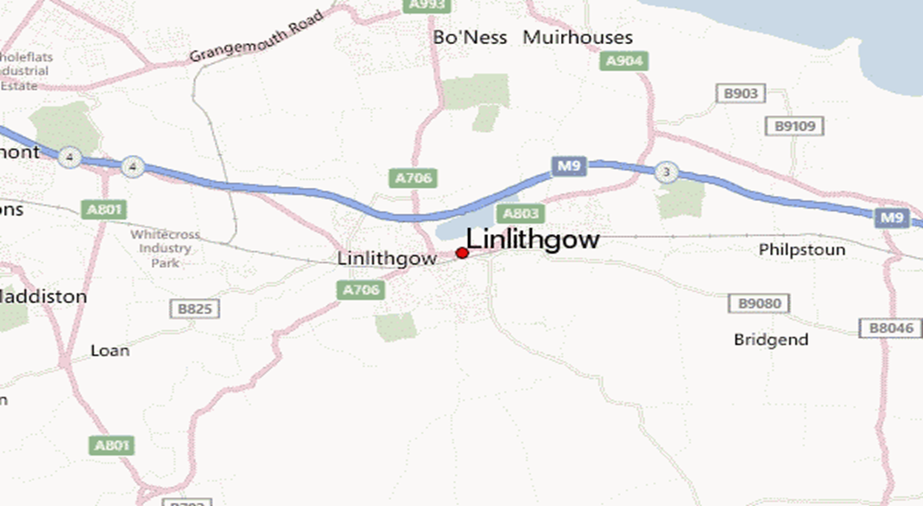

Slide 18
Quiz
1. Who invented the television?
2. What are the kelpies made of?
3. Who invented the telephone?
4. Who had to flee to sky?

Slide 19
Auld Lang Syne
Should auld acquaintance be forgot,
And never brought to mind?
Should auld acquaintance be forgot,
And days of auld lang syne?
And days of auld lang syne, my dear,
And days of auld lang syne.
Should auld acquaintance be forgot,
And days of auld lang syne?
We twa hae run aboot the braes
And pu'd the gowans fine.
We've wandered mony a weary foot,
Sin' auld lang syne.
Sin' auld lang syne, my dear,
Sin' auld lang syne,
We've wandered mony a weary foot,
Sin' auld ang syne.
We twa hae sported i' the burn,
From morning sun till dine,
But seas between us braid hae roared
Sin' auld lang syne.
Sin' auld lang syne, my dear,
Sin' auld lang syne.
But seas between us braid hae roared
Sin' auld lang syne.
And ther's a hand, my trusty friend,
And gie's a hand o' thine;
We'll tak' a cup o' kindness yet,
For auld lang syne.
For auld lang syne, my dear,
For auld lang syne,
We'll tak' a cup o' kindness yet,
For auld lang syne.
https://youtu.be/WTCryF1J54Y?t=7

Slide 20
Thanks For Watching!!!!
Hope You Enjoyed!!!!!!!

Slide 21
