Slide 1
Applying to College

Slide 2
Career Management Skills
Using CMS
will help you choose courses & write a personal statement
Notes:
CMS are the skills that help you to make informed decisions. They are divided into 4 themes and we are going to show how they are relevant for when you are thinking about College and how to do a strong application.
SELF is knowing who you are – Understanding your personality, interests and values which is key to choosing the right course.
STRENGTHS knowing what you are good at – Knowing how to use your talents, skills and personal qualities.
HORIZONS is knowing what courses are out there – Exploring the differences & detail of what is being offered.
NETWORKS is knowing who can help you & using this. SDS staff & teachers available today - but also thinking about how College staff & students can help you.
Working through each of these themes will help you to choose the course that’s right for you and help you write your personal statement.

Slide 3
Before you apply – Choose at least one College & Course
What do you enjoy doing?
What are you interests?
What are you good at?
Will this course help your career?
Notes:
Deciding to go to college is a major career decision. It might involve you leaving school, or stepping away from full-time work to allow you to study. These choices have a cost, either in lost earnings, achieving less qualifications at school or in some other way specific to you. So, before you apply for college, you need to decide whether there is a course there that makes it worth your while.
Think hard about which subject you want to study. Is there something you enjoy and want to do more of, perhaps something you liked at school or do in your spare time? Are you hoping to get the qualifications you need for a particular job or are you trying to gain entry into an industry you’d like to work in? Is there a course you think you might be good at? These are all of the questions you’ll need to ask yourself when choosing what to study and whether to go to college at all.
Courses at college are at different levels and you’ll need to apply for the right level of course for you. One way to do this is to check the entry requirements? Do you have what this course needs? Do you have more, or maybe less? Should you be applying for a higher or lower level of course?
As a first step the colleges require you to register online with an email address, password and basic personal information
Navigate to the course page you are interested in applying for, there will be an “apply now” button somewhere on the page (normally at the top and the bottom).
You will then be prompted to login or register, follow the steps onscreen from there.
The colleges normally require a secure password with Capital letters, numbers and sometimes a special character. Whatever you choose, make sure you will remember your password – your college login will be the easiest way to track your application!

Slide 4
Before you apply – Choosing Colleges
Does the college offer the right courses?
How easy will it be to travel?
Facilities
Oatridge
Notes:
It is also worth giving real thought to which colleges you apply to, bearing in mind that you can apply to more than one. There are a few things to think about here:
Firstly, does the college offer the right course for you?
Secondly, what are the facilities on offer at the college – open days are a great way to explore this while giving you the chance to meet lecturers and picture life as a student there.
Finally, and quite importantly, how easily can you travel there each day? Bear in mind you will need to get to the college between 3 and 5 days a week, often travelling on public transport at busy times. Spend some time on google maps researching your journey time – your commute makes a big difference to your everyday life. However, you might find that some colleges are a lot closer than you thought, and most colleges are willing to help students with the cost of their travel.
A good career decision is one you’ve thought all the way through – choosing a college is no exception.
You will often be eligible for travel expenses and could be eligible for EMA or bursary (if below HNC level) or
SAAS loan (HNC+) – travel expenses vary from college to college, eg City of Glasgow are the most generous.

Slide 5
Before you apply – Register Online
Select “Apply” on the course page
Register with email (not Glow email), password, basic personal information.
Notes:
As a first step the colleges require you to register online with an email address, password and basic personal information. It’s best not to use a Glow email address.
Navigate to the course page you are interested in applying for, there will be an “apply now” button somewhere on the page (normally at the top and the bottom).
You will then be prompted to login or register, follow the steps onscreen from there.
The colleges normally require a secure password with Capital letters, numbers and sometimes a special character. Whatever you choose, make sure you will remember your password – your college login will be the easiest way to track your application!

Slide 6
Personal Details
Basic information will copy over directly from your registration page.
West Lothian College asks for a photo to be uploaded – be ready with this on your phone or in your email.
There will be questions designed to find out whether you will need extra support while at college or during your application.
There will also be equality and diversity-related questions that can seem very personal.
Notes:
There will be questions designed to find out whether you will need extra support while at college or during your application.
These could refer to disabilities, being a carer or having been raised in the care system for example.
Your answers to these questions will not affect your chances of being accepted into college
There will also be equality and diversity-related questions that can seem very personal.
These may refer to sexuality, race, religion or gender identity
The college asks these questions to help them measure and prevent discrimination within the application process.
You can refuse to answer. This, or any other answer, will not affect your chances of being accepted into college

Slide 7
Qualifications
Next you will be asked to list your qualifications.
Include qualifications achieved (with grades) and currently being studied.
Make it clear which is which!

Slide 8
Writing your Personal Statement = the most important part of your application
Why have you chosen the course? 35%
What makes you suitable for the course? 35%
What relevant experience do you have? 20%
Why do you want to study at that particular College? 10%
Notes:
This is a very rough guide - but 1 and 2 should make up bulk of personal statement.
Colleges might break these down into separate questions (eg West Lothian College) or just ask for it in one go.
Write it in a Word document – Saved / can used for other applications
Keep it to half an A4 page (typed).
Write in full sentences, check for spelling, grammar, punctuation.
You are trying to impress the college, if it only took you 10 minutes to write your statement, you haven’t given it enough thought!
If you are struggling, structure your answer by following these 4 questions to keep it focused.
Always make sure that somebody else has read your statement before you send it.

Slide 9
1. Why have you chosen the course?
What sparked the interest? Was it a family trip, a teacher, work experience, a subject you have studied?
Why does it interest you? Show you have a good understanding of what the subject is about.
How does it link to your future? Don’t need to have an exact career in mind but show that you have considered what you could do.
Notes:
What sparked the interest? Give a context. From an exhibition, seeing something in the news, knowing someone who studied it etc. Did it grow from something you enjoyed in your spare time and you want to do more of it.
Why does it interest you? Better to write more detail on a particular topic you’ve really enjoyed than a short bland statement. Ex. I really enjoyed learning about the structure and replication of DNA is better than “I enjoy biology….”
You need to talk with enthusiasm for the course subject. Try to show hat you have an interest, using examples from your life.
If you are applying for vehicle maintenance talk about when you fixed a bike at home and what this experience taught you.
The college do not want you to drop out of the course half-way through, need to convey you are committed.
How does it link to future plans? - Are you hoping to get qualifications you need for a particular job or trying to gain entry into an industry you’d like to work in?
Is it a course you think you might be good at and you want to gain a particular set of skills?
Show you understand the course.
Ex. Studying Psychology is scientific, relies on formulating hypotheses and testing them with data to gain insights into brain and behaviour.
Career Aspirations. Where do you hope to be in 3,4,5 years time?
Enthusiasm for the area of study should come across.

Slide 10
2. What makes you suitable for the course?
What Strengths (qualities / skills) do you have that will help you on the course?
Learnt from studying school subjects
Voluntary Work
Leisure Activities
Hobbies
Online Courses or Training
Clubs
Awards (ie. Duke of Edinburgh, Scouts/Guides)
Positions of Responsibility in/out of school
Life Experiences
What makes you different from other applicants?
Give details of any part-time job or work experience.
Notes:
STRENGTHS Include Personality & Skills
What qualities / skills? Write down your hobbies, interests and social activities & what they reveal/ demonstrate about your personality, skills, abilities.
Link these to the course you are applying for. Cant just be a list, must be a reflection/analysis of these experiences and what they have taught you or what insight theyve given into your chosen career.
Good question to ask yourself: What am I proud of?
School subjects -
Voluntary Work – Fundraising / Sponsored.
Leisure Activities – Daily word or puzzle challenge
Hobbies -
Online courses / Training – You tube or Google learn tutorial, First Aid qualification
Clubs – Sport / Games or member of Society/Organisation.
Awards – (Play an instrument / Piano grades etc)
Responsibility – Babysitting / Saturday job / School Captain / Helping on Parents Evening / Represented the school.
Life Experiences – Shown Resilience, Coped with Change, You Care for someone?
Finding it difficult. Ask someone who knows you to tell you a positive quality they see in you. Give them time to ponder what they admire about you.
How can you show you have the maturity to cope with College study?
What makes you different? You are a unique combination of your learning, interests & life experiences. You are different from the person next to you & you should try to capture that in your PS. Have you observed a situation, person or event that has given you insight/knowledge that someone else wont have?
Part-time job / Work Experience: Does not need to be paid work experience. Try to link experiences to skills or qualities related to the course. Did working in a Fast Food Restaurant Kitchen give you an awareness of Health & Safety - which could be relevant for Engineering or Cookery courses. Did serving members of the public equip you with the skills to work well with people who are different from you?

Slide 11
TOP TIP #1
KNOW WHAT STRENGTHS YOU HAVE
National Parent Forum of Scotland - Nationals in a Nutshell series https://www.npfs.org.uk/downloads/category/revision-guides/higher/
MWOW Skills Explorer Tool:
https://www.myworldofwork.co.uk/tools/skills/start
Notes:
National Parent Forum of Scotland – Nationals in a Nutshell series. Look up a subject you are good at in school. It will tell you skills you are learning from that subject.
MWOW Skills Explorer Tool – Premade list of skills, divided into different themes. Easier to pick out what you are good at from a list in front of you.
MWOW Strengths Tool – (Show Report Produced). Simply answer the questions, it will take less than 15mins.

Slide 12
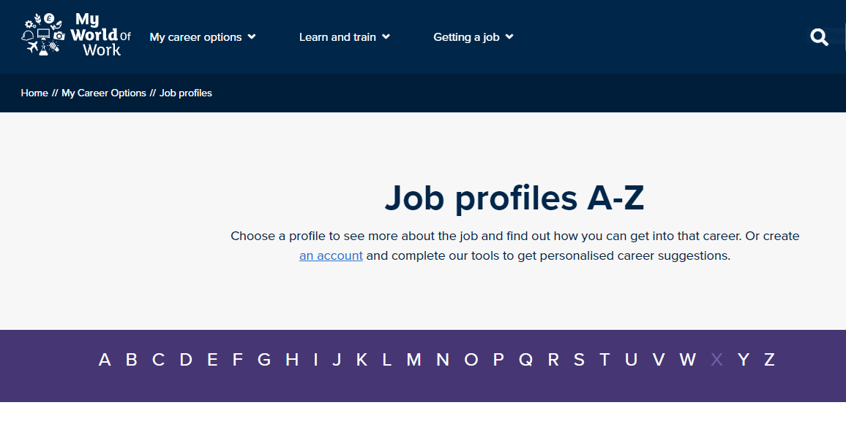
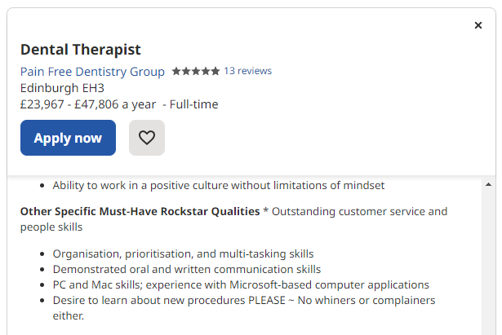
TOP TIP #2
KNOW WHAT STRENGTHS YOU NEED
My World of Work has A-Z Job Profiles. All of them list the Top skills needed for each job:
https://www.myworldofwork.co.uk/my-career-options/job-profiles
Look at a real vacancy for the job you want. What skills do they ask for?
Notes:
Know what skills or qualities the College would want you to have for that course.
MWOW Job Profiles A-Z – Look up the job related to your course. Every profile has a list of the Top Skills needed for that job.
Look up a real vacancy – (Dental Therapist, Jan 2023, Indeed.com) Check what employers are asking for. Dental Therapist – “Ability to work in a positive culture…….Please no whiners or complainers” Remember your mindset/personality are relevant and can be included in your PS.

Slide 13
TOP TIP #3
I am part of the Warhammer Club at school.
I am part of the Warhammer Club at school. I have been able to win games by using different problem solving techniques.
I am part of the Warhammer Club at school. Playing Warhammer has taught me transferable skills such as using strategy, tactics and logic. I have also learned how to problem solve using statistics and maths in order to win games. I have built relationships with other players and have confidence in my own ability. I would be able to apply these skills when studying HNC Cyber Security at West Lothian College.
Expand.
Make it link to the course.
Notes:
Not waffle but expand.
This refers back to not just making it a list of what you do – but reflecting on what it has taught you about yourself & how this is relevant to the course & will make you a successful student.

Slide 14
3. What relevant experience do you have?
Have you studied a school subject(s) that relates to your chosen course?
Have you taken part in any activities that demonstrate your knowledge/ interest in the course?
Work Experience
Trips / Visits / locations
Projects
Virtual Work Experience
Talk / Lecture
Exhibitions
Spoken to someone doing a job related to the course
Do you explore / research the topic in your own time? Do you follow any podcasts, blogs, vlogs, twitter accounts related to your interest?
Notes:
School Subject
Activities that demonstrate your knowledge/ interest: Might have direct Work experience if you are applying for vocational course but if not.
What did they teach you that you didn’t know before?
Explore / research the topic in your own time? How have you taken your interest beyond what you are learning in school? Over and above what you were taught in class. Is there a Meaningful book or information you have sought out. Be honest – you might be asked at interview to speak about them.
What have you done that demonstrates your commitment or passion for a subject?
Are you aware of wider issues relating to your study?
Ex. Applying for an Art course. Are you looking at Gallery websites & there online curated exhibitions. Tate Modern in London has a podcast series.

Slide 15
4. Why do you want study at that College?
Is it because ....
Course content – What are the modules?
Links with Employers or Industry Professionals?
Opportunity to study abroad, take part in competitions, gain work experience?
Success or Career paths of previous students?
Additional qualifications offered by the course accredited by recognised body
Notes:
Cant be “because it’s the closest College”
Good way to find out this information is to attend Open Days. Can be F2F/Virtual, will need to book in advance.
2023 SRUC, Oatridge campus : 21st -24th February 2023 (Virtual, need to register)
2022 Edinburgh College : 5th March (In-person, advance booking)
2022 West Lothian College : 27th January (Virtual)
2022 Forth Valley College : 31st March (In-person)
2022 NCL (Coatbridge): 18th June (In-person)
Additional qualifications: Ex. HNC Fitness, Health & Exercise (Edin College) will give you the HNC Group Award but it will also give you Register of Exercise Professionals REPS 3 award which is allows you to work as a Personal Trainer.

Slide 16
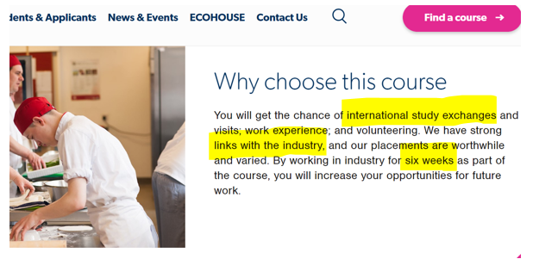
TOP TIP #4
Use the website
Ex. West Lothian College - L6 Professional Cookery.
Notes:
Research on the website.
This Professional Cookery course is offering study changes abroad, links with Industry professionals and 6 wks work experience. If a similar course at another College was only offering 2 wks work experience and no opportunity to study abroad – then this might be a reason to choose this College.
Ex. HNC Professional Cookery (WLC) offers international work experience in France, Italy, Spain & USA.

Slide 17
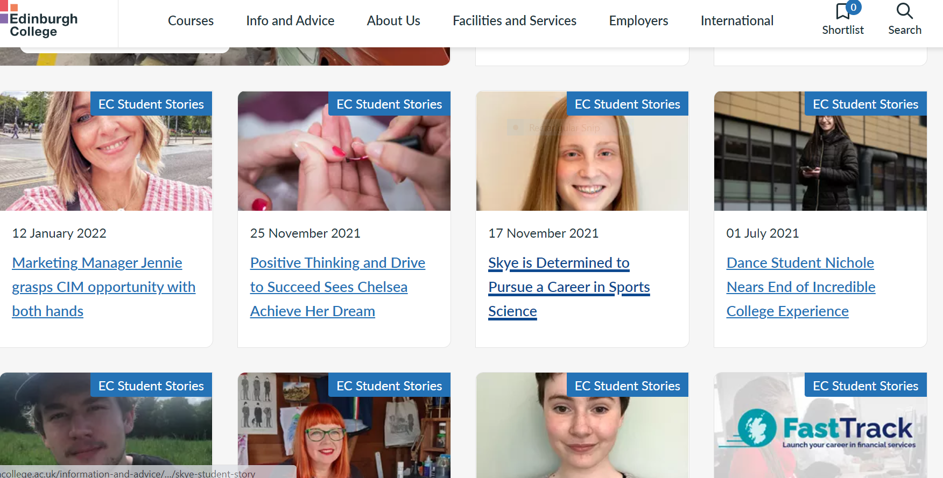
TOP TIP #5
Look for information on
past Students
Ex. Edinburgh College - “ Student Stories”
Notes:
Edinburgh College – Type in “Student Stories” (7 pages of Students successes / Students of the year / Competition Winners etc)

Slide 18
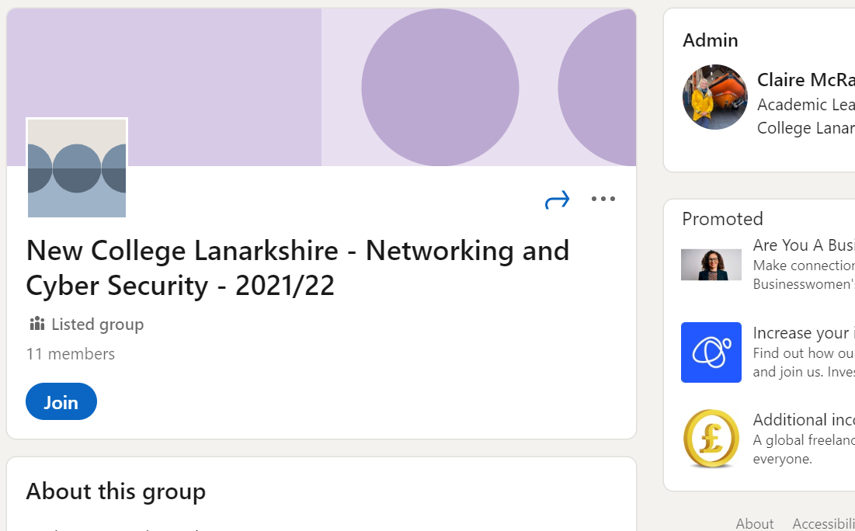
TOP TIP #6
Ask a current Student NCL : Use Linkedin to make connections
Notes:
You could ask a current student about their course.
Universities often have an “Ask a Student” function on their website. Some Colleges may do this.
You could use Linkedin to connect with recent graduates of the course you want to do.

Slide 19
Do you need anything else for entry apart from academic requirements?
Examples
NC Animal Care (Oatridge, SRUC) – 1 wk of work experience related to animals
NC Architecture & Interior Design (Edin) - Portfolio of drawing skills and an understanding of the creative process in sketchbooks and larger-scale imagery

Slide 20
College to University Pathways
7,665 Students entered a first degree via a HNC/HND Over 58% went straight to 2nd or 3rd year
https://www.youtube.com/watch?v=n_NZkDc8tzo
‪
Title
SOURCE: Scottish Funding Council Report on Widening Access 2020-21, published May 2022
Notes:
SDS Video 2min 26sec, highlighting the variety and flexibility of college to university routes.
In 2020-21, 7,665 students entered university first degree courses with an HNC/HND qualification achieved in the last three years. Of those, 4,470 (58.3%) entered university straight into year 2 (with HNC) or year 3 (with HND). This is known as Articulation with Advanced Standing (AS). A quarter (25.1%) of those 4,470 students were from the 20% most deprived areas, 20.7% had a declared disability, 9.2% were black or minority ethnic and 1.9% were care-experienced.
SOURCE: Report on Widening Access 2020-21 https://www.sfc.ac.uk/publications-statistics/statistical-publications/2022/SFCST062022.aspx Scottish Funding Council 17 May 2022
ALTERNATIVE VIDEO: Universities Scotland widening access 2021 animation (1min53) Universities Scotland YouTube https://youtu.be/KcDwao9tUsM (29 Sept 2021)

Slide 21
Articulation Pathways Search Tool (East)
www.pathways.ac.uk
Notes:
Articulation ‘Pathways’ search tool (launched July 2020) Agreed Progression Routes.
Search tool shows pathways between college and university.
Can search by college, university or subject area to see agreed pathways for seamless transition from HND to degree level study. Also has information on whether entry is to second or third year of a degree.
SOURCE: Pathways App https://www.pathways.ac.uk/About
OTHER RESOURCES: Pathways App Demonstration video (6min 24) https://youtu.be/Hkeg5KjR_7c

Slide 22
After you apply
Check regularly
Make a back up plan
Prepare for interview

Slide 23
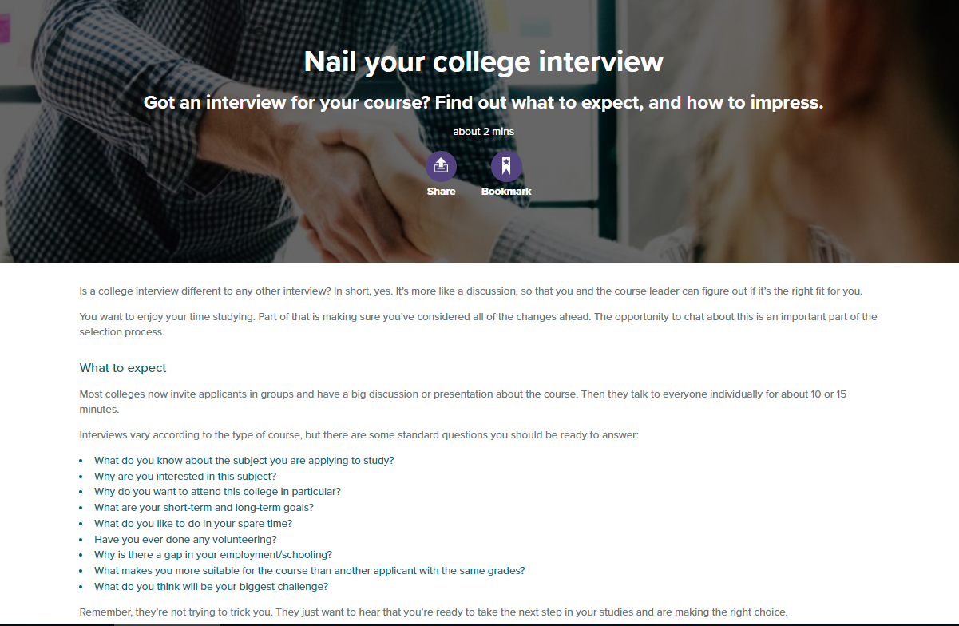
My World of Work – College Interviews
Notes:
Using the “Nail your college interview” page on MyWorldofWork is a great way to prepare for a college interview. The article includes lots of advice about how to approach an interview, as well as a list of likely questions that you can use to help prepare your answers.
I’d suggest picking the 4 questions you think would be hardest to answer, and prepare an answer with pen and paper.
Practice with someone, the first time you say your answer outloud should not be in the interview!

