Slide 1
Mercredi huit septembre deux mille vingt et un
Wednesday 8th September 2021

Slide 2
Today's Plan P2C
8.45 - 9.00 - Get Set
9.00- 10.30 - Maths Mrs Brown
10.30 - 10.45 - Break
10.45 - 11.00 - Story and milk
11.00 - 11.30 - RME / Music / Drama with Mrs Brown
11:30 – 12:30 – finish above, Problem Solving
12.30 - 1.15 - Lunch
1.15- 2:30 – P.E. (field)
2.30 - 3.00 - Health (Jigsaw)
3.00 - 3.15 - Park
Miss Jenkins supporting TM in am

Slide 3
Today's Plan P2MB
8.45 - 9.00 - Get Set
9.00- 10.30 - Writing
10.30 - 10.45 - Break
10.45 - 11.00 - Story and milk
11.00 - 12.30 - Numeracy
12.30 - 1.15 - Lunch
1.15- 2.30 - P.E. (field)
2.30 - 3.00 - Health (Jigsaw)
3.00 - 3.15 - Park

Slide 4
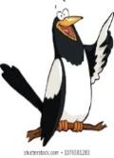
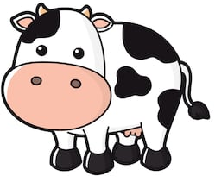
Writing: To write a recount. (with who, where, when, chronological order, past tense and end comment )
Children’s responses
What?​
Why?
Teach: (Purple and Red groups have already done their story on Tuesday. They will work on cvc phonics games and their literacy workbook)
CT retells the story. P2mb – the three little pigs, P2c - the Grace Darling story.
On the whiteboard put the headings: who, where, when, main events and ending comment.
Add notes together to form the scaffolding of the writing.
Pairs practise retelling the recount of the story to each other using their own picture plans and the notes on the board.(with actions if they wish)
Children: Look at next steps from last week.
Write a recount of about 4 sentences.
Self-mark and teacher-mark with traffic lights on the stickers.
Discuss individual next steps.
How?
I can use finger spaces.
I can sound out words.
I can use capital letters and full stops.
*I can write a recount of a familiar story.
How do I know I am successful?
RRS Article 29 education 27 safe home Target W2, 4, 7, 11
Notes:
Teacher input: Explain the task and go over SC. Read the house description here: This is a beautifully designed Manor House in the prestigious area with over 70 stunning rooms, internal and external leisure facilities, a two storey garage and unsurpassed luxury. Its awe inspiring frontage is made from Cotswold stone with Corinthean fluted columns flanking the grand front door. It has fabulous indoor and outdoor swimming pools and a fully equipped, state-of-the-art gym. The living areas are opulent whilst being modern and homely.
Read the example on the next slide from the listening task earlier in the week. Write a house description together to persuade people to buy the house. Write some describing words on the whiteboard as a wordbank. Children write a description to sell the pictured house on the third slide. MA work independently. A work at the teaching table. LA do phonics tasks and games. Children complete other literacy tasks from before break if finished.

Slide 5
Health Jigsaw: To understand the rights and responsibilities as a member of my class and to know that I belong to my class
To become aware of children's rights
Children’s responses
What?​
Why?
(P61 of overview in Health resources folder on P2 sharepoint or Jigsaw folder in orange bag.)
Calm me – chime, breathing
Revise Jigsaw rules – listen respectfully without interrupting, ok to have different ideas and feeling from others, only talk when it is your turn.
Play the game ‘Roll the Ball’. The children all stand up in the circle. They take it in turns to roll the ball to someone in the circle saying “Hello...” followed by the name of the child to whom they are rolling the ball. That child then rolls the ball to another child in the circle again saying “Hello...” followed by the name of the child to whom they are rolling the ball. Ask the children to sit back down when they have had their turn at rolling the ball. The teacher then sums up how important it is to help each other feel special by using their names and including them
Pass Jigsaw Jack around the circle and ask the children to complete the sentence stem when they are holding Jack: “I like learning when...”The teacher asks Jigsaw Jack if she can show the children some of the things in the suitcase. When Jack agrees she secretively takes one item out and asks the children if it is OK for Jigsaw Jack to use this in their classroom. Will it help us all to learn? (Items could include: football, toothbrush, pencil case, reading book.) Explain to Jigsaw Jack that some things need to stay in the suitcase so that we can all have chance to learn. Is Jack OK with this?
Look at each picture on the next slide.
Which fit in with out school values? (next again slide). Check understanding of the school values.
Sing the ‘I am special’ song (to the tune of Frère Jacques):I am special, I am special, I belong, I belong,with my friends and family, with my friends and family, and my class, and my class. Sing it several times with the children holding hands in the circle.
Third page of RRS booklet – discuss, complete sentences and colour.
How?
Talk clearly with my own ideas
Listen carefully
Know my rights and responsibilities as a member of our class.
How do I know I am successful?
RRS Article 3 adults look after you, 19 safe, 27 safe home Target: H 2 who talk to if sad, 3 friendship, sharing, caring, fairness
Notes:
Teacher input: Revise sound recognition using Espresso education phonics and revise how to correctly write the sounds.
Go over spelling words to check understanding of vocabulary.
T – individual jotter task.
C and A - To recognise s,a,t,i,p,n,c,r and spell –at words. Make and say tasks same with own words. Write – practice writing the sounds in jotter. Read and draw in jotter.

Slide 6
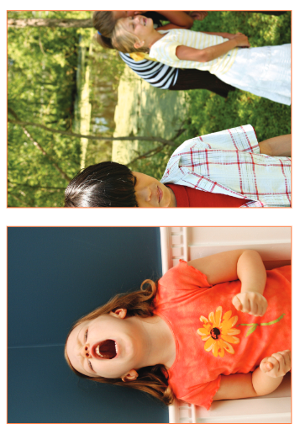
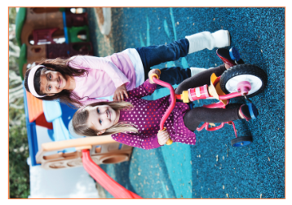
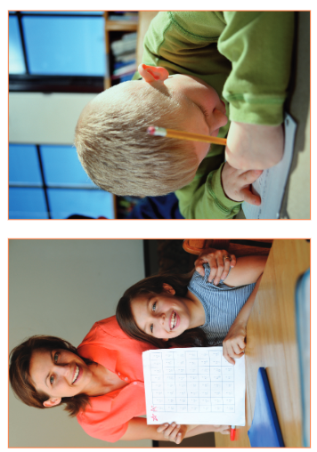
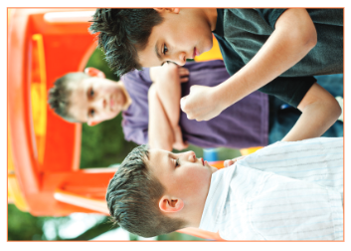

Slide 7
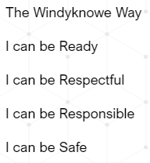
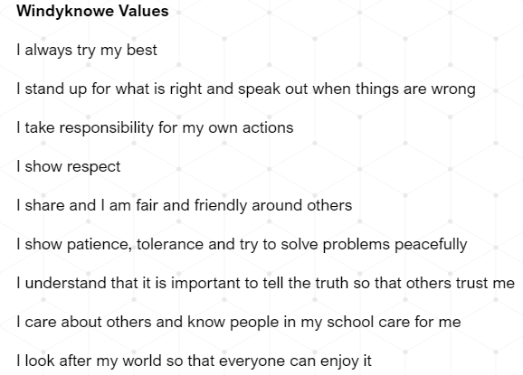

Slide 8
What? (L.I.) | How? (AiFL toolkit, resources) | Why? | Successful?
P2 Maths 3D Shape L.I. to describe 2D shapes using corners, edges and sides | Starter: watch following video – properties of 2D Shapes https://app.discoveryeducation.co.uk/learn/videos/96d40d47-481f-422f-abcf-10bee889da8b Activities: 1. ICT - properties 2D Shapes https://app.discoveryeducation.co.uk/learn/player/35909d57-c850-4db6-85e7-4039c8c958d5 2. Tangram – colour, cut and stick back together 3. 2D Shape picture cards and shapes 4. Create your own Monster – cut out 2D shapes/use lick shapes 5. 2D Pattern Jigsaw 6. 2D Shape Cut and Stick Matching 7. 2D Shape I Spy – Nexus Boards 8. 2D Shape Feely Bag 9. Properties of 2D Shapes Worksheet (TL) Espresso Video: 2D Shapes Around Us https://app.discoveryeducation.co.uk/learn/videos/d9085404-dee5-4cdf-8991-b22d103e0d9b Number Talk: Which One Doesn’t Belong, Shape 21 (shape on next slide): http://wodb.ca/shapes.html | Why is it important to be able to name 2D Shapes? | I can describe 2D shapes
RRS Article 29

Slide 9
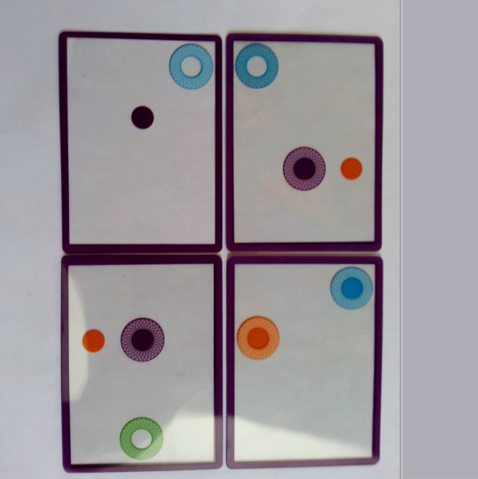

Slide 10
What? (L.I.) | How? (AiFL toolkit, resources) | Why? | Successful?
P2 RME L.I. to discover how Jewish people celebrate Sukkot | Watch clip about Sukkot and discuss: https://app.discoveryeducation.co.uk/learn/videos/d0628975-9eff-40d2-94b8-4efd893e51dc Sukkot is near the end of September this year. When do you have a special meal with your families and friends at home? Write a list on the board. When might you eat with family and friends in an unusual place e.g. picnic, BBQ, campfire? Draw a picture of their experiences of eating in an unusual place. | Why is it important to learn about different celebrstions? | I can describe an unusual place to eat
RRS Article 29

Slide 11
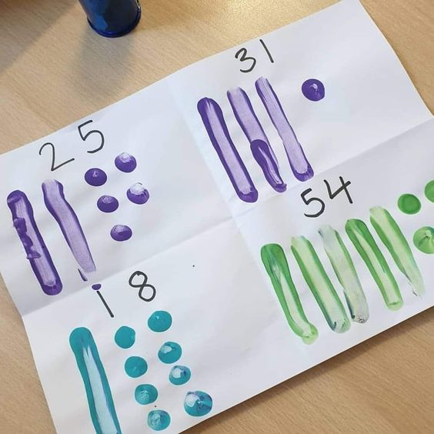
P2MB L.I. To know the position and value of a number including zero
HAM NP1.4 Play Body Numbers (HAM) whole class
Children’s responses
Why?
What?​
Make:
Make 4 different numbers showing tens and units.
Say: Say if the statements about the numbers are true or false.
Write: Question bank NP1.4a
Do: The digit 3 Investigate how many numbers between 0 and 100 have the digit 3. List all the numbers and say whether the digit 3 is a tens digit or a units digit.
Nexus boards 2 Digit Numbers sheet.
How?
How do I know I am successful?
I can say the value of any given number
I can write 2 digit numbers
RRS Article 29 Target
Notes:
Teacher input: Revise sound recognition using Espresso education phonics and revise how to correctly write the sounds.
Go over spelling words to check understanding of vocabulary.
T – individual jotter task.
C and A - To recognise s,a,t,i,p,n,c,r and spell –at words. Make and say tasks same with own words. Write – practice writing the sounds in jotter. Read and draw in jotter.

Slide 12
Children’s responses
T1 wk1
L.I. To jump for distance.
Why?
What?​
Running and Jumping - Jumping Frogs PPT
Warm up – video game
Discuss landing safely and skill jumping for distance.
Do long jump
Discussion
Play Frogs and Lily Pads
Cool Down
How?
I can use the correct technique for take-off.
I can use my arms for distance and balance.
I can cover the longest distance possible when I jump.
I can land safely.
How do I know I am successful?
RRS Article 31 healthy Target 9 travel safely
Notes:
Teacher input: Revise sound recognition using Espresso education phonics and revise how to correctly write the sounds.
Go over spelling words to check understanding of vocabulary.
T – individual jotter task.
C and A - To recognise s,a,t,i,p,n,c,r and spell –at words. Make and say tasks same with own words. Write – practice writing the sounds in jotter. Read and draw in jotter.

Slide 13
