Slide 1
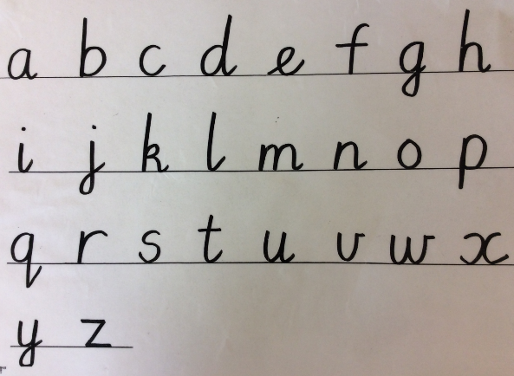
LEARNING FROM HOME
Please scroll through the slides to see all of this week's lesson plans.
Week beginning Monday 30th August 2021

Slide 2
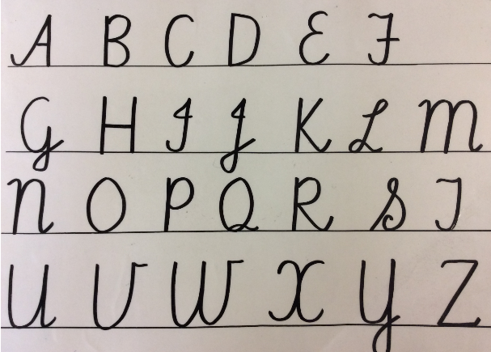

Slide 3
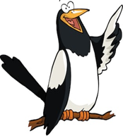
What are we learning? | L.I. To recognise and be able to form the sound ‘p’ Literacy lessons 1 & 2 Monday and Tuesday
How are we learning? | Adult input: Class input – Revise sounds using JP smartboard story, action & song, vowel house colour and mouth formation. Go over letter formation. Identify words beginning with the sound or containing the sound. Free play activities – print with potatoes, make something with paper clips, play with pom poms with tweezers, collage with pasta, make a pasta necklace, write p on post-its, make a pink and purple picture, make a Peppa Pig, hide magnetic letters under cups and play a guessing game, make the letter in sand, make the letter with dough, trace over the letter on nexus boards, write the letter on a chalk board and paint over it with water to make it disappear, letter collage, make the letter with loose parts/construction, reading corner, catch the bottle top with the letter in the water tray, spot the letter in a library book with a magnifying glass, reading corner, tell a story with puppets/story stones/pictures, mark making area Outside – write the letter in chalk/with water Teacher focus – ‘p’ jotter task Plenary - children share their learning with the puppet and each other – lots of teacher modelling of language to use (so you were learning to make/recognise the letter ‘p’ by … so you were learning to share/take turns/work in a team etc)
Why are we learning this? | Consider how we might use this skill in real life. Why do we need to know this sound?
How do we know we have been successful? | Recognise the sound Write the sound Explain to someone Think of words with the letter sound

Slide 4
What are we learning? | L.I. To recognise and be able to form the sound ‘p’ Literacy lessons 3 & 4 Wednesday and Thursday
How are we learning? | Class input – Introduce sound using JP smartboard story, action & song, vowel house colour and mouth formation. Go over letter formation. Identify words beginning with the sound or containing the sound. Free play activities – collage with newspaper, make a nest, collage with noodles, use string as noodles with tweezers, make a night picture, hide magnetic letters under cups and play a guessing game, make the letter in sand, make the letter with dough, trace over the letter on nexus boards, write the letter on a chalk board and paint over it with water to make it disappear, letter collage, make the letter with loose parts/construction, reading corner, catch the bottle top with the letter in the water tray, spot the letter in a library book with a magnifying glass, reading corner, tell a story with puppets/story stones/pictures, mark making area, Smartboard - (Espresso Scrap’s Phonics) Teacher focus:, blending with carpet tiles Plenary – children share their learning with puppet and each other. Show thumbs and discuss any not up. How can I have helped you better today?
Why are we learning this?
How do we know we have been successful? | Recognise the sound Write the sound Explain to someone Think of words with the letter sound

Slide 5
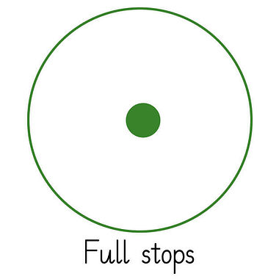
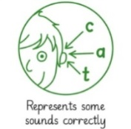
What are we learning? How are we learning this? | Writing Theme: Free Writing L.I. To develop pincer grip. To give meaning to writing. S.C I can tell an adult about my writing Class input – Begin by practicing scissor skills. Discuss how to hold scissors safely and practice cutting lines to warm up our fingers .Where can you see writing in the classroom? Why do we need labels? What do they tell us? Free writing- what could you write for our classroom? Children record any type of writing and discuss what it says for teacher to scribe. Can either stick in jotter or take picture. Free play activities – Fiddly fingers activities e.g threading, tracing, use loose parts, tweezers and pom-poms, scissor control station. Teacher focus – Scribing what they are writing and continuing with baseline assessment Plenary – children share their learning with puppet and tell a friend what they have written.
Why are we learning this? | Consider how we might use this skill in real life?
How do we know we have been successful? | Tell the events in order Use spaces between words Use full stops Sound out some words

Slide 6
What are we learning? Numeracy 1 | Numeracy Number Lesson 1 – L.I. To recognise and count 6 MONDAY
How are we learning this? | Class input – Read Snappy 6 story, sing along https://www.youtube.com/watch?v=anYJvL9kZoU list different ways to make 6 e.g., dice pattern, numicon, fingers, Free play – numicon, number fans, nexus boards, number jigsaws, number 6 activities, collage numbers, number hunt, ‘six’ word work, write 6 in glitter, sand, foam Teacher focus – 6 in number booklet Plenary – pick up 6 things and come back to the carpet, share what you brought, “I brought six.....”
Why are we learning this? | Consider how we might use this skill in real life.
How do we know we have been successful? | I can identify 6 in different ways

Slide 7
What are we learning? Numeracy 2 | Numeracy Number Lesson 2 – L.I. To recognise and count 7 Wednesday
How are we learning this? | Class input – Read Spotty 7 story, sing along https://www.youtube.com/watch?v=PfEqSjgW4tk list different ways to make 7 e.g., dice pattern, numicon, fingers etc Free play – numicon, number fans, nexus boards, number jigsaws, number 7 activities, collage numbers, number hunt, ‘seven’ word work, write 7 in glitter, sand, foam Teacher focus – 7 in number booklet Plenary – pick up 7 things and come back to the carpet, share what you brought, “I brought seven.....”
Why are we learning this? | Consider how we might use this skill in real life.
How do we know we have been successful? | I can identify 7 in different ways

Slide 8
What are we learning? Numeracy 3 | Numeracy Number Lesson 3 – L.I. To recognise and count 8 Thursday
How are we learning this? | Class input – Read Amazing 8 story, sing along https://www.youtube.com/watch?v=kdzD8Z2Ip6A list different ways to make 8 e.g., dice pattern, numicon, fingers etc Free play – numicon, number fans, nexus boards, number jigsaws, number 8 activities, collage numbers, number hunt, ‘eight’ word work, write 8 in glitter, sand, foam Teacher focus – 8 in number booklet Plenary – pick up 8 things and come back to the carpet, share what you brought, “I brought eight.....”
Why are we learning this? | Consider how we might use this skill in real life.
How do we know we have been successful? | I can identify 8 in different ways

Slide 9
What are we learning? Problem Solving | FRIDAY
How are we learning? | Problem Solving L.I to spot a pattern Class input - What is a pattern? https://www.topmarks.co.uk/ordering-and-sequencing/shape-patterns Play activities – Using small resources, can they create their own patterns. 2d shapes, cubes, beads, natural materials etc. Plenary – can you explain what your pattern is?
Why are we learning this? | Consider how we might use this skill in real life.
How do we know we have been successful? | I can work out the answer to the problem and can explain my strategy and answer.

Slide 10
What are we learning? STEM | FRIDAY L.I to work collaboratively on a STEM project
How are we learning? | Teacher input – Discuss the shapes of different buildings and have small pictures e.g. Eiffel tower, pyramids, big ben Task - put out a variety of building materials e.g. duplo, lego, natural resources, art straws. Children try to replicate their building using the picture stimulous. Plenary - share buildings
Why are we learning this? | Consider how we might use this skill in real life.
How do we know we have been successful? | I can work with a partner. I can use problem solving skills.

Slide 11
What are we learning? French | FRIDAY L.I to use French greetings
How are we learning? | Class input - Revise Bonjour and Au’revoi. Introduce Ca Va, Ca va bien, ca va mal and comme ci comme ca. Children wander to the music https://www.youtube.com/watch?v=tkjlYxUf4-M and when the music stops they say hello and ask how someone is in French and wave. Then introduce hello and goodbye in French. Play activities – Colour in French Flag Free play activities – Sand play, constructions, loose parts art, jigsaws, mark making corner, small world, pencil control nexus boards, reading corner. Plenary – can you say hello and goodbye in French to the puppet?
Why are we learning this? | Learning about other cultures. If we ever visited France.
How do we know we have been successful? | I can recognise and respond to French words.

Slide 12
What are we learning? CC Play Based Learning | Can be completed on any day L.I. To learn about all about me (families, homes,how we grow)
How are we learning? | Class input - Who lives in my home? Talk about family and extended members like grandparents, aunties and uncles. Show pictures of babies and older members – how do we know who is the oldest and who is the youngest from looking at the photos? Are the oldest people the tallest? Class experiment and record. Activities – Drawing, picture, model of their home and people in it, Construction, sand (match names on lids to bottle) water (spoons, bowls, pots), mark making area (list of children’s names), , dough, loose parts art(natural materials), fine motor control activity , jigsaws(school), reading corner, nexus boards (pencil control), small world (doll’s house). Teacher focus – interact with children and floor book
Why are we learning this? | To discuss similarities and differences.
How do we know we have been successful? | I discuss who lives in my house/is in my family.

Slide 13
What are we learning? CC Play Based Learning | Can be completed on any day L.I. To learn about all about me (families, homes,how we grow)
How are we learning? | Class input- introduce similarities and differences between each other. Interactive espresso book on similarities and differences – follow up children’s ideas. What is similar and/or different about each other in class? Record ideas on floorbook. Activities – Mirrors, Construction, sand, water(spoons, bowls, pots), mark making area (list of children’s names) , dough, loose parts art(natural materials), fine motor control activity, jigsaws(school), reading corner, nexus boards (pencil control), small world (doll’s house), maps of school Teacher focus – floorbook Class input: follow up children’s ideas from individual floorbooks Activities: Construction, sand (match names on lids to bottle) water (spoons, bowls, pots), mark making area (list of children’s names), dough, loose parts art (natural materials), fine motor control activity, jigsaws(school), reading corner, nexus boards (pencil control), small world (doll’s house), maps of school, models of school (junk)
Why are we learning this? | To discuss similarities and differences.
How do we know we have been successful? | I discuss who lives in my house/is in my family.

Slide 14
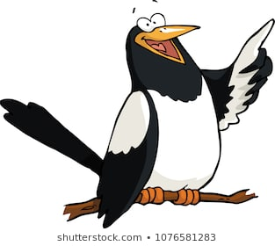
What? (L.I.) | How? (AiFL toolkit, resources) | Why? (skills for life, learning and work, links) | Successful? (success criteria, evidence, target)
P1 Music L.I. to join in with action songs and stories | Listen and Respond, then Games Track: https://www.charangascotland.co.uk/c/1342303-adapted-for-covid-scheme/1342304-primary-1/1342307-everyone/lessons/394042-step-6 Have a go of following the actions of the songs. Revise any past songs/stories (Bear Hunt, The Gruffalo etc) | Why is it important for me to learn different actions? | I can join in with action songs

Slide 15
What are we learning? How are we learning? | P.E. Lesson 1 (Front Playground) L.I. To develop listening skills when moving Class input – Take children up to the playground, discuss hall safety/risks (prompt children to discuss ‘bumping’ into each other. How can we fix this? Zip up into moving bubbles, move through the playground in different directions, forwards, backwards, weaving, high movements, low movements, quick walking, slow walking. Play some listening/instruction games – traffic lights, colours, ‘Simon says’ Lesson 2 (Forest) L.I. To begin to understand our senses. Listening walk. What can you hear? Are you able to draw what you hear? What can you smell and touch in the forest? Is it rough or smooth, hard of soft, loud or quiet? Do some tree rubbings with crayons. Can you see any patterns? Senses Scavenger hunt.

