Slide 1
vendredi trois septembre deux mille vingt et un
Friday 3rd September 2021

Slide 2
Today's Plan P2C
8.45 - 9.15 - Reward time
9.15- 10.30 - Numeracy
10.30 - 10.45 - Break
10.45 - 11.00 - Story and milk
11.00 - 11:20 – Number talk
11:20 – 11:45 – Handwriting
11:45 – 12:00 - park

Slide 3
Today's Plan P2MB
8.45 - 9.00 - Get Set
9.00- 10.30 - Problem solving
- Handwriting
10.30 - 10.45 - Break
10.45 - 11.00 - Story and milk
11.00 - 11.30 - RME/Music/Drama
11:30 – 11:50 – reward Time
11:50 - park

Slide 4
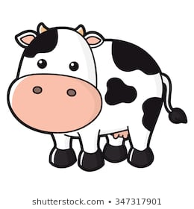
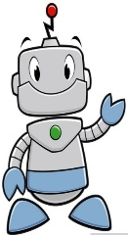
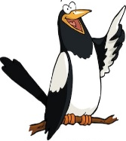
What? (L.I.) | How? (AiFL toolkit, resources) | Why? | Successful?
P2 Problem Solving L.I. to look for a pattern | Starter: Discuss pattern task from last week (what would the 20th object be?) Practise Jack Hartman counting in 2s, 5s and 10s: https://www.youtube.com/watch?v=OCxvNtrcDIs https://www.youtube.com/watch?v=amxVL9KUmq8 https://www.youtube.com/watch?v=W8CEOlAOGas Activities: As a whole class, sit in a circle and play a game of 'buzz' counting in 2s. Then discuss who would say the 10th, 16th and 30th buzz? Try again counting in 10s and then counting in 5s – who would say number 50, 80 and 100 | Why is it important to be able to show patterns | I can explore various patterns
RRS Article 29

Slide 5
P2MB Numeracy To count on and back in a sequence
https://www.youtube.com/watch?v=BokH3_zaLiA
Children’s responses
Why?
What?​
Make: Whole class starter - hop scotch outside in chalk – counting in tens Challenge off the decade
Say: Play Ping Pong (HAM game)
Match number and word
Write: With T write sequences counting in 10, both on and off the decade. Children to finish the sequence. Questioning – activity cards; counting in 10.
Do: Play Clam Collector on the smartboard (HAM)
Play dominoes
How?
How do I know I am successful?
I can say number sequences in tens
I can write number sequences counting in tens
RRS Article 29 Target
Notes:
Teacher input: Revise sound recognition using Espresso education phonics and revise how to correctly write the sounds.
Go over spelling words to check understanding of vocabulary.
T – individual jotter task.
C and A - To recognise s,a,t,i,p,n,c,r and spell –at words. Make and say tasks same with own words. Write – practice writing the sounds in jotter. Read and draw in jotter.

Slide 6
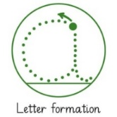
To form letters with a slope up and a backwards loop
e l ee ll
Children’s responses
What?​
Why?
Teacher demonstration of each letter one at a time using writing repeater.
https://www.ictgames.com/mobilePage/writingRepeater/
Handwriting booklets – children write on top then copy below. Children circle their own best example of each letter.
Self assess with a traffic light dot at the end of each line – at the end tell a partner what you did well and what you need to improve on. Add sm beside the date to show that it was self assessed.
Fast finishers: use a whiteboard and pen to draw 2 straight lines with a ruler. Between the lines do a continuous pattern of loops like eeeee joined together. Continue to practise today's letters.
How?
I can form my letters correctly.
How do I know I am successful?
RRS Article: 28, 29 education
Target: W1 neat handwriting W3 form letters correctly
Notes:
Teacher input: Explain task and go over SC. Choose a child in the picture and write a description together. Write some describing words on the whiteboard as a wordbank.MA work independently. A work at the teaching table. LA do phonics tasks and games. Children complete literacy tasks from before break if finished.

