Slide 1
Jeudi deux septembre deux mille vingt et un
Thursday 2nd September 2021

Slide 2
Today's Plan P2C
8.45 - 9.00 - Get Set
9.00- 10.30 - Writing
10.30 - 10.45 - Break
10.45 - 11.00 - Story and milk
11.00 - 12.30 - Literacy (phonics and tricky words) and reading (comprehension focus)
12.30 - 1.15 - Lunch
1.15- 3.00 - Topic
3.00 - 3.15 - Park

Slide 3
Today's Plan P2MB
8.45 - 9.00 - Get Set
9.00- 10.30 - Literacy (phonics and tricky words) and Reading (comprehension focus)
10.30 - 10.45 - Break
10.45 - 11.00 - Story and milk
11.00 - 12.30 - Maths
12.30 - 1.15 - Lunch
1.15- 3:00- Topic
3.00 - 3.15 - Park

Slide 4
Writing: To write a sales description of a house using persuasive describing words. (adjectives).
Children’s responses
What?​
Why?
Teach: Recap L&T activity on the next slide. Model writing a sales description of the house below using persuasive vocabulary. Make a list of useful vocabulary on the whiteboard. Put sentence starters on the board to use if children wish.
How?
This is a It is set in It has There is The garages are The swimming pools are The living areas are The dining room has The kitchen is The garden
I can use finger spaces.
I can sound out words.
I can use capital letters and full stops.
*I can use describing words.
How do I know I am successful?
RRS Article 29 education 27 safe home Target W2, 4, 7, 11
Notes:
Teacher input: Explain the task and go over SC. Read the house description here: This is a beautifully designed Manor House in the prestigious area with over 70 stunning rooms, internal and external leisure facilities, a two storey garage and unsurpassed luxury. Its awe inspiring frontage is made from Cotswold stone with Corinthean fluted columns flanking the grand front door. It has fabulous indoor and outdoor swimming pools and a fully equipped, state-of-the-art gym. The living areas are opulent whilst being modern and homely.
Read the example on the next slide from the listening task earlier in the week. Write a house description together to persuade people to buy the house. Write some describing words on the whiteboard as a wordbank. Children write a description to sell the pictured house on the third slide. MA work independently. A work at the teaching table. LA do phonics tasks and games. Children complete other literacy tasks from before break if finished.

Slide 5
To expand my vocabulary with new describing words (adjectives).
Children’s responses
What?​
Why?
T1 wk3
How?
This exquisite house is set in stunning countryside. It is a grand country house with stone staircases, a double height great hall and beautifully designed gardens. The magnificent courtyard swimming pool is something to be admired. Additionally it has an immaculate grass tennis court, serene private lake and handsome stone stable buildings. Inside all the rooms are equally as impressive.
I can listen and identify the describing words.
How do I know I am successful?
I can talk to my partner about words to describe a house.
Notes:
Teacher input: Read the house description together and identify the describing words. Discuss any new vocabulary. Talk about persuasive language. Look at the next slide and pairs use persuasive describing words to try to sell their house. Report back to the class.

Slide 6
This is a It is set in
It has There is
The garage is The swimming pools is
The garden The living areas are
The dining room has The kitchen is

Slide 7
Literacy: Reading groups– To develop my comprehension skills
Tricky words - To read and spell tricky words.
Children’s responses
What?​
Why?
Teach: Tricky words flashcards. Discuss the new tricky words and identify the trick. Play the ping pong game to demonstrate.
Reading groups focus – front cover features, prediction, title, think of alternative title
How?
Make a bird from card with flapping wings (own design)
make
ng ping pong game – First person says an ng word then the next person says an ng word. Continue to take turns until somebody can't think of a word. They are then out. Words cannot be repeated within a round.
Say
*Write your tricky words in 3 different colours. Blue gp - Write a sentence with one of the tricky words. (Red group use their cvc words.)
Write
Play a consonant blend dice track game
or
write a funny sentence with 3 of the consonant blends words and draw a matching picture
do
I can make today’s craft task by following the instructions and can correctly write the words.
I can read and make my spelling words.
I can correctly spell the words.
I can read and write the consonant blend words.
How do I know I am successful?
RRS Article 29 education 27 Target W4 sound out, W12 tricky words
Notes:
Teacher input: Revise all sounds with flashcards and revise all tricky words covered so far with flashcards. Reading groups. Focus on comprehension with MA.
T – individual jotter task.
C and A - To recognise s,a,t,i,p,n. Wk sheet task.

Slide 8
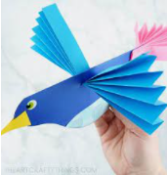
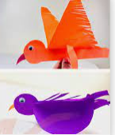

Slide 9
Light Blue
bring
string
strong
stronger
hanging
banging
Blue
thing
bring
hung
sting
string
strong
Green
ring
sang
bang
long
thing
bring
Purple
ring
song
bang
thing
Red
hop
top
mop
pop

Slide 10
To read and correctly spell tricky words.
Light Blue
are
said
could
should
Blue
are
said
could
should
Green
are
said
could
should
Purple
are
said

Slide 11
Initial blends with r
br, cr, dr, fr, gr, pr, tr
brick
brim
brain
crop
cross
creep
pram
drag
drip
drop
drain
frog
from
grab
gran
grip
grin
trap
tram
trot
trip
trim

Slide 12
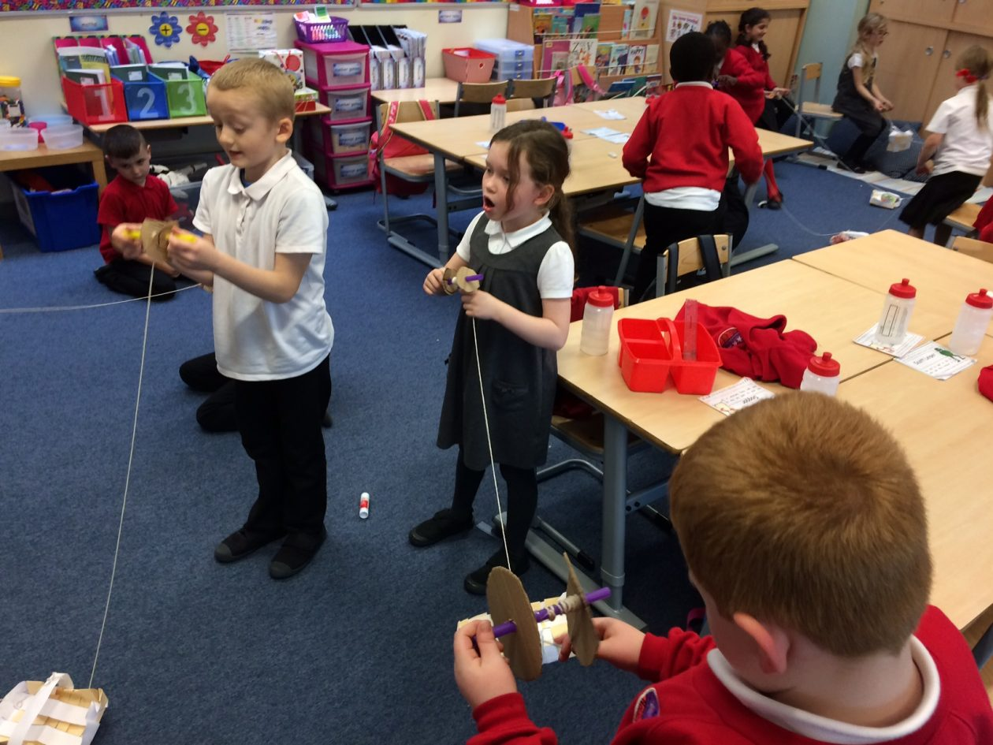
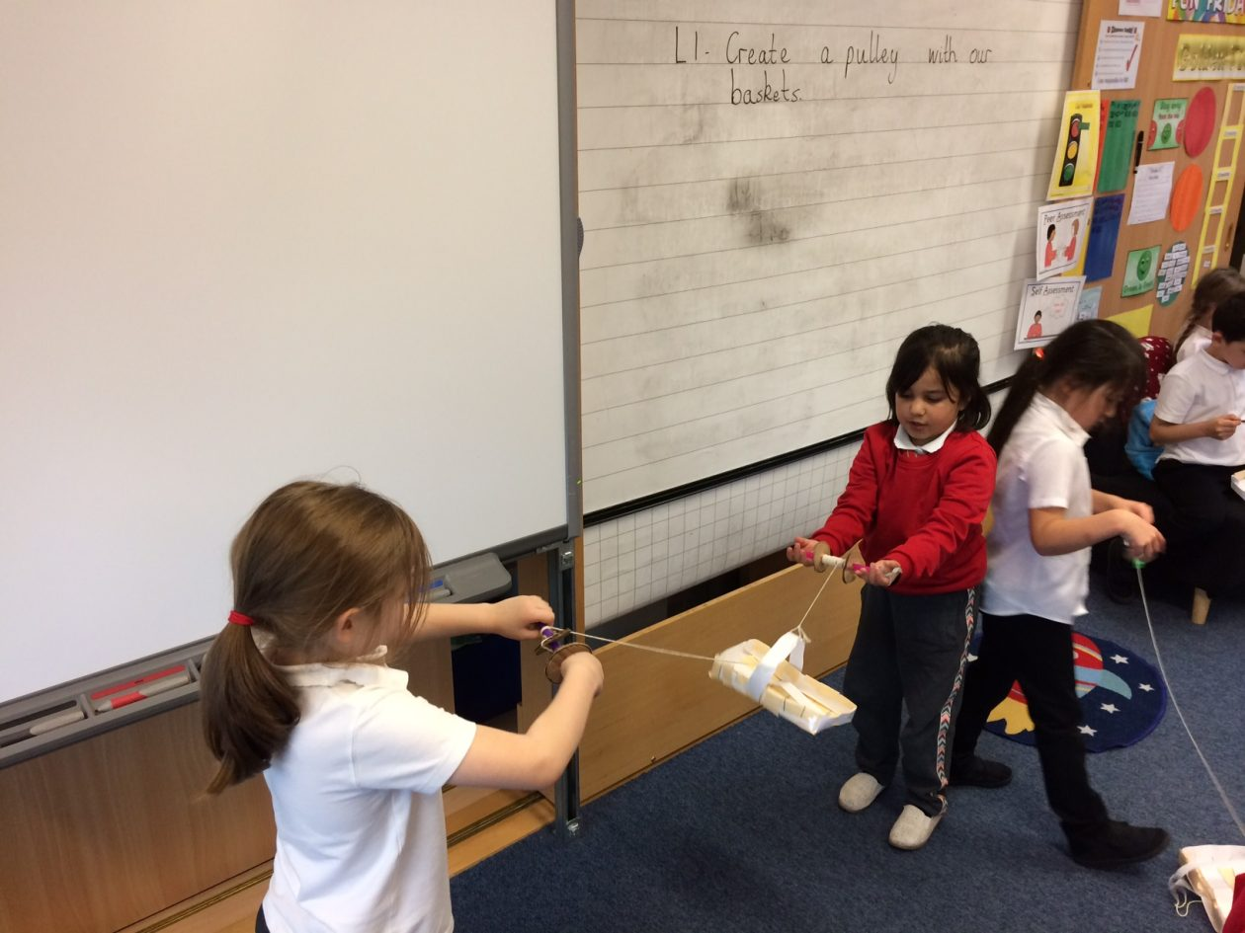
2c Topic: To Express my own ideas
To work in a team. To solve a problem.
Children’s responses
What?​
Why?
Children try to make their own puleys and lunch boxes in groups of 3 after seeing how the class version was created together. Demonstrate how to make a box shape from a piece of card by doing 4 snips near the corners.
Provide sticks, string, card, tape, stickers and glue.
If time allows - Rewatch the story of The Lighthouse keepers lunch. In small groups act out the story using the puleys created.
https://www.youtube.com/watch?v=qsZK6hv7nCU
https://www.teachingideas.co.uk/library/books/the-lighthouse-keepers-lunch
How?
I can listen and respond to a story. I can contribute my ideas. I can solve design problems.
How do I know I am successful?
RRS Article 29 education Target H3 friends, caring, sharing
Notes:
Teacher input: Read the wolf description together and identify the describing words. Tell your partner the word you liked best. Look at the next slide and identify the opposite describing words. Show the third slide and pairs describe the character using as many interesting words as they can. Report back to the class.

