Slide 1
Mercredi un septembre deux mille vingt et un
Wednesday 1st September 2021

Slide 2
Today's Plan P2C
8.45 - 9.00 - Get Set
9.00- 10.30 - Maths Mrs Brown
10.30 - 10.45 - Break
10.45 - 11.00 - Story and milk
11.00 - 11.30 - RME / Music / Drama with Mrs Brown
11:30 – 12:30 – finish above, Problem Solving
12.30 - 1.15 - Lunch
1.15- 2:30 – P.E. (field)
2.30 - 3.00 - Health (Jigsaw)
3.00 - 3.15 - Park

Slide 3
Today's Plan P2MB
8.45 - 9.00 - Get Set
9.00- 10.30 - Writing
10.30 - 10.45 - Break
10.45 - 11.00 - Story and milk
11.00 - 12.30 - Numeracy
12.30 - 1.15 - Lunch
1.15- 2.30 - P.E. (field)
2.30 - 3.00 - Health (Jigsaw)
3.00 - 3.15 - Park

Slide 4
Writing: To write a sales description of a house using persuasive describing words. (adjectives).
Children’s responses
What?​
Why?
Teach: Recap L&T activity on the next slide. Model writing a sales description of the house below using persuasive vocabulary. Make a list of useful vocabulary on the whiteboard. Put sentence starters on the board to use if children wish.
How?
This is a It is set in It has There is The garages are The swimming pools are The living areas are The dining room has The kitchen is The garden
I can use finger spaces.
I can sound out words.
I can use capital letters and full stops.
*I can use describing words.
How do I know I am successful?
RRS Article 29 education 27 safe home Target W2, 4, 7, 11
Notes:
Teacher input: Explain the task and go over SC. Read the house description here: This is a beautifully designed Manor House in the prestigious area with over 70 stunning rooms, internal and external leisure facilities, a two storey garage and unsurpassed luxury. Its awe inspiring frontage is made from Cotswold stone with Corinthean fluted columns flanking the grand front door. It has fabulous indoor and outdoor swimming pools and a fully equipped, state-of-the-art gym. The living areas are opulent whilst being modern and homely.
Read the example on the next slide from the listening task earlier in the week. Write a house description together to persuade people to buy the house. Write some describing words on the whiteboard as a wordbank. Children write a description to sell the pictured house on the third slide. MA work independently. A work at the teaching table. LA do phonics tasks and games. Children complete other literacy tasks from before break if finished.

Slide 5
To expand my vocabulary with new describing words (adjectives).
Children’s responses
What?​
Why?
T1 wk3
How?
This exquisite house is set in stunning countryside. It is a grand country house with stone staircases, a double height great hall and beautifully designed gardens. The magnificent courtyard swimming pool is something to be admired. Additionally it has an immaculate grass tennis court, serene private lake and handsome stone stable buildings. Inside all the rooms are equally as impressive.
I can listen and identify the describing words.
How do I know I am successful?
I can talk to my partner about words to describe a house.
Notes:
Teacher input: Read the house description together and identify the describing words. Discuss any new vocabulary. Talk about persuasive language. Look at the next slide and pairs use persuasive describing words to try to sell their house. Report back to the class.

Slide 6
This is a It is set in
It has There is
The garage is The swimming pools is
The garden The living areas are
The dining room has The kitchen is

Slide 7
Health Jigsaw: To understand the rights and responsibilities as a member of my class and to know that I belong to my class
To become aware of children's rights
Children’s responses
What?​
Why?
Calm me – chime, breathing
Revise Jigsaw rules – listen respectfully without interrupting, ok to have different ideas and feeling from others, only talk when it is your turn.
Say to the children that someone who is special in our class is missing (Jigsaw Jack). “Jigsaw Jack, would you like to join our circle? You are a special member of our class.” Explain Jigsaw Jack’s special job: when you are holding Jack, it is your turn to talk. Practise this by passing Jigsaw Jack around the circle - “Hello everybody, my name is... and I like belonging to class ...”
Teach the ‘I am special’ song (to the tune of Frère Jacques):I am special, I am special, I belong, I belong,with my friends and family, with my friends and family, and my class, and my class. Sing it several times with the children holding hands in the circle.
Show the class the picture of children learning well together. In talking partners ask the children to think about how they can help each other learn. - role play or mime and introduce the language of rights and responsibilities, e.g. we all have the right to belong to this class, we all have the right to ask questions, we all have the right to learn and we all have the responsibility to help each other to learn.
Draw a picture of themselves learning well with their friends.
Second page of RRS booklet – discuss, complete sentences and colour.
How?
Talk clearly with my own ideas
Listen carefully
Know my rights and responsibilities as a member of our class.
How do I know I am successful?
RRS Article 3 adults look after you, 19 safe, 27 safe home Target: H 2 who talk to if sad, 3 friendship, sharing, caring, fairness
Notes:
Teacher input: Revise sound recognition using Espresso education phonics and revise how to correctly write the sounds.
Go over spelling words to check understanding of vocabulary.
T – individual jotter task.
C and A - To recognise s,a,t,i,p,n,c,r and spell –at words. Make and say tasks same with own words. Write – practice writing the sounds in jotter. Read and draw in jotter.

Slide 8
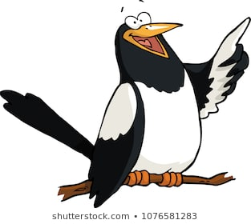
What? (L.I.) | How? (AiFL toolkit, resources) | Why? | Successful?
P2 Maths 3D Shape L.I. to describe 3D objects using faces, vertices and edges | Starter: watch following video – properties of 3D Shapes https://www.bbc.co.uk/bitesize/topics/zjv39j6/articles/zgqpk2p Activities: 1. ICT - properties 3D Shapes https://app.discoveryeducation.co.uk/learn/player/e16a1df4-3a36-4099-a8da-0e680b621af4 2. 3D Shape Sorting – cut and stick 3. 3D Shape Threading 4. Click Shapes 5. 3D Shape sorting – sort everyday objects using own criteria 6. Cone Hats – make own cone party hat 7. Building – Lego and Bricks 8. 3D Shape Feely Bag 9. 3D Shape Sorting Cards 10. Properties of 3D Shapes Worksheet (TL) Espresso Video: Properties of 3D Shapes https://app.discoveryeducation.co.uk/learn/videos/86011086-9ba2-4d7d-b091-e2dd370c61b5 Number Talk: Which One Doesn’t Belong, Shape 20 (shape on next slide): http://wodb.ca/shapes.html | Why is it important to be able to name 3D Shapes? | I can explore various 3D Shapes
RRS Article 29

Slide 9
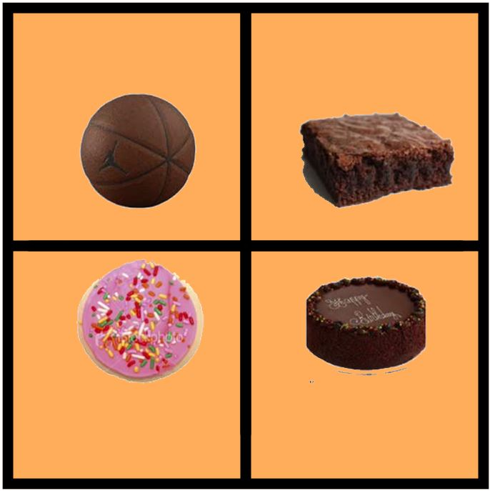

Slide 10
P2MB Numeracy To count on and back in a sequence
https://www.youtube.com/watch?v=BokH3_zaLiA
Children’s responses
Why?
What?​
Make: Whole class starter - hop scotch outside in chalk – counting in tens Challenge off the decade
Say: Play Ping Pong (HAM game)
Match number and word
Write: With T write sequences counting in 10, both on and off the decade. Children to finish the sequence. Questioning – activity cards; counting in 10.
Do: Play Clam Collector on the smartboard (HAM)
Play dominoes
How?
How do I know I am successful?
I can say number sequences in tens
I can write number sequences counting in tens
RRS Article 29 Target
Notes:
Teacher input: Revise sound recognition using Espresso education phonics and revise how to correctly write the sounds.
Go over spelling words to check understanding of vocabulary.
T – individual jotter task.
C and A - To recognise s,a,t,i,p,n,c,r and spell –at words. Make and say tasks same with own words. Write – practice writing the sounds in jotter. Read and draw in jotter.

Slide 11
What? (L.I.) | How? (AiFL toolkit, resources) | Why? | Successful?
P2 Problem Solving L.I. to look for a pattern | Starter: Discuss pattern task from last week (what would the 20th object be?) Practise Jack Hartman counting in 2s, 5s and 10s: https://www.youtube.com/watch?v=OCxvNtrcDIs https://www.youtube.com/watch?v=amxVL9KUmq8 https://www.youtube.com/watch?v=W8CEOlAOGas Activities: As a whole class, sit in a circle and play a game of 'buzz' counting in 2s. Then discuss who would say the 10th, 16th and 30th buzz? Try again counting in 10s and then counting in 5s – who would say number 50, 80 and 100 | Why is it important to be able to show patterns | I can explore various patterns
RRS Article 29

Slide 12
Children’s responses
T1 wk1
L.I. To jump for height.
Why?
What?​
Look at the Kangaroo PPT
Discuss jumping and landing safely.
How?
I can use the correct technique to take off.
I can jump as high as possible.
I can land safely.
How do I know I am successful?
RRS Article 31 Target 9 to travel safely
Notes:
Teacher input: Revise sound recognition using Espresso education phonics and revise how to correctly write the sounds.
Go over spelling words to check understanding of vocabulary.
T – individual jotter task.
C and A - To recognise s,a,t,i,p,n,c,r and spell –at words. Make and say tasks same with own words. Write – practice writing the sounds in jotter. Read and draw in jotter.

Slide 13
