Slide 1
lundi trente aout deux mille vingt et un
Monday 30th August 2021

Slide 2
Today's Plan P2C
8.45 - 9.00 - Get Set
9.00- 10.30 - Phonics and Reading groups
10.30 - 10.45 - Break
10.45 - 11.15 - Story and Number Talk
11.15 - 12.30 - Numeracy
12.30 - 1.15 - Lunch
1.15- 2.30 - Topic
2.30 - 3.00 - Listening and Talking
3.00 - 3.15 - Story

Slide 3
Today's Plan P2MB
8.45 - 9.00 - Get Set
9.00- 10.30 - Number Talk and Numeracy
10.30 - 10.45 - Break
10.45 - 11.15 - Story
11.15 - 12.30 - Phonics and Reading groups
12.30 - 1.15 - Lunch
1.15- 2.30 - Topic
2.30 - 3.00 - Listening and Talking
3.00 - 3.15 - Story

Slide 4
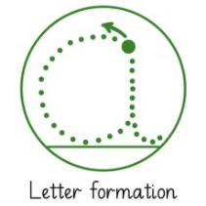
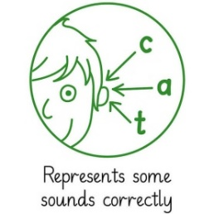
Literacy: To read and spell words with ing, ang, ong, ung.
Why?
Children’s responses
What?​
Teach: https://www.ictgames.com/mobilePage/forestPhonics/index.html
You tube Geraldine Giraffe ng
How?
Make ng by gluing string onto paper.
make
Read a word aloud from your spelling card and your partner writes it on a whiteboard. Check spelling against the card. Challenge: Can you write the words with your eyes closed!
Say
*Write sentences with 3 of your spelling words in your jotter.
Write
Phonics game.
Nexus boards.
do
I can make today’s craft task by following the instructions and can correctly write the words.
I can read and write my spelling words.
I can correctly spell the words within sentences and can form the letters correctly.
I can read my ng words to play the game / complete the nexus board activities.
How do I know I am successful?
RRS Article 29 education Target W4 sound out, R8 read aloud
Notes:
Teacher input: Revise sound recognition using Espresso education phonics and revise how to correctly write the sounds.
Go over spelling words to check understanding of vocabulary.
T – individual jotter task
C and A - To recognise s,a,t,i,p,n,c,r and spell –it / -ap words. Make and say tasks same with own words. Write – practice writing the sounds in jotter. Read and draw in jotter.

Slide 5
Light Blue
bring
string
strong
stronger
hanging
banging
Blue
thing
bring
hung
sting
string
strong
Green
ring
sang
bang
long
thing
bring
Purple
ring
song
bang
thing
Red
hop
top
mop
pop

Slide 6
To read and spell 3 letter words.
o p h t m p
_________________
_________________
stop
_________________
_________________

Slide 7
To count on and back in a sequence
https://www.youtube.com/watch?v=YtNskltyA0E
Children’s responses
What?​
Why?
T1 w2 l1
Whole class starter - In pairs draw number lines outside in chalk. Jump up and down number line, counting on and back.
How?
make
Say missing numbers on the number line (can use the number square for support)
Play Number Ping Pong
RRS Article 29 education Target 3 order and seq, 6 count on
Say
T *write sequence with missing numbers for children to count on/back
Write
Play snakes and ladders
Play Hedgehog Hurry on smartboard (H.A.M)
Match the word to the number
do
I can say missing numbers in a sequence
I can count on
I can count back
How do I know I am successful?
Notes:
Teacher input: penguin place value story
Teacher task –Write: Focus on setting out work in the squares. LA Support task with practical materials such as tens and units and arrow cards and possibly continue to work within 20.
Other Differentiation - Say: different versions available for counting on and off the decade. LA count forwards and back within 20 using a number line if needed.

Slide 8
P2MB
To construct houses using different materials
Children’s responses
What?​
Why?
T1
Resources: newspapers, sellotape, glue, art straws, card, string.
Working in groups of 4. Teacher will choose 2 groups to go to each building material and construct a building for someone to live in. *remember the different types of houses we looked at last week* see next slide – look at the different shapes.
Newspaper – can you roll it in different ways? Does the number of pages matter?
Art straws – what shapes would make it less wobbly?
Card – think about folding it in different ways
At the end discuss the different materials;
What material was the best to use and why?
What shapes made it sturdier?
Who would live in the house that you have built?
How?
I can talk about shape and strength.
How do I know I am successful?
I can talk about different people that may live in these homes.
Notes:
Teacher input: Read the wolf description together and identify the describing words. Tell your partner the word you liked best. Look at the next slide and identify the opposite describing words. Show the third slide and pairs describe the character using as many interesting words as they can. Report back to the class.

Slide 9
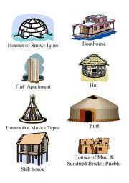
Different types of houses that people live in.

Slide 10
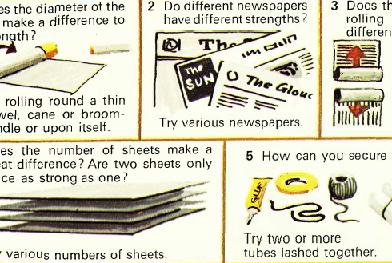
Newspaper

Slide 11
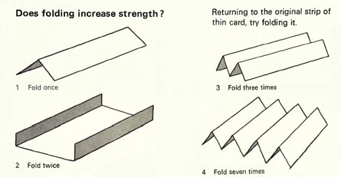
Art straws and card

Slide 12
2c Topic: To Express my own ideas
To work in a team.
Children’s responses
What?​
Why?
T1 wk1
Rapunzel
Read the story. Could the story have reversed roles for the main characters? Can a prince rescue a princess? Could you think of another way to escape from a tower? – LIT (listening and talking), PSD (gender equality)
Rapunzel is a German fairy tale recorded by the Brothers Grimm and first published in 1812 as part of Children's and Household Tales
https://www.dltk-teach.com/RHYMES/rapunzle/story.htm
https://www.youtube.com/watch?v=749w-InEXgQ
Discuss the advantages and disadvantages of building and living in a tower. Make a list of pros and cons. (tower pics in resources folder) – LIT (listening, talking, writing)
Try to make a tower from small wooden blocks (Jenga or similar). What are the issues? TECHNOLOGY, P.S.
How?
How do I know I am successful?
RRS Article 29 education Target H3 friends, caring, sharing
Notes:
Teacher input: Read the wolf description together and identify the describing words. Tell your partner the word you liked best. Look at the next slide and identify the opposite describing words. Show the third slide and pairs describe the character using as many interesting words as they can. Report back to the class.

Slide 13
L & T : To expand my vocabulary with new describing words (adjectives).
Children’s responses
What?​
Why?
How?
RRS Article 29 education 27 safe place to live
Target LT 19 talk about text LT 21 genre
This exquisite house is set in stunning countryside. It is a grand country house with stone staircases, a double height great hall and beautifully designed gardens. The magnificent courtyard swimming pool is something to be admired. Additionally it has an immaculate grass tennis court, serene private lake and handsome stone stable buildings. Inside all the rooms are equally as impressive.
I can listen and identify the describing words.
How do I know I am successful?
I can talk to my partner about words to describe a house.
Notes:
Teacher input: Read the house description together and identify the describing words. Discuss any new vocabulary. Tell your partner the word you liked best. Look at the next slide and pairs describe a house using as many interesting words as they can. Report back to the class.

Slide 14
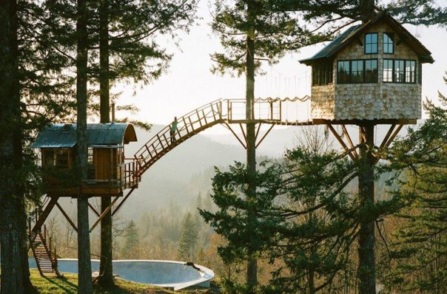
Notes:
Choose a house and describe to a partner.

