Slide 1
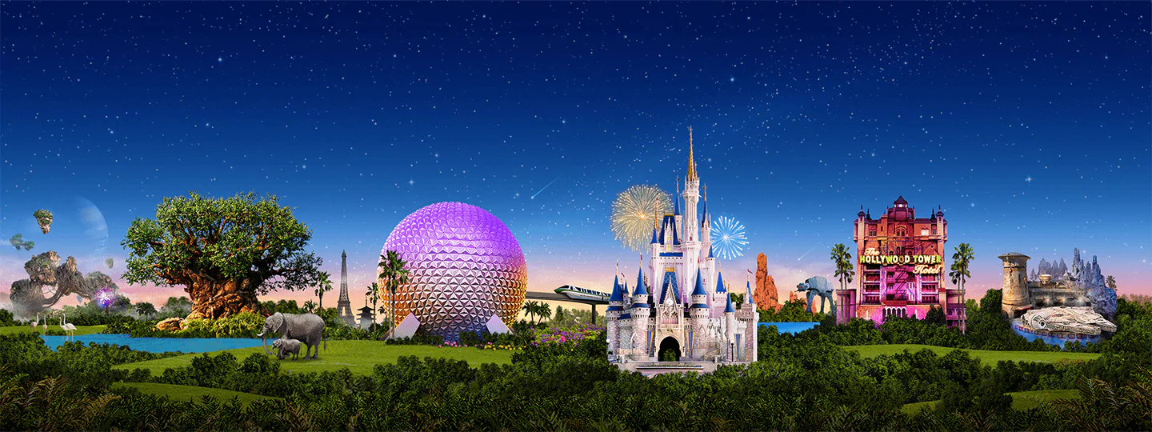
Virtual Disney Trip
Primary 6’s

Slide 2
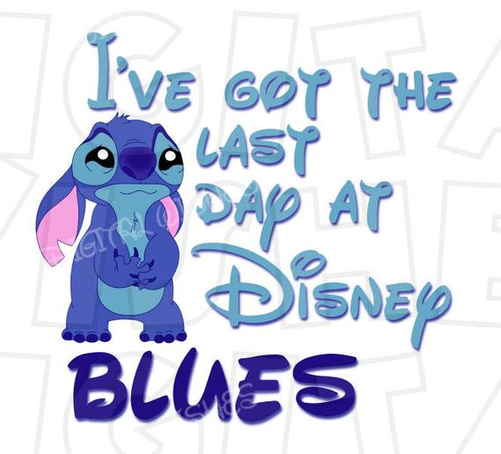
Friday: Day 5

Slide 3
Writing: Monsters Inc.
It’s time to enter Monstropolis, the city of Monsters!
Tasks:
Design a monster.
Name your monster.
Describe your monster using 6 adjectives.
Write a story with your monster as the main character.

Slide 4
HWB: Inside Out
Tell an adult something that makes you feel each of these emotions.
Example: I feel sad when my friends don’t share with me.

Slide 5
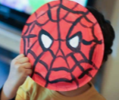
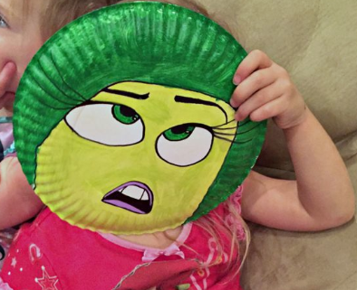
Disney Parade!
Create a mask of your favourite Disney (or any other) character.
Parade Time!
Take part in the parade as your favourite character.

Slide 6
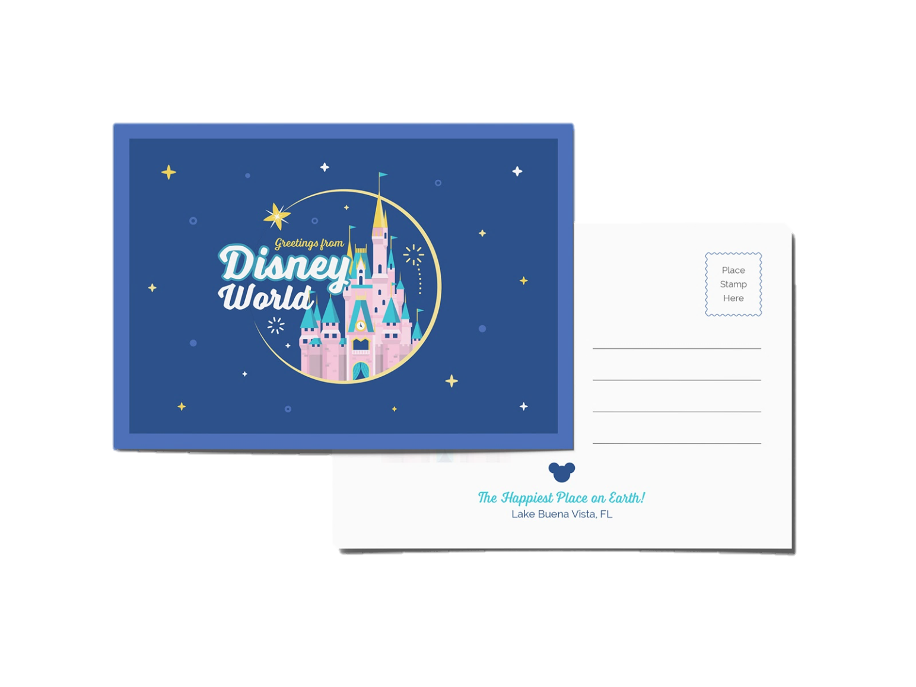
Send a Postcard!
It’s your last day at Disney World. Write a postcard to tell your grandparents/friend/sister/auntie about your school trip to Disneyland.
Draw a detailed picture on one side, and write a descriptive message on the back. Remember to include the address you are sending it to too!

Slide 7
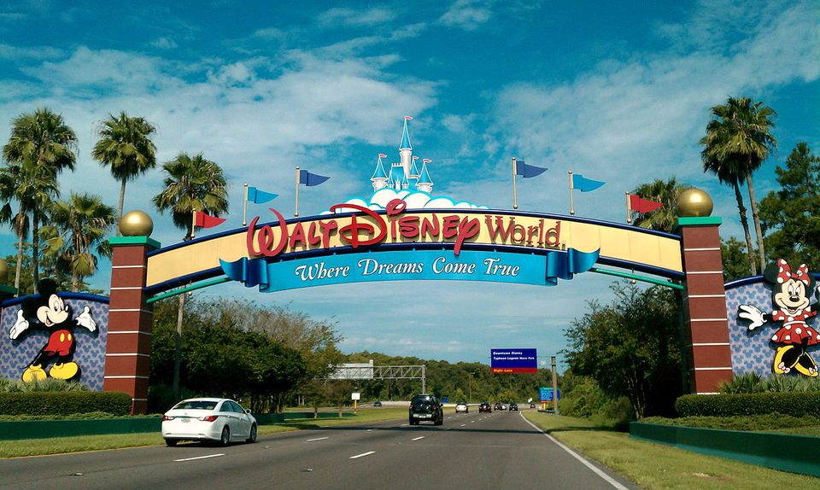
I hope you all enjoyed your trip to Disney World!
Big hugs, Miss Imray x

