Slide 2
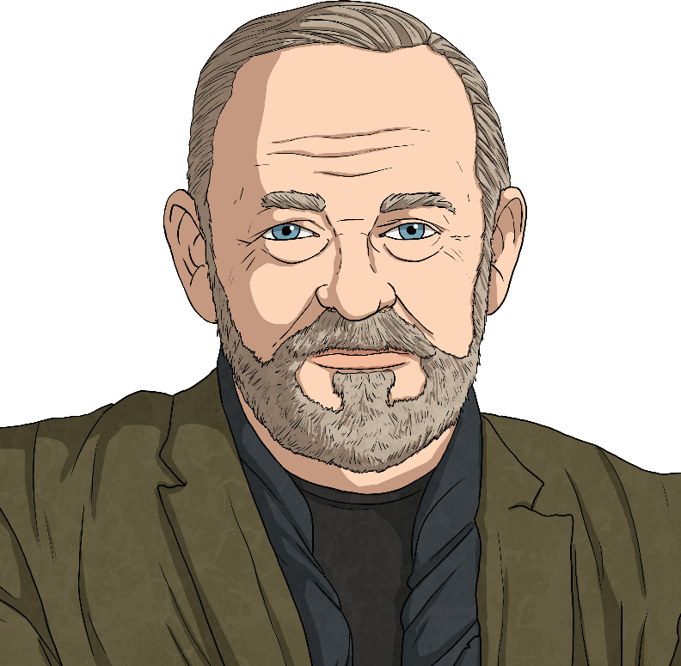
Steven Brown
Steven Brown is a contemporary Scottish artist.
Brown’s abstract paintings are instantly recognisable for their bold and bright colours. His most popular collection is the McCoos. Each McCoo has unique characteristics and of course, a Scottish name.
Click on the link to see some examples.
https://www.stevenbrownart.co.uk/pages/mccoos

Slide 3
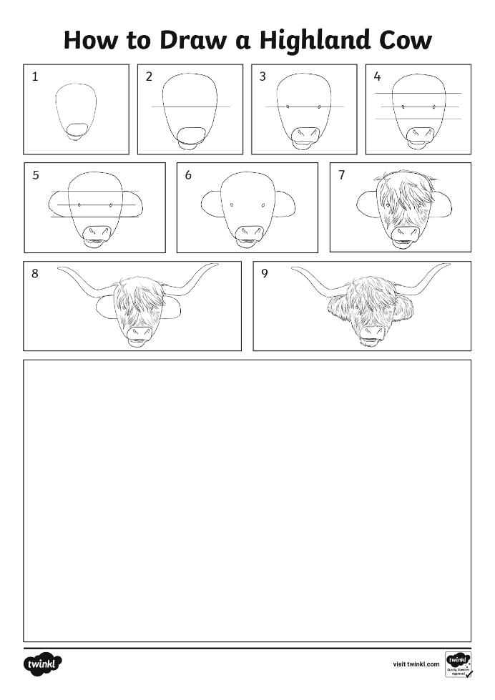
Create Your Own McCoo
You are going to create your own highland cow in the style of Steven Brown.
You will need:
a sheet of dark paper;
seven brightly coloured oil pastels;
‘How to Draw a Highland Cow’ worksheet.

Slide 4
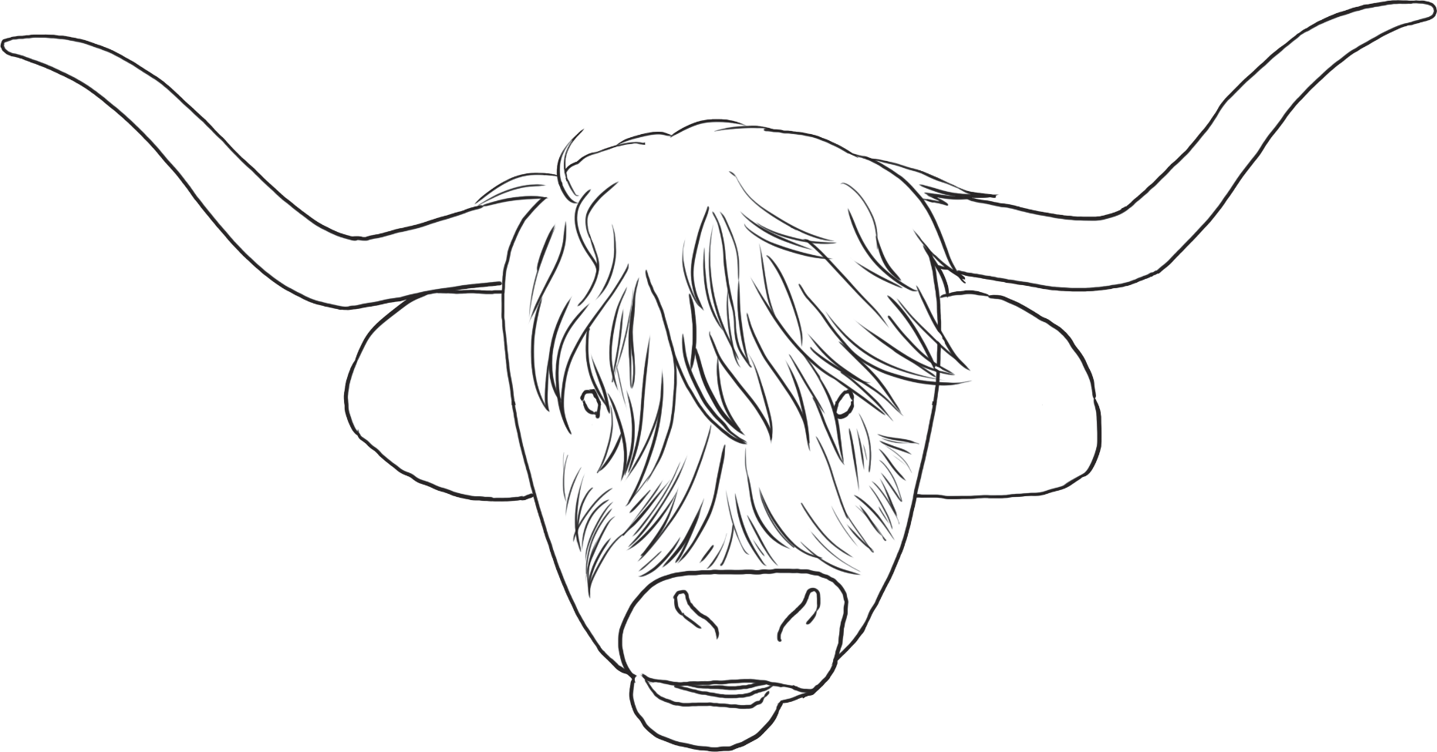
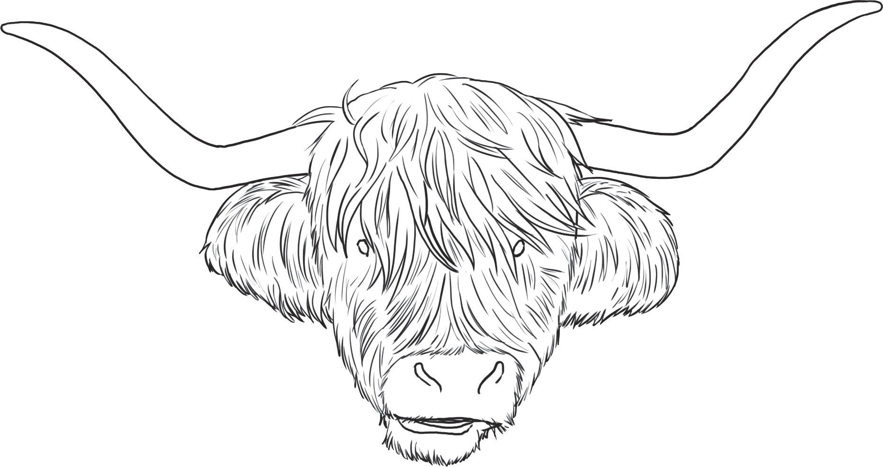
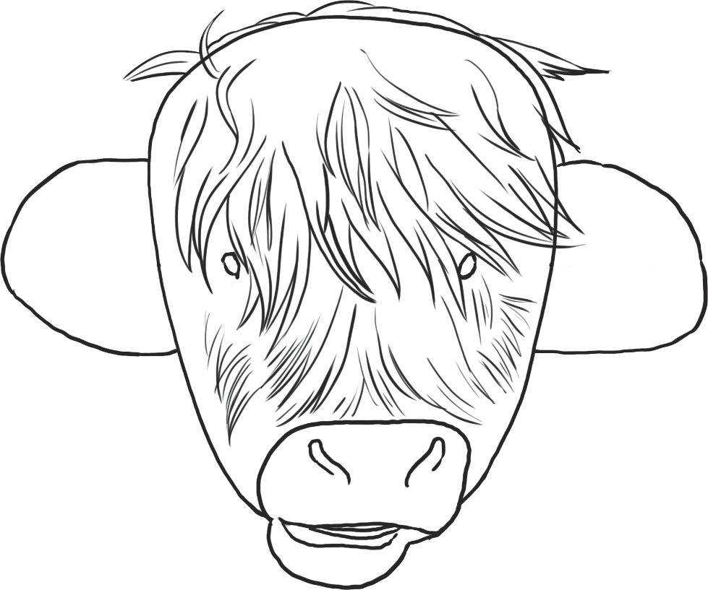
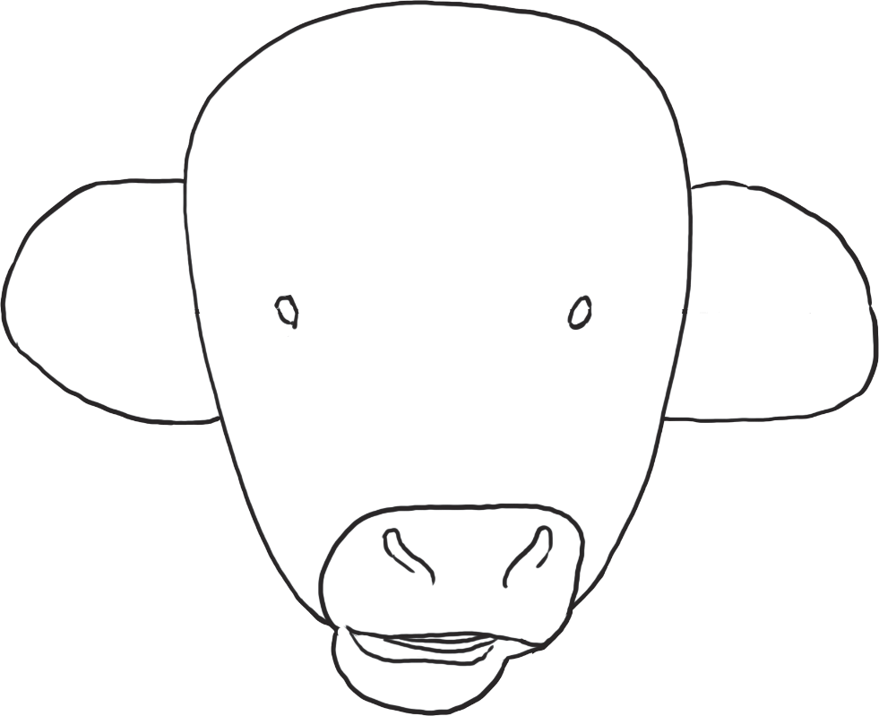
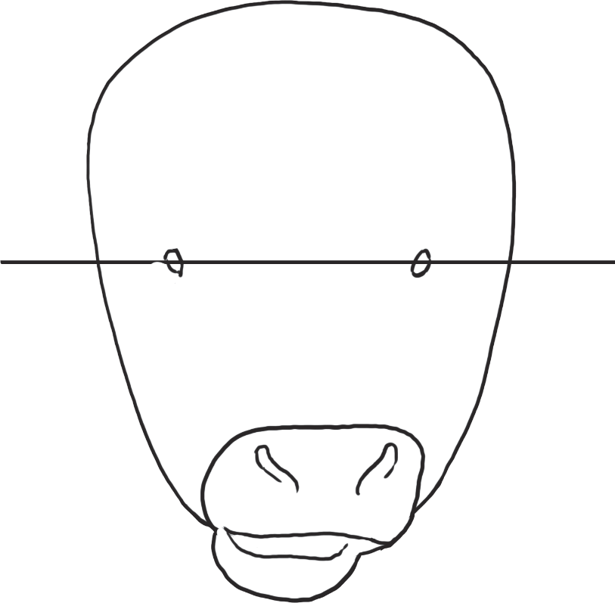
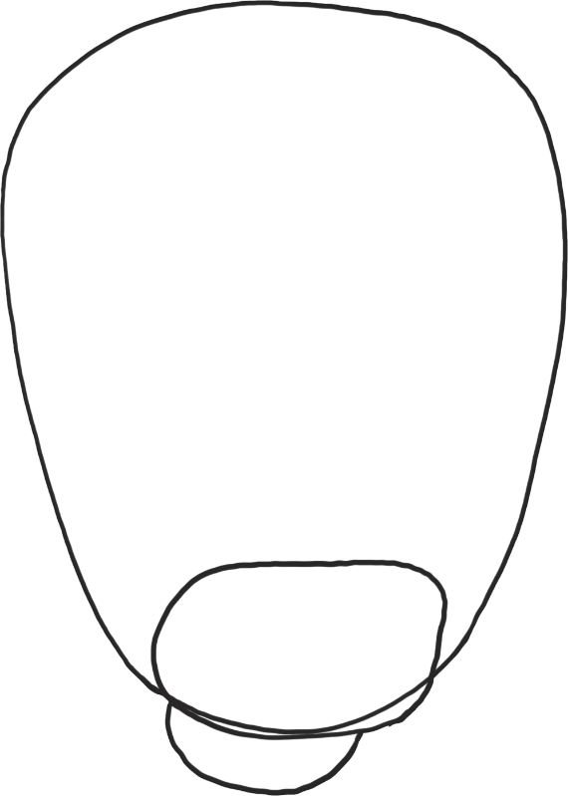
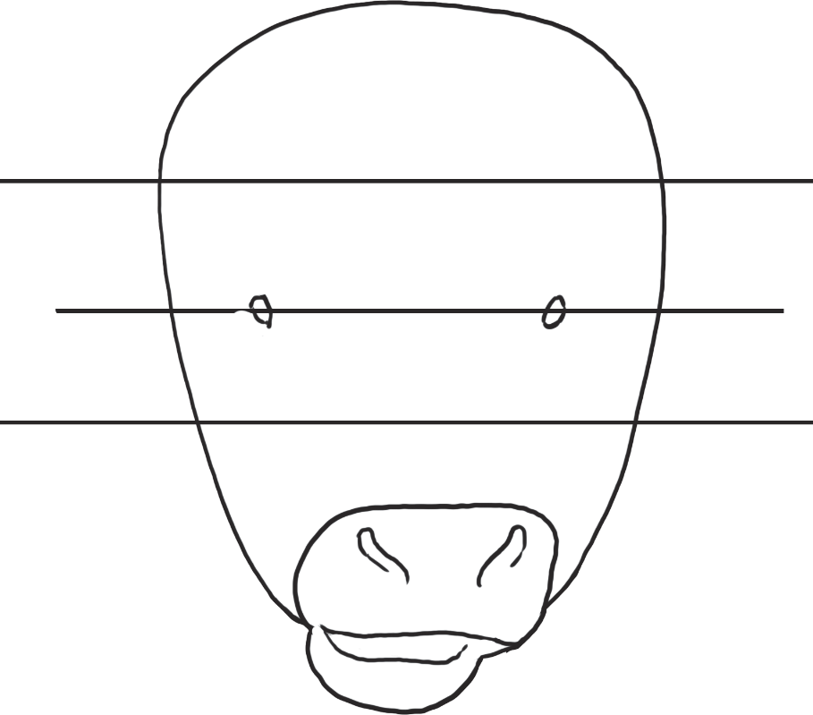
Highland Cow Step-By-Step
First, using an oil pastel and the ‘How to Draw a Highland Cow’ worksheet, sketch the outline of a highland cow.

Slide 5
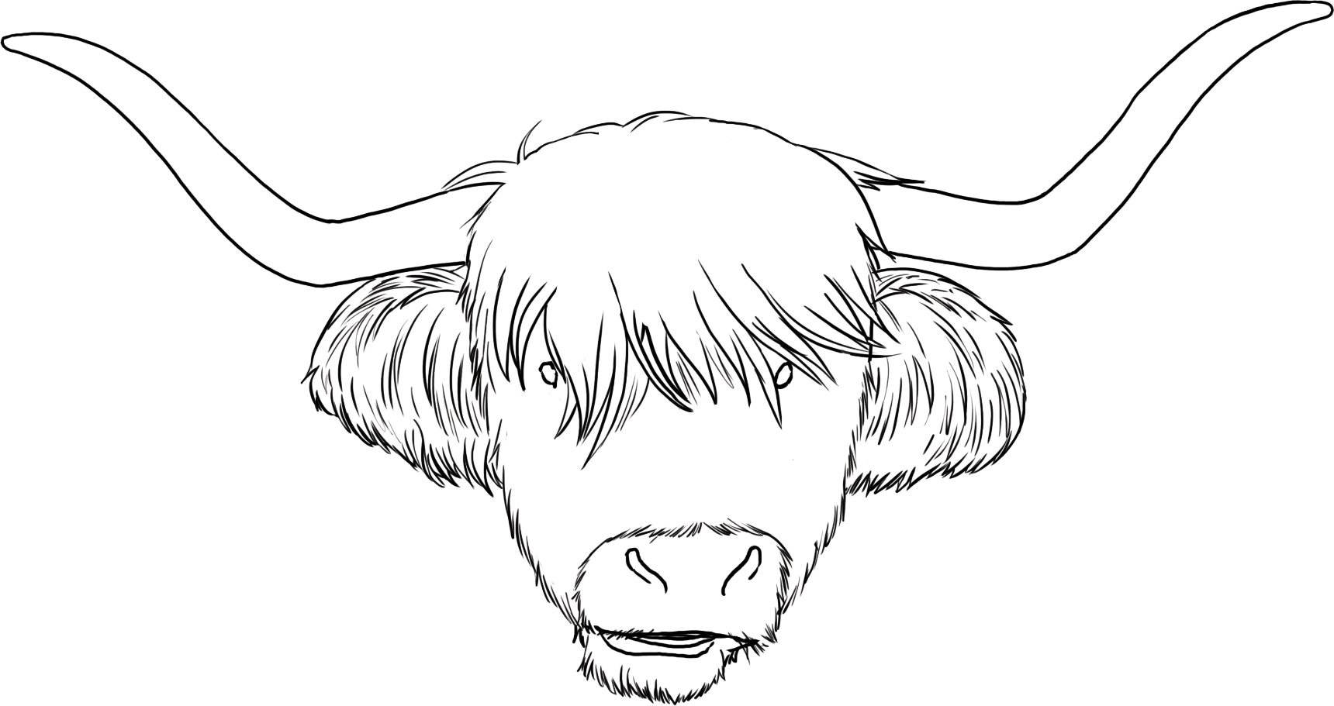
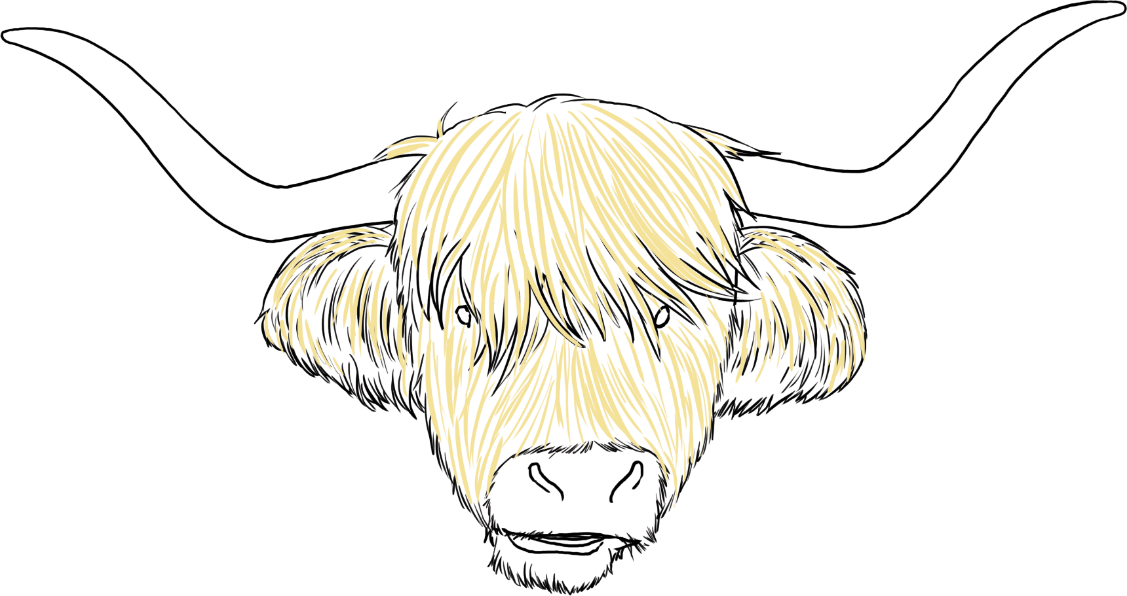
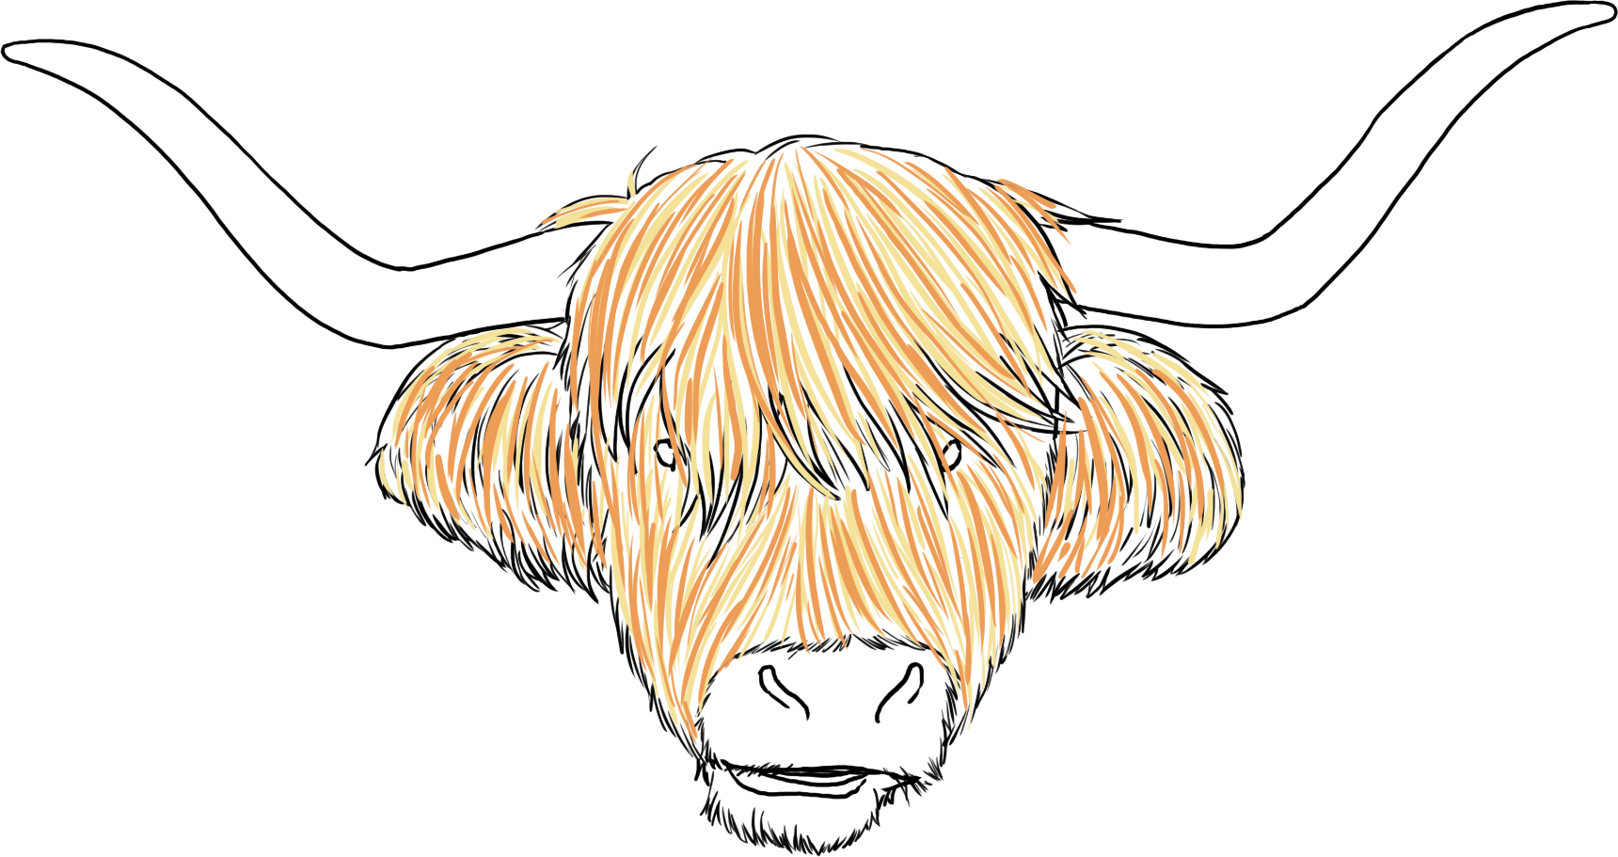
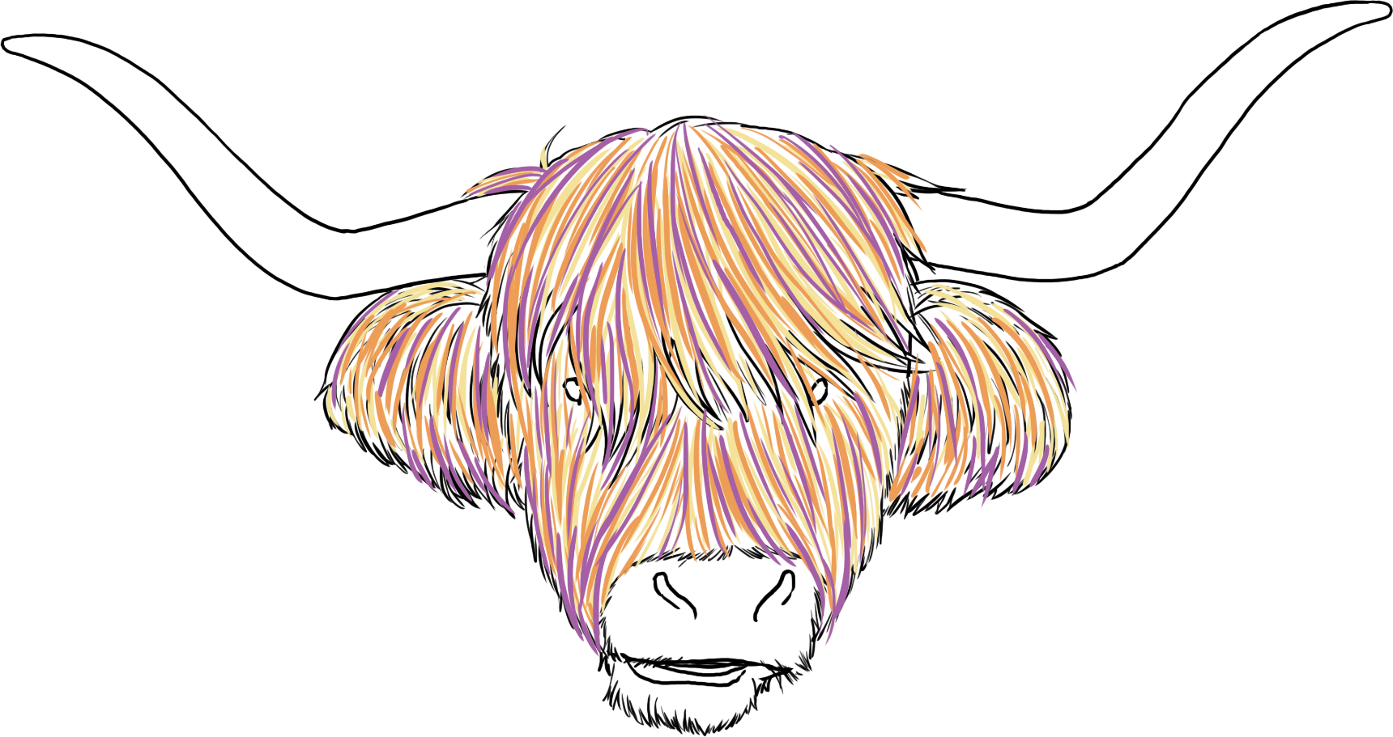
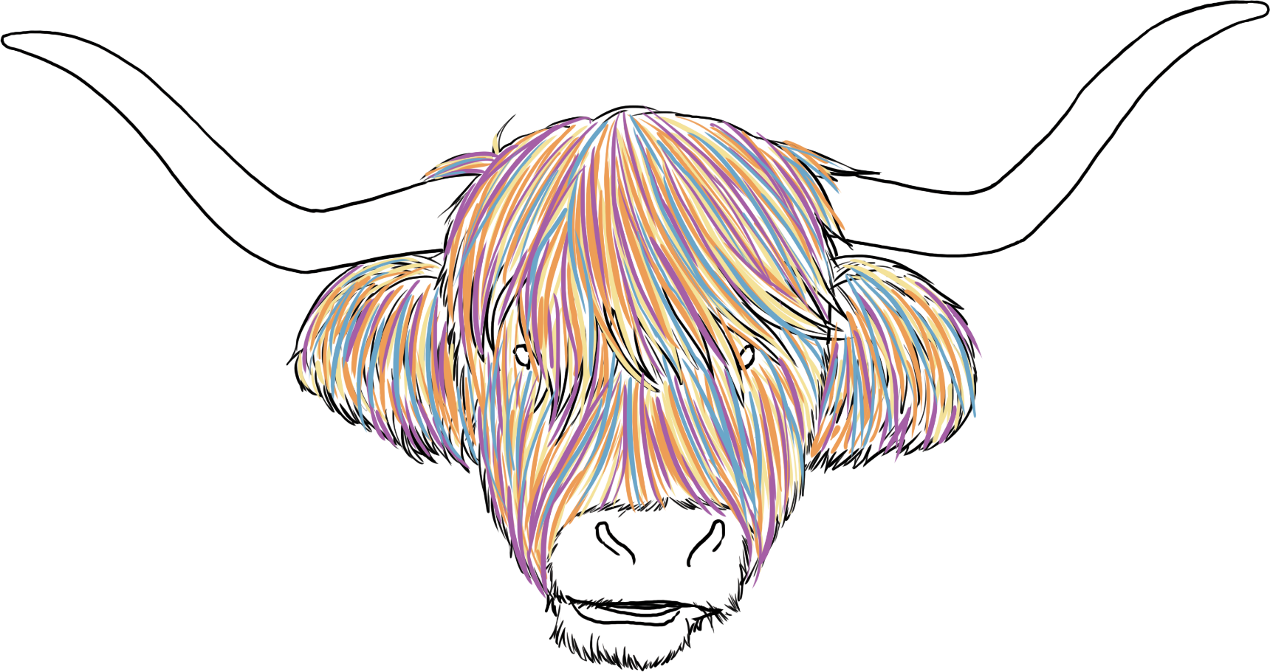
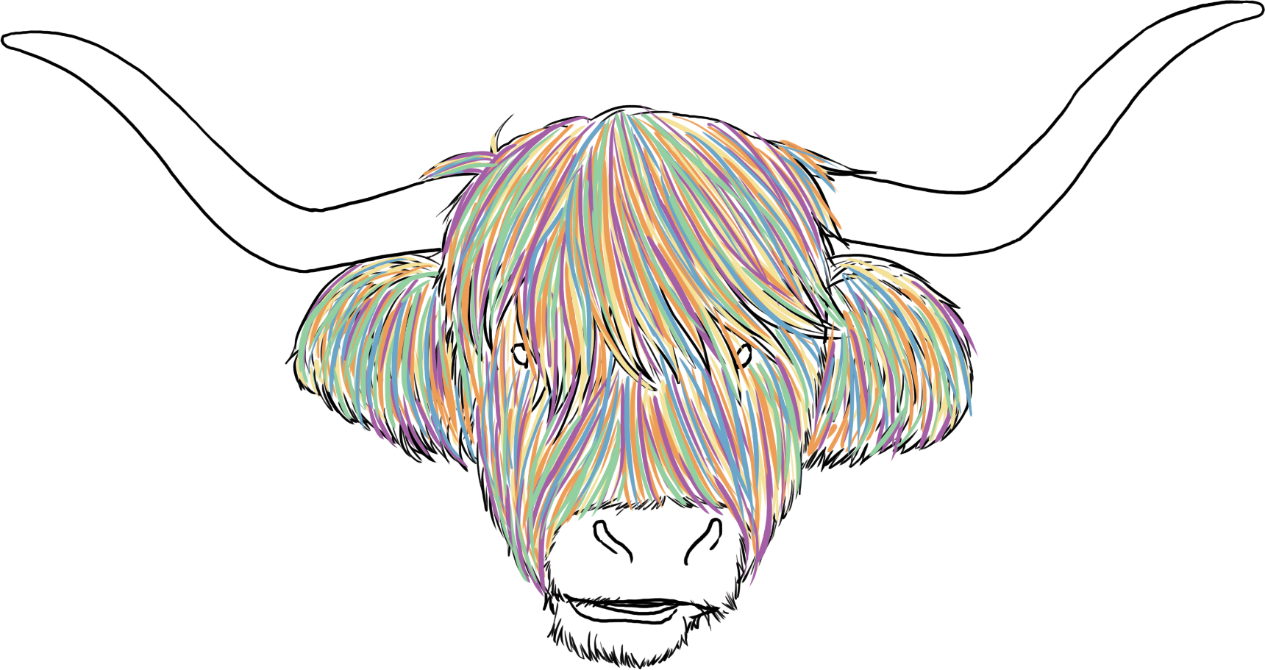
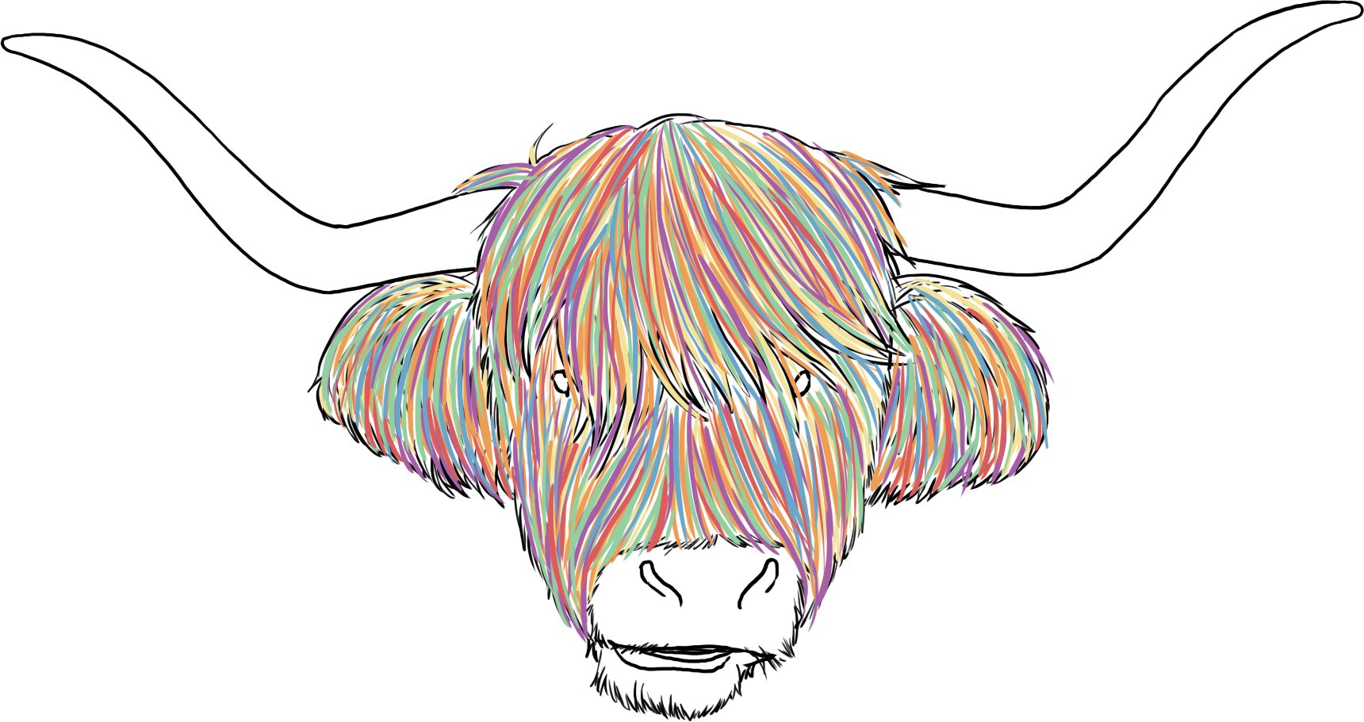
Over to You
Next, using one oil pastel at a time, you are going to draw a series of lines. The lines represent the highland cow’s shaggy hair.
Try to keep the thickness of your lines the same but avoid drawing them as straight lines.

Slide 6
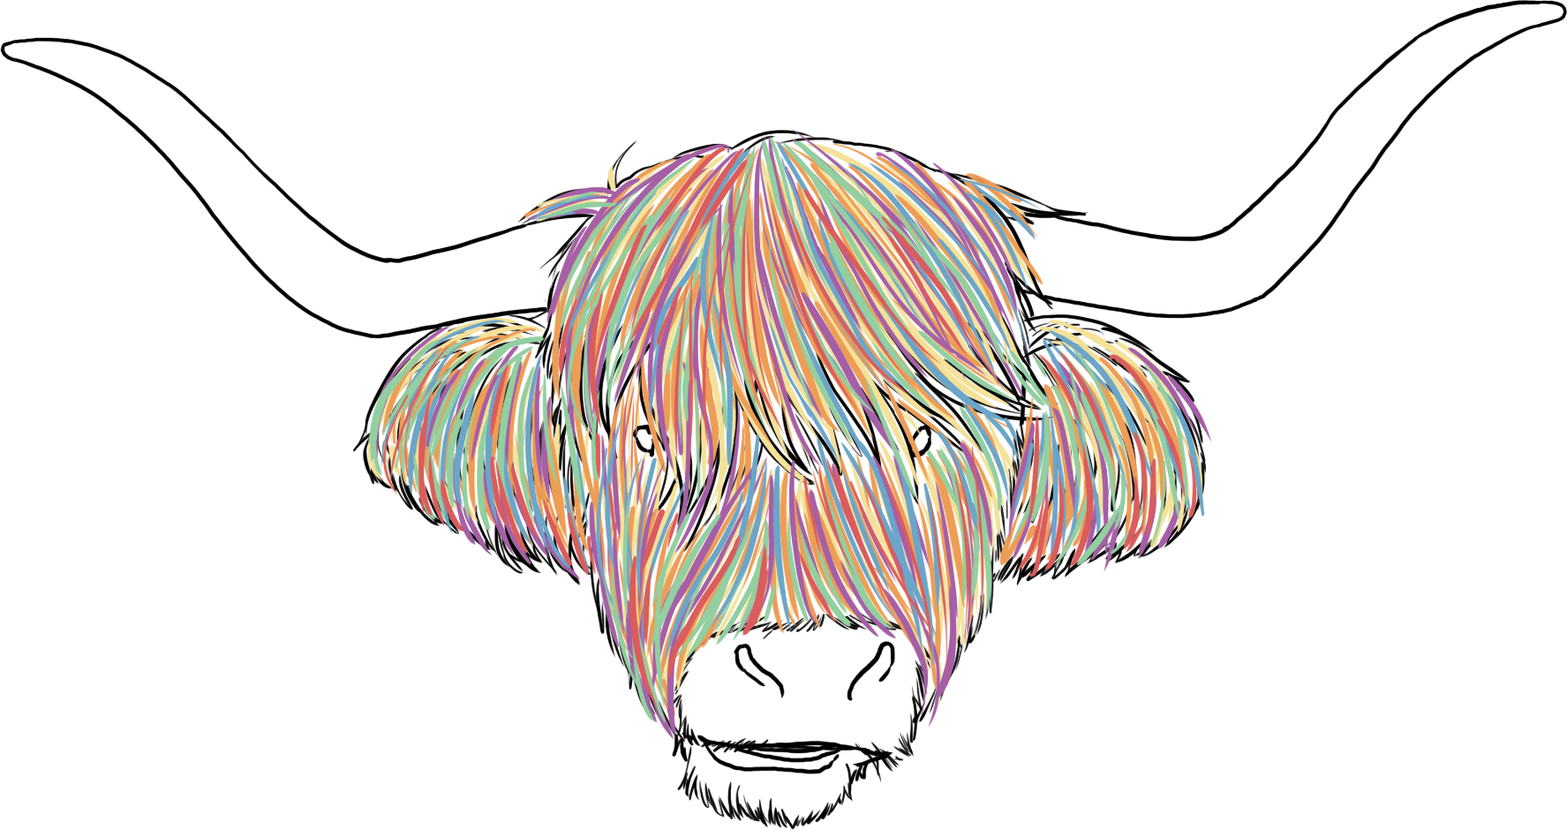
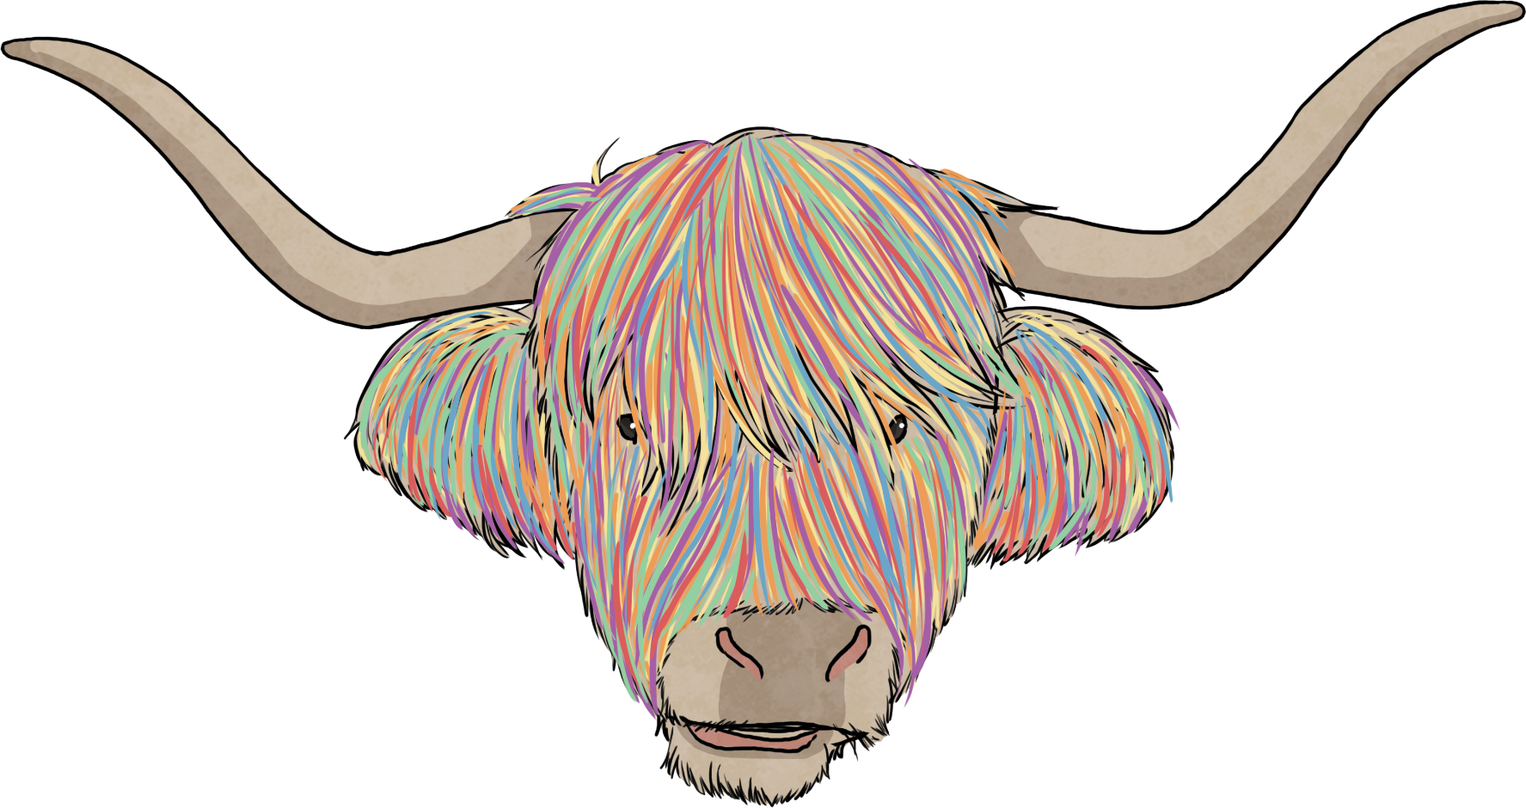
Over to You
Next, choose a neutral colour for the horns and nose.

