Slide 2
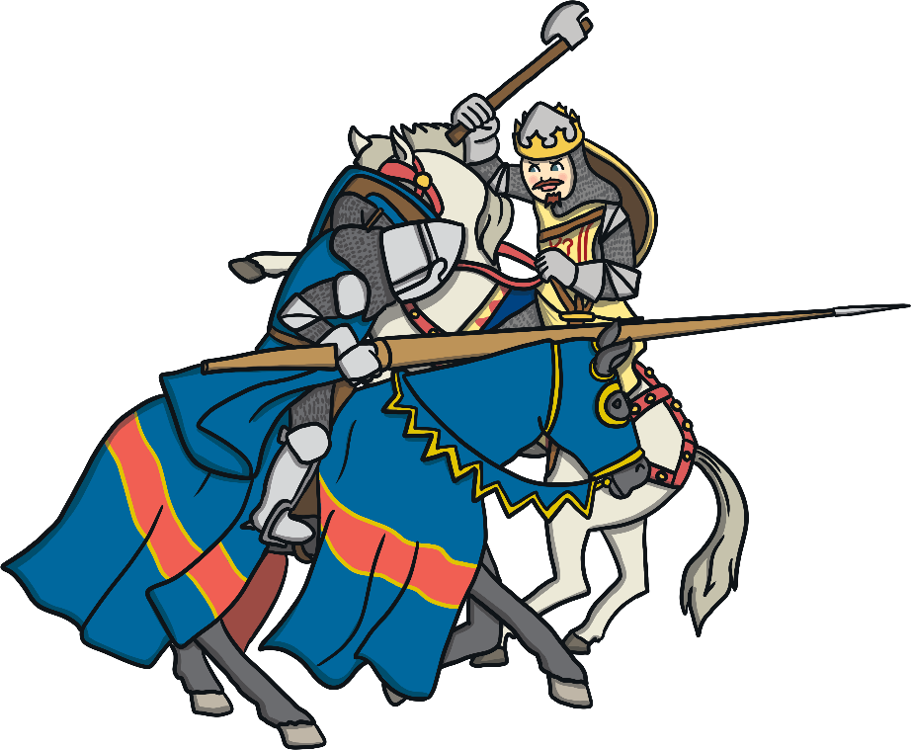
1314
Scotland began to regain independence in 1314 when the Scots defeated the English at the Battle of Bannockburn.

Slide 3
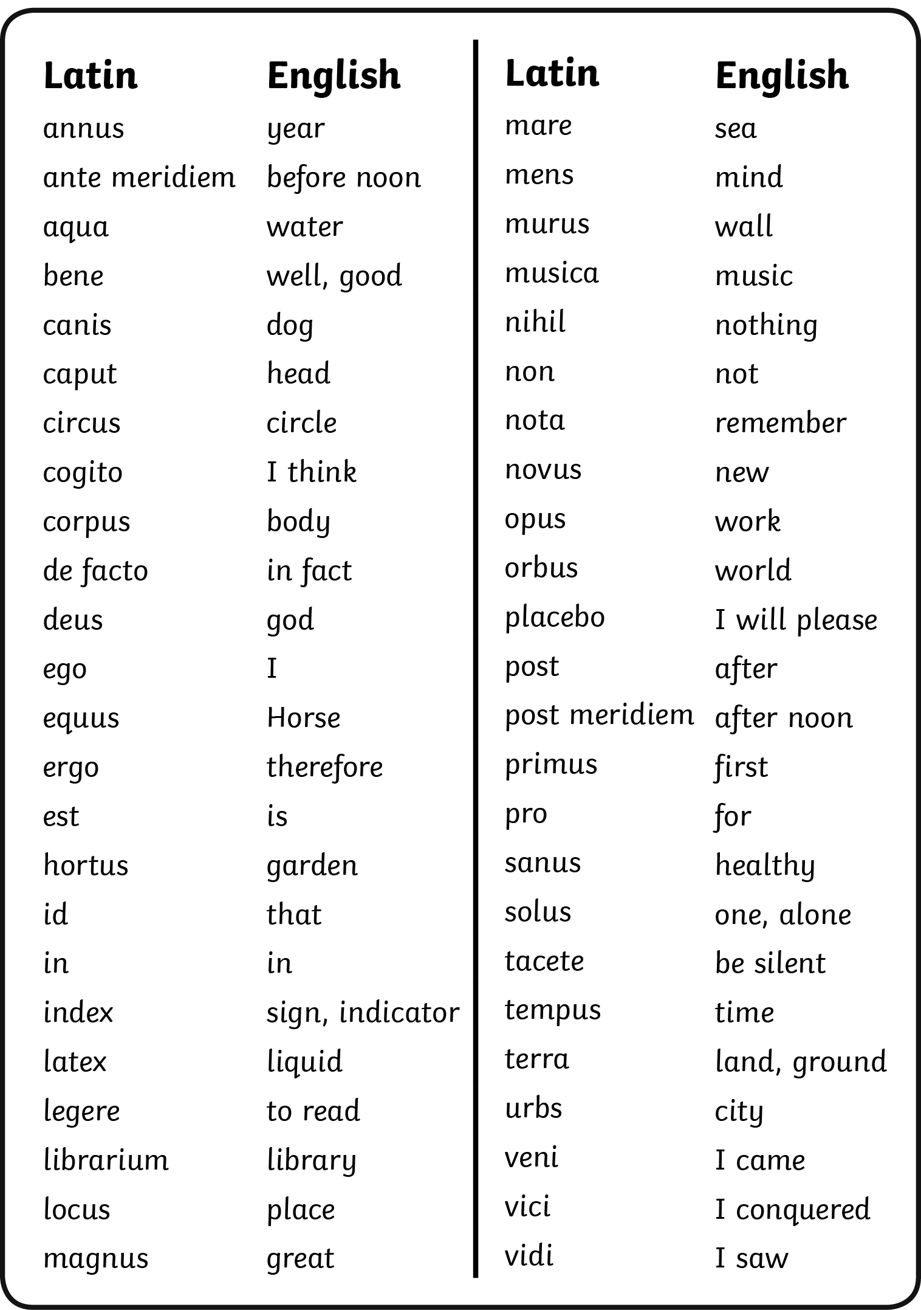
Can you create a phrase in Latin? Ask a partner to work out what it means.
Once Scotland had regained freedom, the Declaration of Arbroath began to be created, most likely by Bernard, Abbot of Arbroath.
It is written in Latin. Here are some Latin words and their meanings.
What does this phrase mean: Sum sanus ante meridiem.
I am healthy before noon.

Slide 4
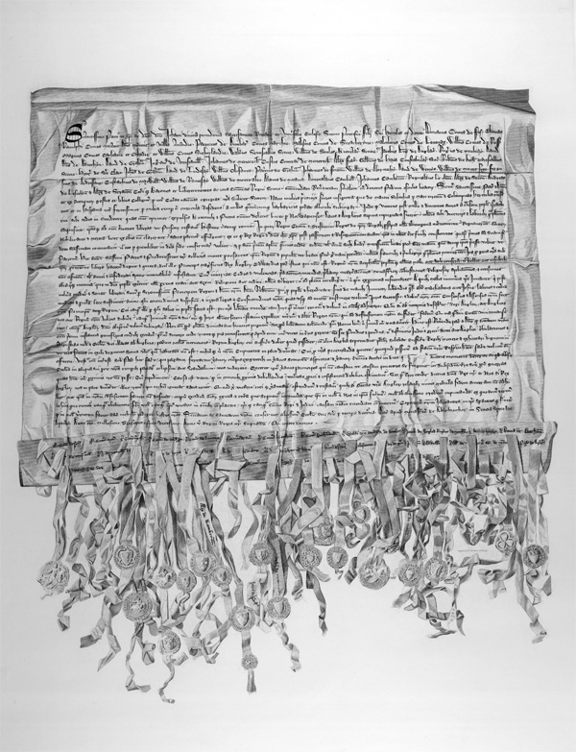
What was the Declaration of Arbroath?
The Declaration of Arbroath was a letter sent to the Pope in April 1320, written by the Earls and Barons of Scotland asking him to recognise Robert the Bruce as Scotland’s King and to recognise Scotland as an independent country.

Slide 5
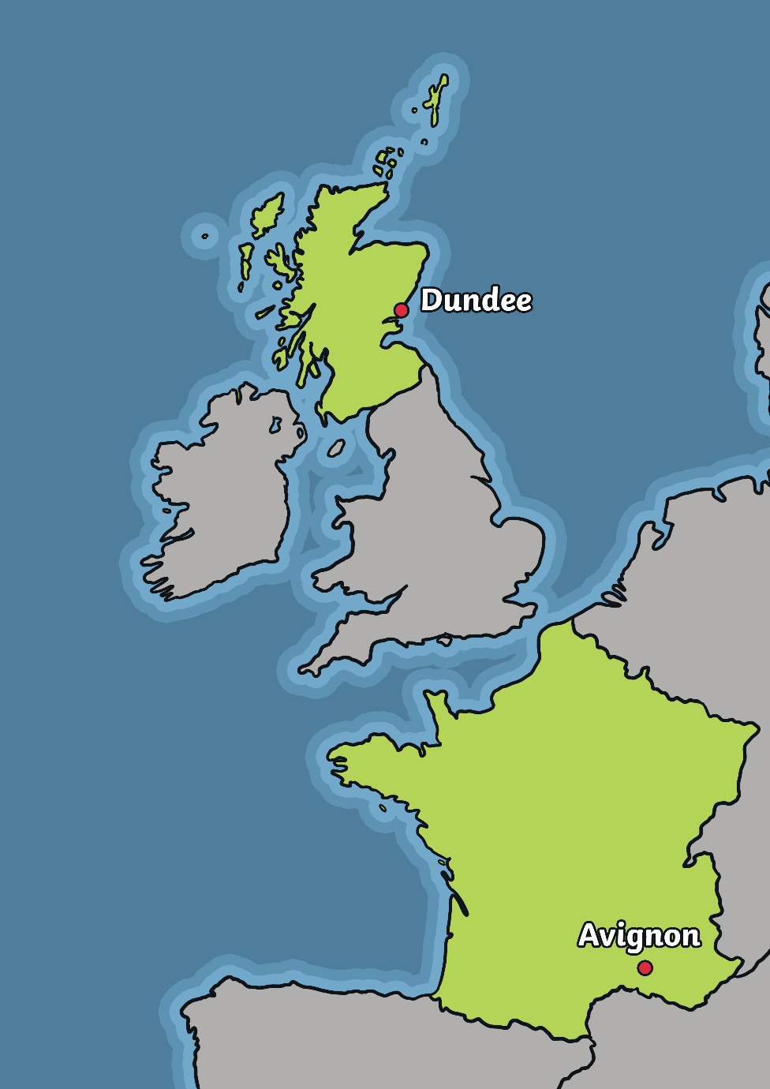
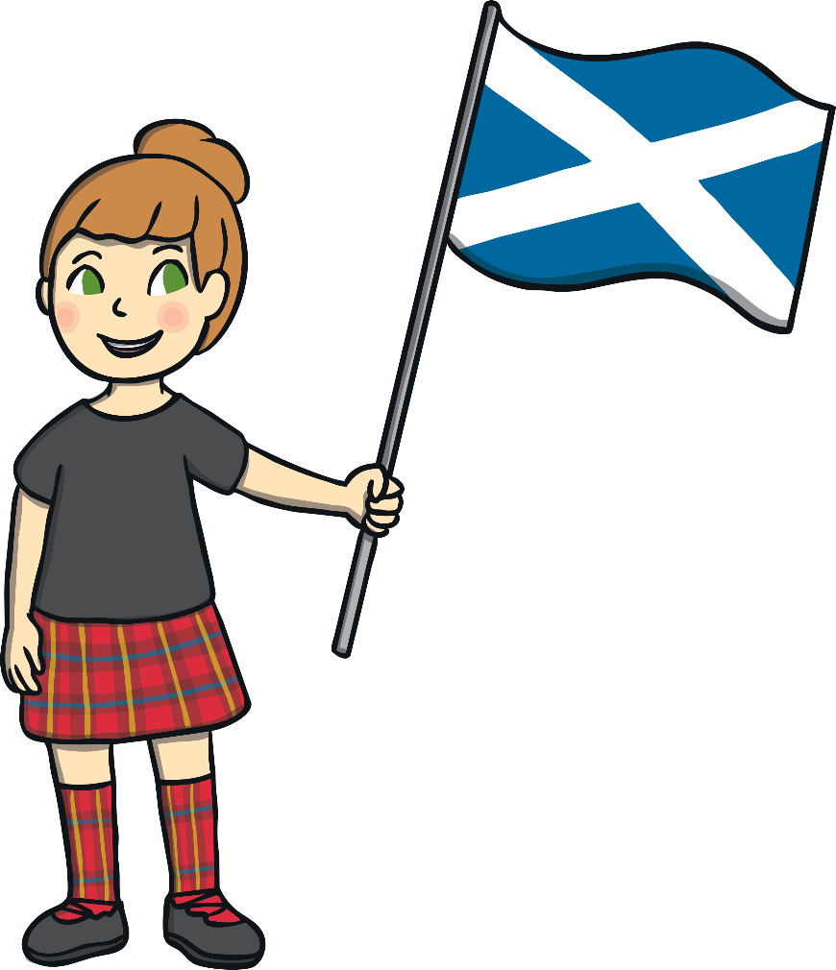
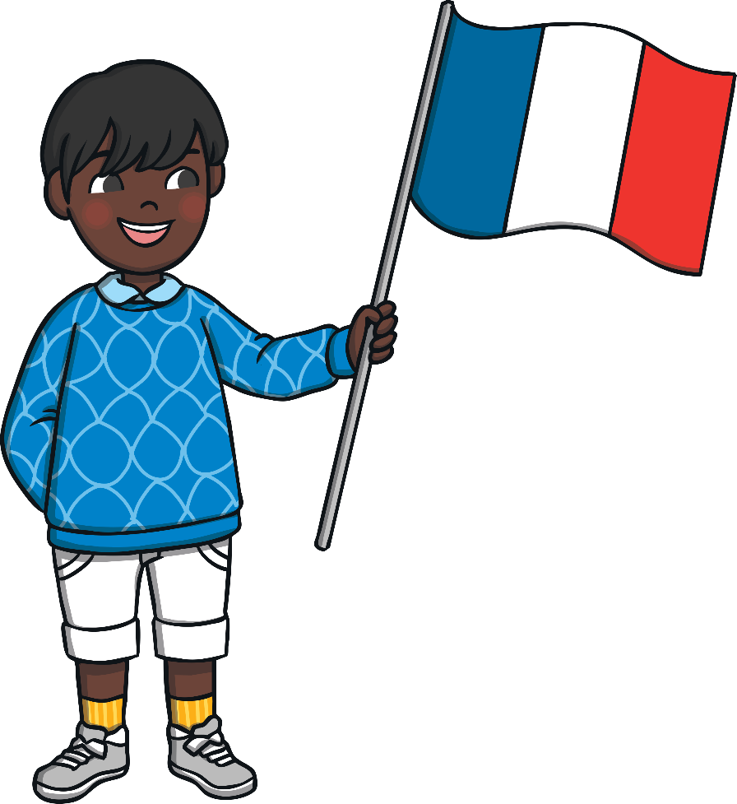

Slide 6
"As long as but a hundred of us remain alive, never will we on any conditions be brought under English rule. It is in truth not for glory, nor riches, nor honours, that we are fighting, but for freedom - for that alone, which no honest man gives up but with life itself"
What do you think it means?
This is one of the most famous quotes from the Declaration of Arbroath.

Slide 7
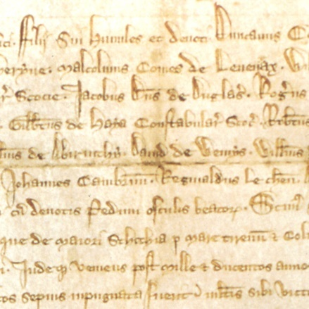
Create a Declaration of Arbroath using this famous quote.
Try creating tea-stained paper to write on.
Can you write the words in a similar font as the real declaration?
You could use scissors to create a ragged edge around your paper to make it appear old.

Slide 8
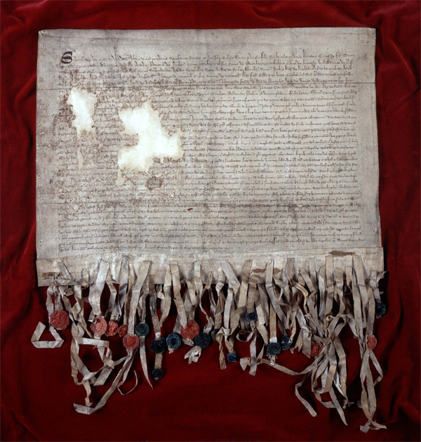
Create your own seal that you could use on important documents.
Try carving into a potato or sponge to create a stamper. Dip it in paint, then use it to seal a ‘document’.
Cut out your design from foam and attach it onto the end of an empty toilet roll. Hold the toilet roll and dip the foam into paint, then use it to seal a ‘document’.
Can you think of another way to create your own seal?

Slide 9
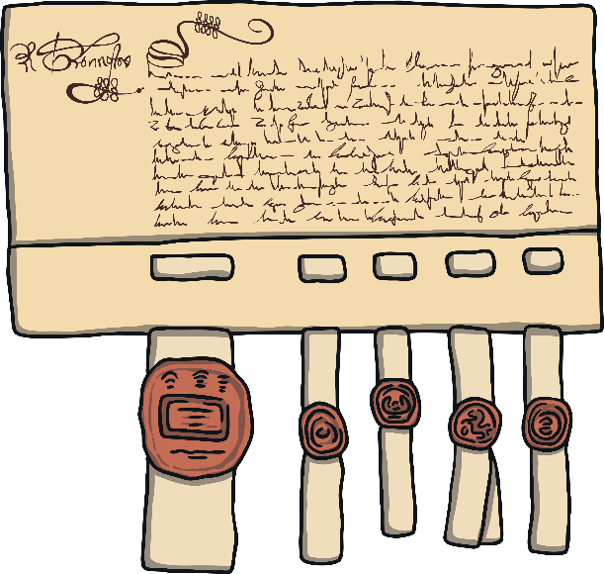
Who Supported the Declaration of Arbroath?
Documents never used to be signed like they are today. Instead, they were sealed. This was when someone would use a stamp to make an impression of their coat of arms or emblem onto a document.
The Declaration of Arbroath was sealed by eight Earls and around 40 barons. This showed their support of Robert the Bruce being King and of Scotland being an independent country.

Slide 10
The Response
The Pope then wrote to King Edward the Second, urging him to make peace with Scotland and Robert the Bruce.
In 1328, the English and Scottish Kings signed a peace treaty called The Treaty of Edinburgh-Northampton.
This made it official that Scotland was an independent country and that is was ruled by Robert the Bruce.

Slide 11
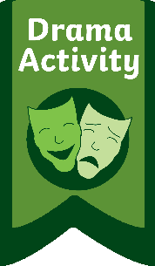
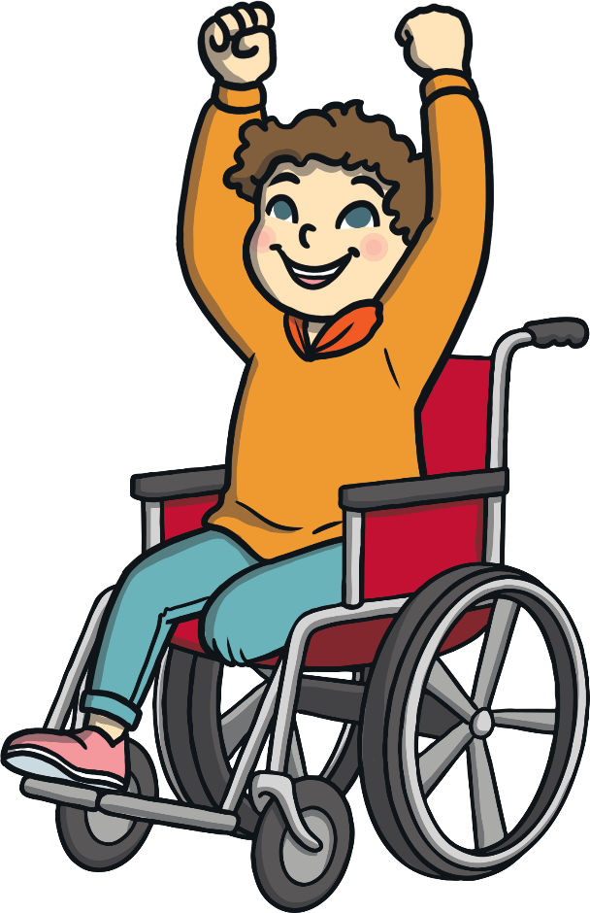
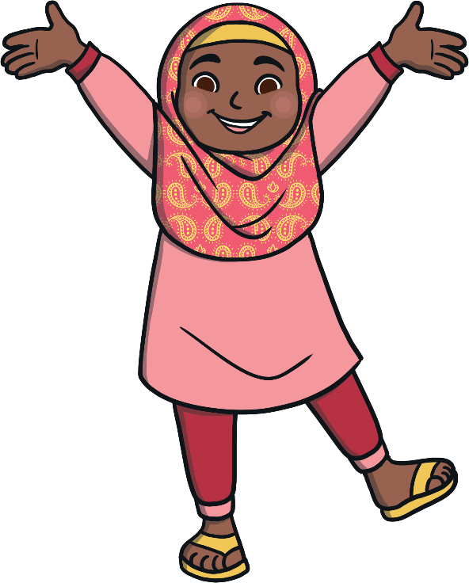
The Response
Some Scottish people may have celebrated when The Treaty of Edinburgh-Northampton was signed.
Act out the different reactions people might have had when they heard about the Treaty.
Think about how people might have received this news in 1328.

Slide 12
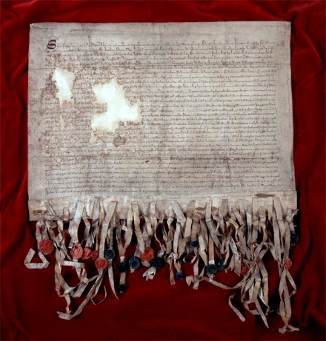
What Is the Declaration Like Now?
The original Declaration was sent to the Pope in 1320. Therefore, the one stored today is the medieval copy of the document. It was damaged during the 17th century when it was taken to Tyninghame while work was being completed on Edinburgh Castle. However, it has been preserved since 1320 and even has some of the original seals!
Here is what the Declaration looks like today.

