Slide 1
Art and Design
Nature Sculptures
Year One
Art and Design | KS1 | Nature Sculptures | Land Art | Lesson 4

Slide 3
Aim
I can make my own land art.
I can talk about the artist Andy Goldsworthy.
Success Criteria
I can choose natural materials for my land art sculpture.
I can choose how I want to arrange my sculpture.
I can arrange my materials carefully to make land art.
I can tell you an interesting fact about Andy Goldsworthy.
I can tell you something about Andy Goldsworthy’s nature sculptures.

Slide 4
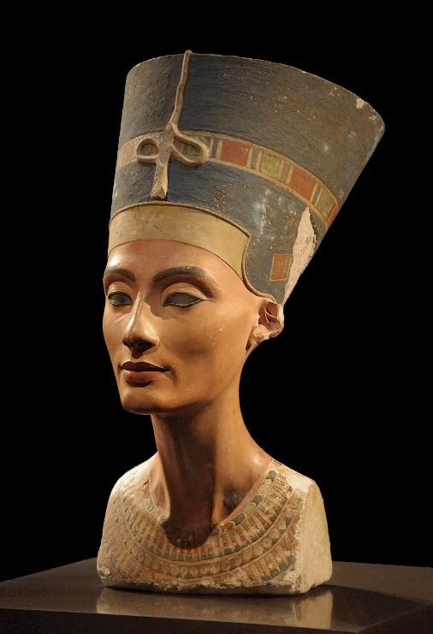
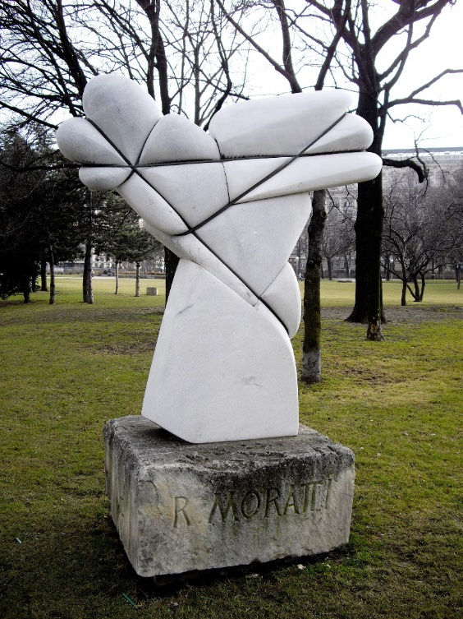
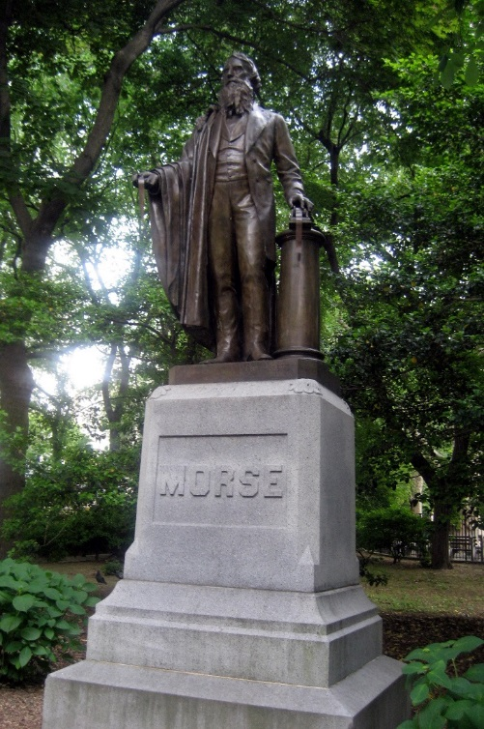
Sculpture
We have been learning about sculpture.
Photos courtesy of Philip Pikart, Rob Young (@Wikimedia.org) and Gennie Catastrophie, archer10 (Dennis) (@flickr.com) - granted under creative commons licence – attribution

Slide 5
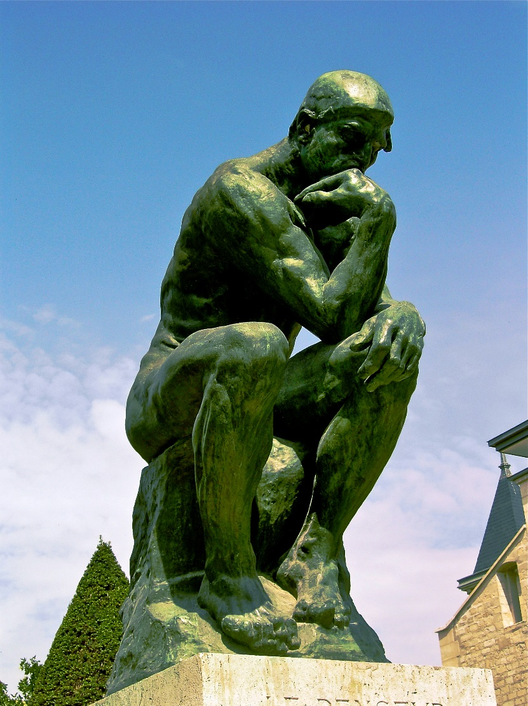
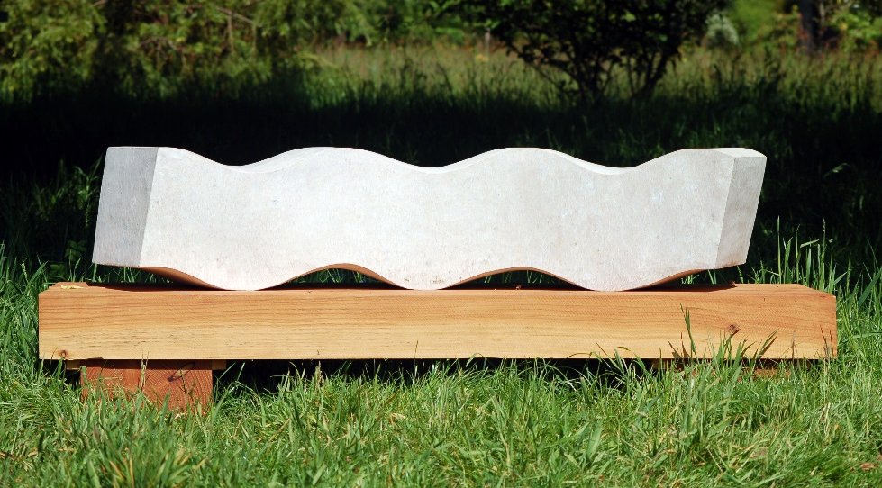
Sculpture
Sculptures are works of art.
Sculptures are 3-D models.
They are not flat like paintings and drawings.
Photo courtesy of archer10 (Dennis) (@flickr.com) - granted under creative commons licence - attribution

Slide 6
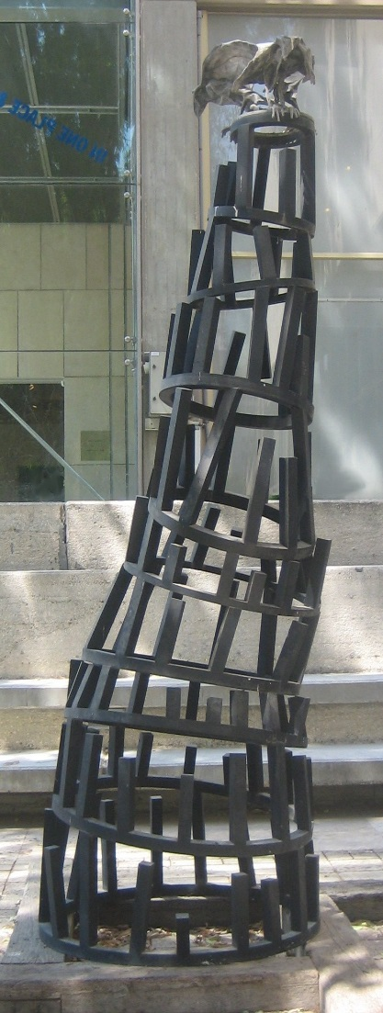
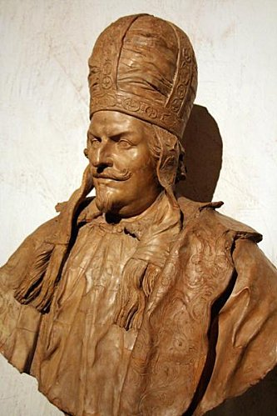
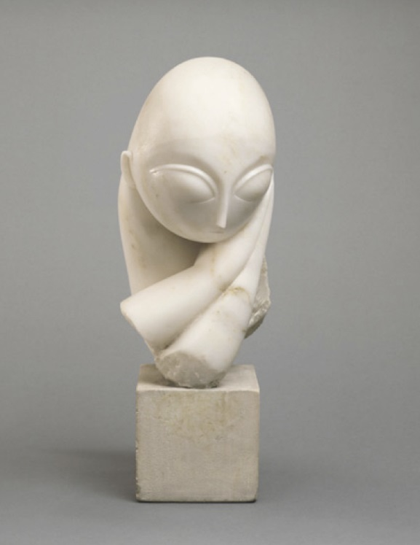
Materials
Most sculptures are made of metal, clay or stone.

Slide 7
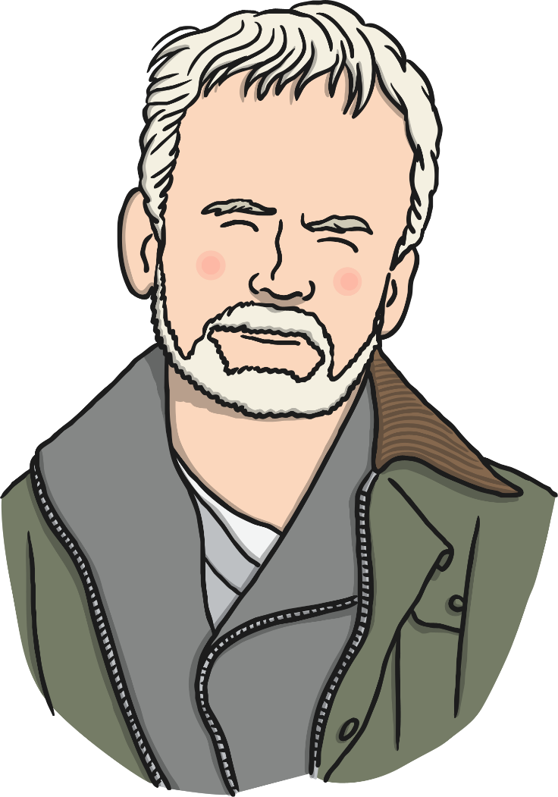
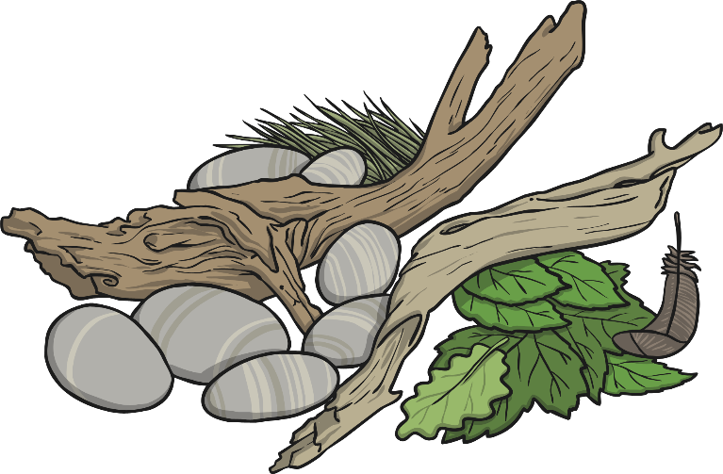
Andy Goldsworthy
Andy Goldsworthy is an artist who makes sculptures from natural materials like rock, sticks and leaves.

Slide 8
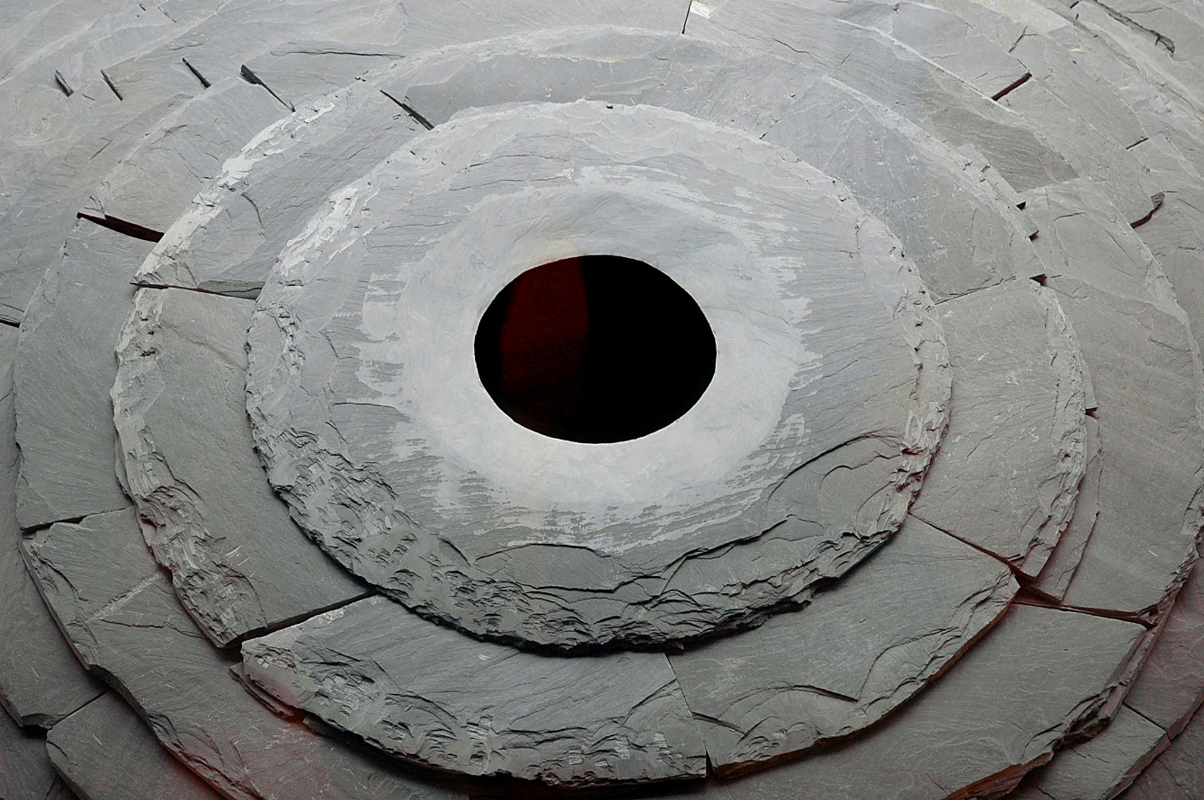
Andy Goldsworthy
This sculpture is made out of a rock called slate.
Roof, 2004 - 2005
Photo courtesy of Thom Watson (@flickr.com)-granted under creative commons licence- attribution

Slide 9
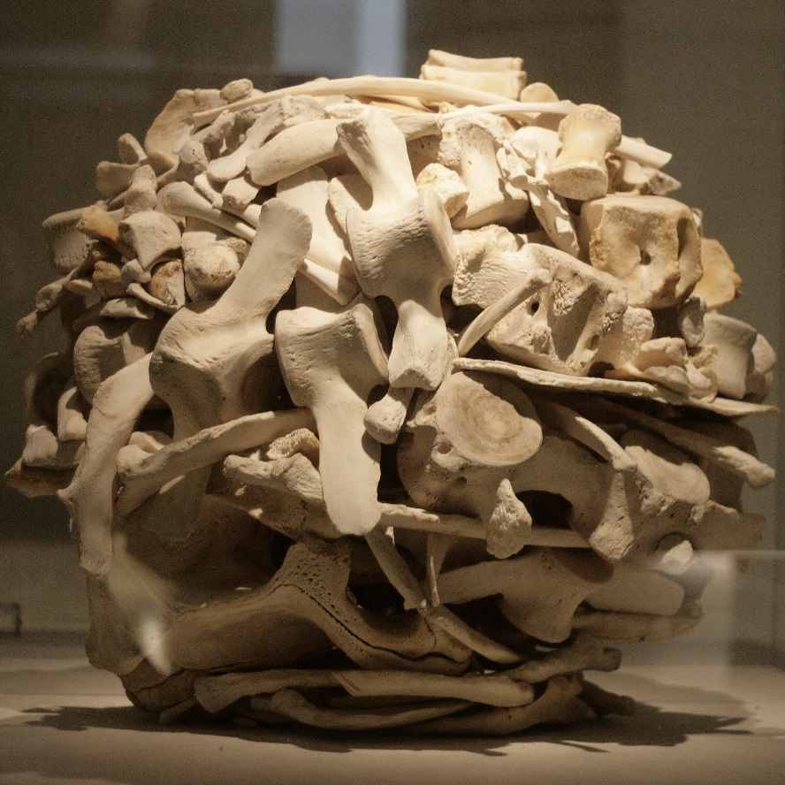
Andy Goldsworthy
This sculpture is made out of whale bones.
Stacked Whalebones, 2001

Slide 10
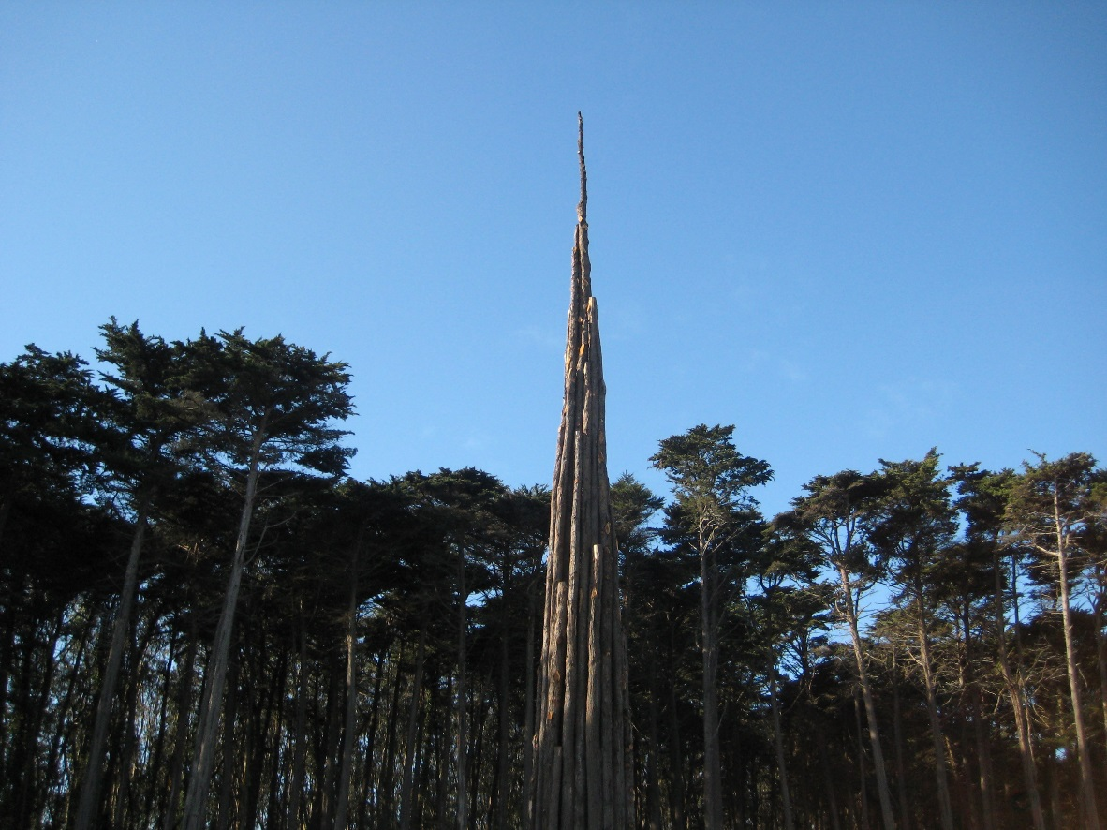
Andy Goldsworthy
This sculpture is made out of wood.
Spire, 2008
Photo courtesy of Moonlightbulb(@flickr.com)-granted under creative commons licence- attribution

Slide 11
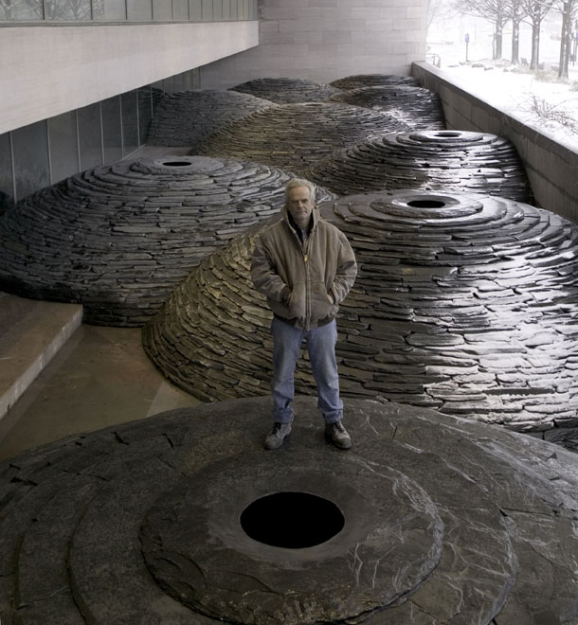
Land Art
Some of Andy Goldsworthy’s sculptures are in museums and galleries.
This is Andy Goldsworthy with one of his sculptures.

Slide 12
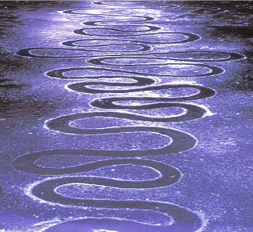
Land Art
Sometimes, Andy Goldsworthy makes sculptures outside. Often these won’t last forever. The weather will wash them away. The natural material they are made from will become part of the landscape.
This is called Land Art.
Photo courtesy of Moonlightbulb(@flickr.com)-granted under creative commons licence- attribution

Slide 13
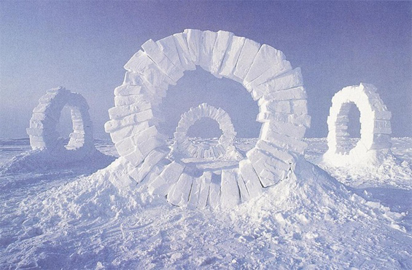
Land Art
Land art that only lasts a short time is called ephemeral art.
‘Ephemeral’ means lasting for a very short time.
Photo courtesy of Moonlightbulb(@flickr.com)-granted under creative commons licence- attribution

Slide 14
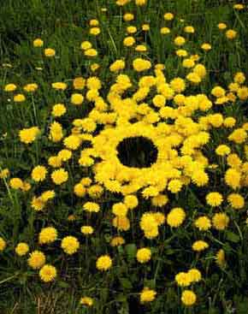
Land Art
What is this land art sculpture made from?

Slide 15
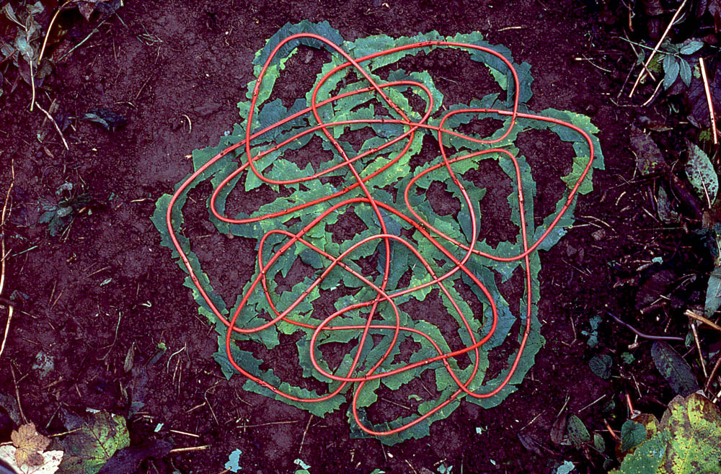
Land Art
What is this land art sculpture made from?

Slide 16
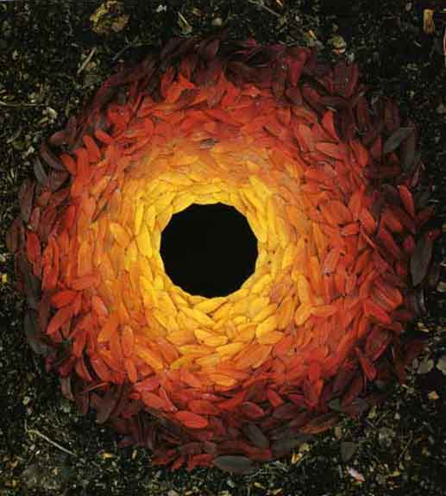
Land Art
What is this land art sculpture made from?

Slide 17
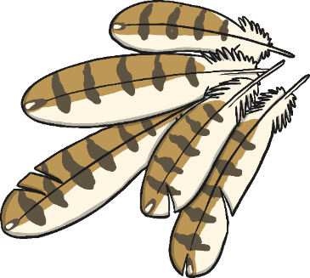
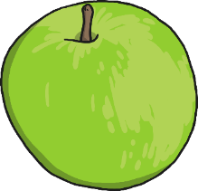
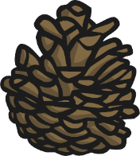
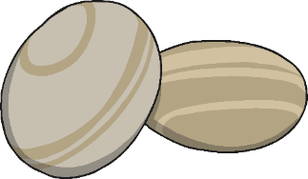
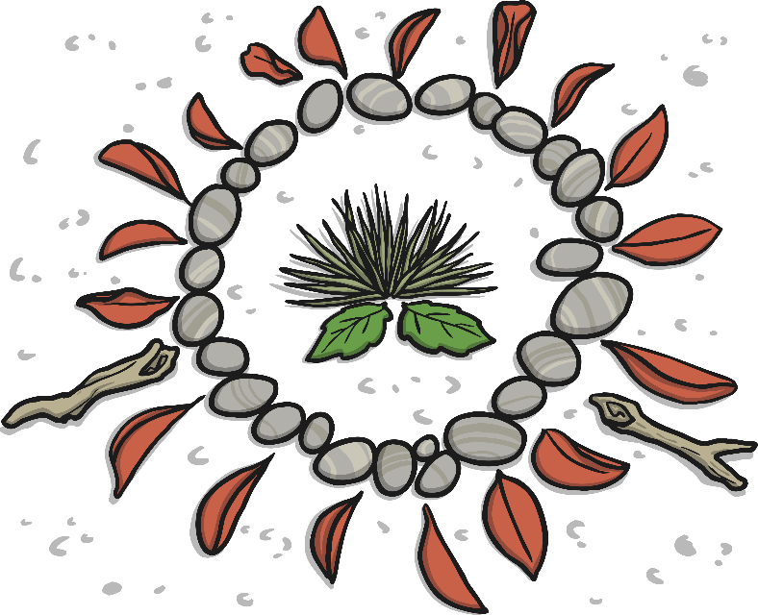
Land Art
We are going to use our natural materials to make land art sculptures like Andy Goldsworthy.

Slide 18
Land Art
This land art is made from pebbles.

Slide 19
Land Art
This land art is made from leaves and stones.

Slide 20
Land Art
This land art is made from leaves, twigs and pine cones.

Slide 21
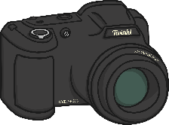
Making Land Art
You will need…
Working in pairs, you are going to use natural materials to make land art outside.
Arrange your materials to make a pattern or picture that you like. Think about the colours you are using. Think about the shape.
Use flour paste to stick your materials to the ground if it is windy.
When you are finished, take a photograph!
Your land art will last a little while and then it will wash away.
Natural materials
Flour paste
Camera

Slide 22
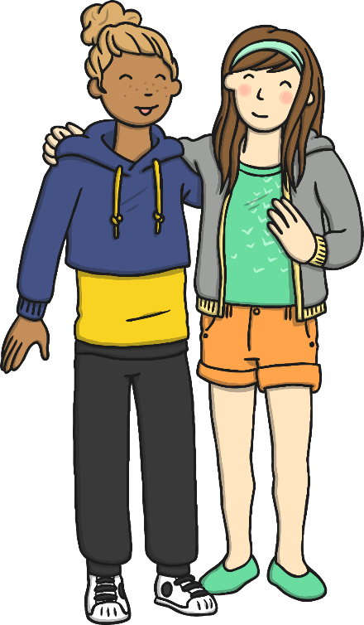
Share
In your pairs, take turns to tell another pair all about your land art.
What shape is it?
What colours did you use?
What materials was it made from?
How did you make it?
How could you improve it?
What do you like most about it?

Slide 23
Aim
I can make my own land art.
I can talk about the artist Andy Goldsworthy.
Success Criteria
I can choose natural materials for my land art sculpture.
I can choose how I want to arrange my sculpture.
I can arrange my materials carefully to make land art.
I can tell you an interesting fact about Andy Goldsworthy.
I can tell you something about Andy Goldsworthy’s nature sculptures.

