Slide 2
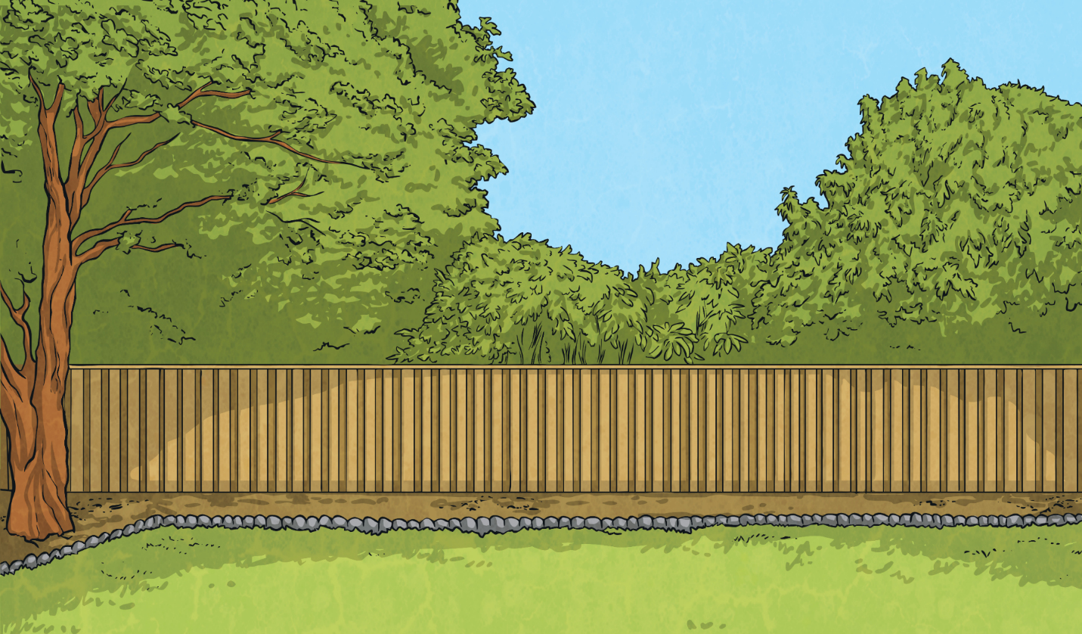
What is a Haiku?
A haiku is a traditional form of Japanese poetry. Haikus do not require a rhyming pattern but they do require a particular pattern of syllables.
俳句
Do you know what a syllable is?

Slide 3
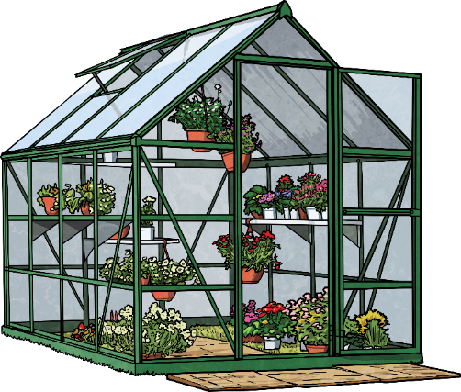
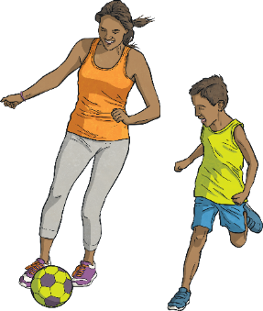
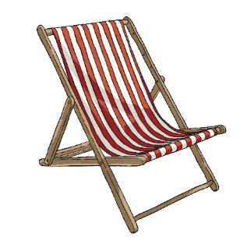
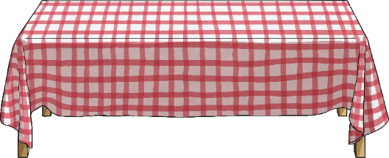
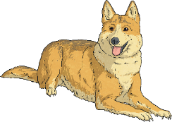
What is a Haiku?
Syllables are the separate beats/parts of words.
Can you work out how many syllables are in these words? Clap them out as you say them if it helps.
?
butterfly
candle
?
?
?
watermelon
ball

Slide 4
What is a Haiku?
Syllables are the separate beats/parts of words.
Can you work out how many syllables are in these words? Clap them out as you say them if it helps.
butterfly
The word ‘butterfly’ has three syllables.
?
candle
The word ‘candle’ has two syllables.
?
?
?
watermelon
ball
The word ‘watermelon’ has four syllables.
The word ‘ball’ has one syllable.

Slide 5
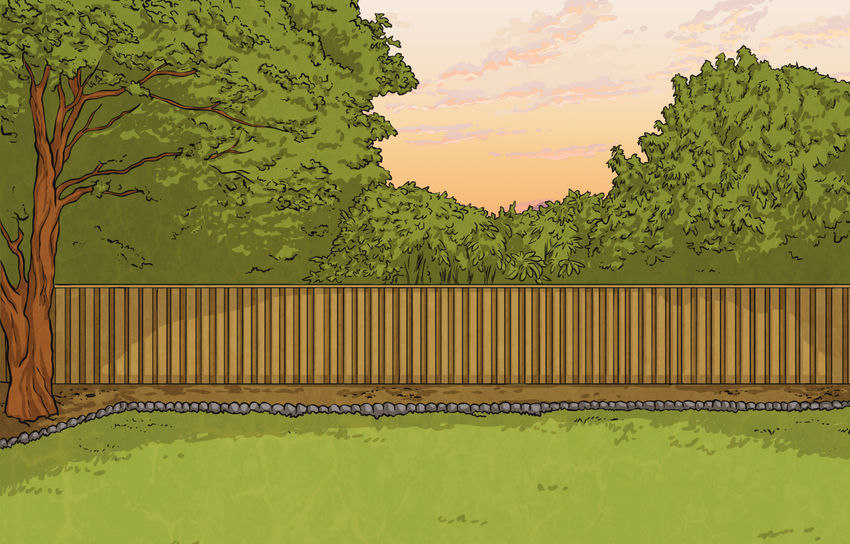
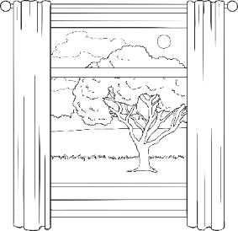
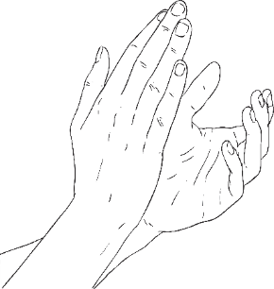
What is a Haiku?
Look at each of these lockdown haikus. Can you recognise a common syllable pattern within them both?
We are going to write haikus about our time during lockdown.
Together
Although apart now,
we are in this together;
never forget that.
Showing Our Thanks
We clap together,
with our neighbours and our friends,
thanking those who help.

Slide 6
What is a Haiku?
Look at each of these lockdown haikus. Can you recognise a common syllable pattern within them both?
We are going to write haikus about our time during lockdown.
Haikus always have three lines of poetry with:
七
五
五
7
5
5
syllables
syllables
syllables
Read each of the haikus again. This time, clap the syllable pattern as you read.

Slide 7
What is a Haiku?
Look at each of these lockdown haikus. Can you recognise a common syllable pattern within them both?
We are going to write haikus about our time during lockdown.
Together
Although apart now,
we are in this together;
never forget that.
Showing Our Thanks
We clap together,
with our neighbours and our friends,
thanking those who help.

Slide 8
Lockdown Haiku Examples
Read and discuss this lockdown haiku.
Keeping in Touch
Communicating
in high-tech ways with loved ones
so our world can heal.
Does it have a 5-7-5 syllable pattern?
What is the poem about?
How does it make you feel?

Slide 9
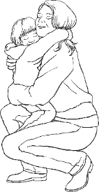
Lockdown Haiku Examples
Read and discuss this lockdown haiku.
Keeping in Touch
Communicating
in high-tech ways with loved ones
so our world can heal.
Family Time
Outside the window,
the world is silent; inside,
it’s full of laughter.
Does it have a 5-7-5 syllable pattern?
What is the poem about?
How does it make you feel?

Slide 10
Creating a Haiku
Rearrange these words to create a haiku about learning at home during school closures. You can write it in your green jotter
My
Teaching
closed
new
now
School
dad
is
is
my
today.
me
skills.
teacher!
五
七
五
Remember the 5-7-5 syllable pattern.
5
7
5
syllables
syllables
syllables

Slide 11
Creating a Haiku
Rearrange these words to create a haiku about learning at home during school closures.
My
Teaching
closed
new
now
School
dad
is
is
my
today.
me
skills.
teacher!
My
dad
is
now
my
teacher!
Here’s an idea to help you. Remember the 5-7-5 syllable pattern.
五
七
五
5
7
5
syllables
syllables
syllables

Slide 12
Creating a Haiku
Did you manage to rearrange the words so that it had the correct numbers of syllables to fit the 5-7-5 syllable pattern to make a haiku? You could have done it like this…
School
is
closed
today.
My
dad
is
now
my
teacher!
Teaching
me
new
skills.

Slide 13
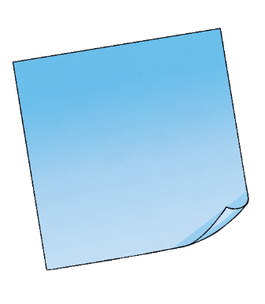
Planning a Haiku
Now, write your own haiku about your time in lockdown.
What could your haiku be about?
Here are some ideas:
fun times with the people that you live with
?
keeping in touch with friends and family
?
?
learning at home
your feelings and thoughts during lockdown
?
?
?
daily exercise
thanking key workers

Slide 14
Planning a Haiku
Now, write your own haiku about your time in lockdown.
What could your haiku be about?
Here are some ideas:
fun times with the people that you live with
keeping in touch with friends and family
learning at home
your feelings and thoughts during lockdown
daily exercise
thanking key workers

Slide 15
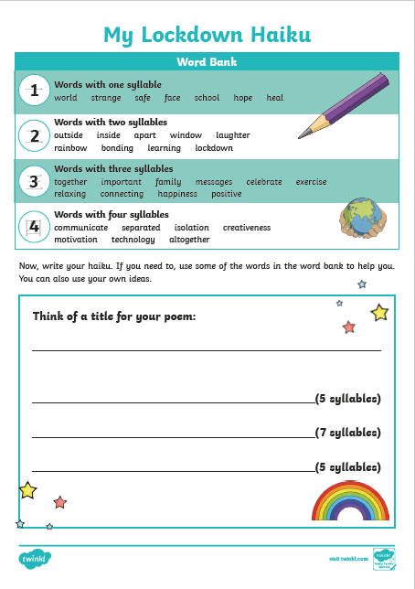
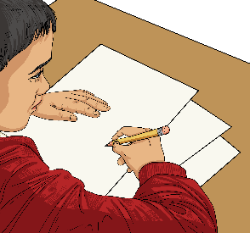
Writing a Haiku
Use our Lockdown Haiku Writing Frame to write and illustrate your haiku. You could even write a collection of haikus and perform them for the people you live with.

Slide 16
Writing a Haiku
Use our Lockdown Haiku Writing Frame to write and illustrate your haiku. You could even write a collection of haikus and perform them for the people you live with.
Try out some ideas. Clap the syllables of your haiku lines to check that you have the correct 5-7-5 pattern.

