Slide 1
Edinburgh castle
By rohan thomson

Slide 2
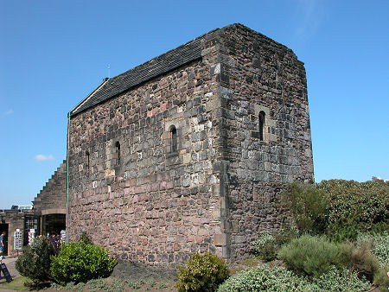
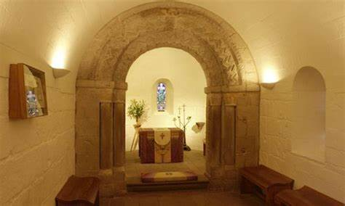
History of the castle
The castle is on castle rock.
It is made of volcanic rock from an extinct volcano.
People lived there for over 3000 years since the bronze age.
The oldest building today is St Margaret's chapel.

Slide 3
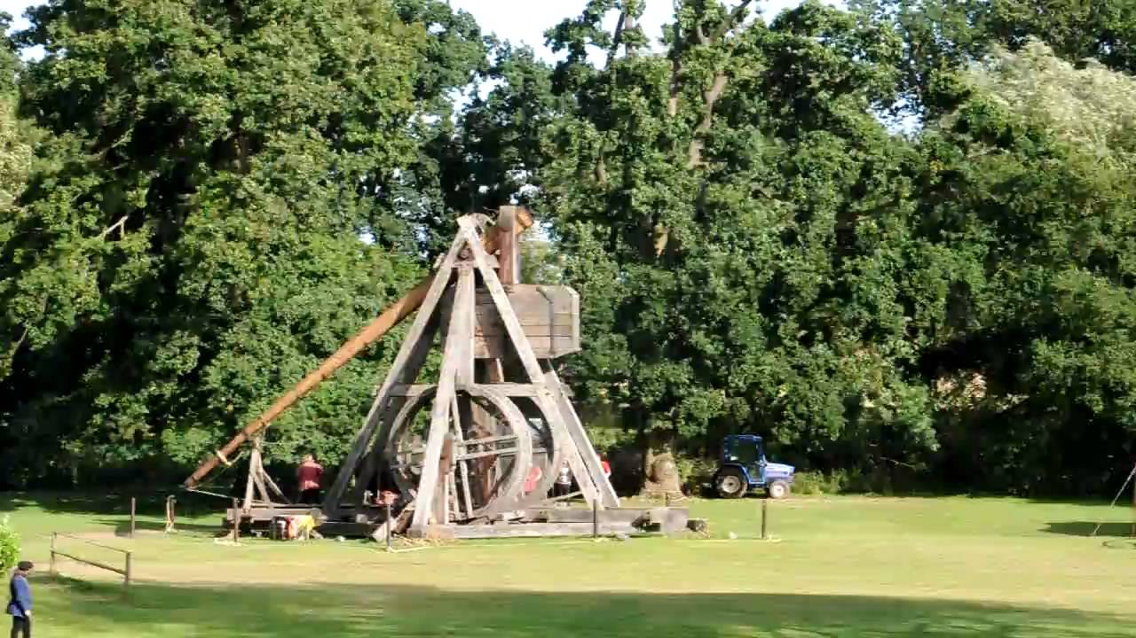
Slide two of the castle
It has been attacked 23 times.
By Scottish clans, English kings and in WW1.
Edward 1 used the war wolf to break the castle.
The Scottish took it back by climbing the rock.

Slide 4
Gun and bands
Every day they fire the one o’clock gun
Every year they throw the military tattoo

