Slide 2
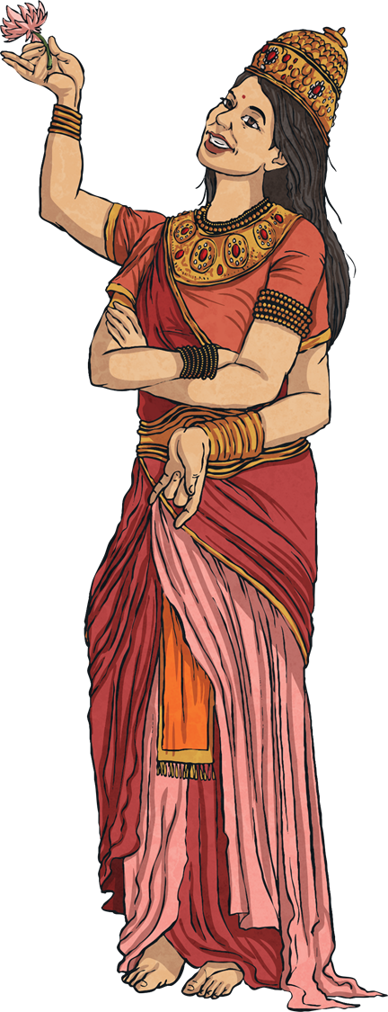
Symbolism
Symbolism is used in most religions. Here are a few Hindu symbols…
next

Slide 3
Lotus Flower
This is a very important symbol as Hindus believe that Brahma the Creator came from a lotus flower.
Despite growing in muddy waters, the lotus turns into a beautiful flower.
It represents how people should always be kind and good.
next

Slide 4
Hindu Swastika
The Swastika represents the sun god Syrya.
It represents how Hinduism is present in every aspect of your life.
What do you think the four spokes represent?
next

Slide 5
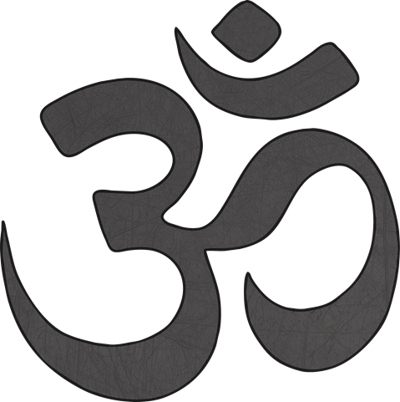
Aum
This is the most important symbol in Hinduism.
It represents Brahman and the universe.
It is pronounced ‘Ohm’.
next

Slide 6
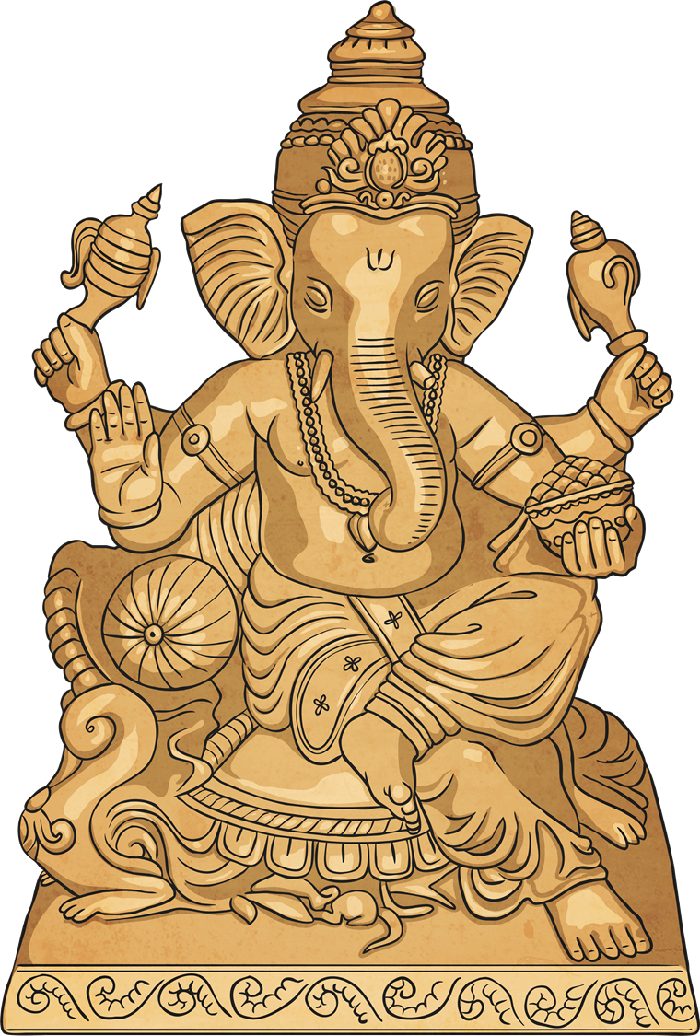
Your Task
Now design a symbol that represents you.

