Slide 2
Aim
L.I. To estimate the answer to a calculation and use inverse operations to check answers.

Slide 3
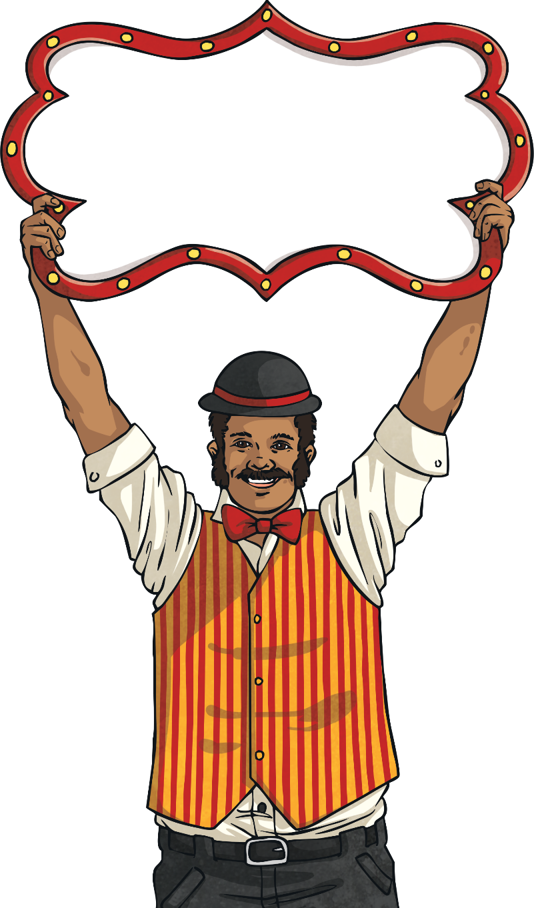
Estimate Answers to Calculations
Diving
Estimate the answer to:
622 + 39
622 is near to 620
39 is near to 40
620 + 40 = 660

Slide 4
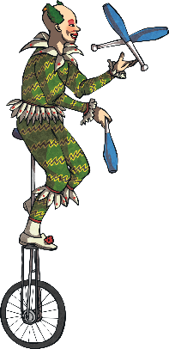
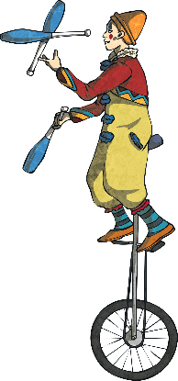
Estimate Answers to Calculations
Diving
Two clowns riding unicycles are positioned at different distances across the big top as seen here in metres:
0
50
100
Estimate how far apart they are from each other in metres.
40 metres

Slide 5
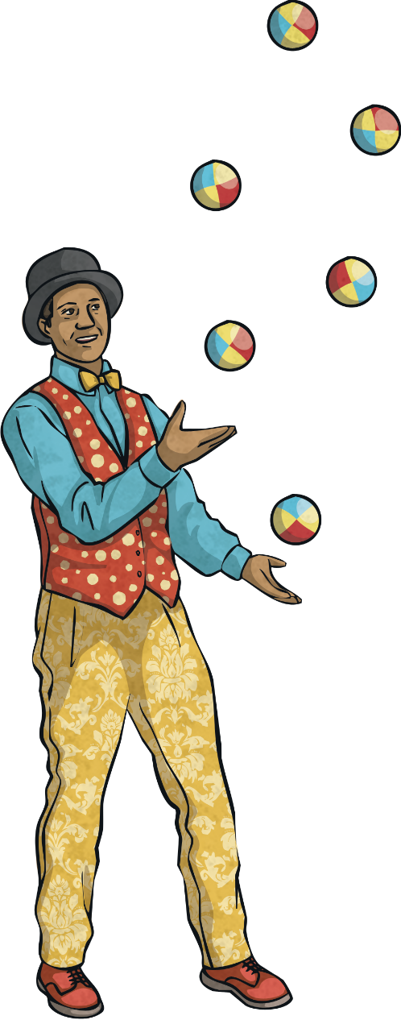
Estimate Answers to Calculations
Deeper
The circus uses 78 juggling balls in the opening act and 31 in the final act.
Which is the best estimate for the total number used?
100
110
90
120

Slide 6
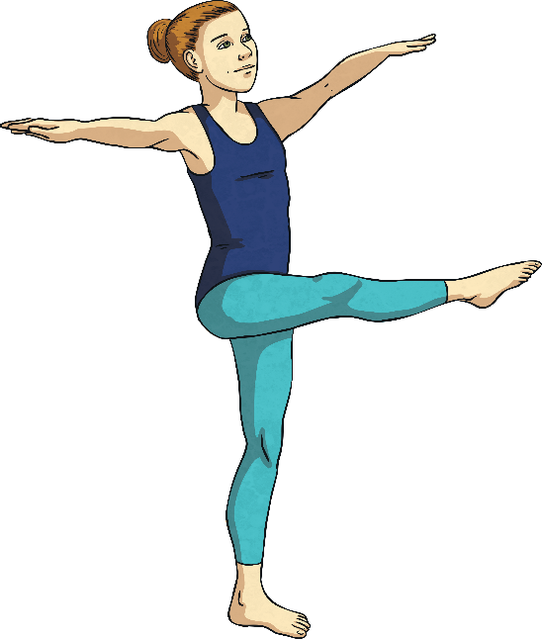
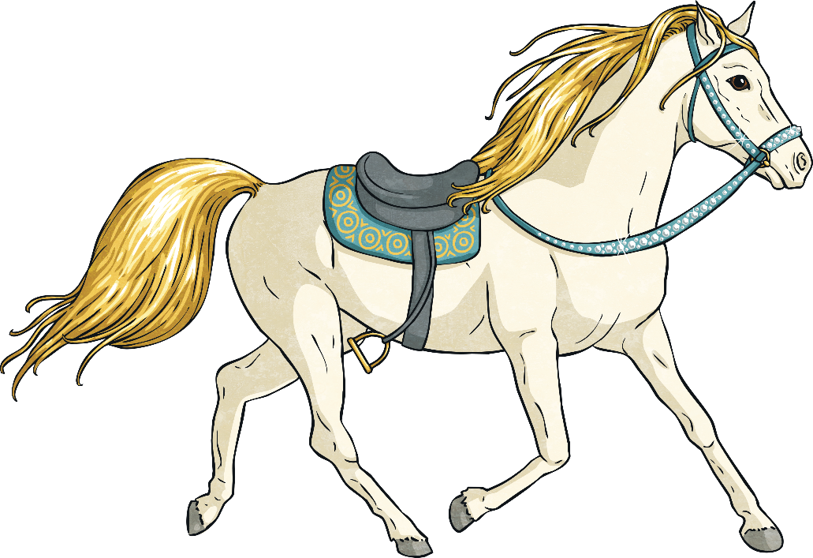
Estimate Answers to Calculations
Deeper
Which of the following calculations could have an answer of roughly 220?
312 – 82
209 + 28
299 – 78

Slide 7
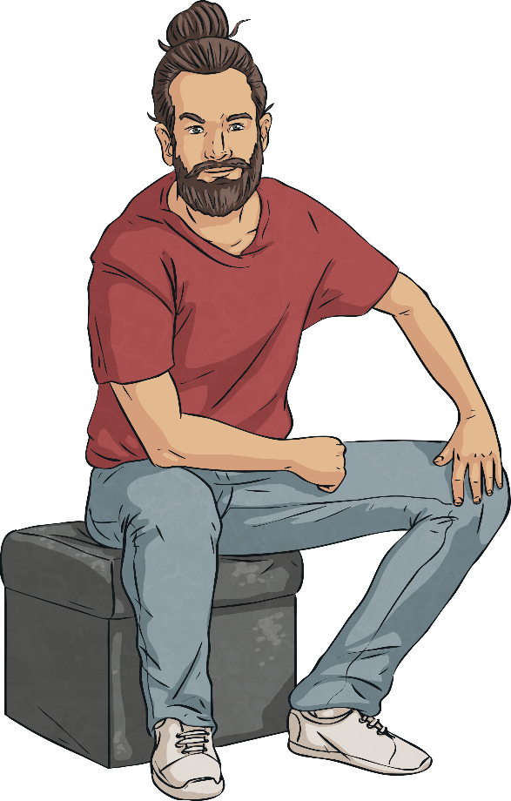
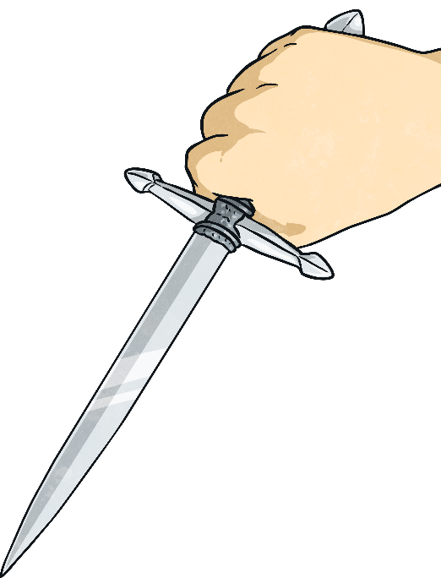
Estimate Answers to Calculations
Deepest
The sword swallower works out that with his bag of 27 swords and 111 daggers, that he has about 30 + 110 items in total, which is 140.
Discuss with your partner if you agree with him.

Slide 8
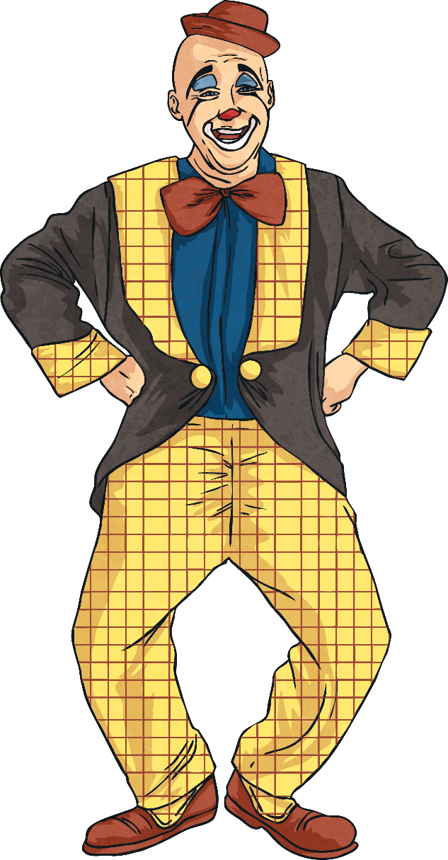
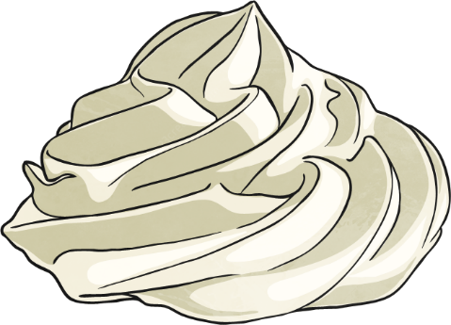
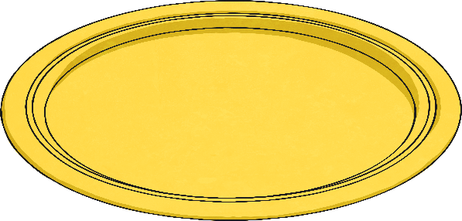
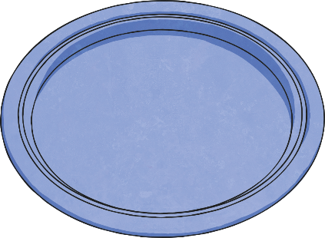
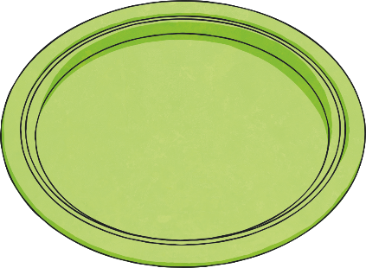
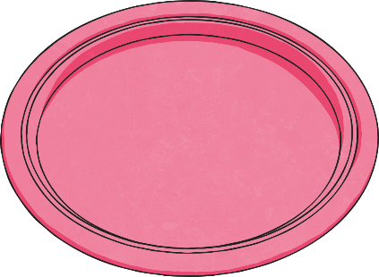
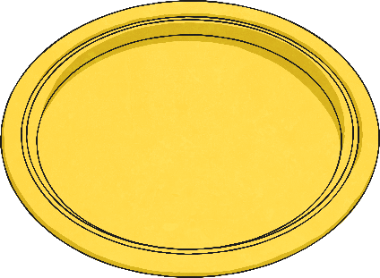
Estimate Answers to Calculations
Deepest
Which packs of paper plates combined will give the clowns roughly 290 plates for their custard pies?
152
159
148
131

