Slide 2
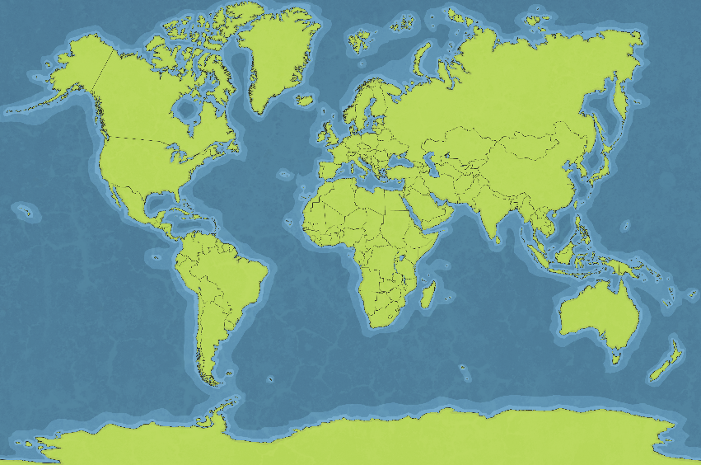
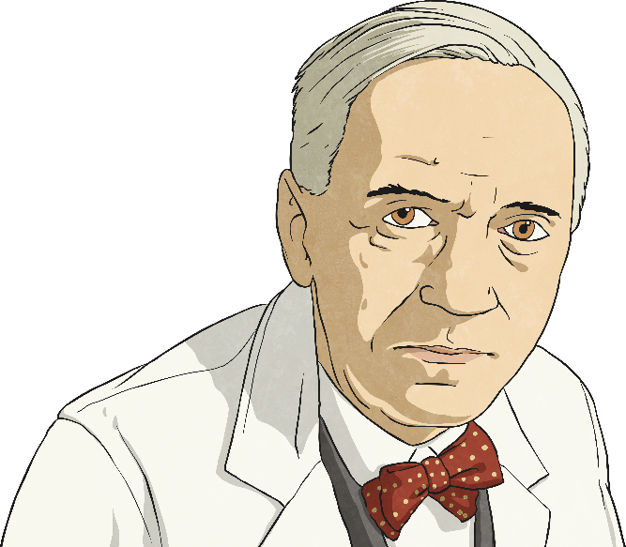
Life in
1920s
Scotland
Poverty and unemployment were high and as a result, many people left Scotland and emigrated to countries such as Australia, Canada, England, New Zealand and South Africa.
Did You Know…?
Scottish scientist, Sir Alexander Fleming discovered penicillin. This was a huge medical breakthrough as these antibiotics help to fight infection in your body.

Slide 3
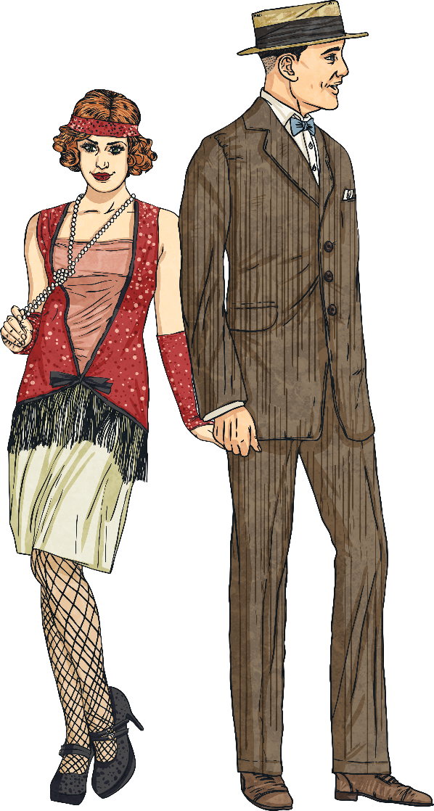
1920s
Fashion
Women’s clothing was becoming looser and less lacy in the 1920s. The flapper dress was all the rage. Men wore suits with waistcoats. Usually men’s clothing was black, blue, brown, grey or white.

Slide 4
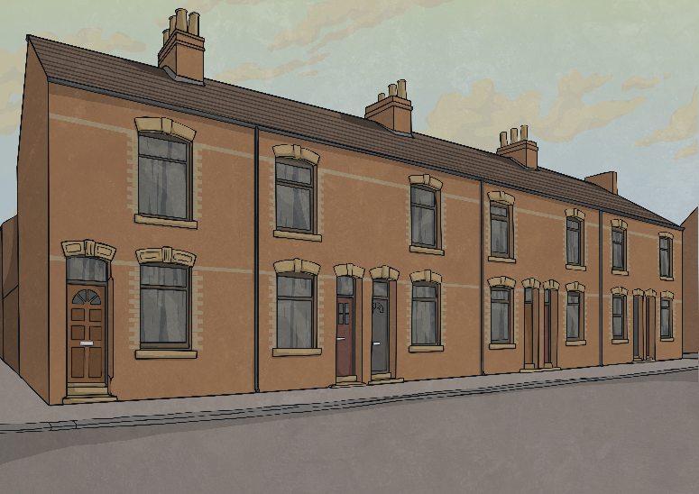
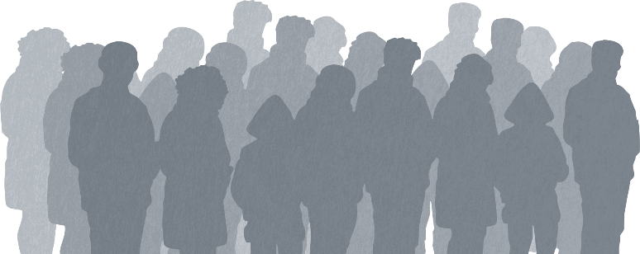
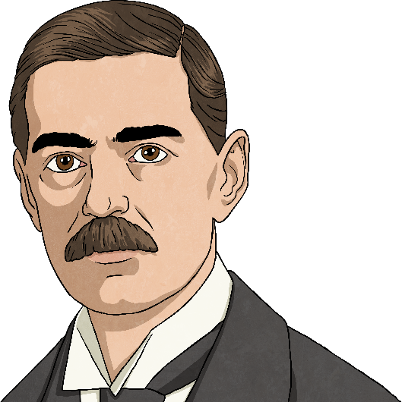
Life in
1930s
Scotland
The 1930s was the decade of The Great Depression. Life was pretty bleak for many people in Scotland because of poor standards of living. Unemployment was high, there was a shortage of housing and sanitation was poor.
Did You Know…?
In 1939, Neville Chamberlain, who was the Prime Minister for Great Britain, declared war on Germany when they invaded Poland. This was the beginning of the Second World War.

Slide 5
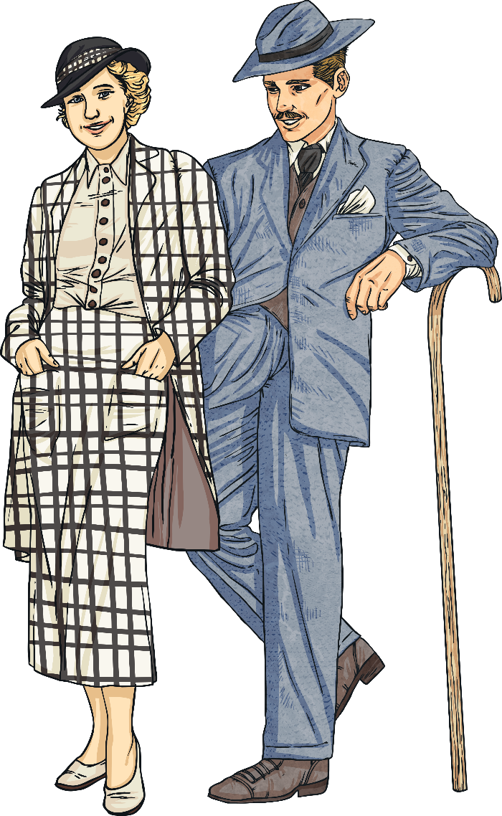
1930s
Fashion
1930s fashion for men did not change very much. They were still wearing suits and waistcoats in the colours of brown, blue, black, green and grey.
For women, the style went back to dresses that were cinched in at the waist and small shoulder pads. Hats were in fashion for both men and women.

Slide 6
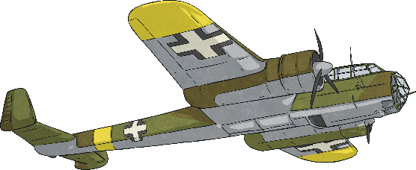
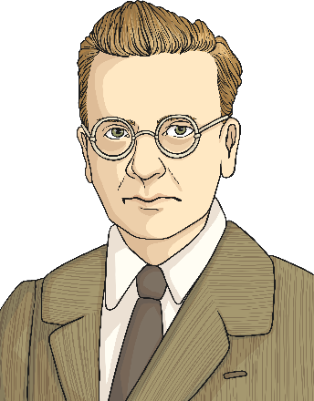
Life in
1940s
Scotland
The first half of the 1940s was dominated by the Second World War. Many people were sent away to war and those who remained at home lived on what was allowed by the government. Foods were in short supply and so eggs, bacon, milk and sugar were all rationed.
In 1941, Clydebank suffered one of the worst air raids by German bombers over two nights. Most of the town was destroyed and there were a large number of causalities. The raids were targeting shipbuilding along the River Clyde.
Did You Know…?
John Logie Baird, the Scottish inventor from Helensburgh, introduced the first colour TV.

Slide 7
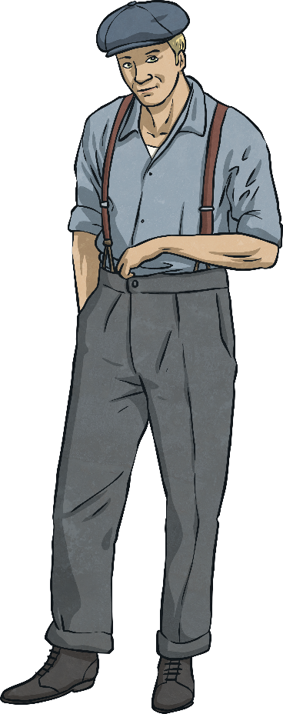
1940s
Fashion
Because of rationing during the war, clothing was restricted. Clothes went unlined and scarves and gloves became a luxury. Women had fewer pleats in their skirts and men’s trousers lost their turn-ups.

Slide 8
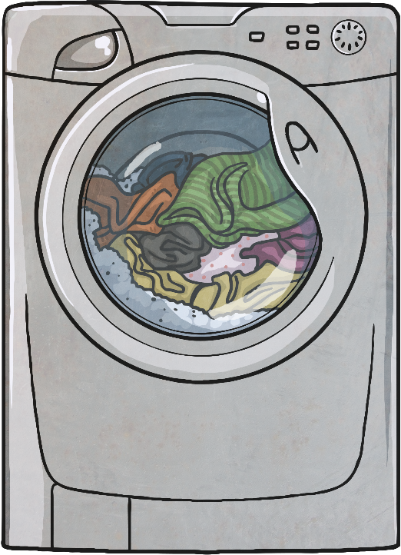
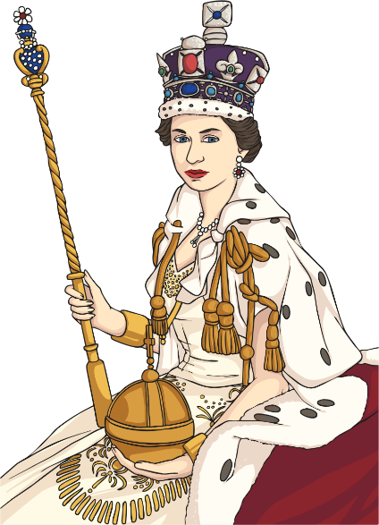
Life in
1950s
Scotland
In the early 1950s, the country was still recovering from the destruction and devastation of the war but soon the 1950s became the era of rock‘n’roll with dancing being a popular way of socialising. Refrigerators and washing machines were becoming more popular in households.
Did You Know…?
Queen Elizabeth II became the British monarch and was coronated in June 1953.

Slide 9
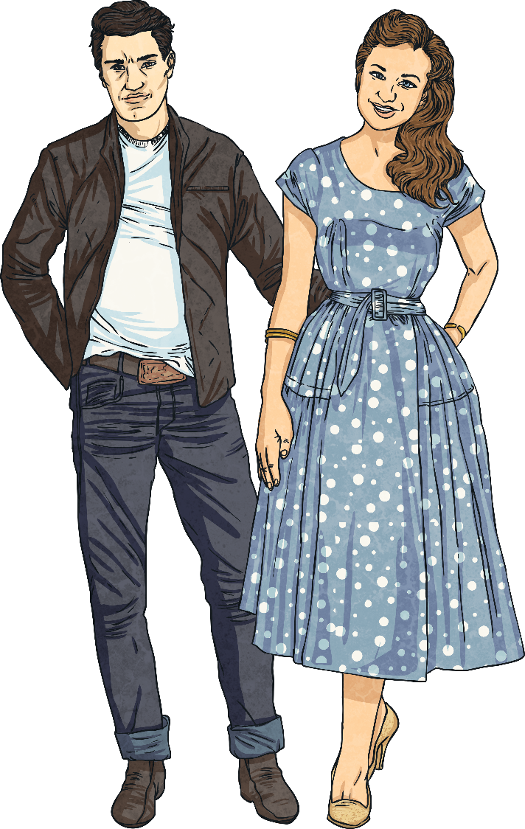
1950s
Fashion
In the 1950s, it became more common for women to wear trousers and men started wearing jeans.
More patterns became available for material and women wore more swing dresses.

Slide 10
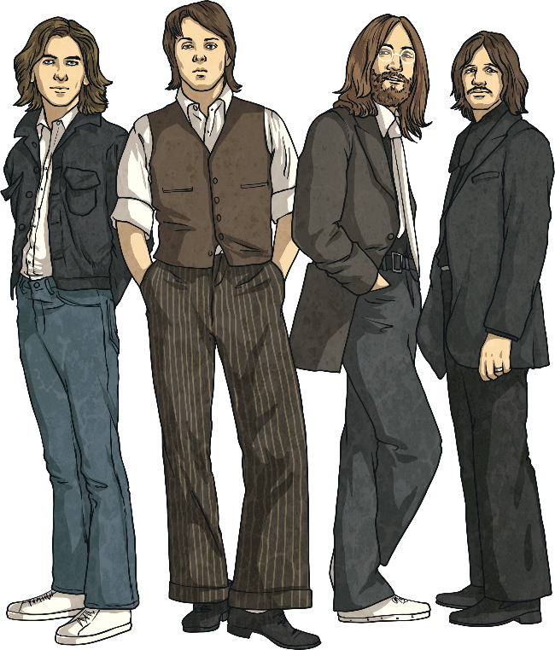
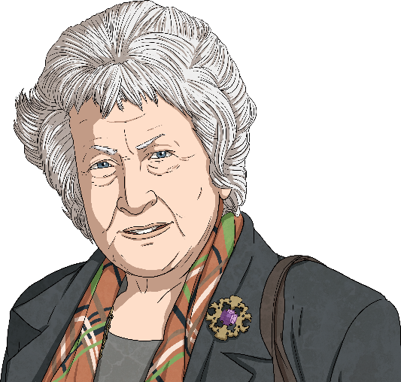
Life in
1960s
Scotland
The Swinging Sixties, as it is often referred to, became the decade of teenage freedom. More and more women were also entering the world of work. It was the decade that gave rise to British pop music with The Beatles becoming one of the most famous bands of all time.
Did You Know…?
Winnie Ewing became the first ever Member of Parliament for the Scottish National Party (SNP).

Slide 11
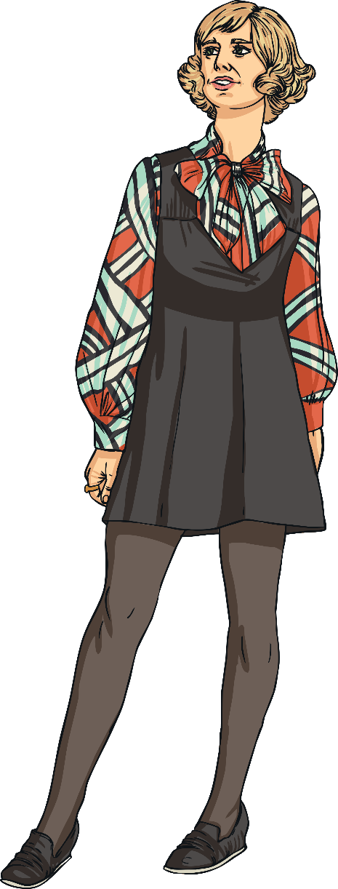
1960s
Fashion
Many women were wearing miniskirts and men were wearing jeans. Clothing was becoming less restrictive.

Slide 12
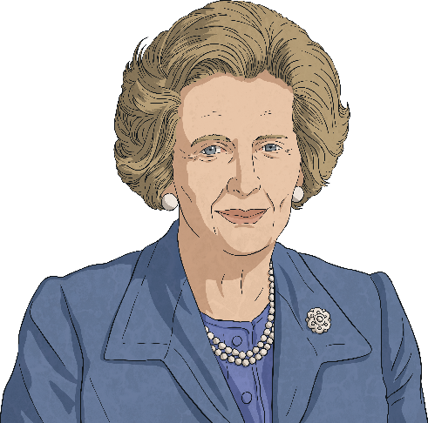
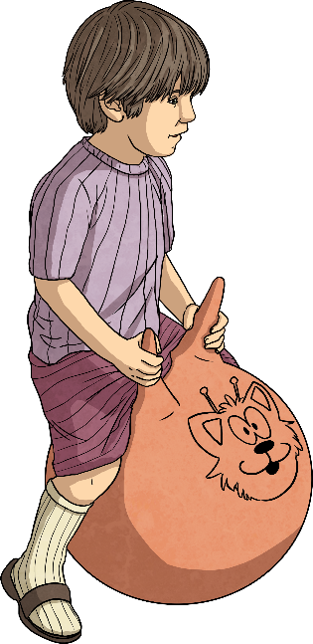
Life in
1970s
Scotland
The 1970s were a somewhat unsettled time in Scotland with high levels of unemployment. It was a historic moment in politics as Margaret Thatcher was elected the first female Prime Minister of Britain. The music of Queen, ABBA and the famous Scottish pop rock band The Bay City Rollers was popular during this era. Space hoppers were the popular toy of choice among children.
Did You Know…?
Blair Drummond Safari Park opened during the 1970s.

Slide 13
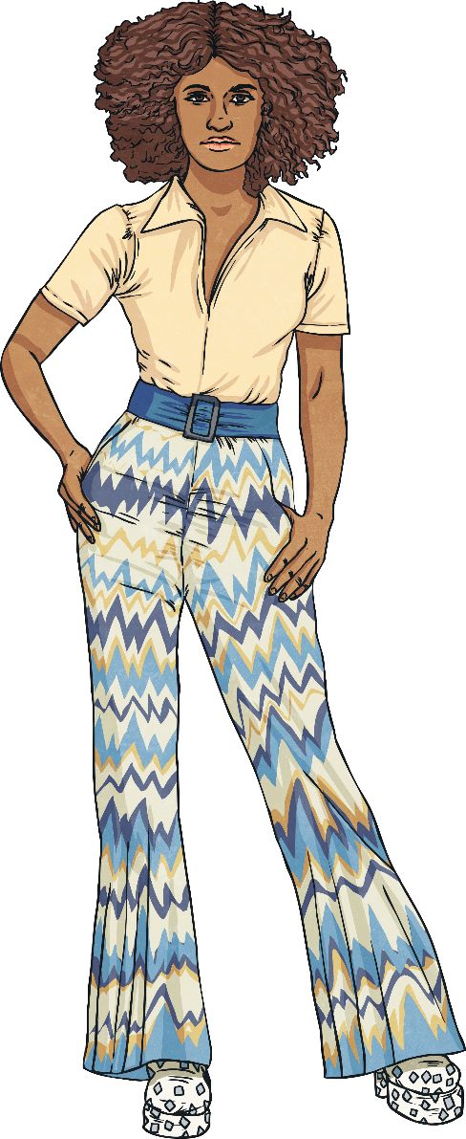
1970s
Fashion
Women joined men and started wearing jeans with large flares and T-shirts. Bright colours were in fashion and platform shoes were all the rage. People often wore their hair long.

Slide 14
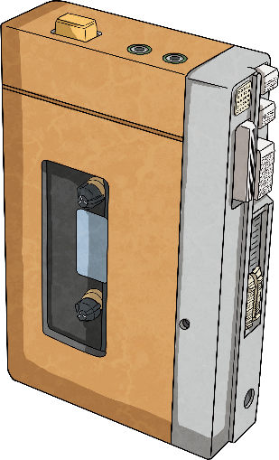
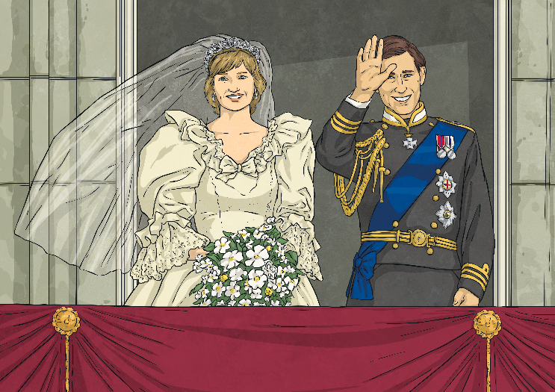
Life in
1980s
Scotland
Technology really started to move forward in this era with the development of personal computers and the increasing popularity of portal cassette players. The Rubik’s cube also became a popular source of entertainment.
Did You Know…?
Prince Charles and Lady Diana married in 1981. Prince William, the second in line to the throne, and Prince Harry were also born during this decade.

Slide 15
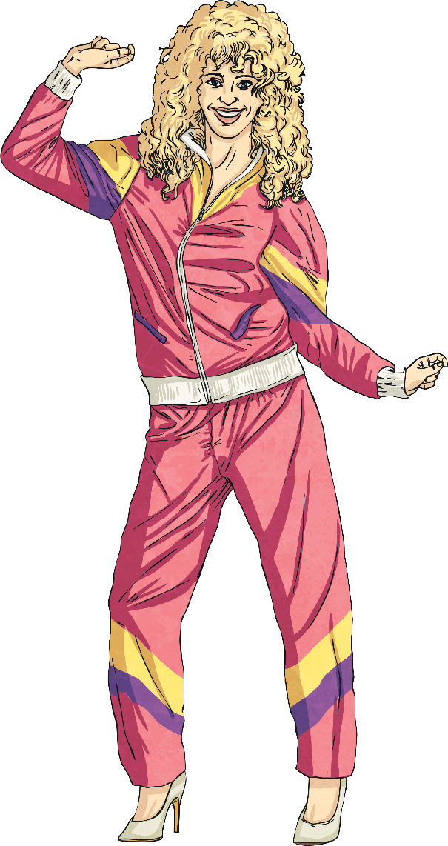
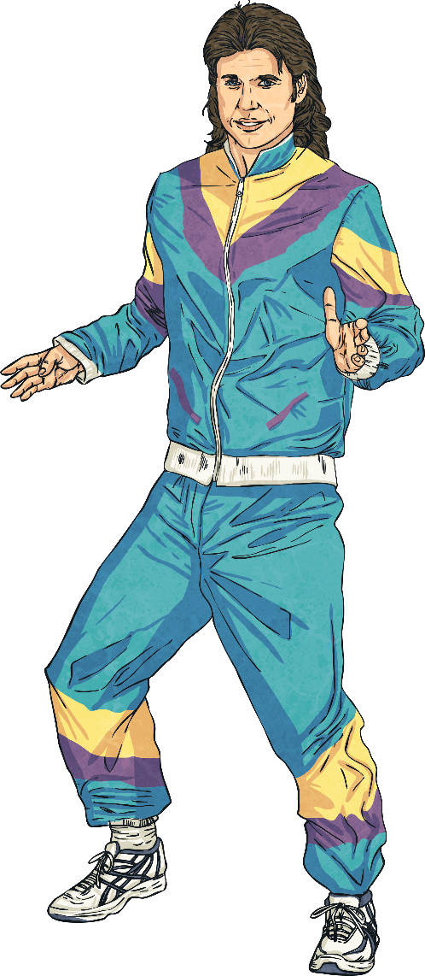
1980s
Fashion
Fashion in the 1980s can be defined by shoulder pads, bright, bold colours, leggings and loose-fitting jumpers. Big, permed hair was also the style of choice during this decade.

Slide 16
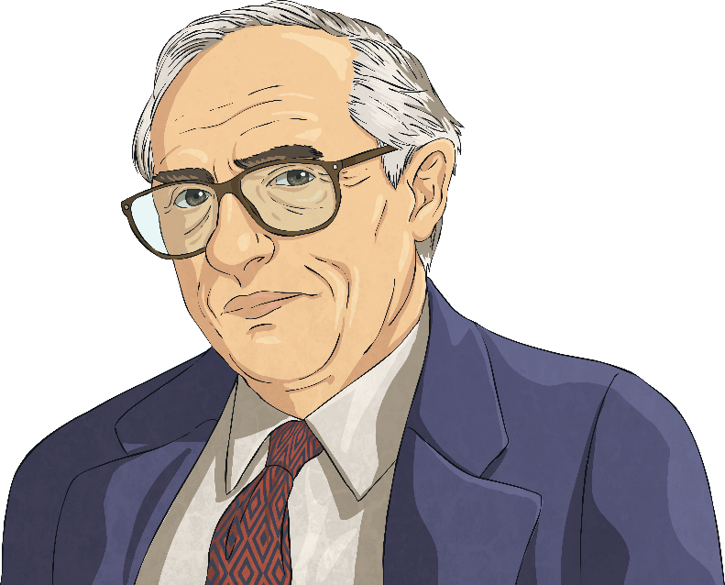
Life in
1990s
Scotland
The 1990s were a politically important decade for Scotland. The people of Scotland voted to have their own devolved Parliament during a referendum in 1997. The Scottish Parliament was then opened in May 1999.
Did You Know…?
Donald Dewar became the first Minister of Scotland.

Slide 17
1990s
Fashion
Baggy jeans and big round glasses were popular. Women wore necklaces called chokers and men often wore flannel shirts. Patterns were still big, but black clothing was becoming more and more popular.

