Slide 1
Autobiographies

Slide 2
Learning Intention
To write an autobiographical text
Success Criteria
I can explain the differences between an autobiography and a biography
I can identify the features of an autobiography
I can write in an autobiographical style.

Slide 3
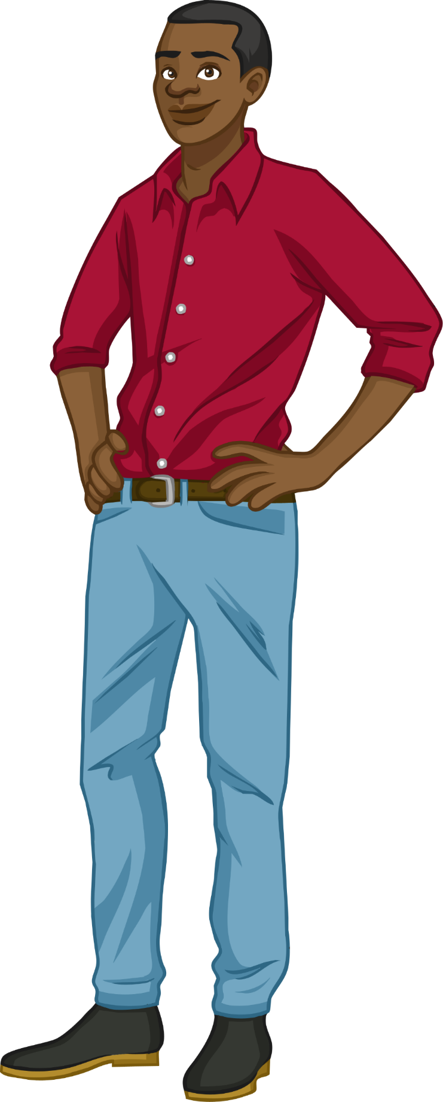
Biographies
A biography gives facts about a person’s life. It is not written by the subject of the book but by an author who has done their research and knows a great deal about that person. Biographies are written in the third person and can be written about someone who is no longer alive.

Slide 4
Autobiographies
An autobiography is where someone writes about their own life. This is often a famous person.
An autobiography is different to a biography because it is written in the first person, explaining important events in their life. The subject may write about what has influenced them and include details of their feelings during different experiences they have had.
Autobiographies are primary historical sources of information whereas biographies are secondary sources.

Slide 5
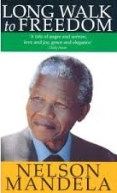
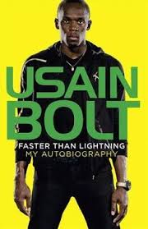
Here are some examples of autobiographies:
Do you recognise some of these famous faces?

Slide 6
Looking at an autobiography We are going to look at part of the autobiography of Jessica Ennis-Hill. She is an English athlete who won a gold medal at the Olympic Games in 2012, and a silver medal in 2016. We are going to find out more about her life and how she feels.
https://www.youtube.com/watch?v=5ogwLIPAjKk

Slide 7
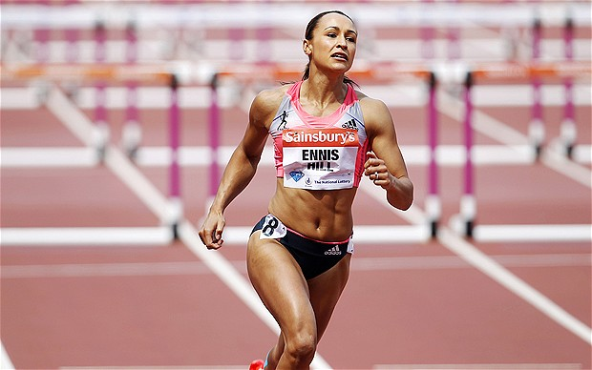
“I am crying. I am a Sheffield schoolgirl… bullies are waiting for me tomorrow… I feel insecure and frightened”. Where is Jessica Ennis from? What was life like at school? What words does she use to tell you this? How does this make you feel about her?

Slide 8
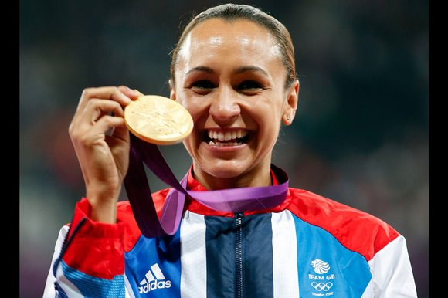
“I was the smallest in the class and I became more self-conscious about it as the years went by… I can still see this young, timid girl standing by the side of a pool quaking with anxiety. I was small”. How did Jessica feel about swimming? What words tell you this?

Slide 9
Your autobiography
Either in your green jotter or online, write an autobiography about your life.
Focus on important and interesting events in your life making sure you write in chronological order.
Points to mention:
When and where you were born
Your family
Starting school
Making new friends
New experiences and feelings related to these experiences
An exciting event in your life
People who have influenced you.
Remember: write in chronological order.

