Slide 2
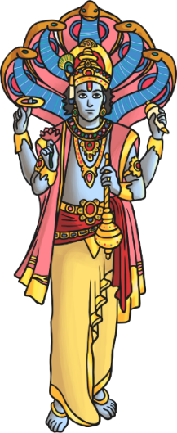
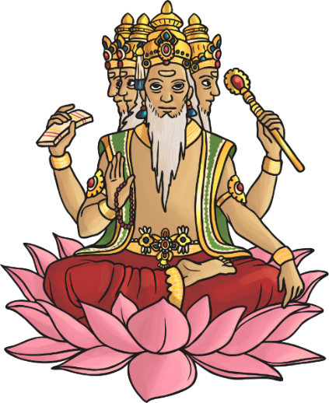
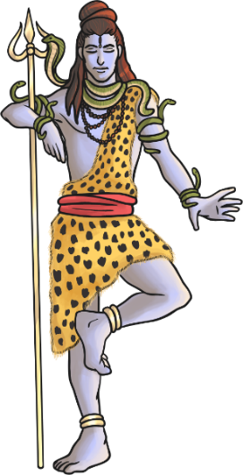
Hindu Deities
Hindus recognise one God, Brahman. The gods of Hinduism are different expressions of Brahman.
These are considered the Trimurti
- the three aspects of the universal supreme God.
v
Vishnu
Brahma
Shiva

Slide 3
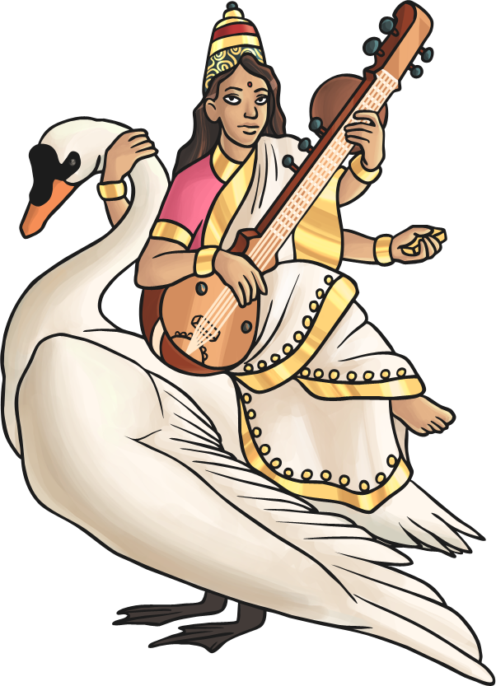
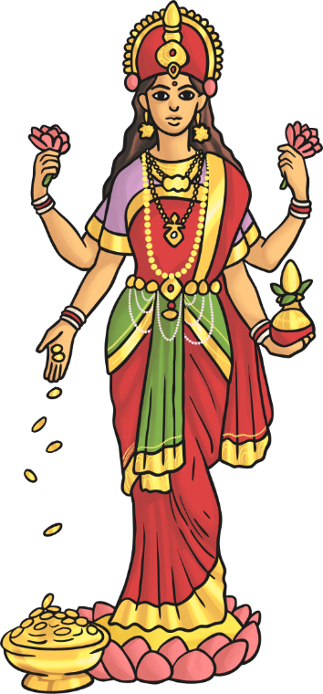
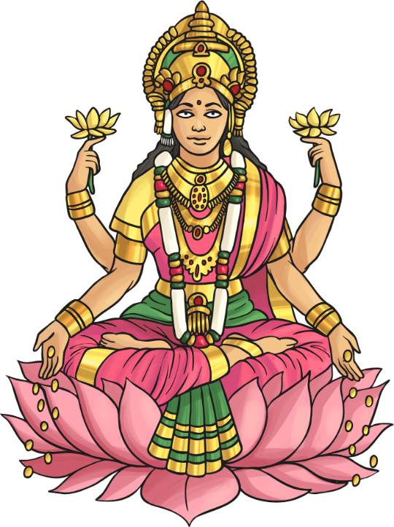
Hindu Deities
The Tridevi are goddesses who are equally important.
Saraswati
Lakshmi
Shakti

Slide 4
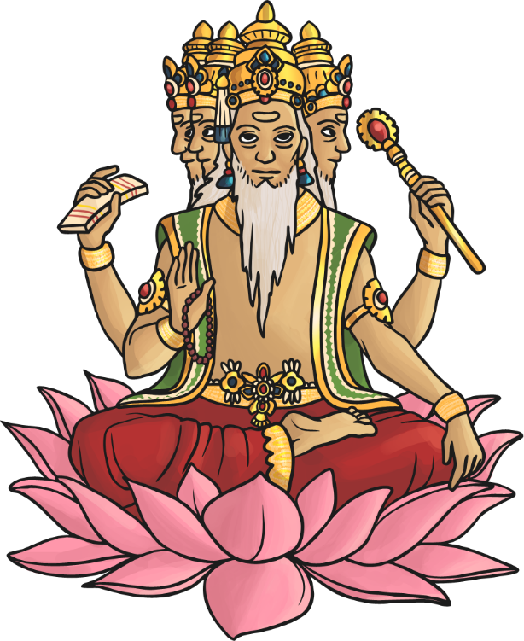
Hindu Deities - Brahma
Brahma is the god (deva) of creation.
He has four arms and four faces, looking in the four directions.
Each of his four heads is believed to be responsible for one of the four Vedas (sacred Hindu texts).
Brahma is not worshipped as much as the other gods, as it is believed his role as creator is over.
His wife is Saraswati – the goddess
of knowledge.

Slide 5
Hindu Deities - Saraswati
Saraswati is the goddess (devi) of knowledge and the arts.
Her swan personifies pure knowledge. She is sometimes depicted with a peacock which is said to represent the arts.
She taught Brahma (her husband) how to sense, think, comprehend and communicate.
Saraswati rejected material things in favour of pure wisdom.

Slide 6
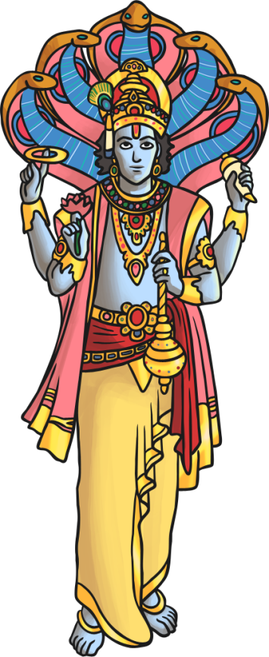
Hindu Deities - Vishnu
Vishnu is the god responsible for preserving and protecting the universe.
His role is to return to Earth during troubled times to restore the balance between good and evil.
His incarnations (human forms of Vishnu) include Rama and Krishna.
His last incarnation is said to be Siddartha Gautama – otherwise known as ‘Buddha’ (the founder of Buddhism).
His wife is Lakshmi.

Slide 7
Hindu Deities - Lakshmi
Lakshmi is the goddess of wealth and purity.
She is depicted with four arms and standing on a lotus flower.
Hindus believe that if she is worshipped sincerely and not in greed, she will bless them with fortune and success.
Like her husband, Lakshmi has also had incarnations on Earth as Sita, Radha
and Rukmini.

Slide 8
Hindu Deities - Shiva
Shiva is the god of destruction. His role is to destroy the universe in order to re-create it.
He is seen as the source of both good and evil.
His wife, Shakti, is said to enable him to gain balance.
He is often depicted with . . .
a third eye (representing wisdom and insight);
a cobra necklace (representing destruction and recreation – snakes represent this in the way they shed their old skin for new skin);
vibhuti (three lines drawn across the face to represent his power);
a trident (which represents the three functions of the Trimurti).

Slide 9
Hindu Deities - Shakti
Shakti is the mother goddess - the source of all energy, power and creativity in the universe.
She represents nature and therefore can be nurturing as well as dangerous.
She can appear as:
Parvati
(kind)
Kali
(cruel and frightening)
Durga
(protector)

Slide 10
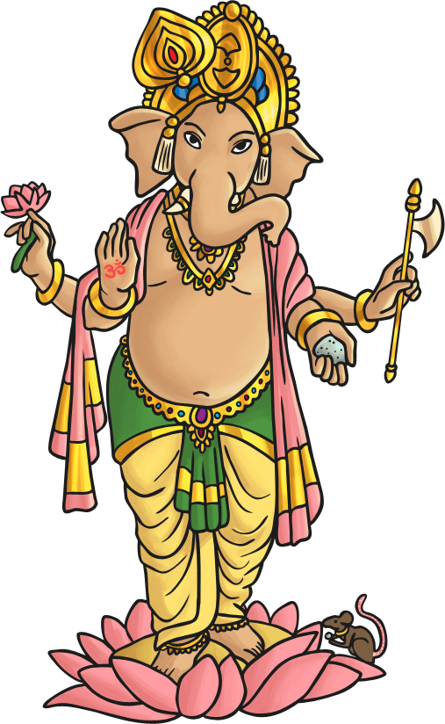
Hindu Deities - Ganesha
Son of Parvati and Shiva – he has an elephant’s head and a
human body.
His tusks – one broken and the other unbroken – represent imperfection and perfection in the world.
Ganesha is worshipped by Hindus, who believe he bestows good fortune and wisdom.
He is often prayed to when his followers are starting something new in their lives, e.g. getting married, starting a new job.

Slide 11
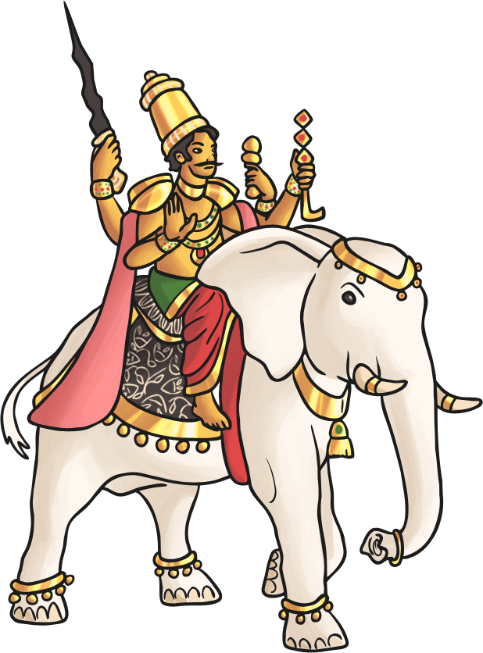
Hindu Deities - Indra
Indra is the king of heaven and lord of the gods who maintain the heavens.
He wields a thunderbolt, creates thunderstorms and provides rain.
He wages war against the opponents of the gods and thus is considered the god of war.
The rainbow is referred to as Indra’s bow.

Slide 12
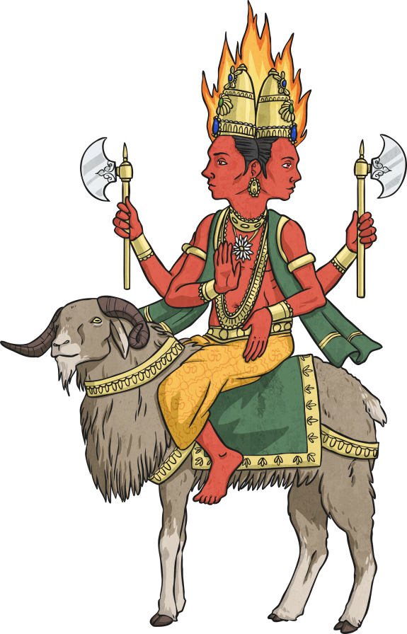
Hindu Deities - Agni
Agni is the god of fire.
Fire holds a special place in many Hindu ceremonies, including weddings.
The sacrifices and offerings made to him go to the other gods, as he is a messenger from and to them.
He lives on Earth among humans, rather than with the gods.

Slide 13
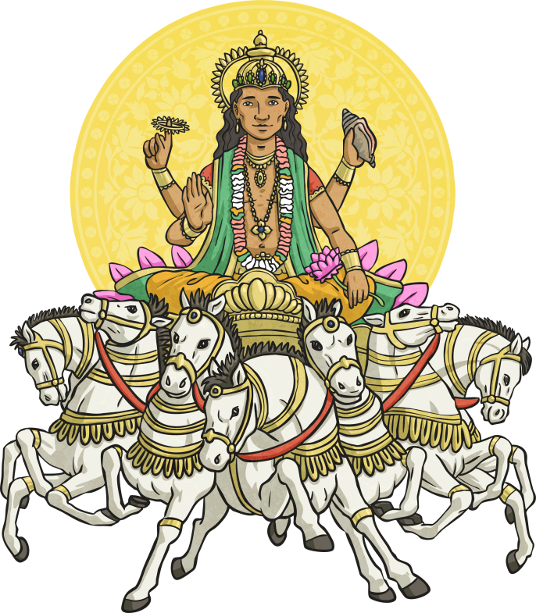
Hindu Deities - Surya
Surya is the Sun god.
He is depicted as a warrior on a chariot pulled by seven white horses.
He is thought to be capable of healing the sick and dispelling darkness by illuminating the world.
Hindus believe that placing the sign of the Sun over main doors will bring them good luck.

Slide 14
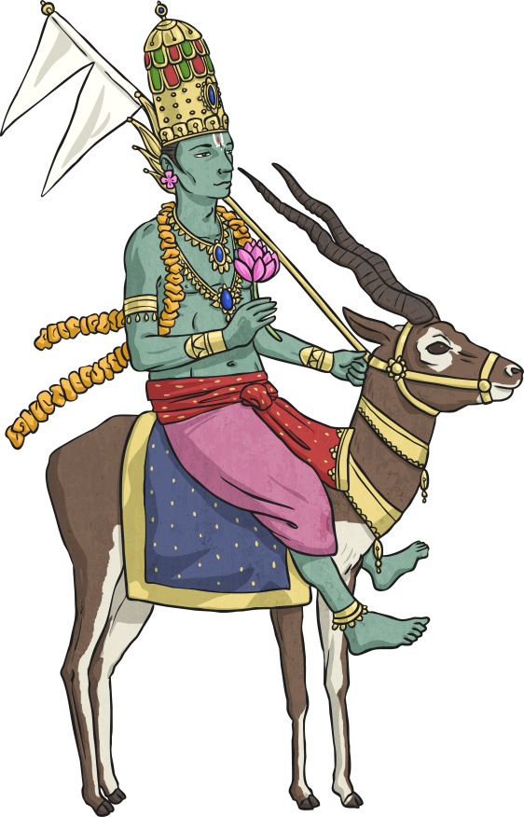
Hindu Deities - Vaya
Vayu is the god of air/wind.
He is also considered the god of life, as air is vital to being alive.
Vayu is also known by the names of Pavana, Vata and Prana.
He is the father of Hanuman, who is known as Pavanaputra (son
of Pavana).
Like other gods, he is considered a fighter, destroyer, powerful and heroic.

Slide 15
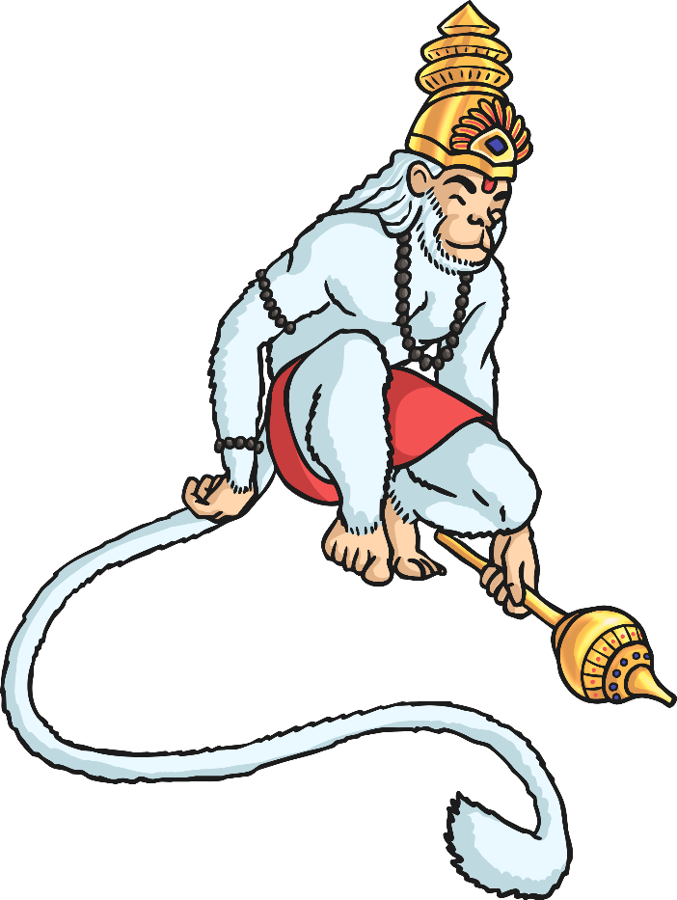
Hindu Deities - Hanuman
Hanuman is the Hindu monkey god.
They believe that as a child, Hanuman was mischievous and liked to play tricks!
However, it is his role in the story of the festival of Diwali for which he
is known.
He commanded an army to aid Rama’s fight against the demon Ravana in order to rescue Sita.

Slide 16
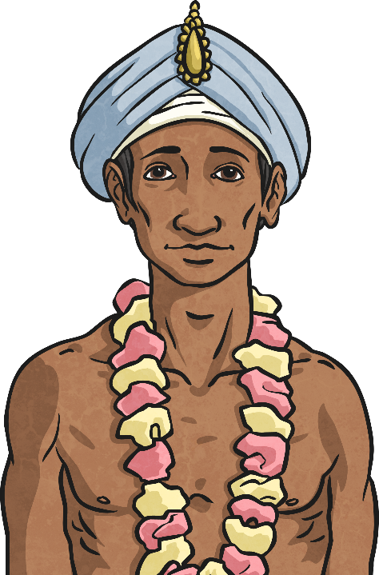
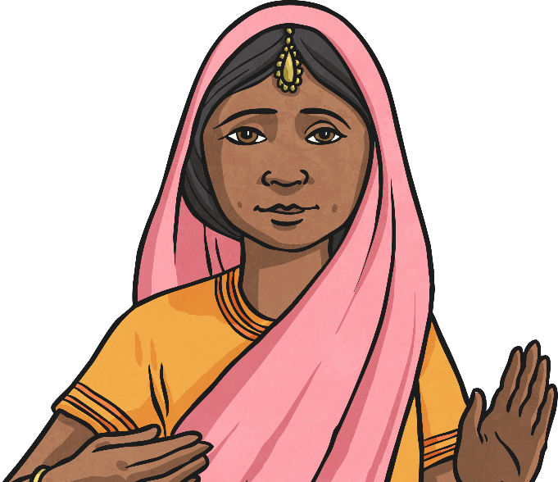
Main Beliefs
Hinduism is a religion that has fused many different traditions and practices. There is no one way to be a Hindu.
However, there are some core beliefs that all Hindus share.
Truth is eternal
Dharma
Reincarnation
Moksha

Slide 17
Main Beliefs - Truth Is Eternal
Hindus believe that they should pursue knowledge and understanding of the truth.
Truth is the only reality.
There is one truth, but the wise can express this in many ways.

Slide 18
Main Beliefs – Dharma
Hindus believe that there are right and wrong ways to behave.
Dharma is a complex idea that includes the right behaviour, following the moral law (and not just what you feel like doing) and taking ones duties seriously.
Dharma is a central part of a Hindu’s daily life.
According to this belief, it is necessary to do the right thing at all times.

Slide 19
Main Beliefs – Reincarnation
Hindus believe that all living things have a soul (athma).
They believe that the soul cannot be destroyed.
Instead they believe in reincarnation, which means the soul exists in the body. When a living thing dies, it enters new living thing.
Karma – good and bad actions committed during one’s life – affects which living thing the soul will be reborn into. For example, it is possible for a human soul to be reborn as a cat!

Slide 20
Main Beliefs – Moksha
Hindus believe that the ultimate goal for all Hindus is Moksha.
Moksha means liberation of the soul from the cycle of death and rebirth.
It occurs when the soul reunites with the god Brahma.
There are several ways this can happen by following the:
Path of Duty;
Path of Knowledge;
Path of Devotion to God.

