Slide 2
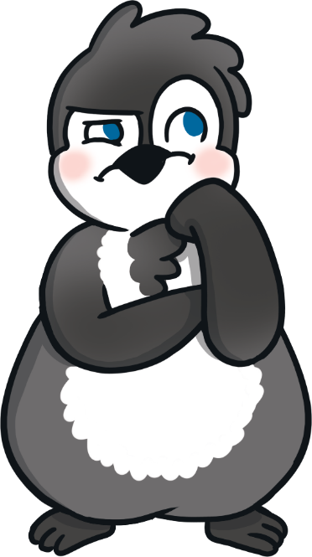
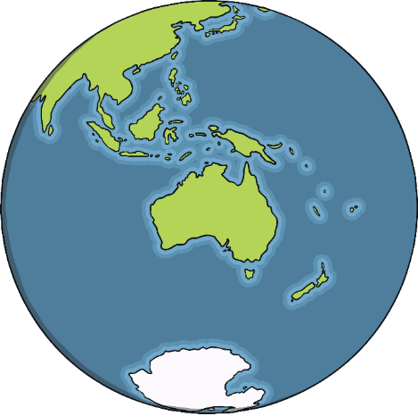
Where Do Penguins Live?
Penguins are found in lots of different countries. Some people think they only live in cold places but there are some types of penguins that live in much warmer countries.
Can you name any countries where penguins live?

Slide 3
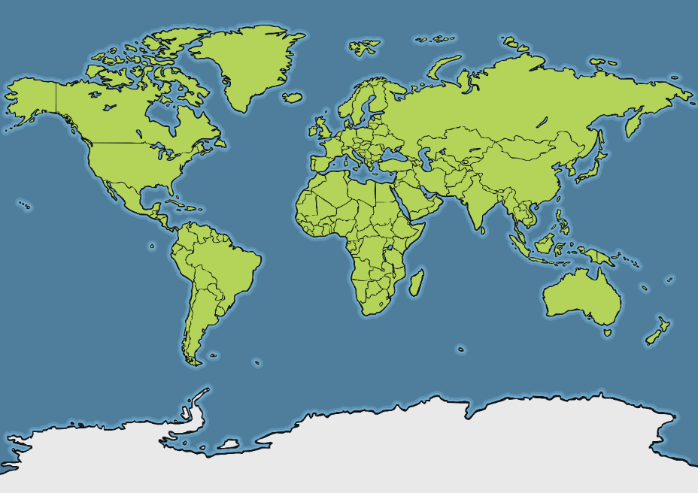
Where Do Penguins Live?
Galápagos Islands
Argentina
Peru
South Africa
New Zealand
Chile
Australia
Falkland Islands
South Georgia and South Sandwich Islands
Antarctica
What do you notice about where penguins live?

Slide 4
Where Do Penguins Live?
Galápagos Islands
Argentina
equator
Peru
South Africa
New Zealand
Chile
Australia
Falkland Islands
South Georgia and South Sandwich Islands
Antarctica
Almost all penguins live in the southern hemisphere. This is the area south of the equator.

Slide 5
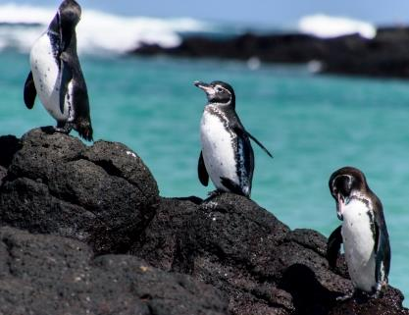
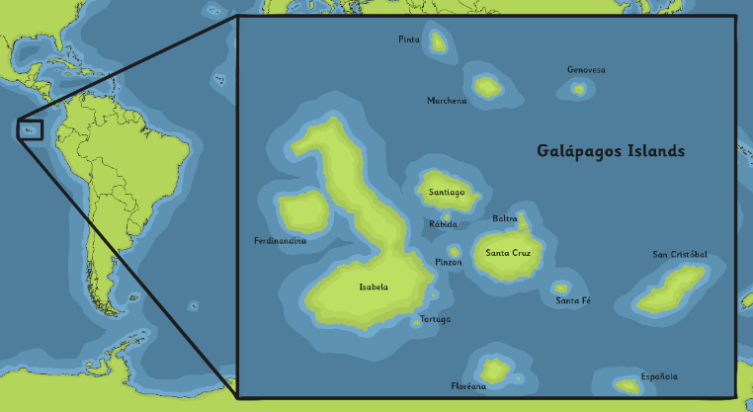
Galápagos Penguin
Galápagos penguins live on the Galápagos Islands, near Ecuador in South America. They are the only type of penguin that lives north of the equator. It is much warmer here than other places where penguins live.
Galápagos penguins are one of the smallest penguins in the world.
Galápagos Islands
They live in small groups compared to other penguin species. They eat small fish, such as anchovies and sardines.
“Penguin Hike” by [peterswaine2] is licensed under CC BY 2.0

Slide 6
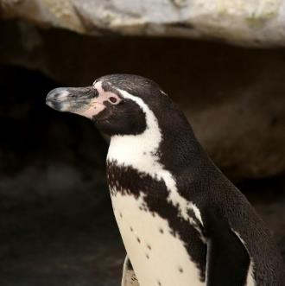
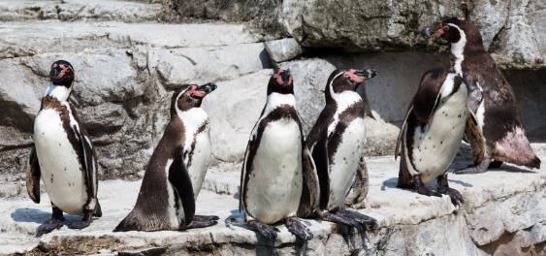
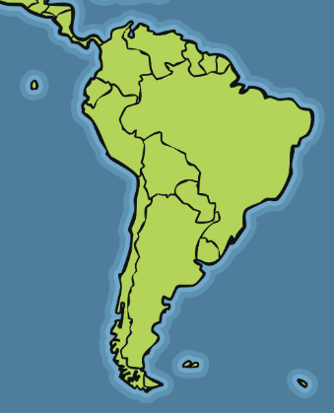
Humboldt Penguin
Humboldt penguins are named after the area of water they swim in – the Humboldt current. They live on sandy beaches and rocky coasts.
Humboldt penguins each have a unique spotty pattern on their chests.
Peru
Humboldt penguins live in Peru and Chile in South America. It is very rocky where they live, so they have become excellent jumpers and climbers.
Chile

Slide 7
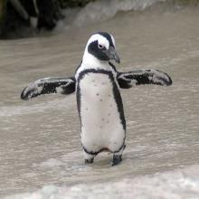
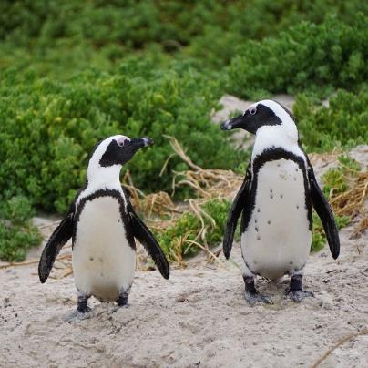
Magellanic Penguin
Magellanic penguins are named after Ferdinand Magellan, the famous explorer.
Magellanic penguins eat krill, squid, cuttlefish, sardines and anchovies.
Argentina
Magellanic penguins can be found in Chile and Argentina in South America. They can also be found on the Falkland Islands.
Magellanic penguins are the largest penguin found in South America.
Falkland Islands
Chile

Slide 8
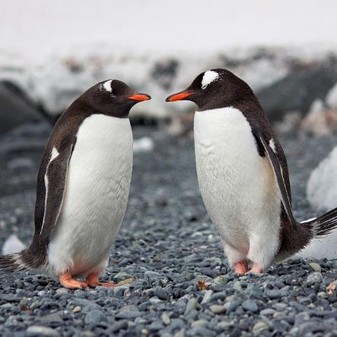
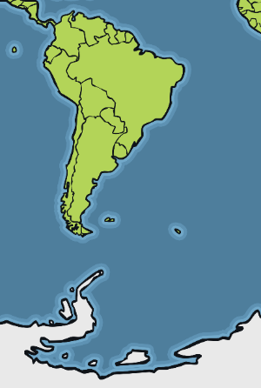
Gentoo Penguin
Gentoo penguins have bright orange beaks and peach-coloured feet.
They are the fastest penguin underwater and can reach 22mph! Gentoos can make as many as 450 dives a day searching for food.
Chile
Gentoo penguins live in Chile, the Falkland Islands and Antarctica.
They like to live in ice-free areas, such as along the coast, in valleys and on cliffs.
Falkland Islands
Antarctica

Slide 9
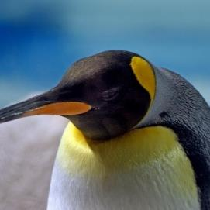
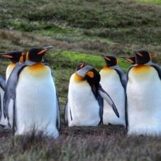
King Penguin
King penguins are the second-largest penguin in the world.
King penguins don’t build nests. Instead, they keep their egg warm by balancing it on top of their feet under a loose fold of skin. King penguin parents take turns looking after the egg in this way.
King penguins live in Chile, the Falkland Islands and Antarctica.
The biggest ever king penguin colony had more than 500,000 pairs of birds! Do you know how many king penguins in total that would be?
Chile
Falkland Islands
Antarctica

Slide 10
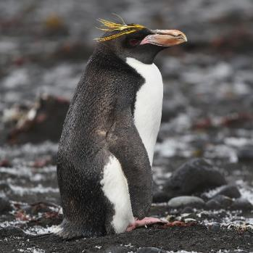
Macaroni Penguin
Macaroni penguins are one of the largest crested penguins. Crested penguins have yellow or black feathers that stick up on their heads.
It is rare to see a macaroni penguin on land because they spend so much time swimming.
Macaroni penguins can be found in Chile, the Falkland Islands and South Georgia and South Sandwich Islands.
There are more macaroni penguins than any other type in the world, with over 18,000,000 alive today!
South Georgia and South Sandwich Islands
Chile
Falkland Islands
“Macaroni Penguin” by [laikolosse] is licensed under CC BY 2.0

Slide 11
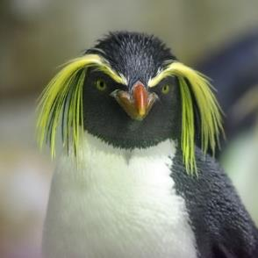
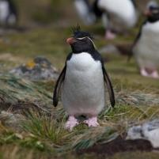
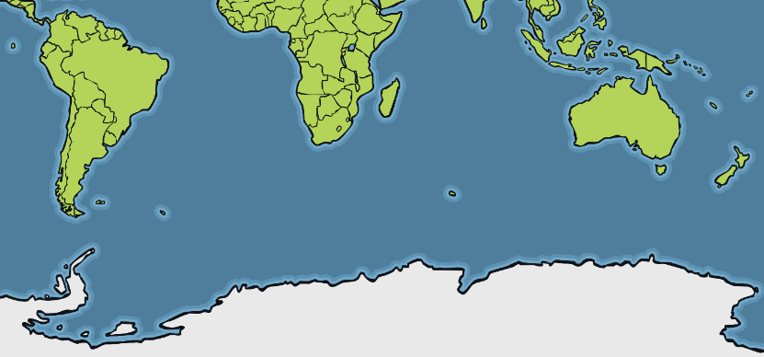
Rockhopper Penguin
Rockhopper penguins get their name from the way they move – they jump or hop, rather than waddling like some other penguins.
There are two different types of rockhopper: the southern and northern.
Rockhopper penguins can be found in lots of different places, including Chile, the Falkland Islands, Antarctica and New Zealand.
Chile
Falkland Islands
New Zealand
Antarctica

Slide 12
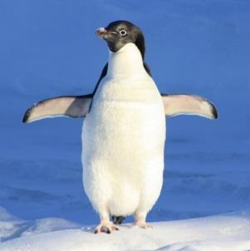
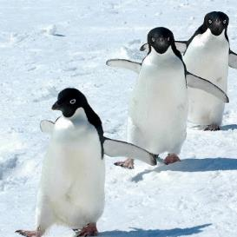
Adélie Penguin
Adélie penguins use rocks to build their nests and keep their eggs off the cold ground. However, Adélies can be sneaky. To save hunting for rocks, they’ll often steal them from other penguins’ nests!
Adélie penguins can only be found in Antarctica and its nearby islands.
Adélies may travel a 185-mile round trip to find food!
Antarctica

Slide 13
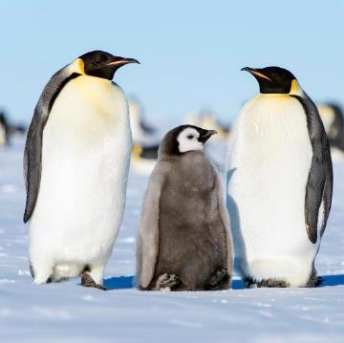
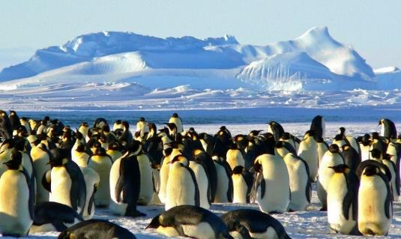
Emperor Penguin
Emperor penguins are the biggest type of penguin in the world. They are only found in Antarctica.
Like king penguins, emperors don’t build nests. The male penguin keeps their egg warm by balancing it on top of his feet under a loose fold of skin. He will do this for up to 75 days! All this time, the male won’t eat anything until the egg has hatched and the female has returned with food.
Antarctica
“Emperor Penguins” by [Christopher.Michel] is licensed under CC BY 2.0

Slide 14
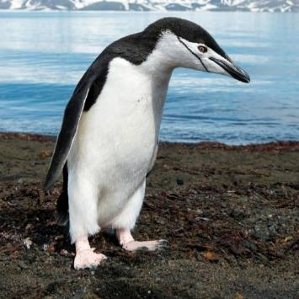
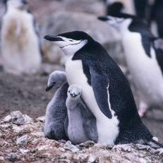
Chinstrap Penguin
Chinstrap penguins get their name from the markings on their feathers. It looks like they have a strap under their chin!
Chinstrap chicks will stay with their parents until they are a month old. Then, they will huddle together with other chicks to keep warm.
Chinstraps are only found in Antarctica and South Georgia and South Sandwich Islands.
The biggest colony of penguins ever recorded is here and has about 2 million penguins!
South Georgia and South Sandwich Islands
Antarctica

Slide 15
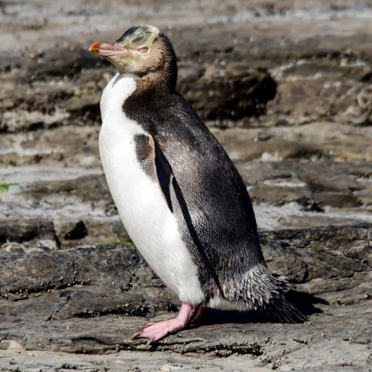
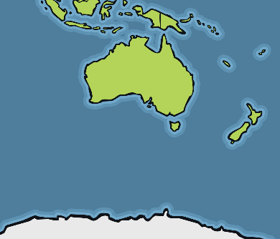
Yellow-Eyed Penguin
Yellow-eyed penguins are one of the rarest species of penguins in the world.
Unlike most other penguins, yellow-eyed penguins don’t live in large colonies. Instead, they build their nests away from others. Both parents will look after the chicks and hunt for food.
New Zealand
Yellow-eyed penguins are only found in New Zealand.

Slide 16
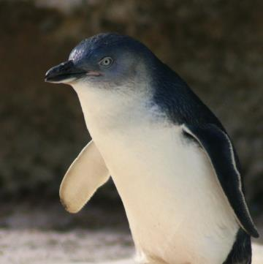
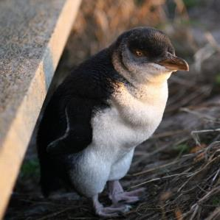
Little Blue Penguin
Little blue penguins are the smallest type of penguin in the world. They are mostly nocturnal.
Little blue penguins eat sardines, anchovies, squid and krill. They will dive up to 800 times a day when looking for food at sea!
Little blue penguins can only be found in Australia and New Zealand.
New Zealand
Australia

Slide 17
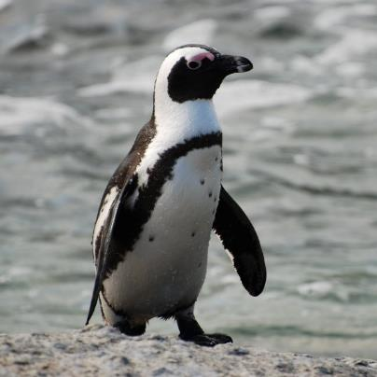
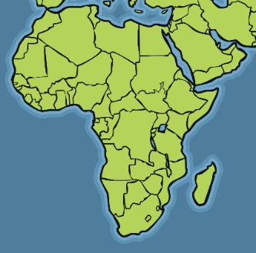
African Penguin
African penguins dig burrows to lay their eggs. This keeps them safe and out of the sun.
Most of their diet is fish. They can dive as deep as 130 metres to find food.
African penguins have a loud call that sounds like a donkey!
African penguins live in South Africa. They are the only penguins found on the continent of Africa. They can get very warm living here, so they spend a lot of their time in the sea to keep them cool.
South Africa
“African penguin, near Boulders Beach, South Africa” by [Paul Mannix] is licensed under CC BY 2.0

Slide 18
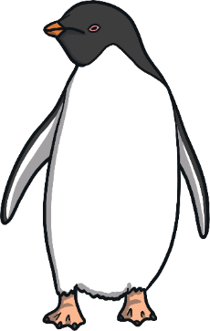
Glossary
climate the usual weather conditions in one area
continent a large solid area of land
equator the imaginary circle around the Earth that
divides the planet in half
nocturnal active at night
species a group of a certain type of animal
unique the only one of its kind

