Slide 1
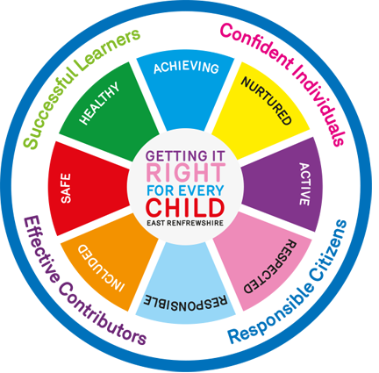
Willliamston Primary School- The Rationale for our Curriculum
The Four capacities of the Curriculum for Excellence Successful Learner Confident Individuals Responsible Citizens Effective Contributors
Our Key Drivers
Learning for Sustainability
Rights and values-based education
Local identity and heritage v global citizenship
Improving attainment and achievement of all
Health and well-being
Critical thinking and political literacy
Biodiversity and tackling climate change
Social justice and Fair Trade
Outdoor learning and contact with nature
Peace and conflict
Developing and learning skills for life and work
Vision
At Williamston Primary School we work together as a community to provide a happy, secure and stimulating environment where children are motivated to learn, are valued as individuals and encouraged to reach their full potential through our curriculum for excellence.
#BE THE BEST YOU CAN BE!
Ideal Learning in Williamston PS happens when:
Children lead their own learning
Children are actively involved
Opportunities are given to work independently and collaboratively
Children are engaged and purposeful
Learning is experiential and active
We use the natural environment and outdoors whenever possible
Learning provides challenge and is differentiated
We nurture the whole child and create nurturing caring and supportive learning environment.
Our School Values..
All of our curriculum activities, programmes and opportunities for learning aim to provide our learners, parents and staff to develop and exemplify our CORE school values of
Respect Responsibility Kindness
Respect for yourself, others and the environment
Responsibility for all your actions
Kindness Always.
Principles for Curriculum Design:
• challenge and enjoyment
• breadth
• progression
• depth
• personalisation and choice
• coherence
• relevance

