Slide 1
Welcome to
Williamston Primary School
Mrs Fiona Hollands
Head Teacher

Slide 2
Structure of the morning
9.30–10am – Welcome and Meet your Teacher
10am-11:15am – Presentation and Q &A session
11:15am-11:30am – Joining your children in their new classroom
11:30am – 12pm – Lunch with your child in the hall

Slide 3
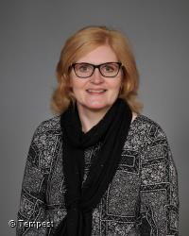
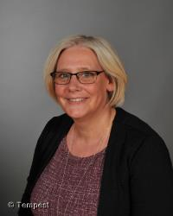
Senior Leadership Team
Mrs Fiona Hollands – Head Teacher
Mrs Lynn Dare – Depute Head Teacher

Slide 4
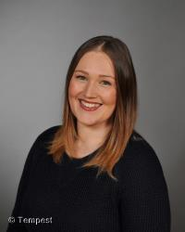
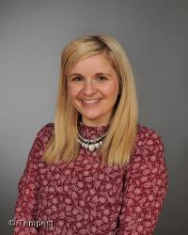
Senior Leadership Team
Mrs Roisin Thomson – Principal Teacher for the Early Years
Mrs Karlie Gray – Principal Teacher for Support for Learning

Slide 5
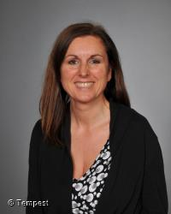
Primary 1A
Mrs Rachael Banks

Slide 6
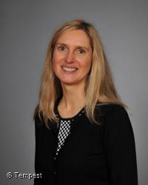
Primary 1/2
Mrs Noreen Lytle

Slide 7
Starting School at Williamston

Slide 8
Williamston Primary School Values

Slide 9
Curriculum for Excellence
Learning for sustainability at the heart of what we do

Slide 10
iJournALs
Tracks your child’s progress through Early Level experiences and outcomes and beyond.
Evidenced by photographs, pieces of work, assessments and staff observations.
Sharing with parents

Slide 11
Positive Behaviour
Repairing relationships through Restorative Practice.
Stickers, awards, public praise and visit to HT, DHT or PT
Positive feedback to parents/carers
House points
Growth Mindset – ‘I can’t do it, yet!’

Slide 12
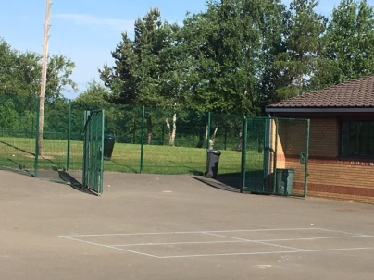
The First Day
Wednesday 21st August 2019
P1A – 9:15am
P1/2 – 9:45am
Entrance to Primary 1 from the main playground
Parents are welcome to come in with their child and help them settle into the class.
A plea – only photograph your own child and be wary of posting on social media.

Slide 13
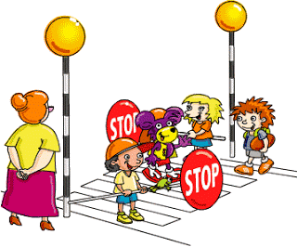
Morning Safety at School
Breakfast Club
Available from 8am – from day two with no need to book.
If using the car park, parents should park in the drop off zone and escort their child to the breakfast club doors.
Children not attending breakfast club should be walked round from Bankton Lane to the playground at the rear of the school – playground supervision is in place from 8.30am, please do not arrive early.

Slide 14
Morning Safety at School
Late Arrivals
If your child is arrives after the bell, please take them to the office to collect a late slip.
We follow a Safe Arrivals Procedure – if your child does not register for school by 9:30am and we have had no contact from a parent/carer we would notify the Safe Arrivals Team who may contact you, visit you and if they cannot contact you, the police will be notified.

Slide 15
End of the day safety - Walking
Children will be released one-by-one from their class teacher to their known adult in the playground.
It is important that your child stays with the teacher until “their grown up” collects them.
If whoever normally comes to collect your child at the end of the day is late, your child will be taken to the main office.
Please notify the school of any changes to your child’s normal pattern of leaving school.

Slide 16
End of the day safety – Car or Bus
Children are escorted to the car line area and supervised by a member of staff.
Parents who wish to collect their child by car will need to park in the turning circle, get out of their car and collect their child from the gate.
Children will not be allowed to leave the playground until an adult comes to collect them.
Children who take the bus will be escorted from the school to the bus by a member of staff.

Slide 17
Preparing for School

Slide 18
What does my child need for starting school?
School Uniform – please take a look at the back of the hall
Change of shoes for all weather break and lunch– named (to be kept in school)
Indoor and Outdoor P.E. Kits in bags – named (to be kept in school)
No football colours please.
Indoor PE kit | Outdoor Learning/PE kit
White T-shirt | Jumper/Fleece
Black shorts | Joggers/Leggings
Trainers or gym shoes | T-shirt
 | Outdoor shoes Water proofs

Slide 19
School uniform
White or maroon polo shirt
White shirt or blouse with school tie
Grey or maroon sweatshirt/jumper/cardigan
Grey skirt/pinafore/trousers
Suitable outdoor shoes and indoor shoes

Slide 20
Drinks, Snack and Lunch
For morning break children will need:
one small healthy snack
Typical lunch time for P1 is 12:30pm – 1:15pm however pupils will have an early lunch in term 1.
Children can have a school lunch, packed lunch or a home lunch.
Lunches need to be ordered on a Monday using the Ipay system (log in details will be sent out in August).
Children are encouraged to bring a water bottle with them to school to help them stay hydrated. Water bottles should not contain flavoured water or juice.

Slide 21
Medication and Absence
If your child requires to take medication during school time, parent/carers must complete forms which are available from the school office
It is essential that you contact the school as soon as possible, if your child is too unwell to attend school
Please be aware that if your child has sickness and/or diarrhoea they should not return to school until 48 hours after the last episode.

Slide 22
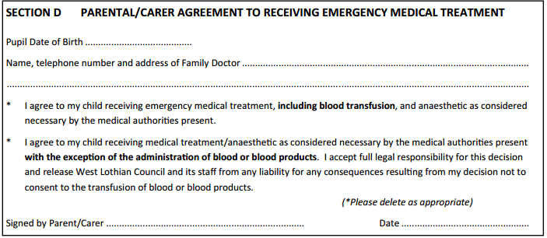
EE2 Forms for Trips

Slide 23
Parents/ Carers visiting school
All doors locked, entry system in place
Always report to the school office
We love working with our parents – those who wish to help in class will need to be PVG checked. Please collect one as soon as possible so that you can start as soon as possible after the summer.
Parents can speak to P1 teacher informally about concerns or small issues at the end of the day – please wait until the teacher has dismissed the full class
Appointments can also be made to discuss larger concerns

Slide 24
The Importance of Play
Mrs Roisin Thomson
Principal Teacher for the Early Years

Slide 25
The importance of play in the Early Years
UPSTART

Slide 26
So what does this mean for us a Williamston?
Our staff have already undergone professional development in Froebelian Practice with the university of Edinburgh and Play in P1 training from Lynda Keith.
We have also been on a best practice visit to South Morningside Primary and Infant School in Edinburgh where this approach has been in place for two years already.
Many schools in West Lothian are also following a similar model.
It is time for us to be brave and do what is best for our learners.
We are proud to introduce…

Slide 27
ONE-derland at Williamston

Slide 28
How will this look different?
Children will be immersed in play for the majority of the day.
4 learning zones will be set up across the 2 Primary 1 classrooms to create our ONE-derland with children allowed to free flow between them.
Carefully planned activities will be set up across these play zones to ensure children make very good progress towards the benchmarks for the end of Early Level.
Children will also have planned small group time with the teacher for literacy and numeracy – no more than 6 per group.

Slide 29
A Typical Day
Short whole class mental maths
Numeracy teacher time (children continuously playing until they are called)
Break
Short circle time in own class to introduce sound and number of the day
Literacy teacher time (children continuously playing until they are called)
Lunch
Short topic input
Children continuously playing with afternoon outdoor learning time
Storytime

Slide 30
Learning Zones
Imaginative
Sensory
Creative
STEAM – Science, Technology, Engineering, Art and Mathematics
Outdoor – we need your help

Slide 31
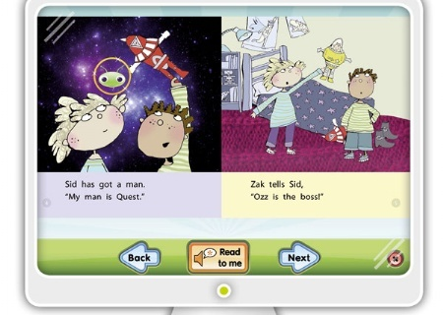
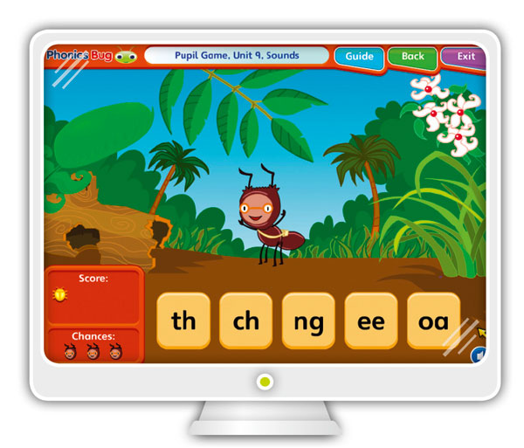
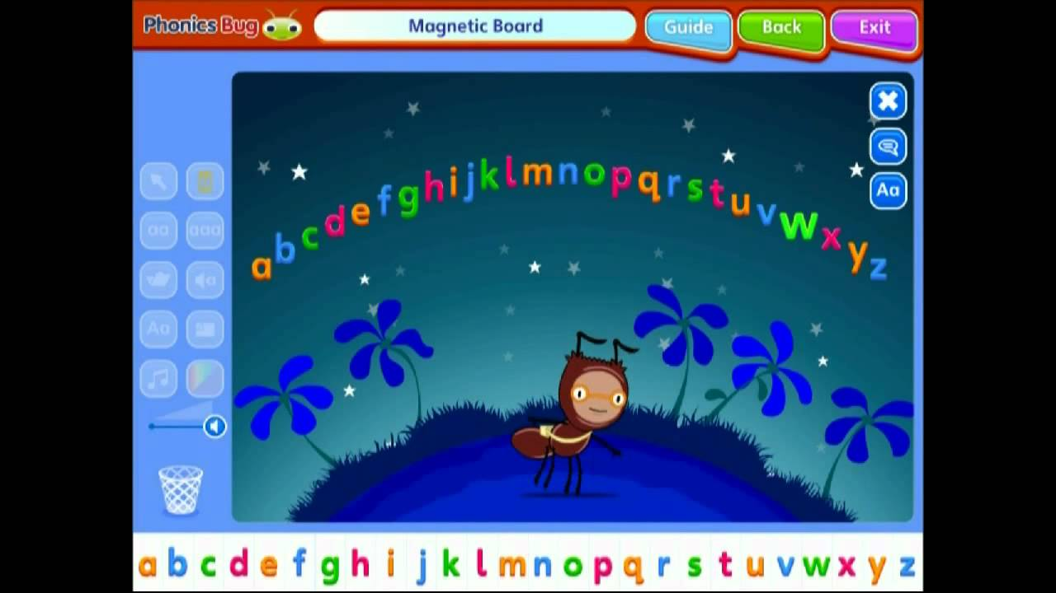
Literacy – Phonics Bug and Bug Club reading scheme
Reading using our books in class to support skills such as prediction and answering inferential questions.
Wonderful interactive teaching tools and games.
Reading online at home and completing game based assessments to promote enjoyment of reading.

Slide 32
Welcome to ONE-derland! Questions?

Slide 33
Parent Council

Slide 34
Simply Play

Slide 35
Final Information
Information packs at back of the hall – please return all documents before the end of term where possible.
School Uniforms are available at the back to get an idea of style and size
SLT will be on hand to answer any questions you may have

Slide 36
Thank You!

