Slide 1
Welcome to
Williamston Primary School
Mrs Fiona Hollands
Head Teacher

Slide 2
Structure of the morning
9.30–10am – Welcome and Meet your Teacher
10am-11:15am – Presentation and Q &A session
11:15am-11:30am – Joining your children in their new classroom
11:30am – 12pm – Lunch with your child in the hall

Slide 3
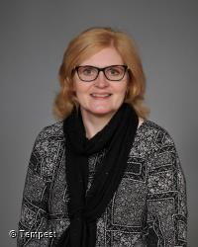
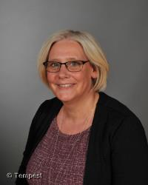
Senior Leadership Team
Mrs Fiona Hollands – Head Teacher
Mrs Lynn Dare – Depute Head Teacher

Slide 4
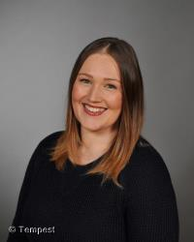
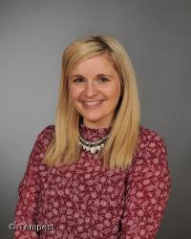
Senior Leadership Team
Mrs Roisin Thomson – Principal Teacher for the Early Years
Mrs Karlie Gray – Principal Teacher for Support for Learning

Slide 5
Primary 1A
Mrs Roisin Thomson
Monday, Tuesday and wednesday
Mrs Rachel McConnachie
Wednesday, Thursday and Friday

Slide 6
Primary 1B
Mrs Rachael Banks

Slide 7
Primary 1C
Mrs Noreen Lytle

Slide 8
The Importance of Play
Mrs Roisin Thomson
Principal Teacher for the Early Years

Slide 9
The importance of play in the Early Years
UPSTART

Slide 10
So what does this mean for us a Williamston?
Our staff have already undergone professional development in Froebelian Practice with the university of Edinburgh and Play in P1 training from Lynda Keith.
We have also been to visit South Morningside Primary and Infant School where this approach has been in place for a year already.
It is time for us to be brave and do what is best for our learners.
We are proud to introduce…

Slide 11
ONE-derland at Williamston

Slide 12
How will this look different?
Children will be immersed in play for the majority of the day.
5 learning zones will be set up across the 3 primary 1 classrooms to create our ONE-derland with children allowed to free flow between them.
Carefully planned activities will be set up across these play zones to ensure children make very good progress towards the benchmarks for the end of Early Level.
Children will also have planned small group time with the teacher for literacy and numeracy – no more than 6 per group.

Slide 13
A Typical Day
Short circle time in own class to introduce sound and number of the day
Literacy teacher time (children continuously playing until they are called)
Break
Short whole class mental maths
Numeracy teacher time (children continuously playing until they are called)
Lunch
Short topic input
Afternoon outdoor learning time
Fine motor skills teacher time (children continuously playing until they are called)

Slide 14
Learning Zones

Slide 15
Learning Zones
Communication
Imaginative
Sensory
Creative
STEAM
Outdoor!

Slide 16
Teacher Time

Slide 17
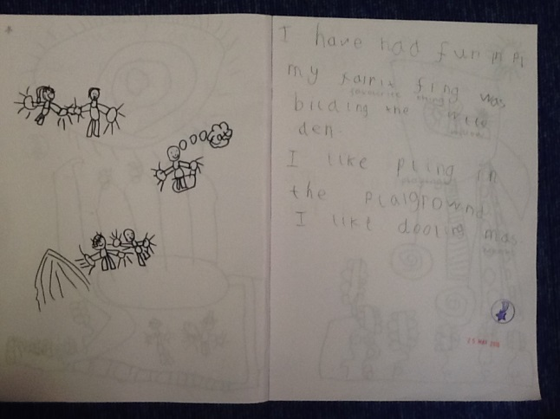
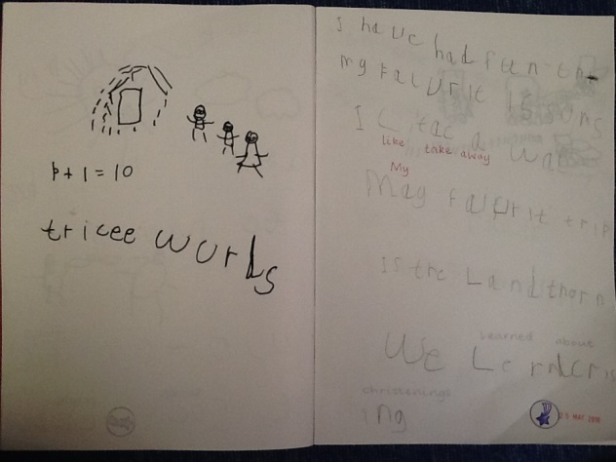
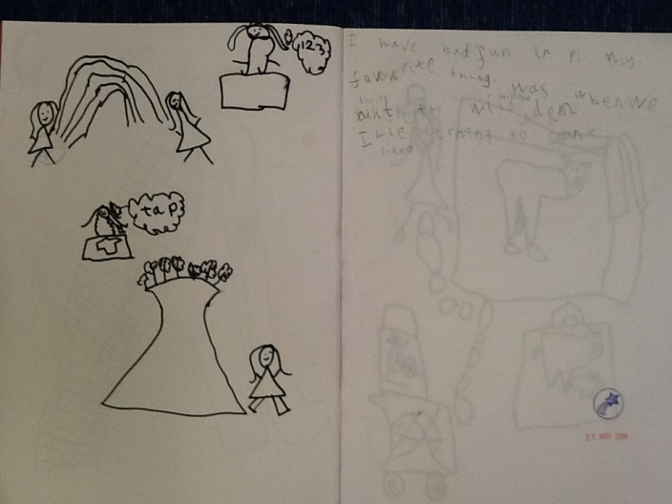
Literacy - Writing

Slide 18
Literacy – The Big Bedtime Read
At Williamston Primary School and Nursery Class we are passionate about giving your children the best start in life and helping them to ‘be the best they can be’ but this begins with you at home.
Building bedtime stories into your routine at home can:
* help your child become a confident learner
* establish a good bedtime routine
* improve concentration and behaviour
* help your child develop decision making skills
* improve attachment and bonding between parents and children
* be great fun for all the family!
So how will it work?
The Big Bedtime Read’s aim is to ensure that children are read a bedtime story on 4 or more nights a week. Children will receive a pack with 5 books to take home each week.

Slide 19
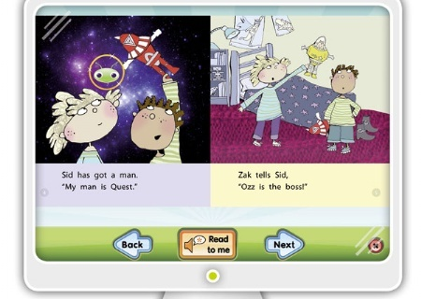
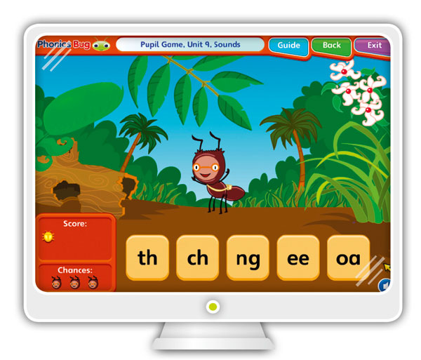
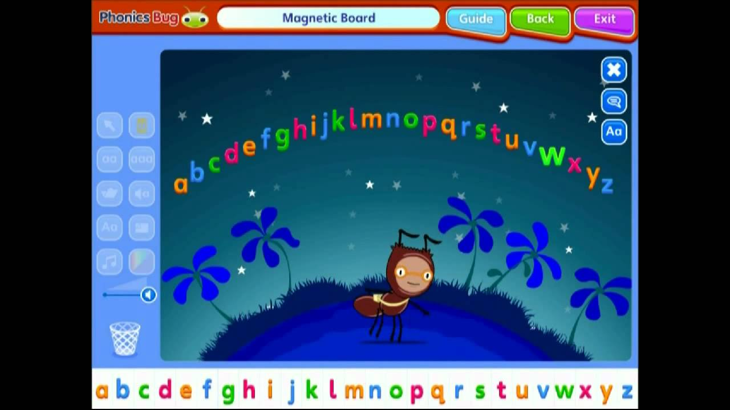
Literacy – Phonics Bug and Bug Club reading scheme
Reading using our books in class to support skills such as prediction and answering inferential questions.
Wonderful interactive teaching tools and games.
Reading online at home and completing game based assessments to promote enjoyment of reading.

Slide 20
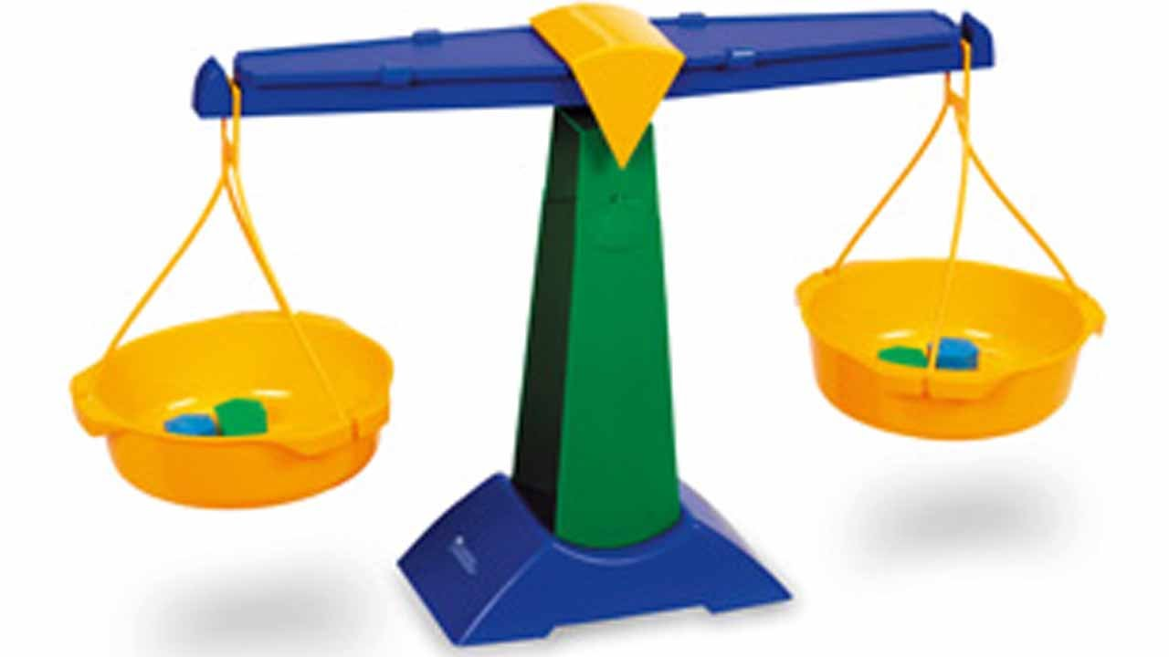
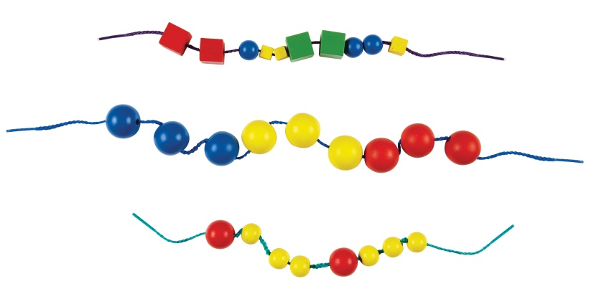
Maths

Slide 21
Welcome to ONE-derland! Questions?

Slide 22
Starting School

Slide 23
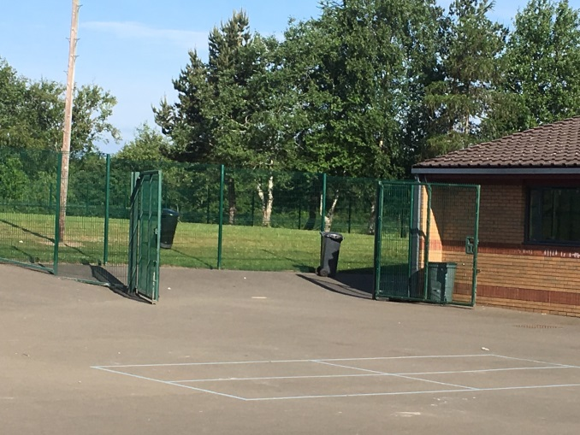
First Day – Where Memories are Made
All children will start on the first day and will be given a staggered start time.
Please arrive as close to the time given as possible
P1A – 9:10
P1B – 9:20
P1C – 9:30
Entrance to Primary 1 from the main playground
Parents are welcome to come in with their child and help them settle into the class.
A plea – only photograph your own child and be wary of posting on social media.

Slide 24
School Hours
Monday to Thursday: 8.50am – 3.15pm
Friday: 8.50am – 12.25pm
On the first day, please can all children be collected from the playground at 3pm unless attending wraparound.
Please make arrangements to walk as there is limited parking around the school.

Slide 25
Morning Safety at School
Breakfast Club
Available from 8am – from day two with no need to book.
If using the car park, parents should park in the drop off zone and escort their child to the breakfast club doors.
Children not attending breakfast club should be walked round from Bankton Lane to the playground at the rear of the school – playground supervision is in place from 8.30am, please do not arrive early.

Slide 26
Morning Safety at School
Late Arrivals
If your child is arrives after the bell, please take them to the office to collect a late slip.
We follow a Safe Arrivals Procedure – if your child does not register for school by 9:30am and we have had no contact from a parent/carer we would notify the Safe Arrivals Team who may contact you, visit you and if they cannot contact you, the police will be notified.

Slide 27
End of the day safety - Walking
Children will be released one-by-one from their class teacher to their known adult in the playground.
It is important that your child stays with the teacher until “their grown up” collects them.
If whoever normally comes to collect your child at the end of the day is late, your child will be taken to the main office.
Please notify the school of any changes to your child’s normal pattern of leaving school.

Slide 28
End of the day safety – Car or Bus
Children are escorted to the car line area and supervised by a member of staff.
Parents who wish to collect their child by car will need to park in the turning circle, get out of their car and collect their child from the gate.
Children will not be allowed to leave the playground until an adult comes to collect them.
Children who take the bus will be escorted from the school to the bus by a member of staff.

Slide 29
After School Care
Children who attend Simply Play will be collected at the school and escorted to their relevant locations.
Wraparound Care is provided within the school Nursery playroom and children who use this service make their way to the Nursery at the end of the day.

Slide 30
Wraparound
Miss Emily Peat – Wraparound Team Leader

Slide 31
When you receive your contract what do you do?
Contact wraparound on 01506 416 093.
Fill in a registration pack filled with emergency contacts, EE2 forms and medical information.
Medication must be brought in a container and paperwork must be filled in. School and wraparound need their own.
A contract must be signed by you to pupil placement before your child can attend wraparound.
We will not know who we are getting until you do!

Slide 32
Transition from class to wraparound
Children are collected from their classrooms.
Register the child with a member of staff.
Children choose what they would like to do inside the playroom.
Have an afternoon snack
A choice of play before a quiet story to end the day.

Slide 33
Your child will need know
They need to know the days they attend wraparound.
To remember all their belongings in their classroom when being collected from staff.
To know which after school clubs they attend.
To respect and follow all rules of the playroom and school.
To have fun!

Slide 34
What you need to bring
To bring indoor shoes for inside the nursery.
To wear suitable clothing for each day.
Sun cream when the weather gets better.
Medication

Slide 35
School Holidays
Paperwork will be given to fill in a month before each holiday this will allow your child to attend.
No charge when not using the holidays.
Opening hours 8am – 5:30pm
Session choices:
Full day - 8am-5:30pm
Half day - 8am-1pm or 12:30pm-5:30pm.
Packed lunch must be brought.
Breakfast offered from 8am-9am, AM and PM snack will be provided both for a small fee (to be confirmed)
A fun range of activities and games will be provided and the children choose their own day.

Slide 36
Conclusion
We aim to create a fun and stimulating environment for every child.
Each child has a choice to voice their own opinions of what they would like to do.
Any questions come and ask at the end of the induction.

Slide 37
Preparing for School

Slide 38
Snack and Lunch
Morning break 10.30-10.45am
Children will need:
one small healthy snack
suitable shoes and outdoor clothes.
Typical lunch time for P1 is 12:15pm - 1pm however pupils will have an early lunch in term 1.
Children can have a school lunch, packed lunch or a home lunch.
Lunches need to be ordered on a Monday using the Ipay system (log in details will be sent out in August).

Slide 39
Getting ready for school
Practise dressing skills… buttons, shoes, jumpers, buckles – please avoid shoes with laces unless your child can confidently tie their laces.
Encourage handling of pencils, books, crayons and scissors… share with others … listen to and follow instructions … tidy up
Train your child to follow basic hygiene routines independently

Slide 40
School uniform
White or maroon polo shirt
White shirt or blouse with school tie
Grey or maroon sweatshirt/jumper/cardigan
Grey skirt/pinafore/trousers
Suitable outdoor shoes and indoor shoes

Slide 41
What does my child need for starting school?
School Uniform – please take a look at the back of the hall
Change of shoes for break and lunch– named (to be kept in school)
Indoor and Outdoor P.E. Kits in bags – named (to be kept in school)
No football colours please.
Indoor PE kit | Outdoor Learning/PE kit
White T-shirt | Jumper/Fleece
Black shorts | Joggers/Leggings
Trainers or gym shoes | T-shirt
 | Outdoor shoes Water proofs

Slide 42
Positive Behaviour
Repairing relationships through Restorative Practice.
Stickers, awards, public praise and visit to HT, DHT or PT
Positive feedback to parents/carers
House points
Growth Mindset – ‘I can’t do it, yet!’

Slide 43
Medication and Absense
If your child requires to take medication during school time, parent/carers must complete forms which are available from the school office
It is essential that you contact the school as soon as possible, if your child is too unwell to attend school
Please be aware that if your child has sickness and/or dia they should be 48 hours clear of symptoms before they return to school.

Slide 44
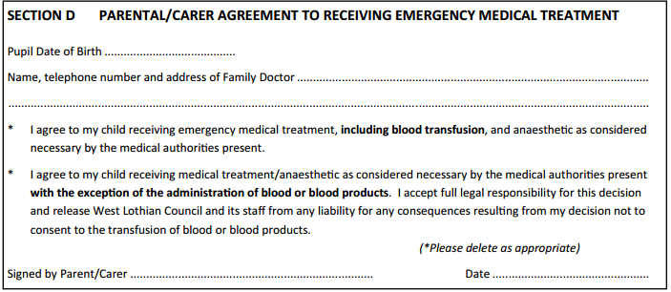
EE2 Forms for Trips

Slide 45
Parents/ Carers visiting school
All doors locked, entry system in place
Always report to the school office
Parents can speak to P1 teacher informally about concerns or small issues at the end of the day – please wait until the teacher has dismissed the full class
Appointments can also be made to discuss larger concerns

Slide 46
iJournALs
Tracks child’s progress through Early Level experiences and outcomes and beyond.
Evidenced by photographs, pieces of work, assessments and staff observations.
Sharing with parents

Slide 47
Additional Information
Information packs at back of the hall – please return all documents before the end of term where possible.
School Uniforms are available at the back to get an idea of style and size
Emily Peat and the SLT will be on hand to answer any questions you ma have

Slide 48
PSA

Slide 49
Thank You!

