Slide 1

Welcome to Williamston P.S.
Early Learning and Childcare
Mrs Roisin Thomson
Principal Teacher for the Early Years

Slide 2
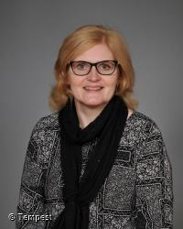

Senior Leadership Team
Mrs Fiona Hollands – Head Teacher
Mrs Lynn Dare – Depute Head Teacher

Slide 3


Senior Leadership Team
Mrs Roisin Thomson – Principal Teacher for the Early Years
Mrs Karlie Gray – Principal Teacher for Support for Learning

Slide 4

The Early Years Team
Miss Laura Purves – Early Years Officer

Slide 5



The Early Years Team
Miss Lorna Green – Early Years Practitioner
Mrs Doris Stewart – Early Years Practitioner
Miss Emily Peat– Nursery Nurse

Slide 6
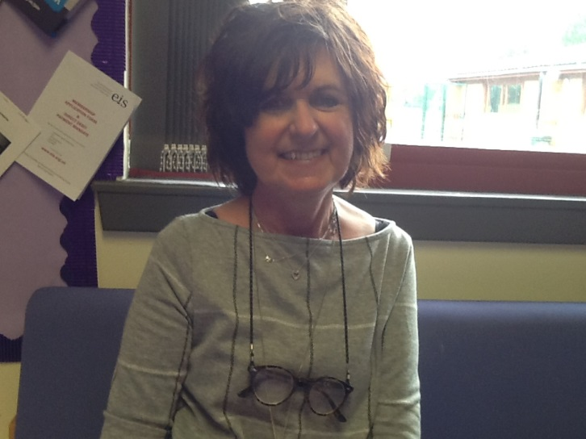
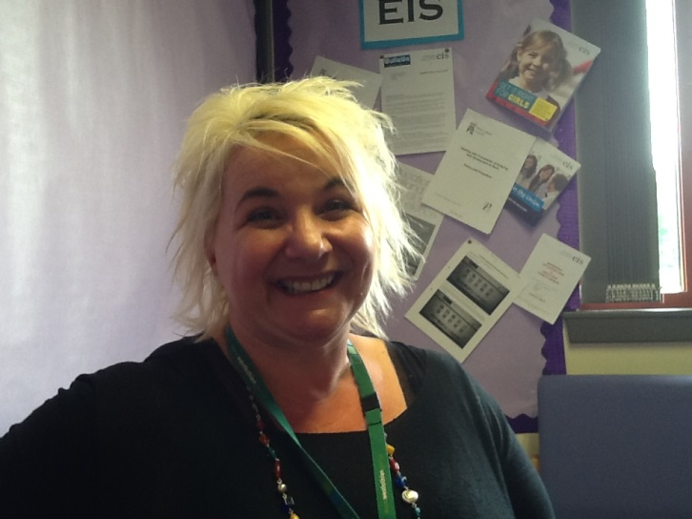
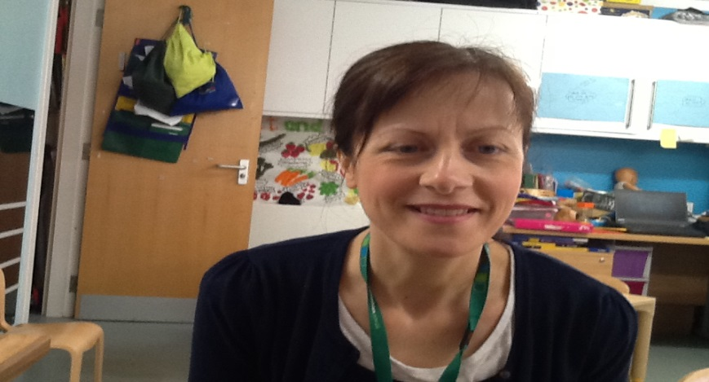
The Pupil Support Workers
Mrs Maureen Inkster – Support Assistant
Mrs Jo McNaughton – Support Assistant
Mrs Alison Orr – Support Assistant

Slide 7
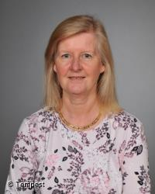
The Early Years Team
A Wraparound Team Leader and Care Assistant will be appointed in due course
Mrs Jacquie Cowan
Wraparound Care Assistant

Slide 8
Important Information
Morning Nursery
Monday – Thursday: 8am – 11:10am
Friday: 8am – 11:08am
Afternoon Nursery
Monday – Thursday: 12:15pm – 4:12pm
Full day Nursery 8am – 4pm (possibility of childcare until 5:30pm)
Our Blog: https://blogs.glowscotland.org.uk/wl/williamstonprimaryschool/
Follow us on Twitter : @williamstonNurs

Slide 9
Nursery Groups

Slide 10
Key Worker System
To be the safe and secure link person between home and school
To undertake the tasks of assessing, recording and reporting on your child’s progress
Your child will have the same key worker as far as possible for the duration of their nursery experiences.

Slide 11
Curriculum for Excellence
Numeracy and Mathematics
Literacy
Health and Wellbeing
Expressive Arts
Technologies
Sciences
Religious and Moral Education
Social Studies

Slide 12
Building the Ambition
Principal drivers for children’s experiences in Early Learning and Childcare settings
Communication
Wellbeing
Motivating and Challenging contexts

Slide 13

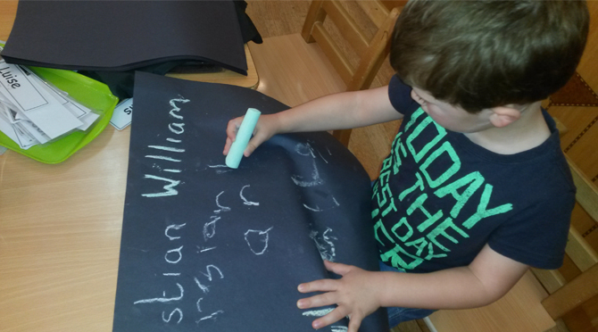
Communication Zone
Story corner
Listening Centre
Mark making
Smartboard

Slide 14
Outdoor Zone
Bikes and scooters
Garden area / mini-beast hotel
Assault course, slide
Book Nook
Sand pit
Transient Art Area
Visual stimulation

Slide 15
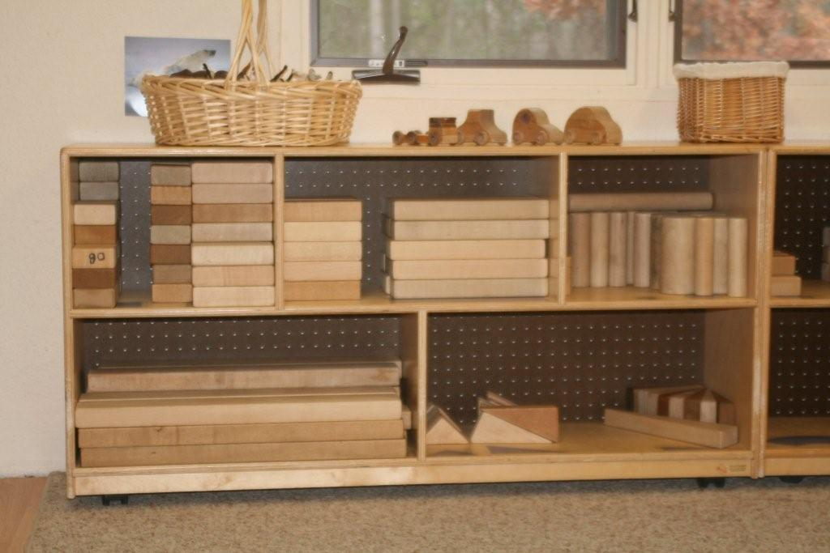
Imagination Zone
Block play
Small world
Prop play

Slide 16

Creative Zone
Painting
Craft
Role Play
Drama
Transient art

Slide 17
Sensory Zone
Playdough
Sand
Water
Music area

Slide 18

STEAM Zone
Science – exploration and discovery
Technology – screws, hammers, nails,
Engineering – making hinges, folding paper etc
Art – paint, mixing, experimenting
Maths – jigsaws, number, games and puzzles

Slide 19

Snack
Health Promoting School
Encourage independence
Social experience

Slide 20

Learner’s Journey
Tracks child’s progress through Early Level experiences and outcomes
Evidenced by photographs, pieces of work and staff observations
IjournAL
Shared with parents
Assessment

Slide 21

Parent Partnership
Involvement in all aspects of nursery
Parent helpers – We need you!
Stay and Play
Talents
Open door policy

Slide 22
Other Information…
If you were not able to attend our Information Morning or Stay and Play Session your pack including a start date will be sent to you.

