Slide 1
Online Learning Journals
Mrs Roisin Thomson
Principal Teacher (Acting)

Slide 2
Traditional Learner’s Journey
Tracks child’s progress through Early Level experiences and outcomes
Evidenced by photographs, pieces of work and staff observations
Online Learning Journals
Shared with parents
Assessment

Slide 3
Online Learner’s Journey
Accessible online 24 hours a day.
Secure encryption with passwords set by yourselves
“Home Links” and “Personal Achievements”
Provides a talking point about learning at home.
Nursery and Primary 1
Primary 2 – Primary 7

Slide 4
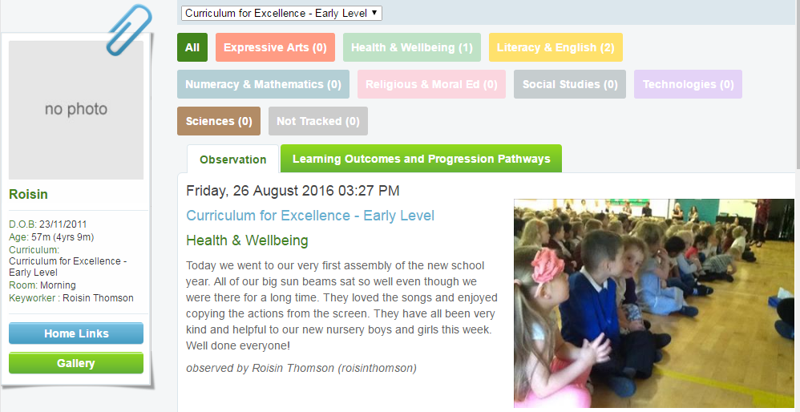
Online Learner’s Journey – P2-P7

Slide 5
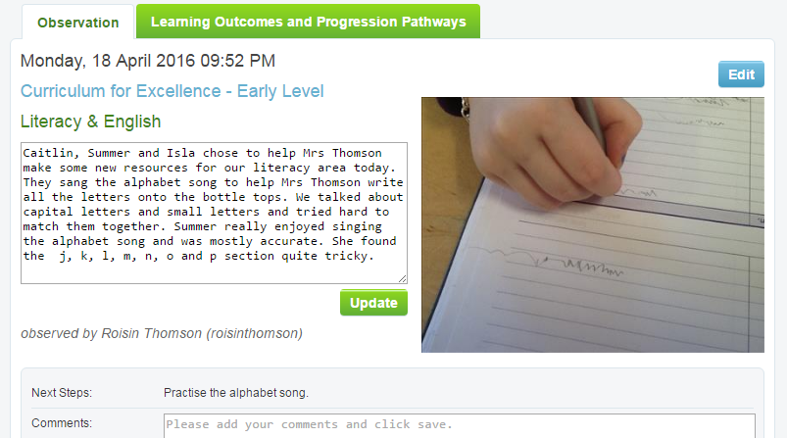
Online Learner’s Journey – Nursery and P1

