Slide 1
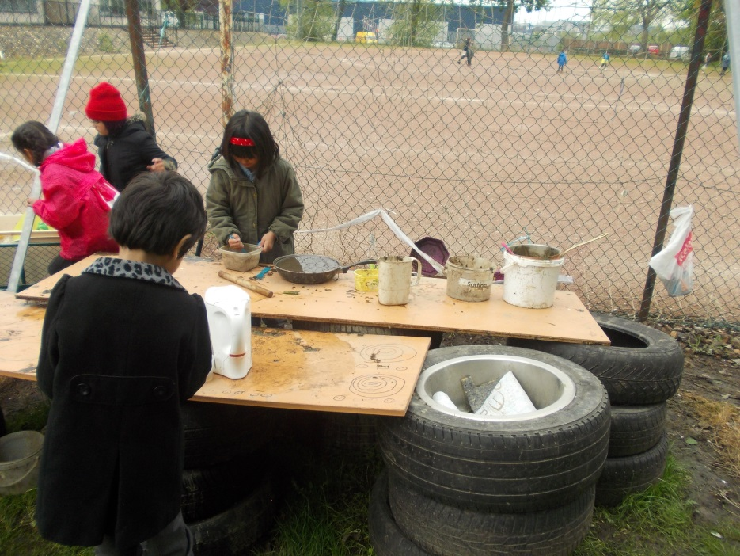
Outdoor Learning and Play at Williamston Primary School

Slide 2
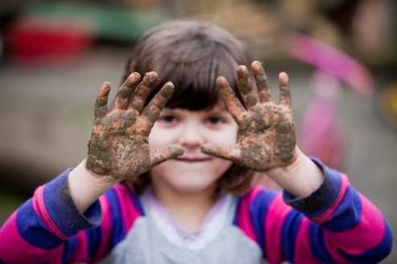
Importance of Play
Develop healthy, active lifestyles
Unique experiences with the natural world such as weather and the seasons
Respect nature and the environment
Problem solving skills, creativity and inventiveness
Play safely and freely while learning to manage and assess risk

Slide 3
Outdoor Learning

Slide 4
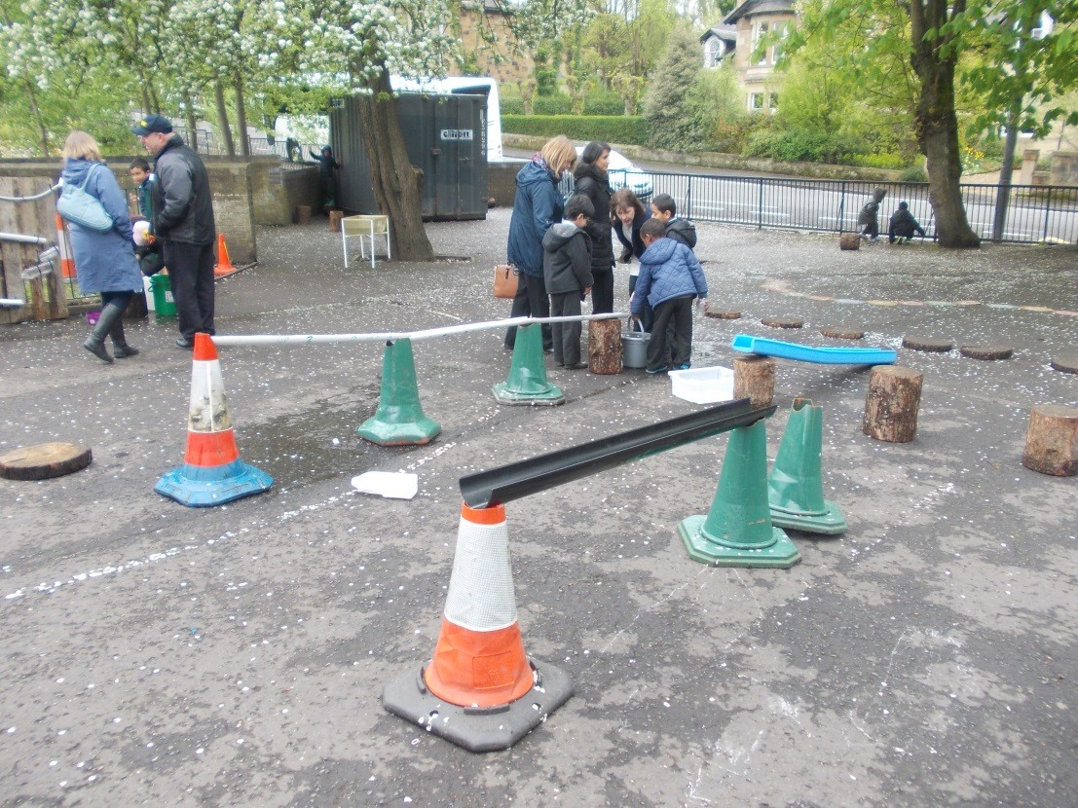
Loose Materials

Slide 5
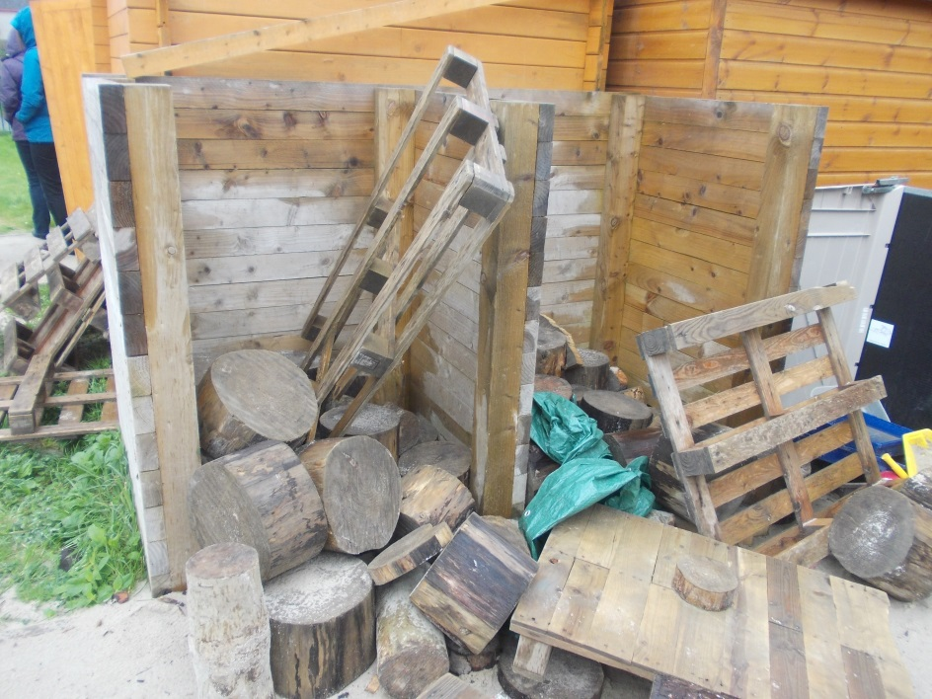
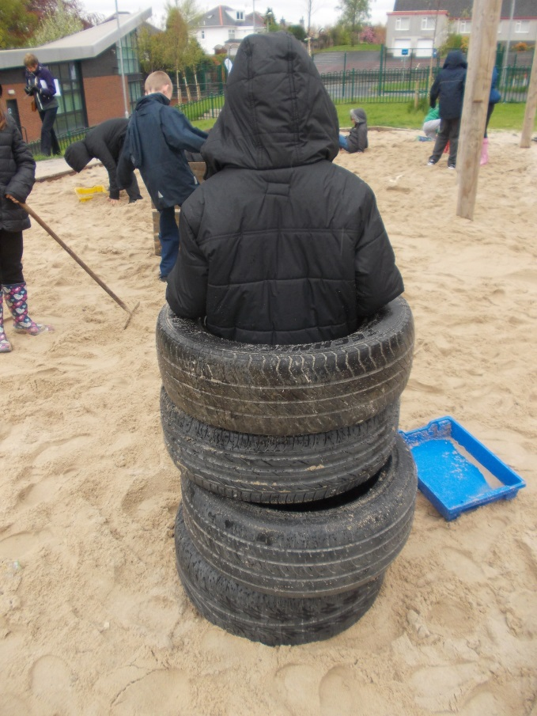

Slide 6
Container
PSA money £2500

Slide 7
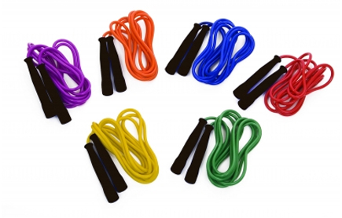
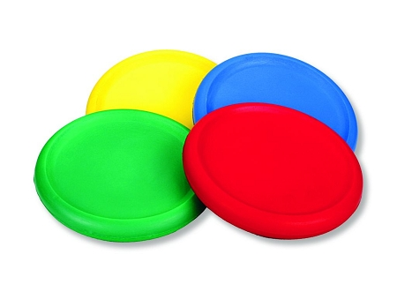
Play Equipment
Sainsury’s Vouchers and PSA money

Slide 8
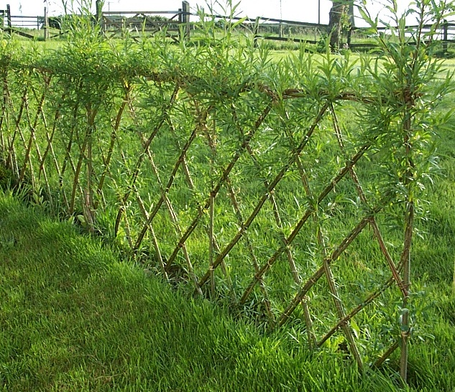
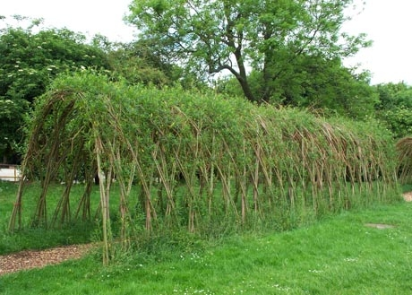
Willow Work
PSA money £1000

Slide 9
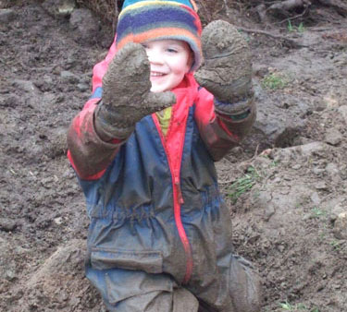
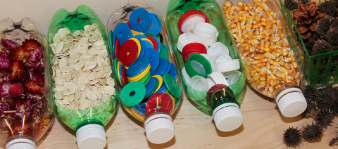
How can you help?
Ensure your child has access to appropriate clothes for the weather
Provide a change of shoes and waterproof bottoms to allow access to the field
Support the PSA
Lend a hand…. Friday September 23rd – Day of Work or become a parent helper

