Slide 1
Meet the Teacher
Miss McMillan – P4A
Mr Mackie – P4B
Session 2016-2017

Slide 2
The Four Capacities
Learning through Play
Skills for life, learning and work
Growth Mindset
L
Outdoor Learning
Our School Motto: Be The Best You Can Be!
Article 29: Children’s education should develop each child’s personality, talents and abilities to the fullest.
Eco Schools
Vertical Learning
Rights Respecting School
Connecting Classrooms
Pupil Voice
SHANARRI
Assessment of Learning ; Assessment for learning and Assessment as learning.
Parents as Partners

Slide 3
Staff
Throughout the year, your children will also be taught by specialists.
This term they will be:
Mr Eoin Swan – Tennis Coaching (Tuesday)
Ms MacDonald – Music (Wednesday)
Mr Muldoon – P.E. (Thursday)
Other teachers may include – Mrs Hardie, Mrs Logan. Miss Trotter.
Mrs Rutherford - Support for Learning teacher.
Other adults support the children in school and in the playground, including: Mrs McNaughton, Mrs Inkster, Mrs Waterston, Miss K Brown, Mrs Orr and parent helpers.

Slide 4
Outdoor Learning
We are developing our use of outside areas, both within and outside the school grounds.
It will be used to enhance children’s learning across the curriculum.
Active learning outside enthuses, motivates and challenges children.
It develops communication, teamwork and problem solving skills.
Learning outdoors develops children’s knowledge, enjoyment and respect of our local environment.

Slide 5
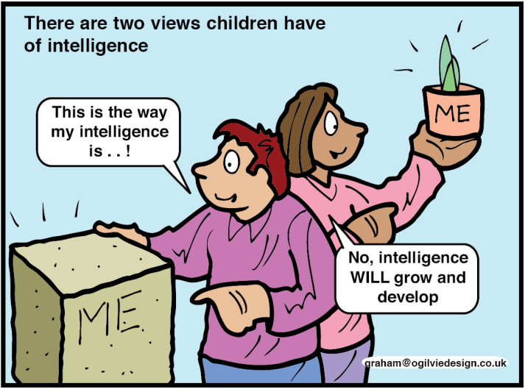
Mindset-the psychology of learning “I can’t do it…yet!”
‘Fixed’ Mindset
‘Growth’ Mindset
Abilities can be developed through dedication and hard work. Brains and talent are just the starting point.
Learning to learn: children should understand how they learn, including the ‘brainology’ of it. (Carol Dweck).
teachers encourage students to believe that they can learn more and become smarter if they work hard and practice.
“You must have worked very hard’.
Having a ‘fixed’ mindset can limit learning. Believing you are either ‘smart’ at something or that you are not good at it and that failing just proves this.
“You are smart”.

Slide 6
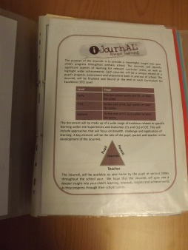
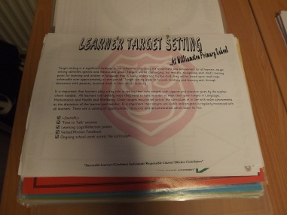
I-JournAL
Is a Pupil Profile that builds on the Learner’s Journey which is currently used in Nursery.
An individualised document and process that captures the rich and significant learning for every learner.
A document and process that enables learner/staff/parents/carers to have regular input and involvement.
Shows evidence of planning, individual target setting, significant learning, assessment and wider achievement both in and beyond school.
Provides regular updates on progress and achievement.
Each document will contain the progress in learning for each level.
Opportunities for children, parents and staff to make comments on learning progression and next steps.
.... is a much loved story of your child’s journey through Primary School.

Slide 7
Primary 4 Interdisciplinary Topics
Wonderful Water
(September - November
Scotland
(November – February)
Enterprise (Comic Relief)
(March)
P4 Show
(April – June)

Slide 8
Life in Primary 4
You will be notified of any outings this year.
Other events throughout the year may include:
woodland visits (e.g. pond dipping)
outings within the local area
focus weeks and special days (e.g. Roald Dahl)
Sport festivals (e.g. Handball Festival)
P4 Chaplaincy Service with cluster schools
Keep up to date with what’s happening with our
blog and school twitter.

Slide 9
P4 Expectations…
Personal organisation including outdoor shoes.
PE Kit in on Mon-Fri (In addition, sometimes an outdoor PE kit will be required)
Uniform
Behaviour- Golden Time, time-out, class reward system, choose time, house points.
Responsibilities- re-cycling, classroom, playground, pupil groups.
Hometime - Please remind your child where they are going at the end of the day and how they are to get there.

Slide 10
Using iPayimpact
We encourage you to use iPayimpact where possible to order and pay for lunches
Any lunches you want to pay for in cash, please put in a sealed and labelled money envelope before sending into school

Slide 11
Thank you for coming!

