Slide 1
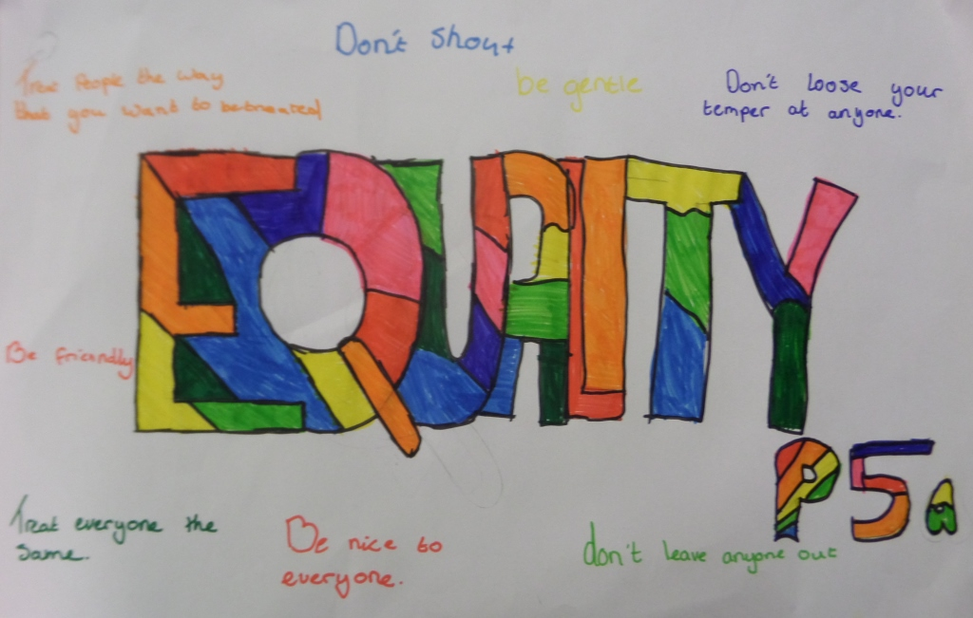

Slide 2
Article 2
The convention applies to every child, regardless of race, colour, language, place of birth, religion, politics, disability and status
Article 1
Everyone under the age of 18 has all the rights in the convention

Slide 3
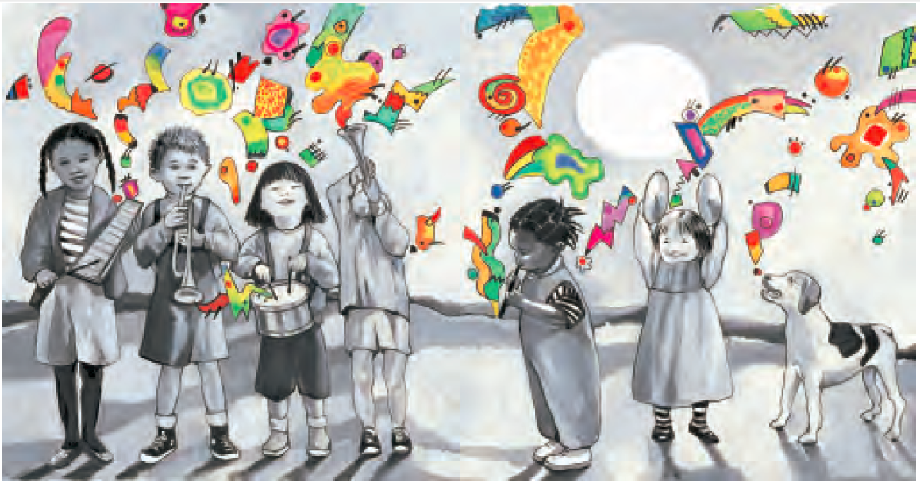

Slide 4
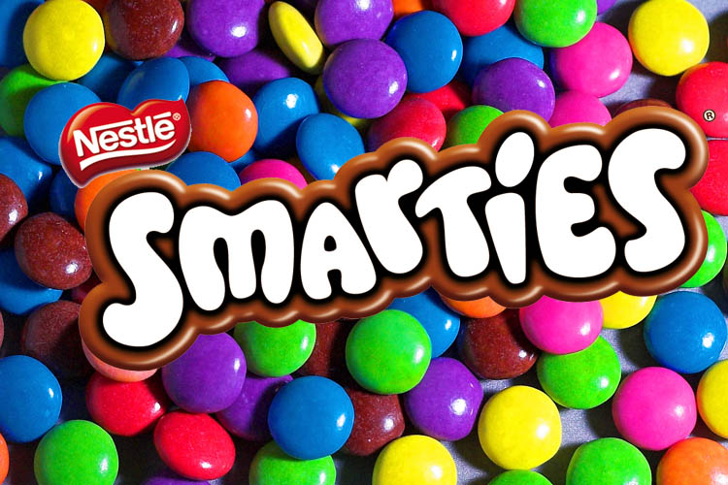
Smarties Video

Slide 5
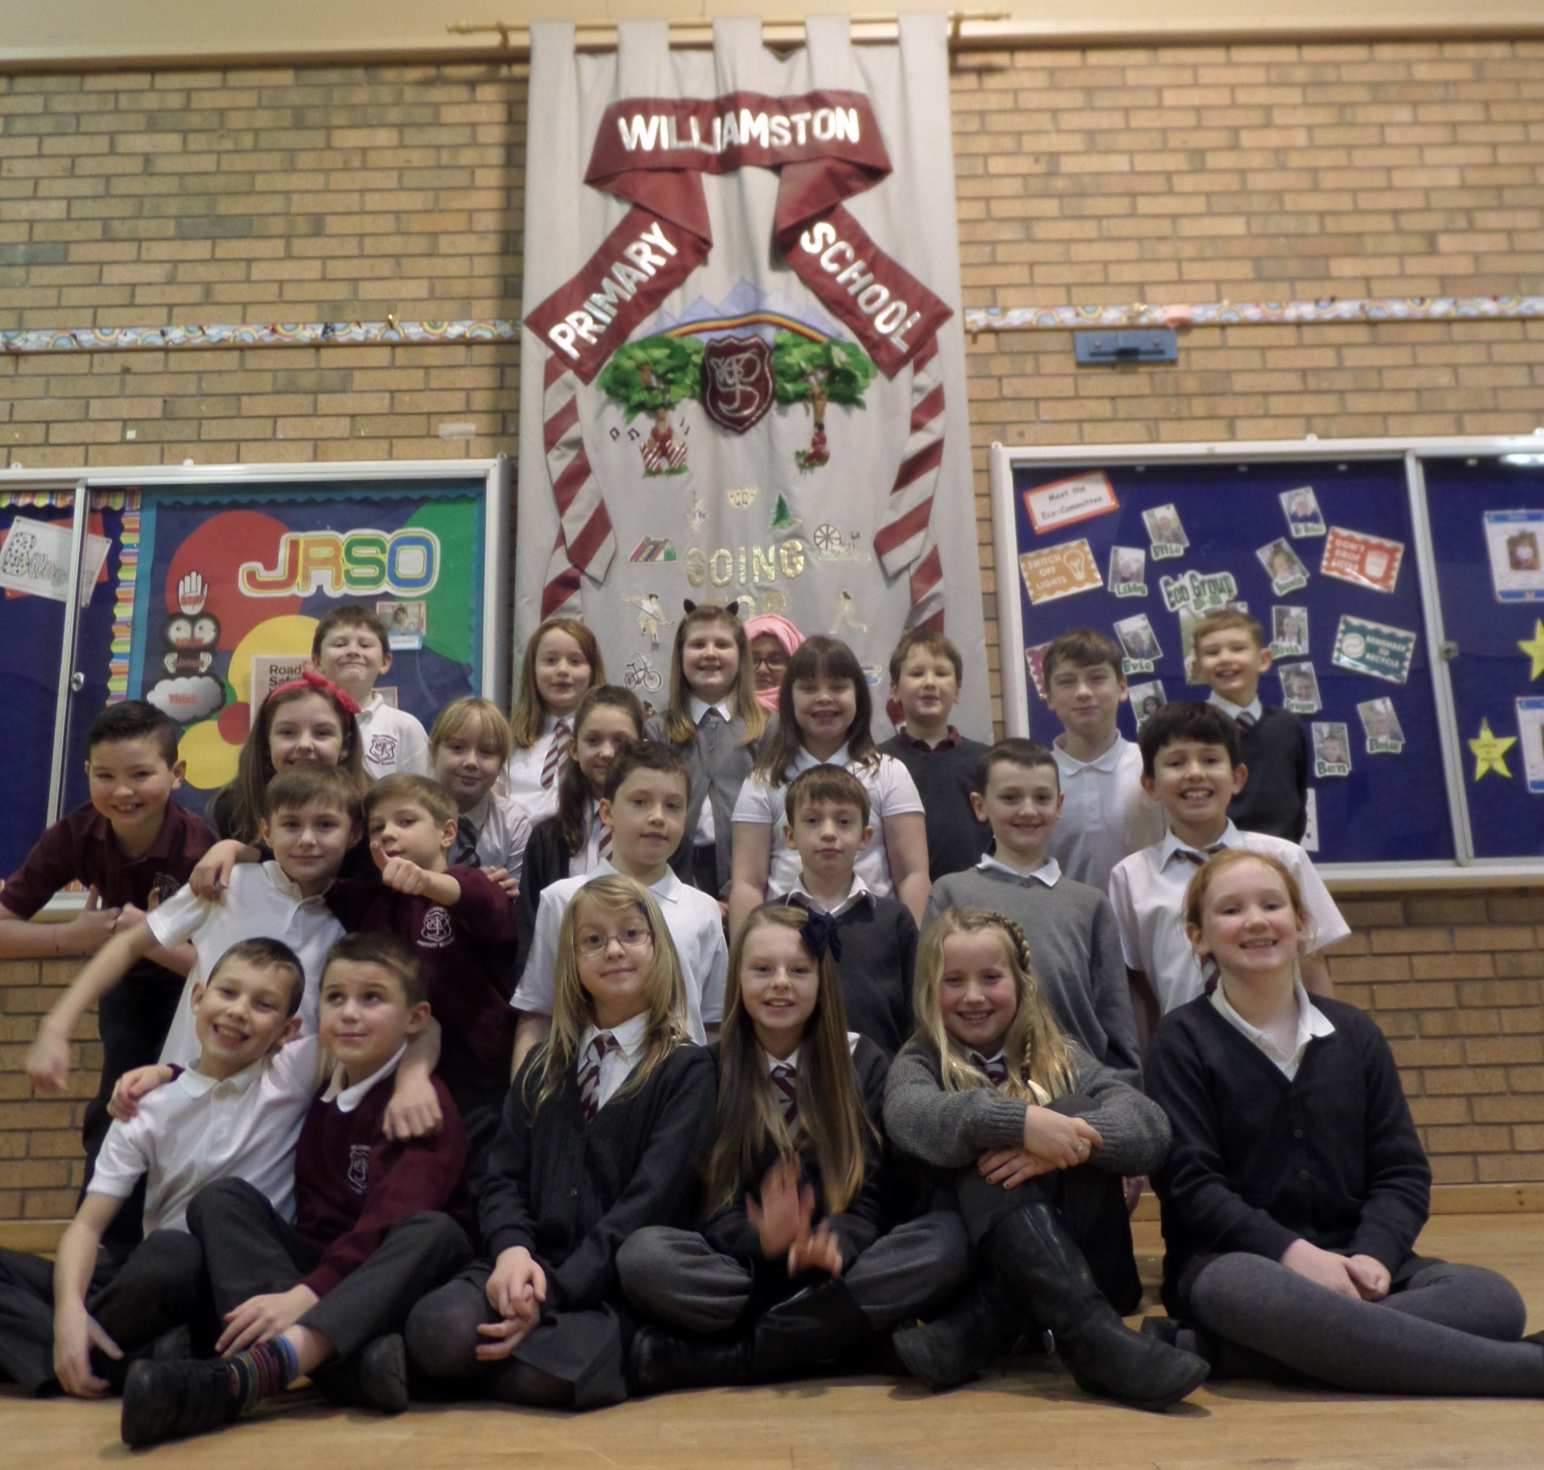
Williamston Primary

Slide 7
Anne Frank

Slide 8
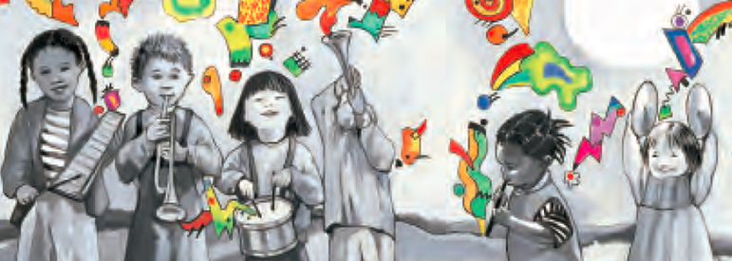
Every Child Has Rights
Every child has a right to dignity, life and liberty, Justice in the law
Every child has a right to company, friends and family,
With no fear of war
To every child their own identity, nationality, Time to rest and play
To every child of each ability each necessity, Growing from day to day
Children have the right to be healthy, to go to school and learn
And say their prayers in their own religion’s words
Anytime and anywhere around the big wide world
These are the rights of every boy and girl

Slide 9
Every child has a right to safety, free from slavery,
Somewhere to call a home
Every child has a right to security, confidentiality, Language of their own
To every child responsibility, sensitivity To all the people of Earth
To every child their individuality in diversity, Knowing each others’ worth
Children have the right to speak and have their voices heard
What’s best for them should be the main concern
Anytime and anywhere around the big wide world
These are the rights of every boy and girl
Anytime and anywhere around the big wide world
These are the rights of every boy and girl
These are the rights of every boy and girl
Yes, these are the rights of every boy and girl

Slide 10
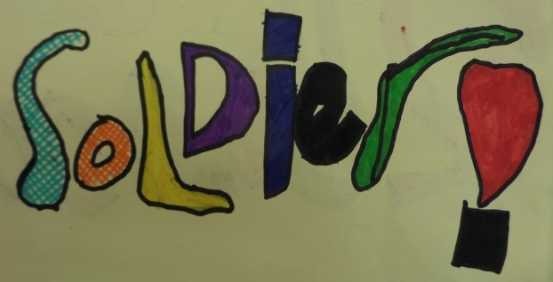
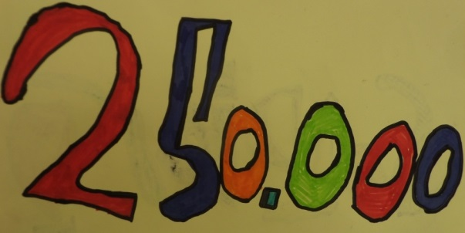
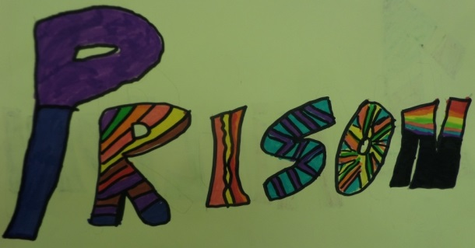
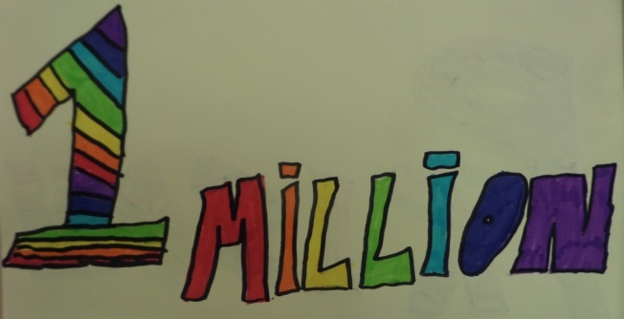
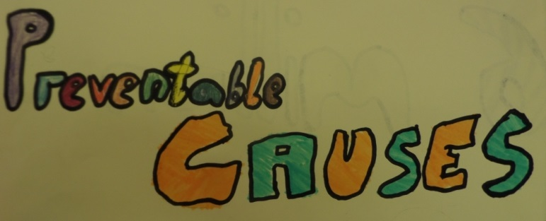
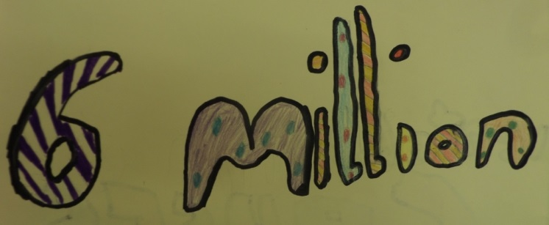
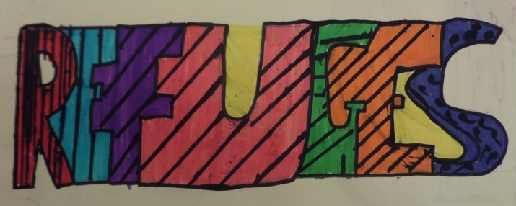
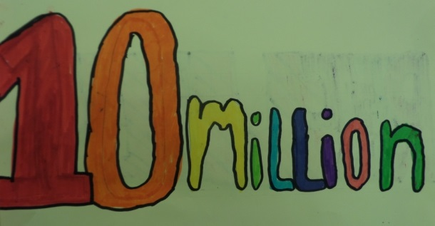

Slide 11
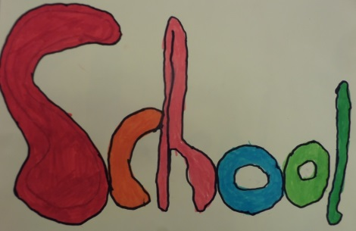
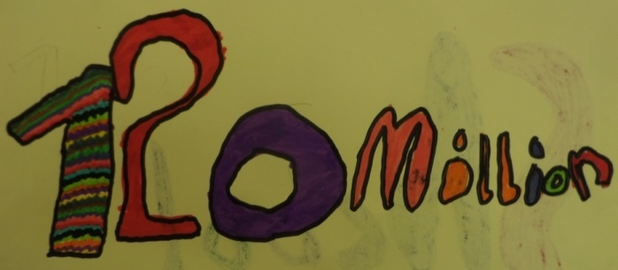
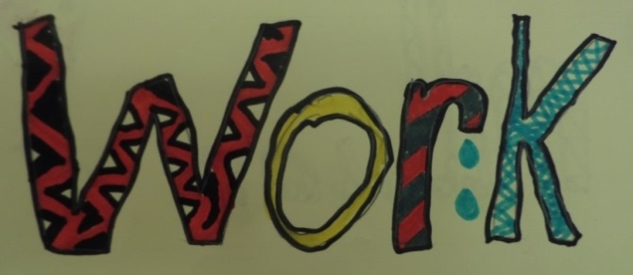
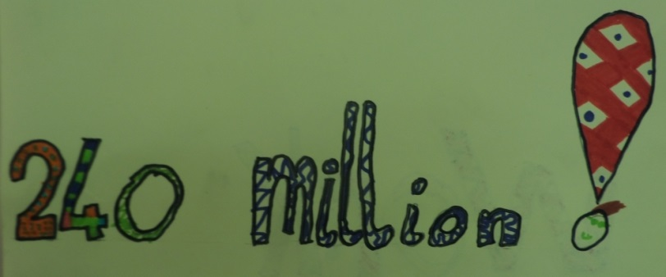
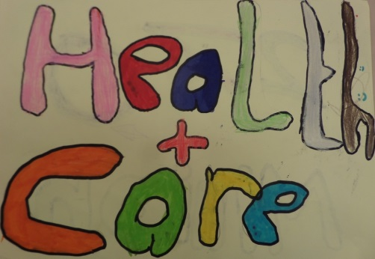
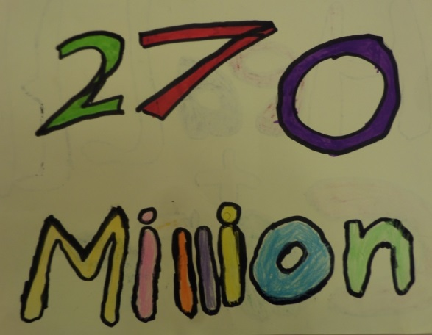
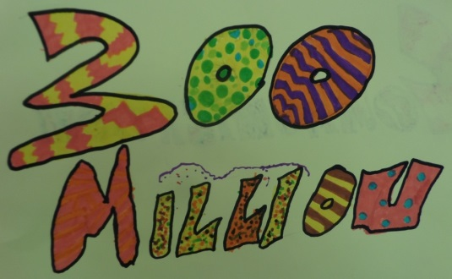

Slide 12
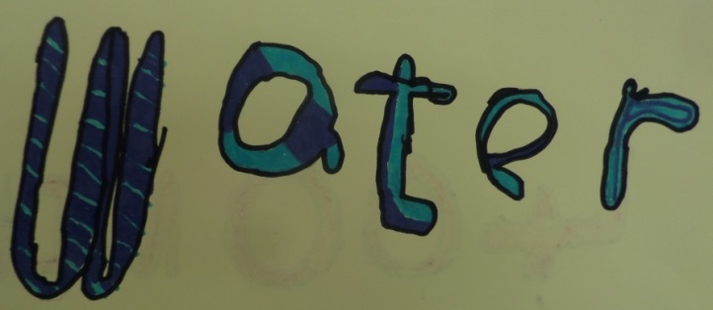
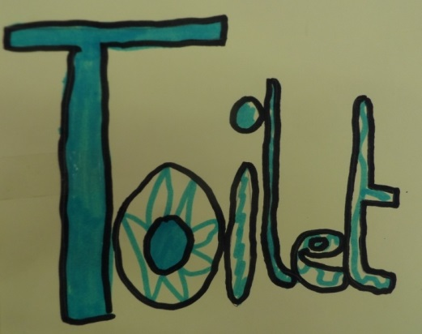
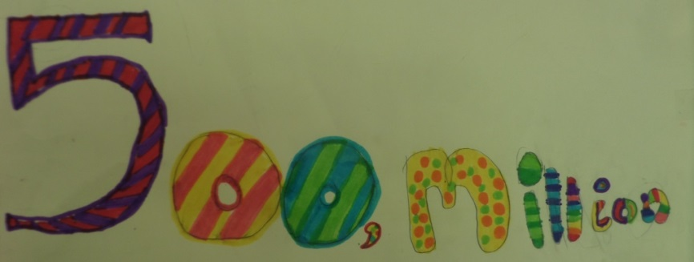

Slide 14
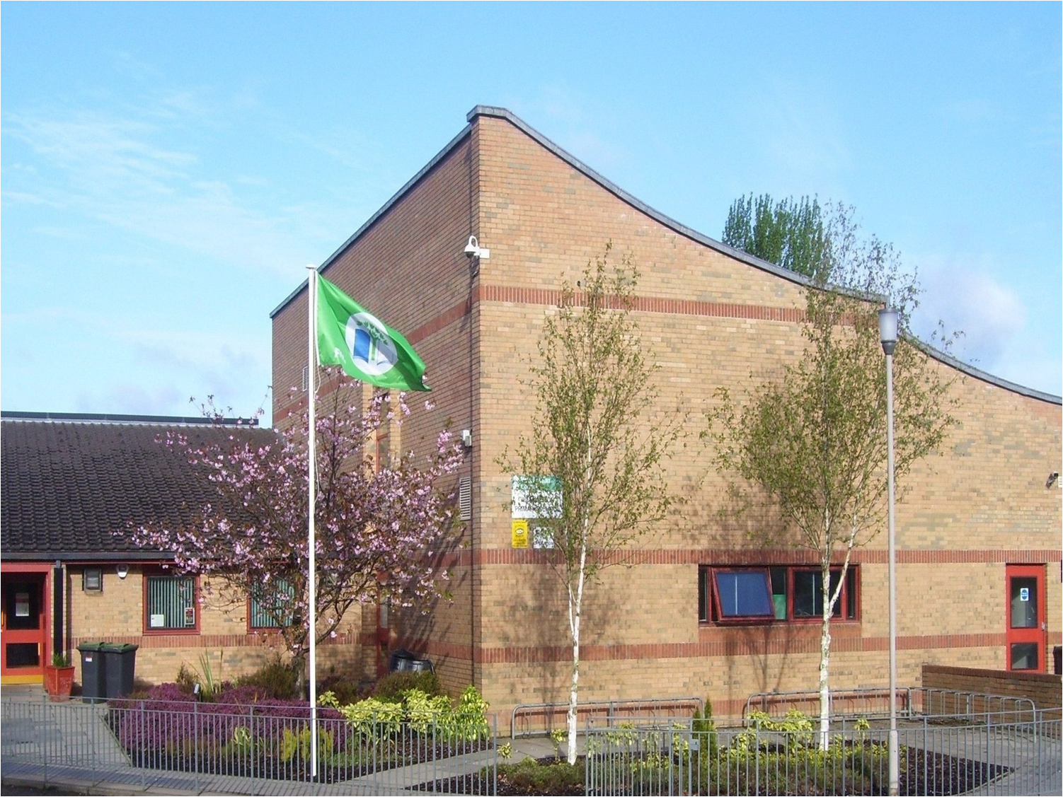
Williamston Primary School

Slide 15
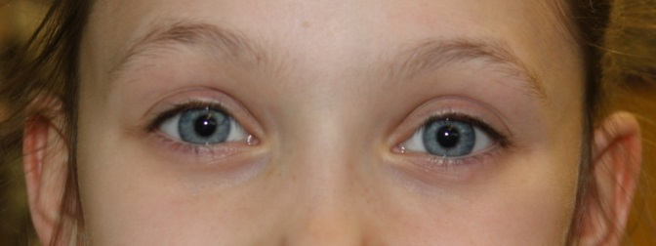
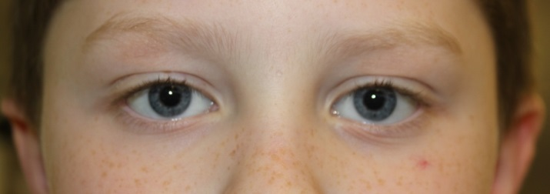
1
2
3
4
5
6
7
People with blue eyes must wear their 'Blue Eyes Sticker' at all times so they can easily be identified.
At listening time, they must sit at the carpet, while others can sit in their chairs.
Those without blue eyes will always have the right to speak first.
Blue eyed people must wait for everyone else to leave for break before they may go.
At break time blue eyed people must only use the infant playground.
People with blue eyes must not play with others.
People with blue eyes will be served last.

Slide 16
Sad
Annoyed
Unloved
Neglected
Disliked
Depressed
Mad

Slide 17
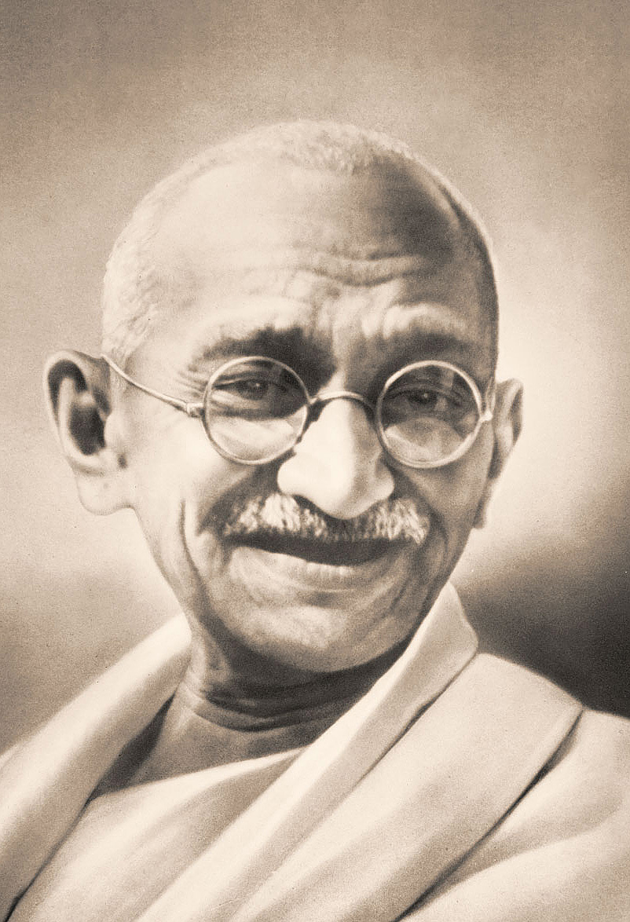
Mahatma Gandhi

Slide 19
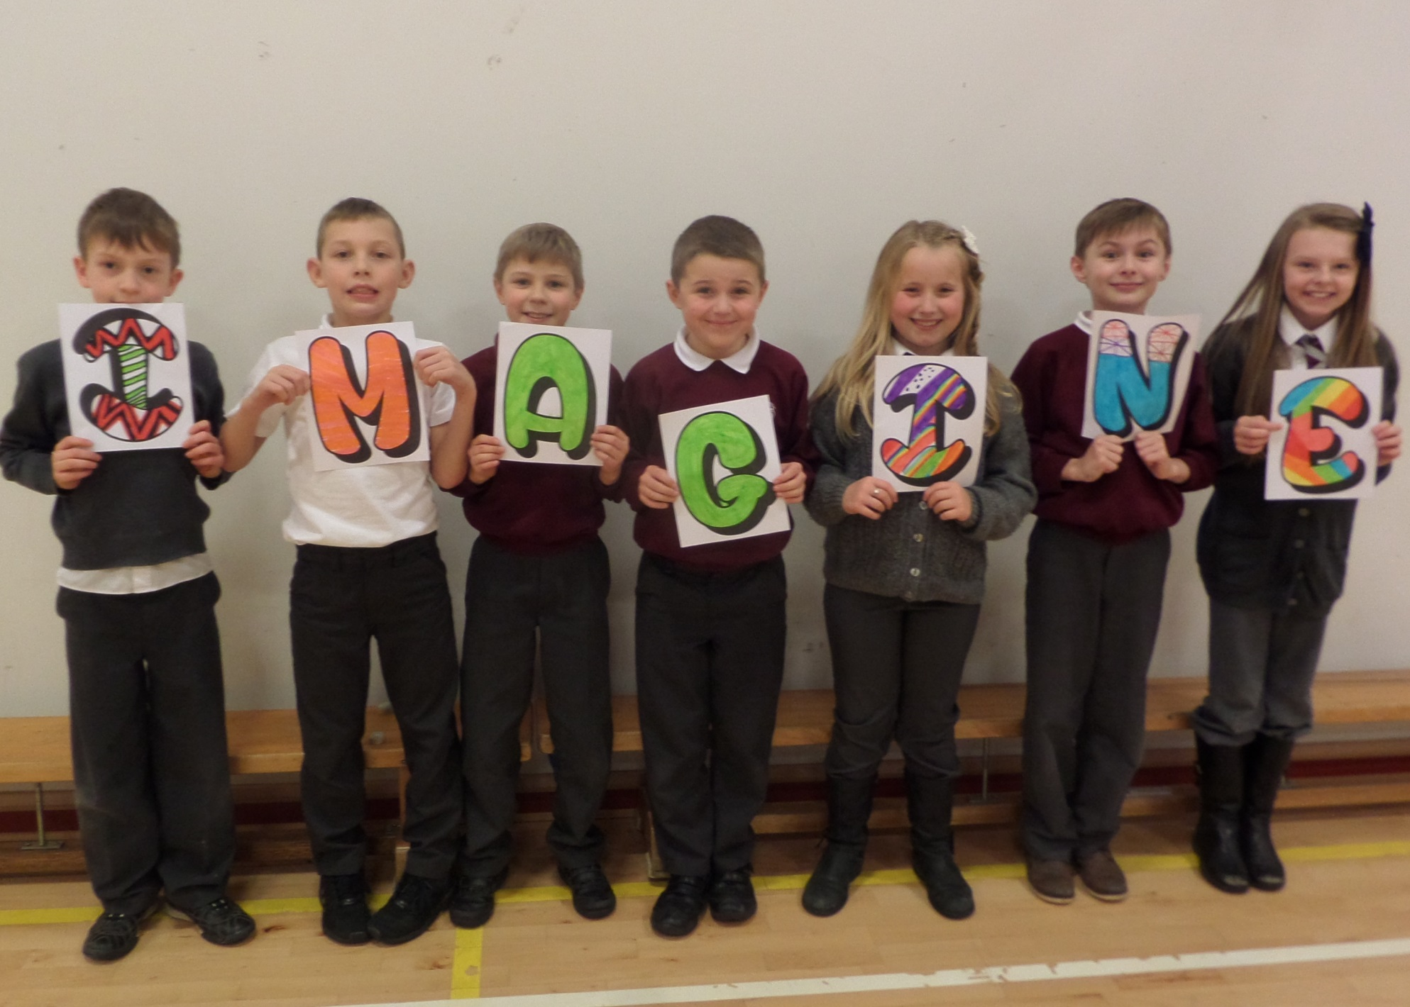

Slide 20
