Slide 1
Merry Christmas & a Happy New Year
From Williamston Primary School.

Slide 2
Our Christmas card
This is one of the winners of the Christmas card competitions.

Slide 3
A Christmas card with relaxing fire
A Christmas card with a fire for Father Christmas.

Slide 4
A very happy Christmas tree that is excited for Christmas

Slide 5
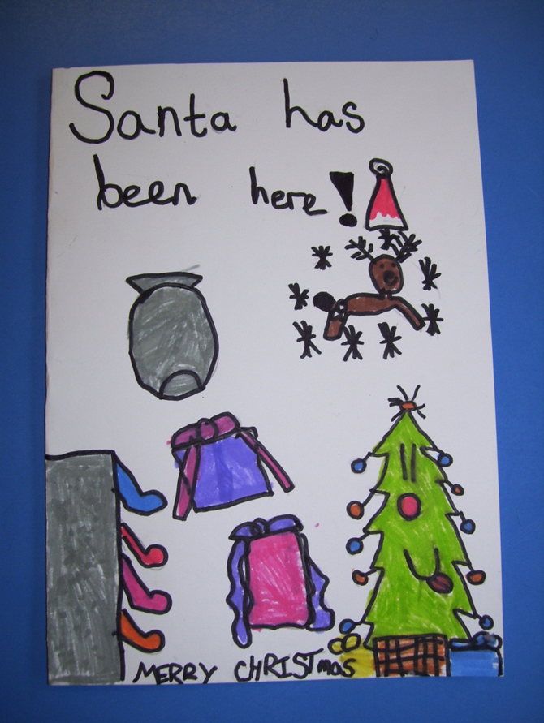
This is describing a very merry christmas
Christmas time has finally come !

Slide 6
Santa’s hat !
A wonderful drawing of Santa’s hat .

Slide 7
Some festive Christmas art
Each class created a piece of art based on a famous Christmas song…

Slide 8
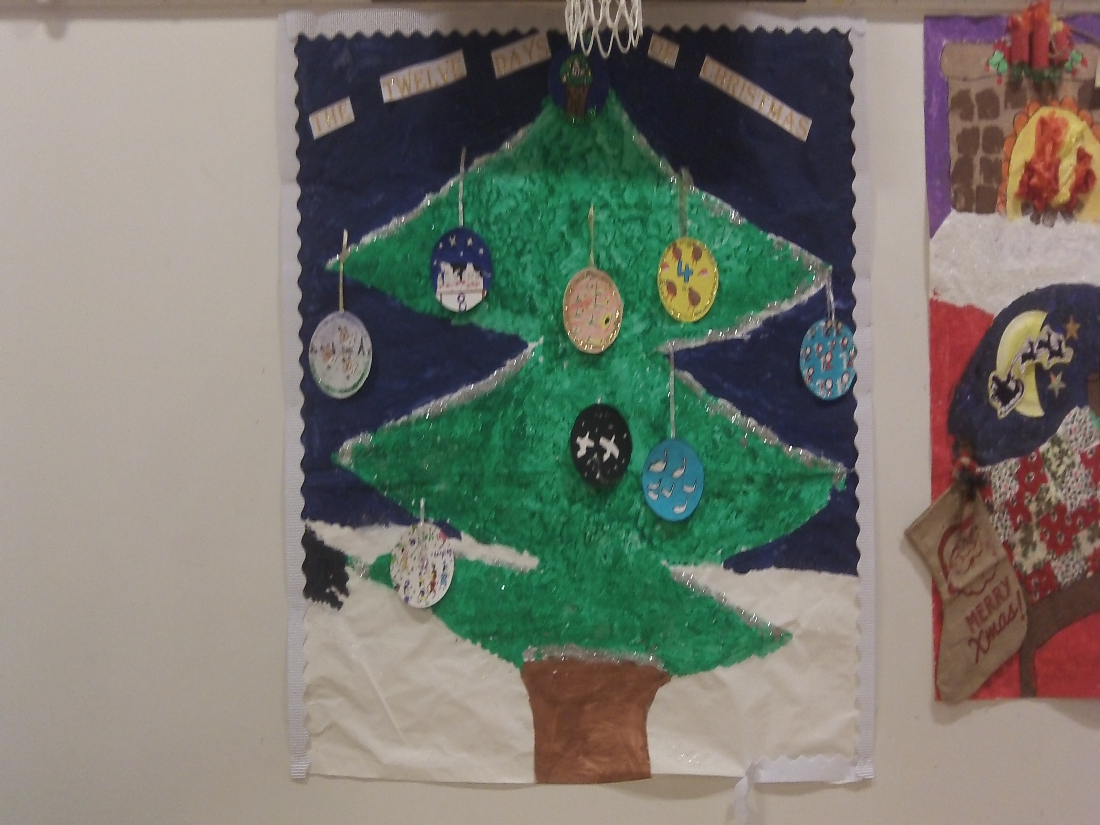

Slide 9
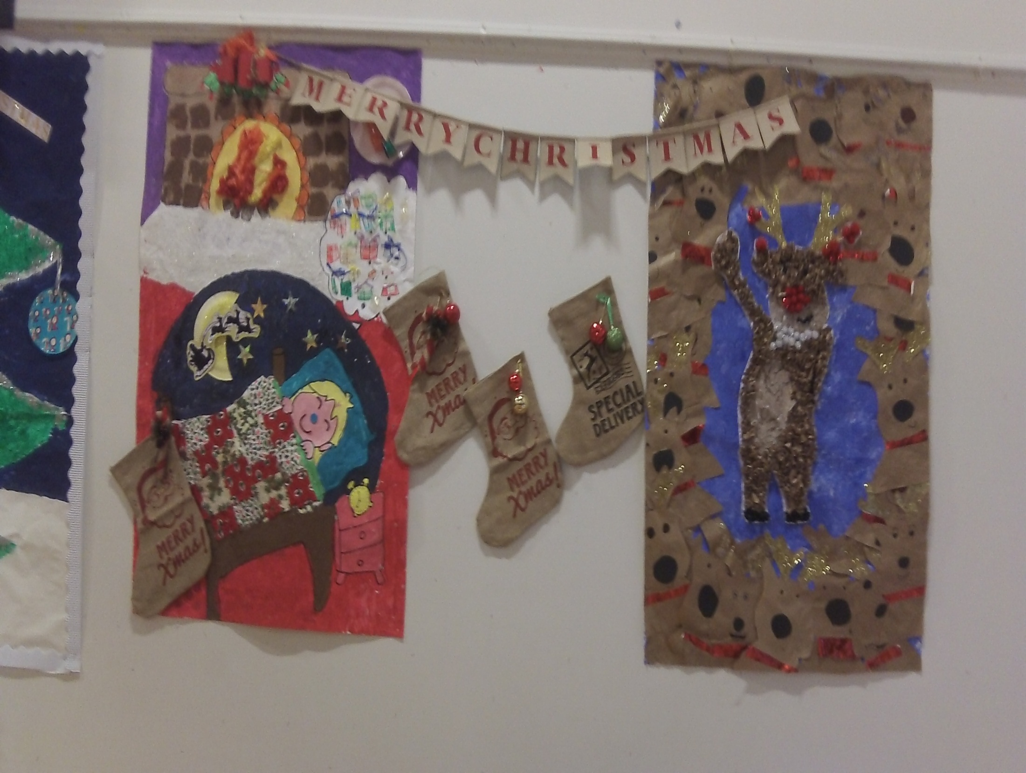

Slide 10
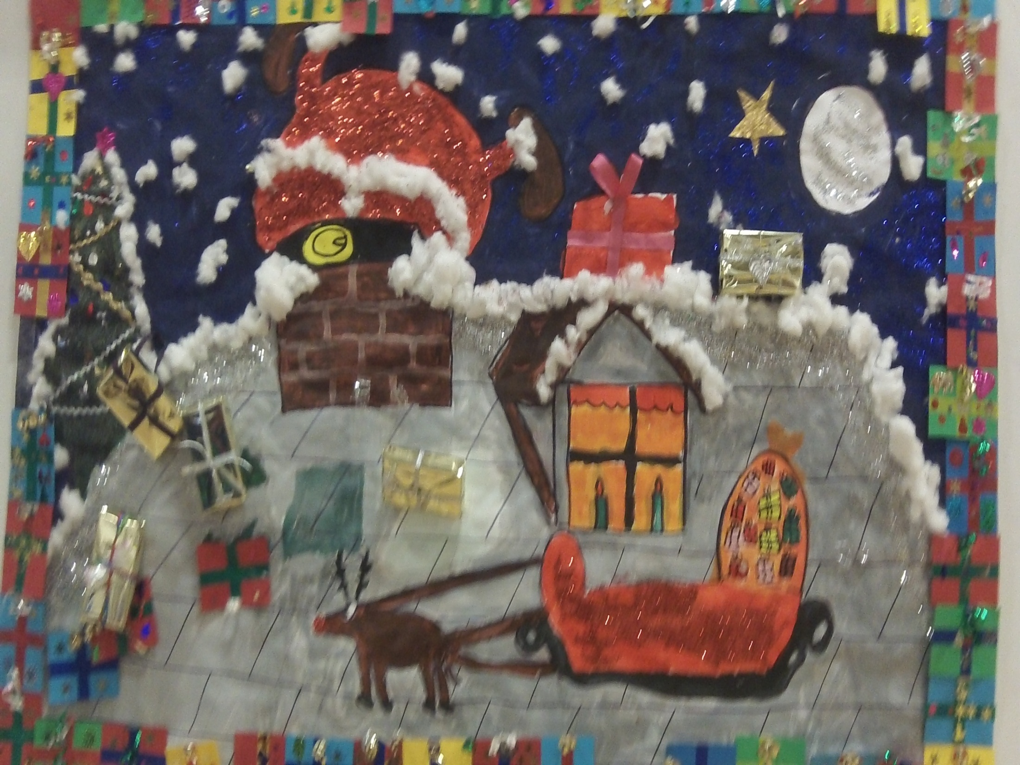

Slide 11
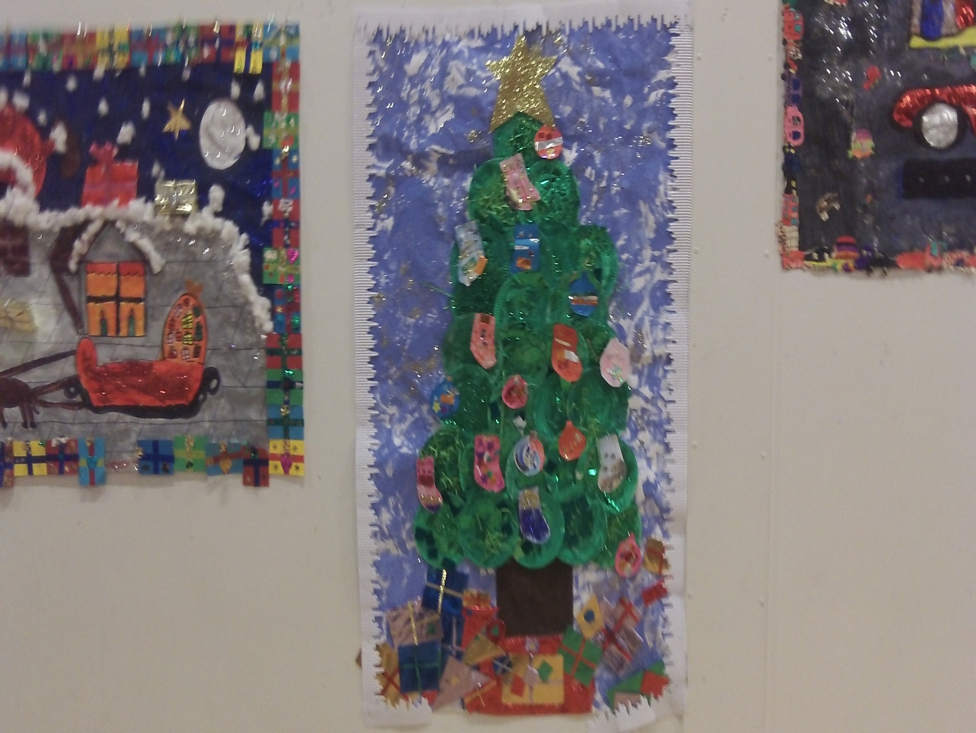

Slide 12
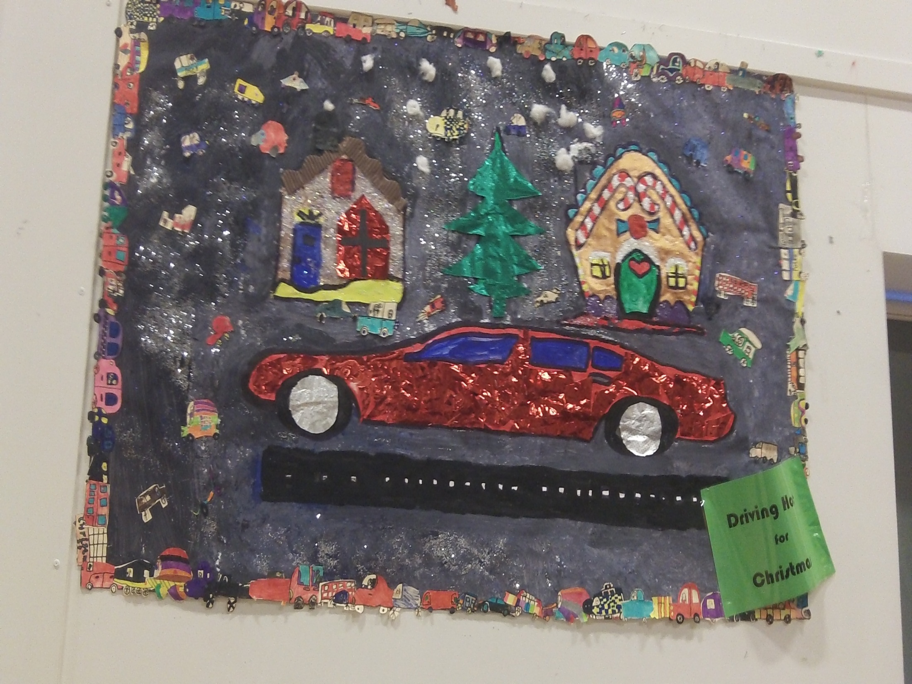

Slide 13
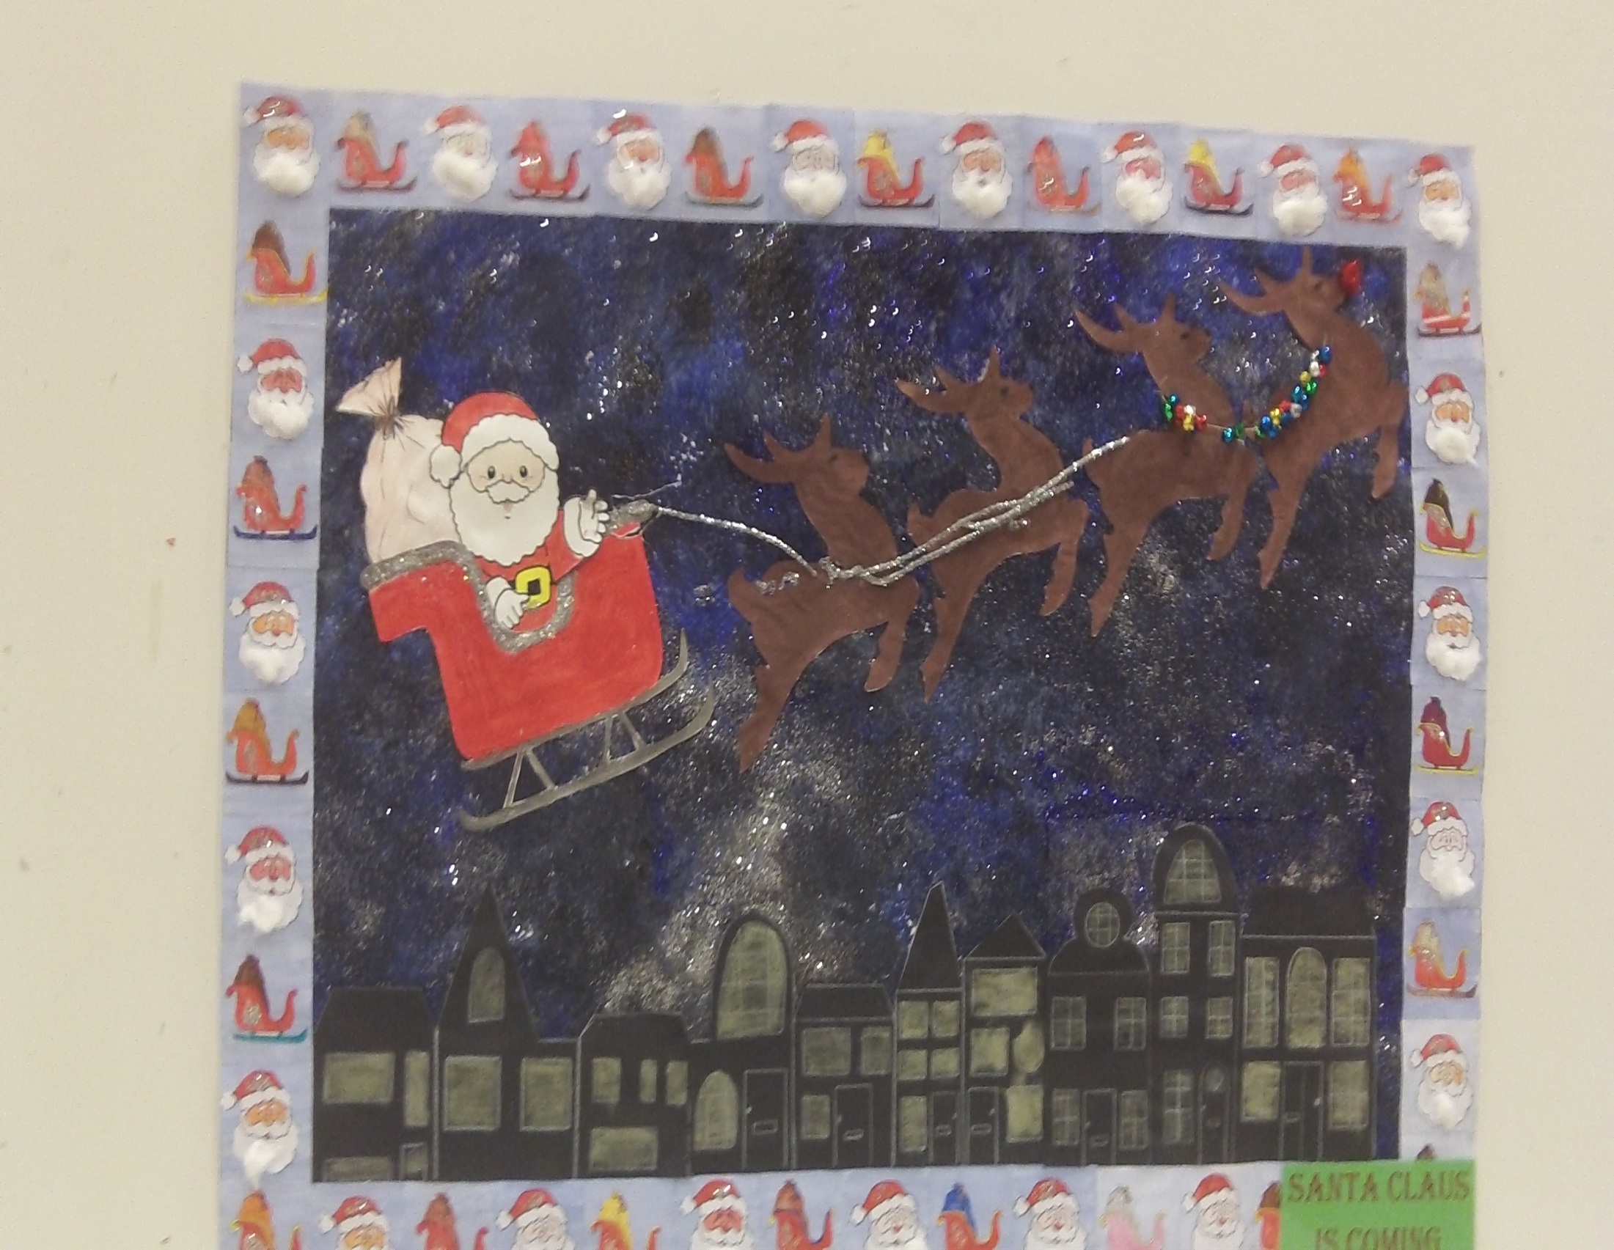

Slide 14
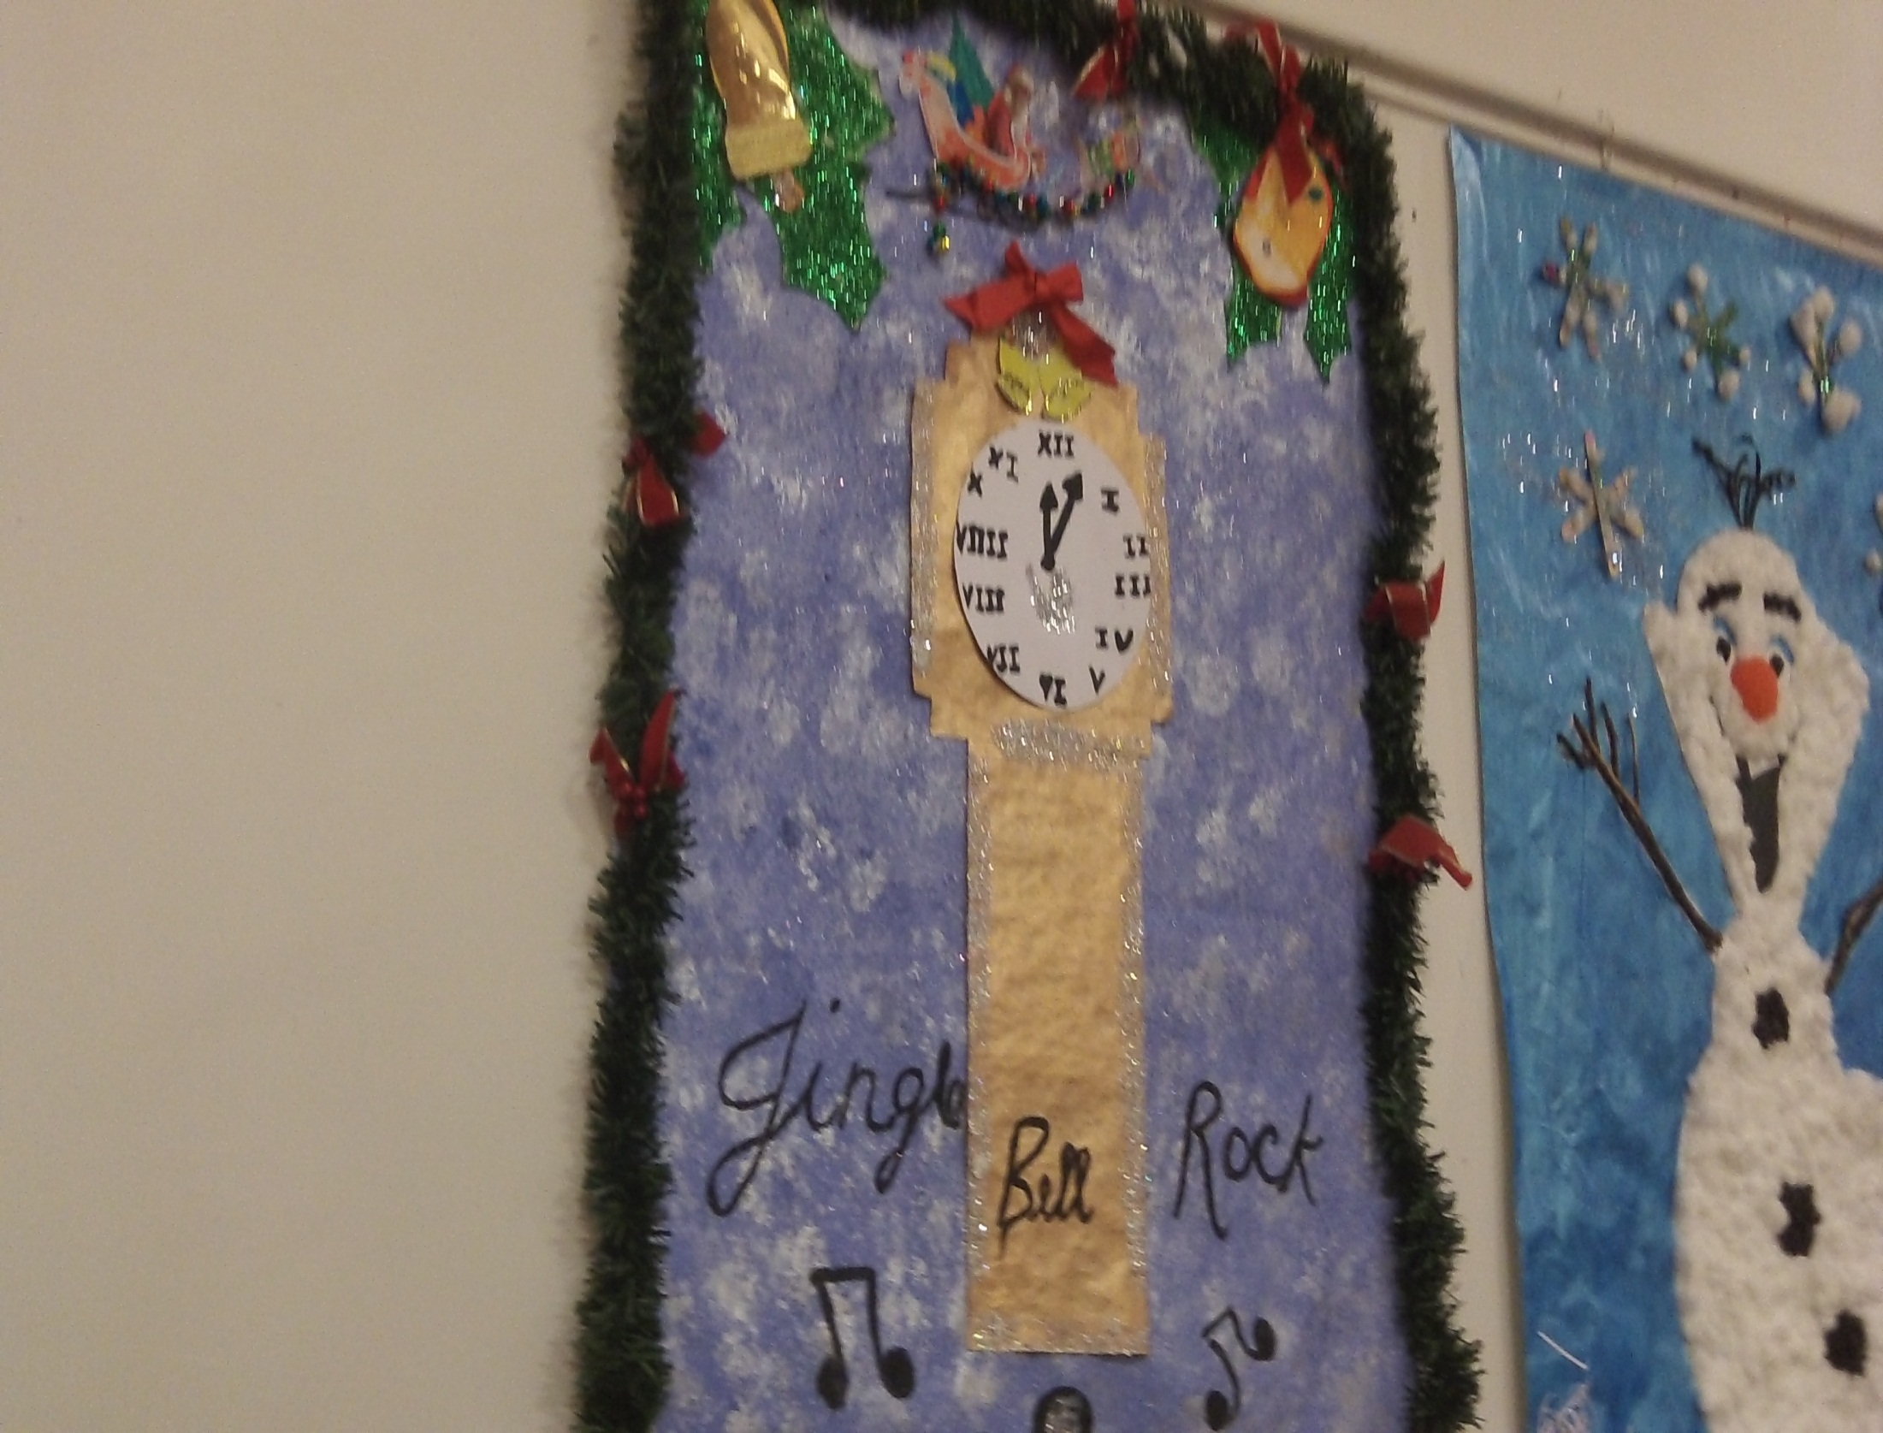

Slide 15
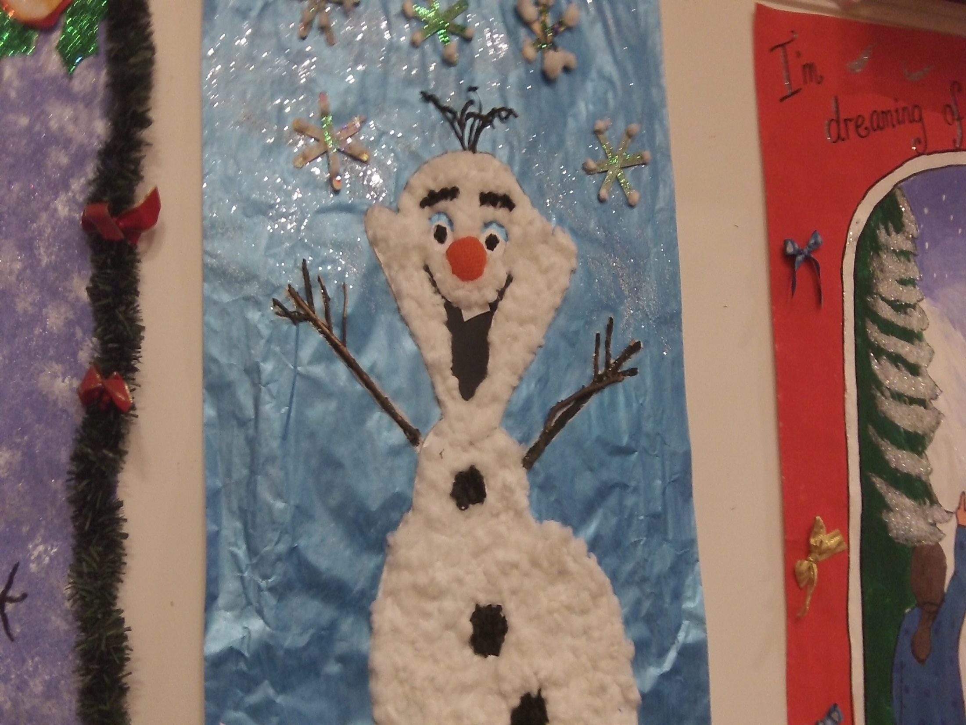

Slide 16
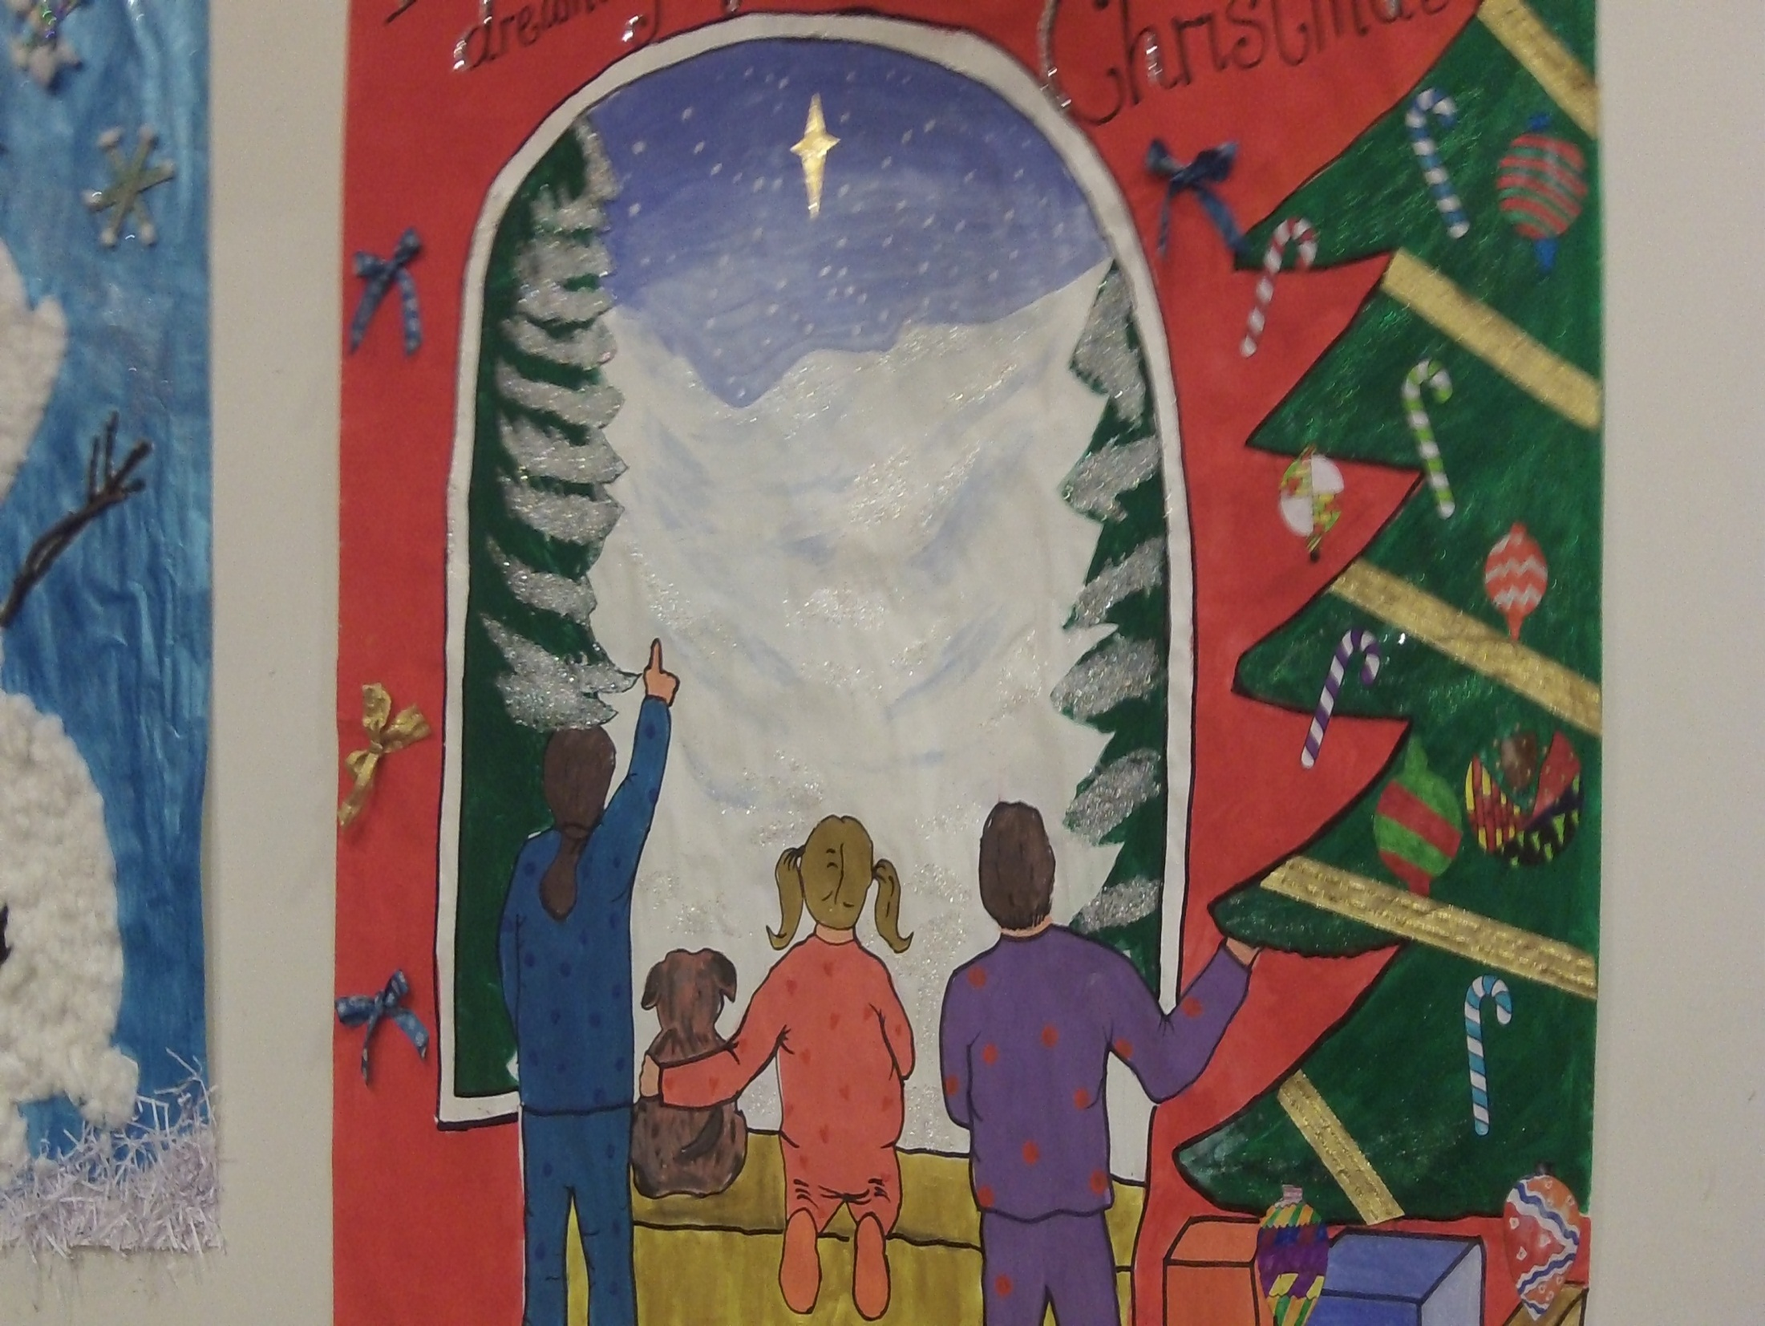

Slide 17
Our Christmas trees!

Slide 18
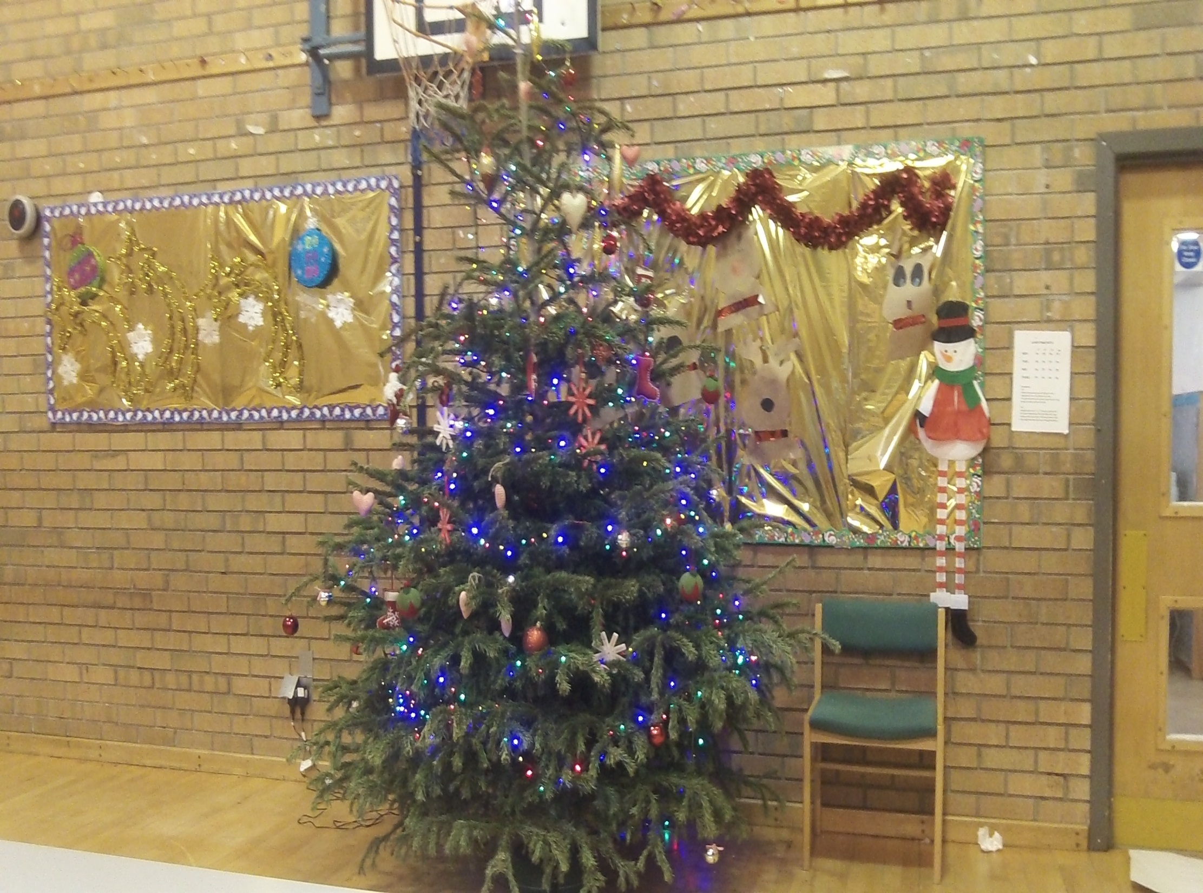
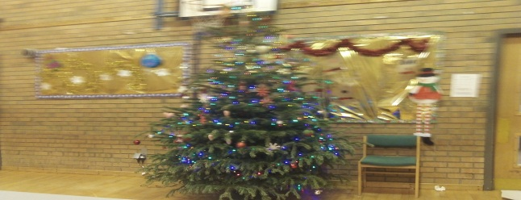

Slide 19
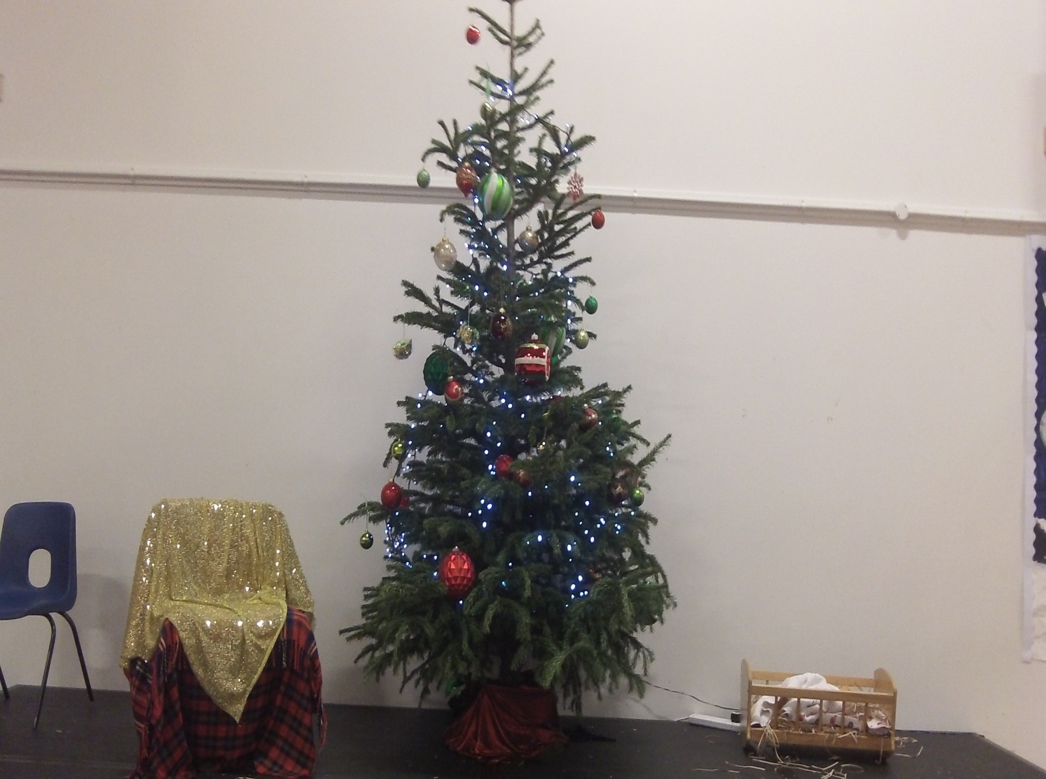

Slide 20
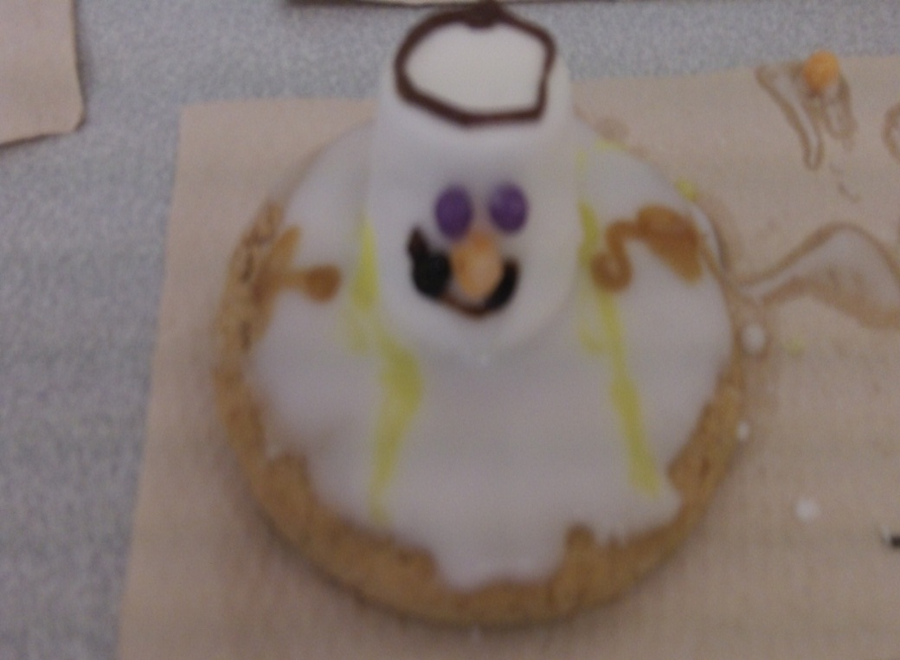
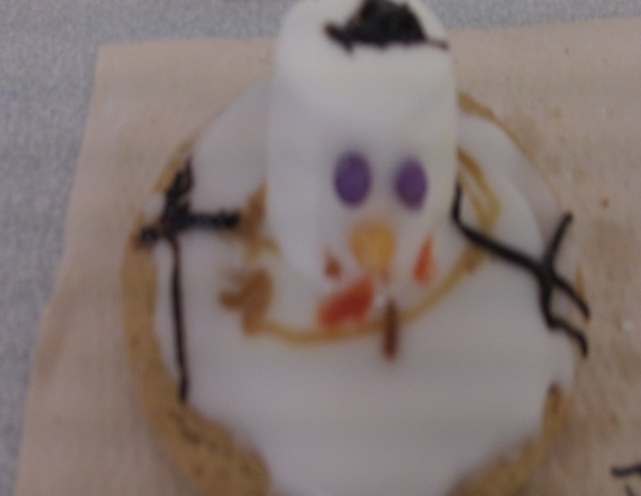
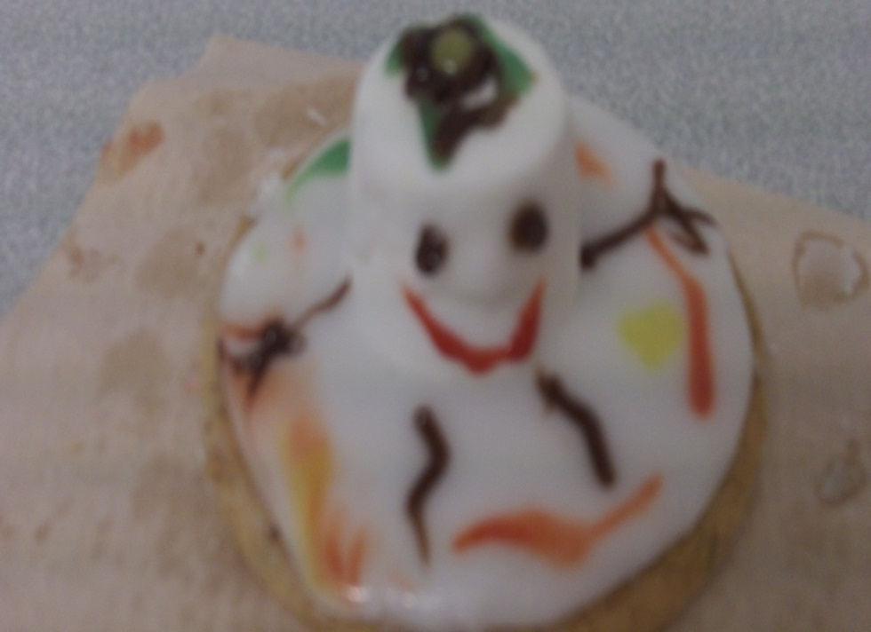
Mrs Logan made some melted snowmen with P7, P6 and P5 in food technology.

Slide 21
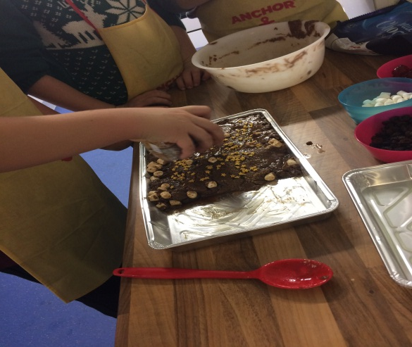
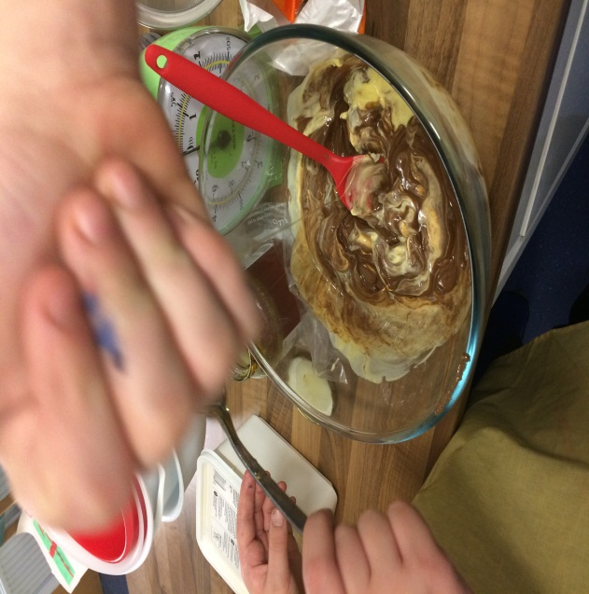
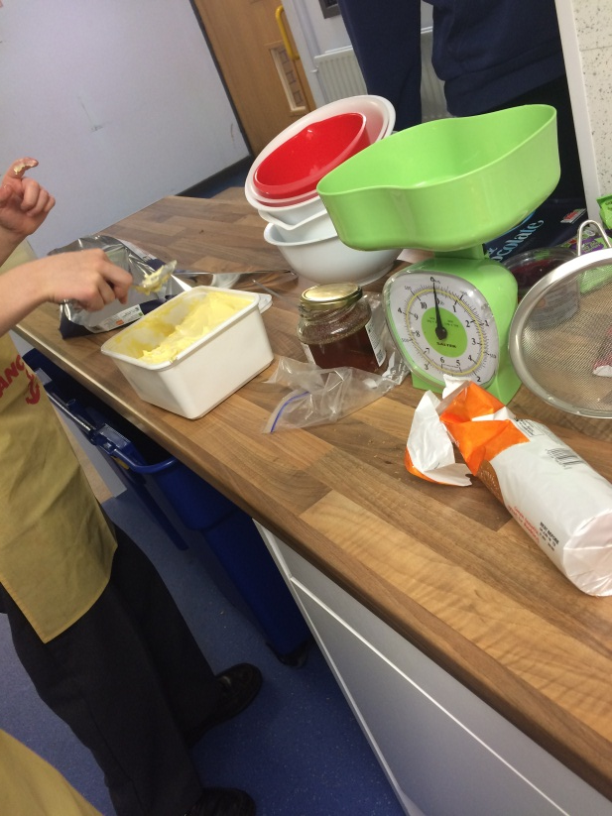
P6b worked together to make delicious rocky road to give as a gift! (They managed to taste some too!)

Slide 22
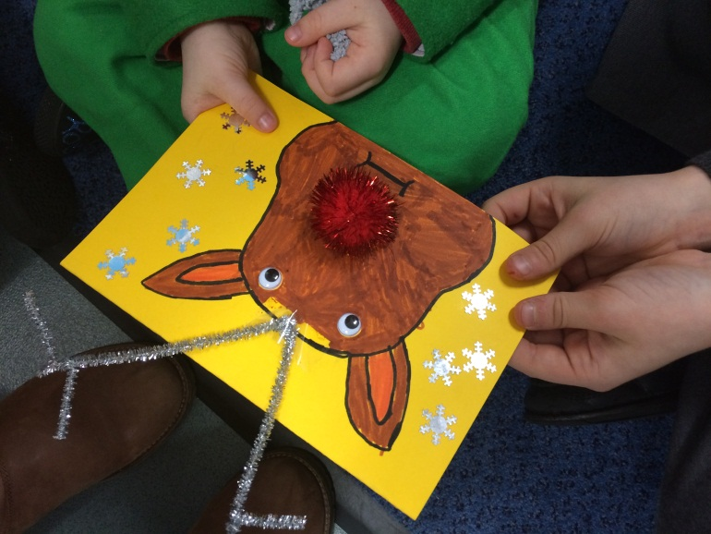
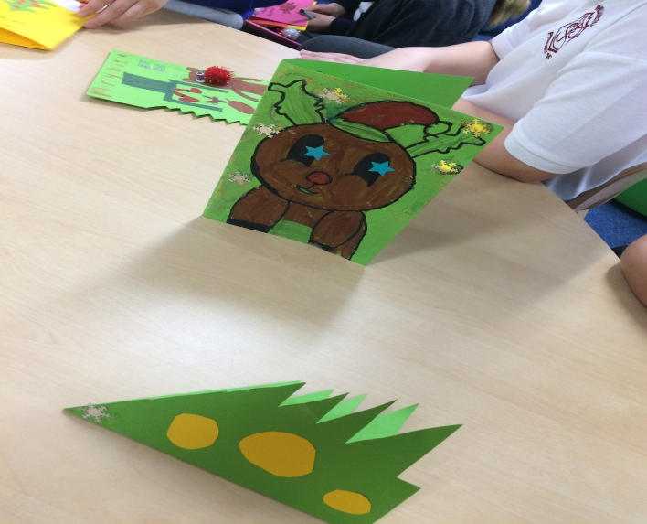
P6 made super Christmas cards to give to their friends in the nursery.

Slide 23
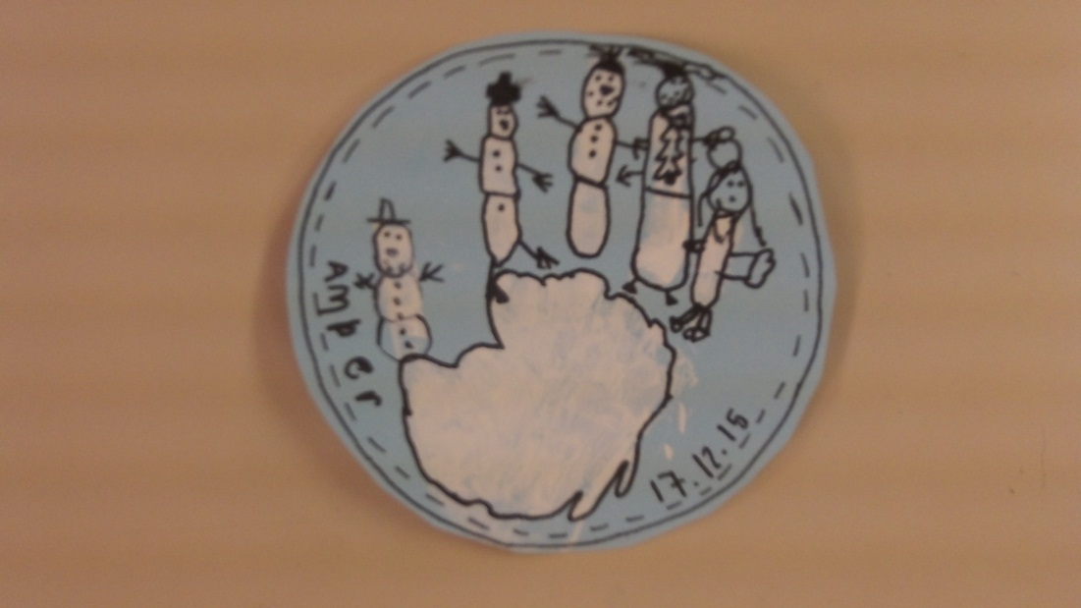
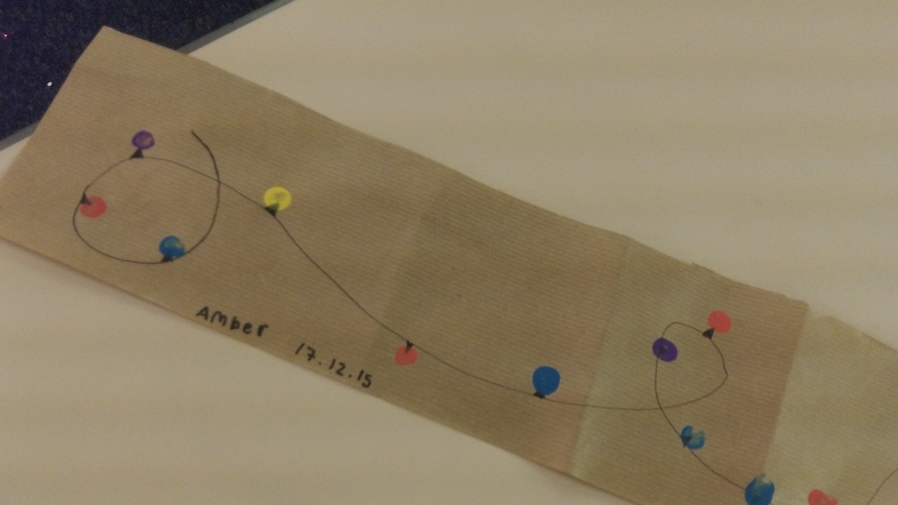
P7 worked with their P1 buddies to create some wonderful Christmas crafts.

Slide 24
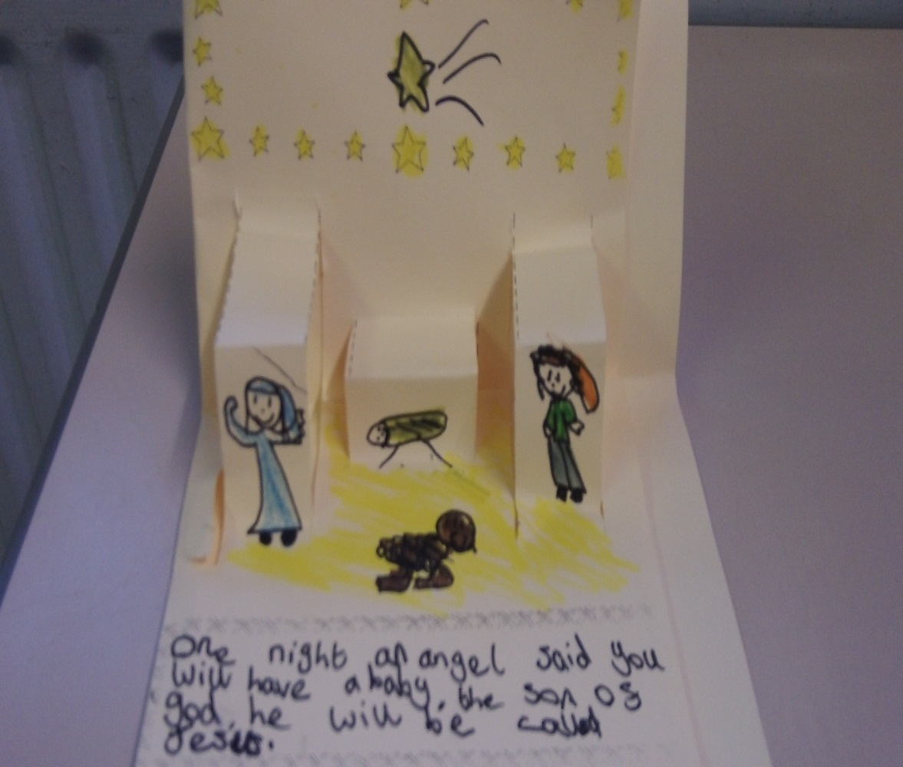
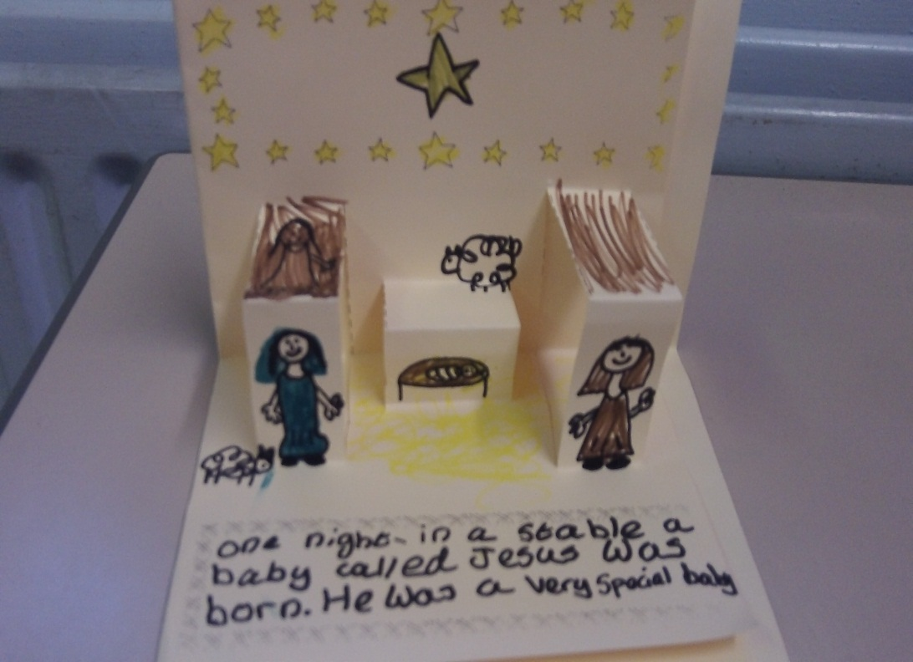
P4 made Nativity scenes, don’t they look fantastic?

Slide 25
Merry christmas and a Happy New Year

