Slide 1
Deans Primary P1Transition Info
23rd May 2019

Slide 2
Classes
Primary 1
Primary 1/2
Don’t panic!!

Slide 3
Staggered intake
All pupils start on Tuesday 20th August
Pupils will be given specific start times for first day
Children will be in school for the full day from day 1
It’s important that we know how your child is getting home

Slide 4
Buddies
One of the ways to help children settle is by teaming them up with a P7 buddy
These have been allocated and your child should have met their buddy by now

Slide 5
Uniform
Pupils at Deans have pride in their school and a way we celebrate that is through wearing our school uniform. An application form for the uniform is included in your pack
Gym kits – all children have 2 hours of PE a week and require a gym kit (shorts, t-shirt and gym rubbers). Gym rubbers are worn inside school at all times. Gym kits can be ordered in the same way as school uniforms

Slide 6
Labelling!
Really important to label everything!
Lost property kept in school

Slide 7
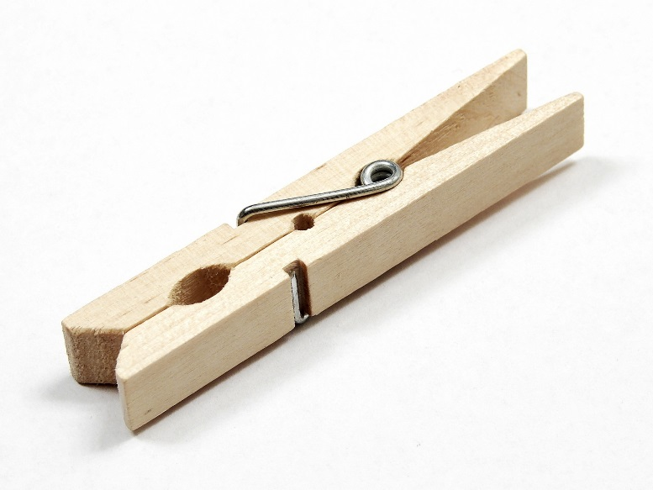
Behaviour
The school has a promoting positive behaviour policy and as part of this we operate a peg system similar to our nursery

Slide 8
Celebrating Success
Magic Moments
Values Champions
Class wow walls
Star awards

Slide 9
Lunches and Snack
School dinners – start from day one with the buddies helping out
School dinners are free to all p1-3 pupils
We have a 3 tray system in place – menus come out in August
We are using a new online system across West Lothian to order lunches- Ipay impact
Children may bring a packed lunch and we try to encourage healthy eating at Deans
Your child can bring in their own snack for playtime
School milk is available, forms in your pack

Slide 10
Entitlements
Entitlements -If you are entitled to benefits and free meals/clothing grant – these forms are included in your pack

Slide 11
Communication
Newsletters
Questionnaires & workshops – we ask for your help by completing questionnaires or attending open evenings as it all helps your child.
Open door policy - if you have any concerns we would encourage you to come and speak to us about them
School Blog

Slide 12
Parent Council, PPA & parent helpers
Parent council – Carol Ann Wilson
Another way to support the school is to help in school – speak to a member of staff if you’re interested!

Slide 13
Completion of Consent forms
Please either complete your forms today or bring them along on 6th June

Slide 14
Start of the day
Children line up outside the P1 door.
Breakfast club – starts at 8.10am, forms in pack
Traffic Issues within the school grounds – no parking or drop off in car park
Attendance/absence

Slide 15
End of Day Arrangements
Vital from day one that we know how your child is getting home and who is picking them up
Any changes to this please let us know as soon as possible.
Please don’t put notes regarding transport or other vital pieces of information in homework diaries!

Slide 16
Reminders
P1 taster lunch Wednesday 19th June – 11.30-12pm, money will be collected on the day
Meet the teacher – 6th June 1.30pm at the front entrance

Slide 17
Extra Curricular Experiences
After school clubs
Let’s get cooking
PEEP
Workshops
Family Nights
Fundraisers
Committees
Sharing the Learning events

Slide 18
Families Connect
Families Connect focuses on supporting parents and children to learn together.
It helps parents to support their children’s learning in three key areas:
Literacy and language development
Numeracy
Emotional development
The eight-week programme provides a series of activities, techniques and games that parents and carers can do with their children at home.

Slide 19
What Families Connect will look like in Deans Primary School
Children enjoying learning and spending 1:1 time with their parent/carer
Learning across the curriculum together
Parents/carers coming together for a cup of tea and a chat
Families provided with many ideas and a range of resources to take home with them to continue enjoying fun learning experiences
Snacks provided for the group to enjoy together
Childcare options for any siblings
A celebration at the end of the programme

Slide 20
Interested?
Pop your name and your child’s name down so we can get in touch with you!

