Slide 1






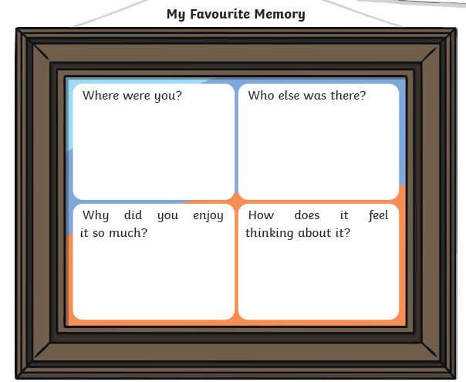



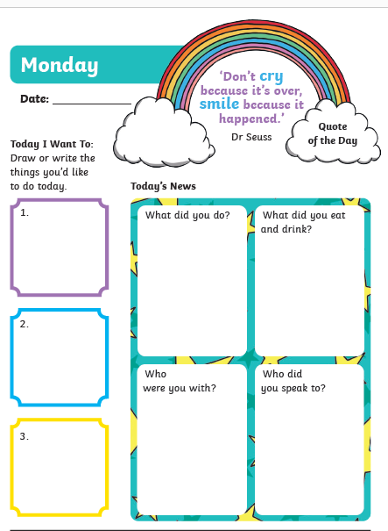

Well done, you have made it to the end of home learning!
It was lovely to be able to see some of you last week when you picked up your report. You are all STARS!
This week, we will remember your time spent home learning and look forward to NEW BEGINNINGS.
We are all busy in school this week making the new classrooms as safe and welcoming for you as possible. We look forward to seeing you all next session. Have a lovely SUMMER HOLIDAY!
Mindful Monday Maths Challenge yourself with some summer code breaker tasks: https://www.twinkl.co.uk/resource/summer-themed-calculations-code-breaker-worksheet-t-n-2546939 | Terrific Tuesday Home Learning Please reflect on your time of home learning and answer a few questions online: https://forms.office.com/Pages/ResponsePage.aspx?id=oyzTzM4Wj0KVQTctawUZKVWPOp5BW2hJnapxBMJasGVUQ1JHMVQwMTBOWlZQVDVLWEoyVUk2RjlRWi4u | Wellness Wednesday Emotion works - Blue cog Please look at Mrs Kinnear’s Emotion Works slides about regulation strategies.
Thoughtful Thursday Transition By now you know who your new teacher is! Think about your current teacher(s) and new teacher(s). What would you say to them? If you want, why not try a self-portrait and a teacher portrait! https://www.twinkl.co.uk/resource/t-m-279-postcard-writing-template |  | Fun Fact Friday Favourites and the future Please share with us your favourite lesson, memory, or piece of news from your time of home learning. What’s been your best achievement? What are you looking forward to in the future? (see Journal pack for details templates).
End of term activity book and wellbeing journal packs: | Getting ready for next year… Wash your hands: https://www.youtube.com/watch?v=oxu2oSzRQAY Helping your child prepare to go back to school: https://www.youtube.com/watch?v=F1xHZbUCri8 | Listen and sing along… https://www.youtube.com/watch?v=UOjuq-1Q4FM How does this make you feel? Discuss with someone at home and share your thoughts. You can let us know too. We’re still here x
type
type
type
NEW BEGINNINGS!
WEEK 12
type
type
type

