Slide 1
Emotion Works
Week 5

Slide 2
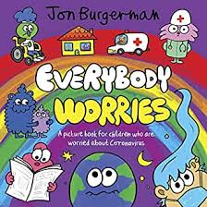
Read
Read with an adult/watch online- Everybody Worries by John Burgerman
Everybody really does worry! It is normal to feel nervous, worried and scared, especially when we are unsure about things.
Link to ebook - https://en.calameo.com/read/000777721945cfe5bb9cc?authid=Xu9pcOzU3TQx
Link to video - https://www.youtube.com/watch?v=ST3WHJt4fZw

Slide 3
Think
Think about a time you were worried or scared about something?
Did the feeling last a long time?
Did the feeling go away?
How did you feel better? Did someone help you?
Talk to an adult about what makes you feel better when you feel worried or scared.
Last week you had a think about all the emotions you have felt lately.
We all show our emotions in different ways, for example when Mrs Kinnear is grumpy she can be a bit snappy with eyebrows that look like this
What colour is Lucy’s hair when she is:

Slide 4
Create
After talking to an adult about what makes you feel better, pick one of your regulation strategies and make a poster to share your idea with other people!
Going for a walk
Talking with my friends
Ten deep breaths
Getting a hug
Singing my favourite song
Reading a story

Slide 5
Share
If you would like to share your poster of your regulation strategy we would love to see them! Share in your class blog or tweet @TEAMUphallPS

